Slide 1
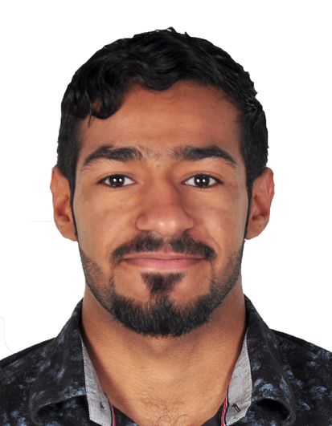
Curriculum vitae
EDUCATION
Qusay Sadiq Salman
Jedhafs industrial boys school 2014-2017 (Electrical specialization)
37231200
33985835
Qusay9912@gmail.com
SKILLS
Bahrain, jedhafs
Professional
Languages
20 years old
MS WORD
ARABIC
Material status : single
COMPUTER
Address: H:1839 / R:2549 / B: 425 / Jedhafs
ENGLISH
POWERPOINT
HOBBIES
CINÉMA MUSIC GAMES BOOKS
References:
References availabe upon request
License: valid Driving License

