Slide 1
RAW MATERIAL AND PRODUCTS OF PHOTOSYSNTHESIS
1) RAW MATERIAL INPUTS :
Carbondioxide (CO2)
Water ( H2o)
Sunlight energy
2) PRODUCTS (OUTPUTS)
Glucose (C6 H12 O6)
Oxygen (O2)

Slide 2
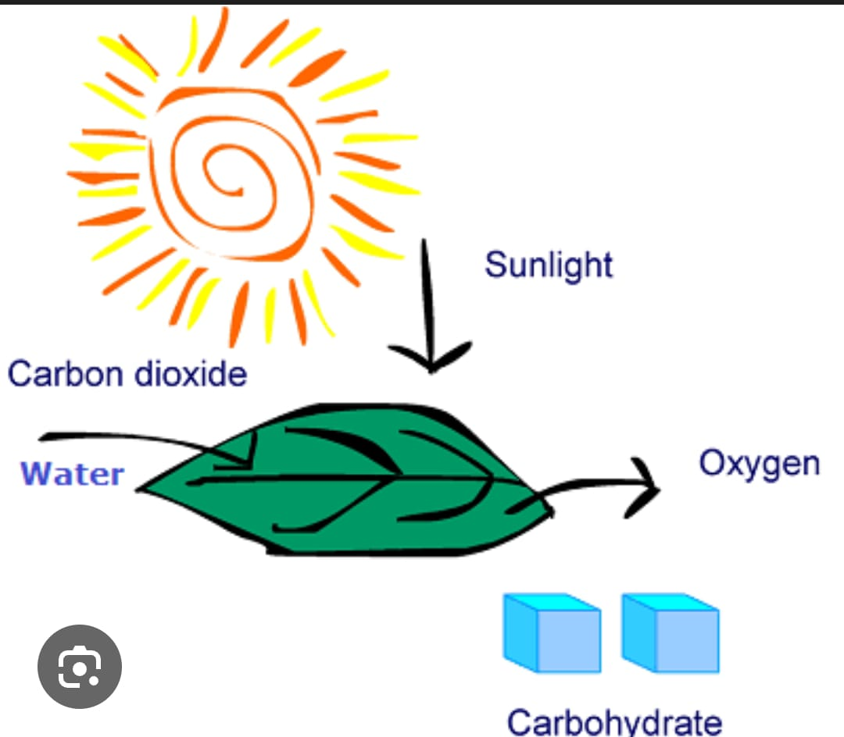
1.1)CARBON DIOXIDE :(CO2)
A colourless gase in air ( 0.04%)
Enters leaves through stomata
Role :
Used in calvin cycle to make gulocose .
Provides carbon atom ‘n’ backbone of glucose
Helps produce carbon as byproduct .
Without co2,plants cannot make carbohydrate .

Slide 3
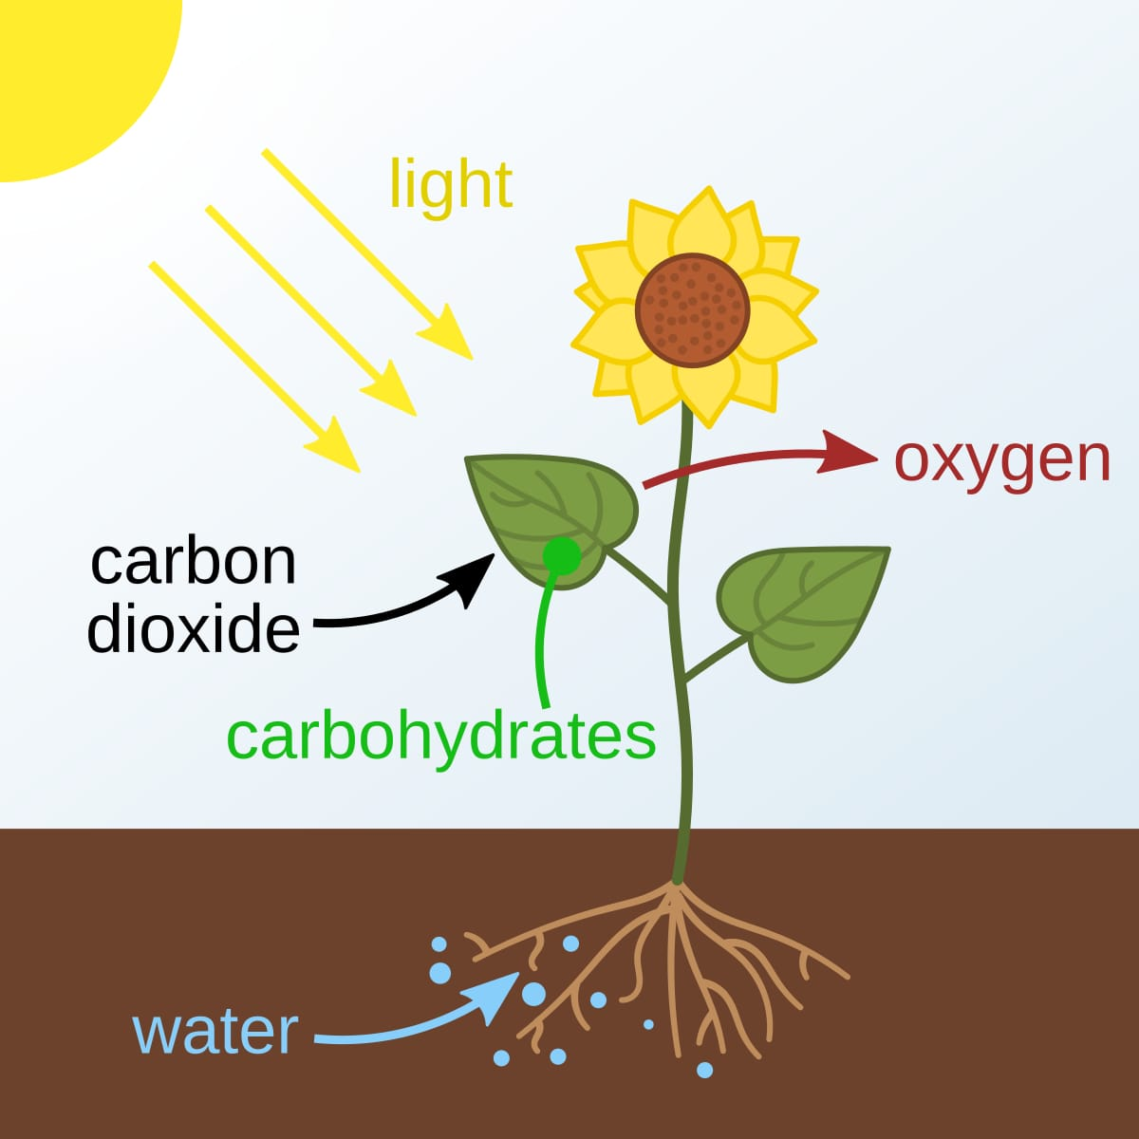
1.2 )WATER ( H2O)
Taken from soil by roots
Travels to leaves through xylem.
Role :
Gives hydrogen to build glucose
Release oxygen whenwater split during sunlight reaction (photolysis).
Supplies electron to start energy reaction .
Maintains leaf structure (keep cells firm to capture sunlight)
Thus, water support both food makingand plant strenghth.

Slide 4
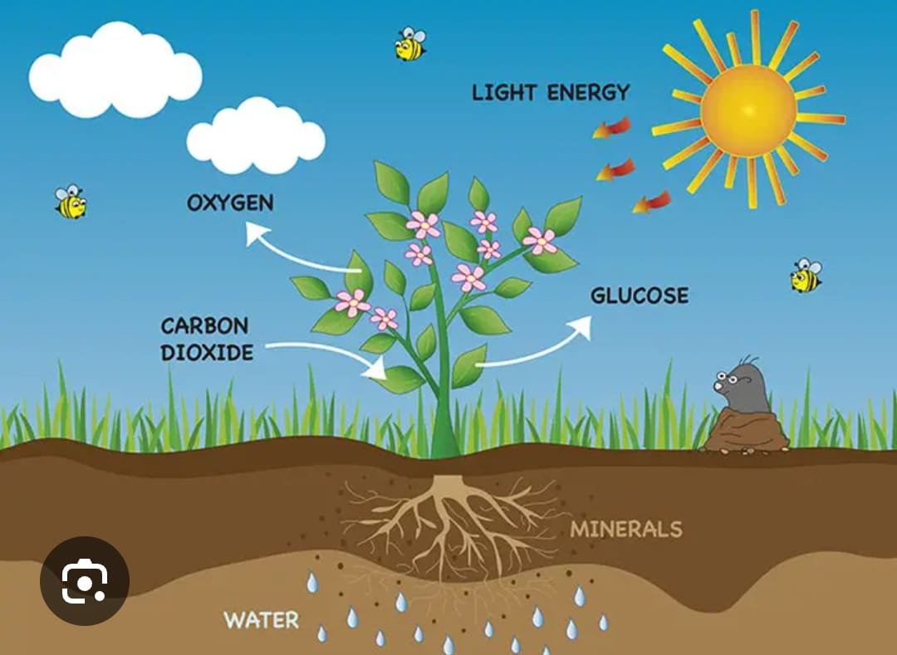
1.3) LIGHT ENERGY (SUNLIGHT):
Main energy source for photosynthesis :
Role :
Used in light dependent reaction
Help break water (photolysis)
Provides evergy to combine CO2+Hdrogen ‘n’Glucose .
Thus , without sunlight ,photosynthesis cannot begin .

Slide 5
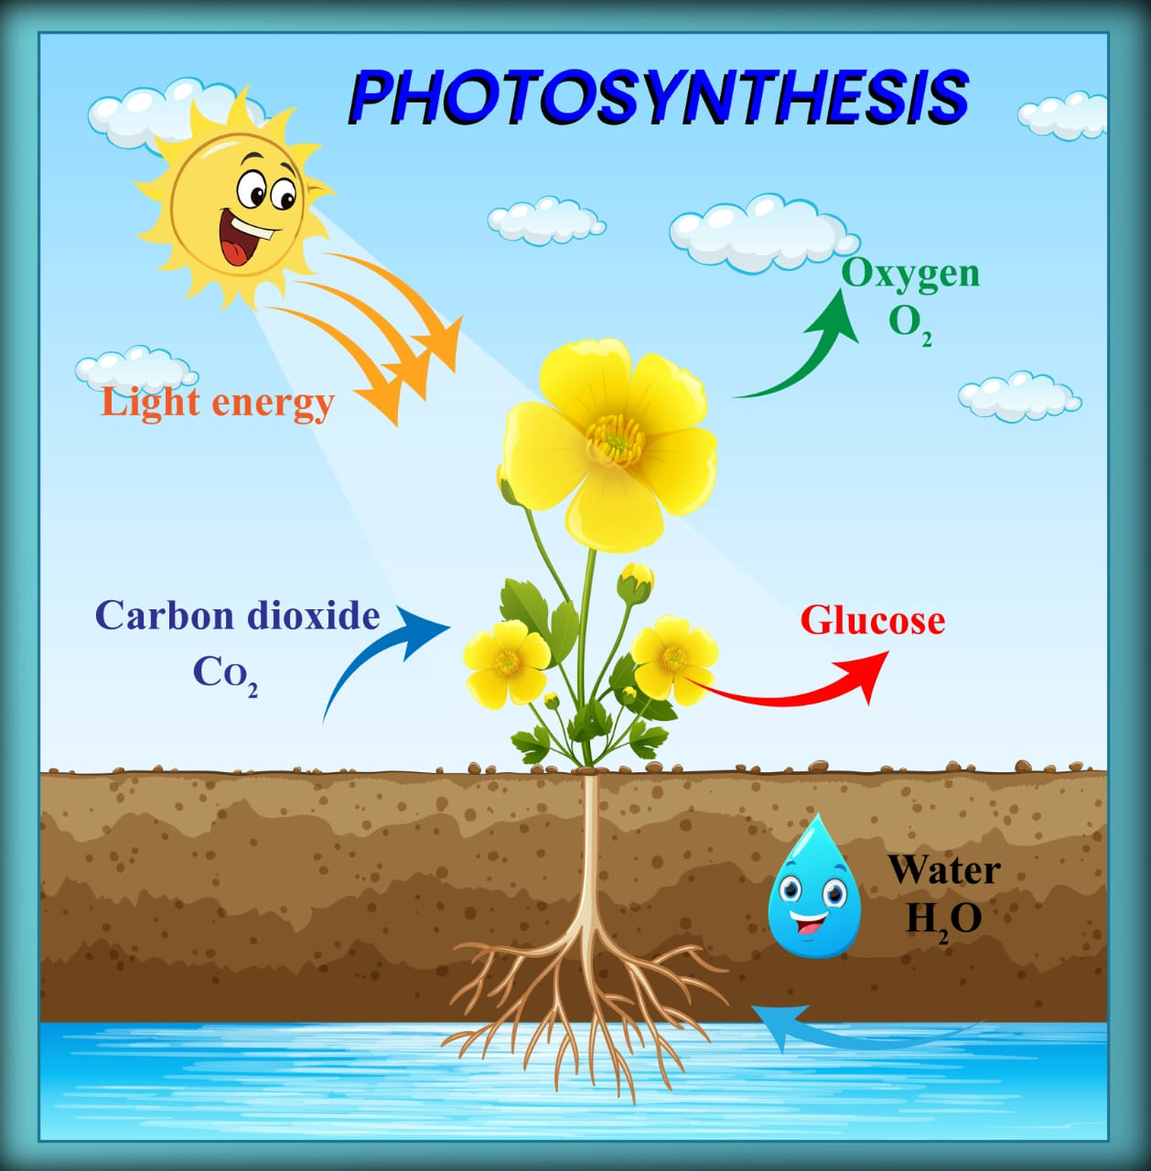
2)THE PRODUCT (OUTPUT)
2.1) GLUCOSE (C6 H12 O6)
It’s a simple sugar molecule (ecarbohydrate ) produce by photosysnthesis.
Role :
Used fot growth ,repair ,and energy
Its stored as starch in leaves ,stem and roots .
Its used to make cellouse for cell walls
Passed to animal and human when they eat plants .

Slide 6
2.2) OXYGEN ( O2) :
A colourless orderless gase Its essential for Aerobic life.
Its formed when water split
Its released through stomata .
Role :
Required by human and animals to live.
It help to keep atmospheric gas balance .

