Slide 1
1
Welcome

Slide 2

2
221002173
Md Sohel

Slide 3

Contents
3
01
Introduction
02
Simulation of Input
03
Algorithm & Main Logic
04
Submission Verdict

Slide 4
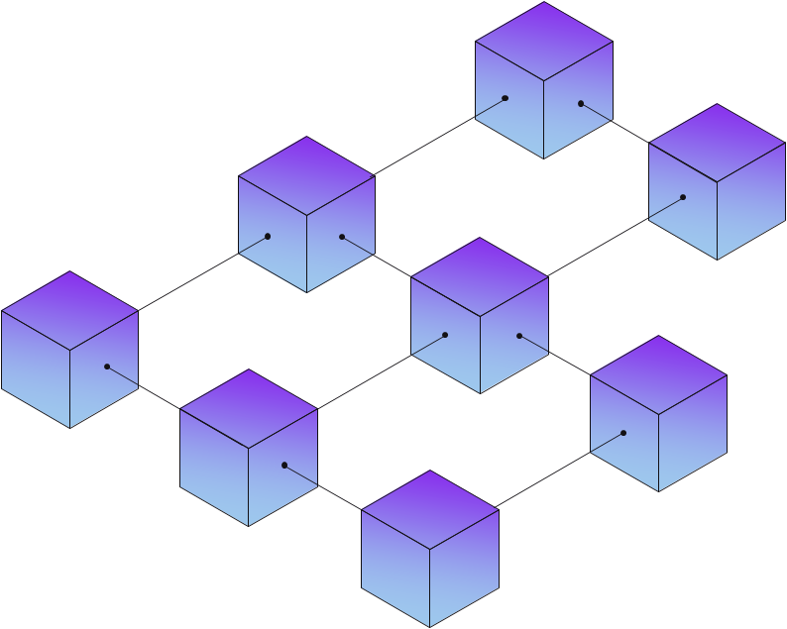
4
UV-10305 : John has N tasks to do. Some tasks are dependent. Before completing the dependent tasks, he must have to complete the precedent tasks.
1
2
4
5
3
4
1
5
2
3

Slide 5
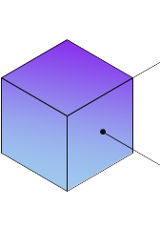
1
5
1
1
1
3
3
3
3
5
4
5
4
4
5
5
2
2
2
2
4
Stack
1
3
5
2
4

Slide 6
Algorithm
5
DFS(graph, vertex, visited, stack):
mark vertex as visited
for each neighbor in graph[vertex]:
if neighbor is not visited:
DFS(graph, neighbor, visited, stack)
push vertex onto stack
topologicalSort(graph, vertices):
for each vertex in vertices:
if vertex is not visited:
DFS(graph, vertex, visited, stack)
while stack is not empty:
print pop(stack)

Slide 7
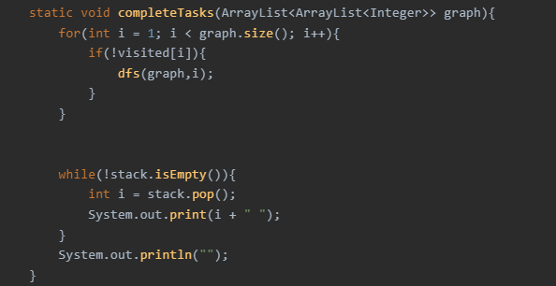
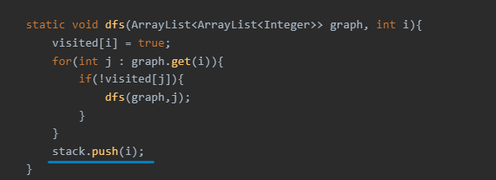
Code of the Main Logic
6

Slide 8
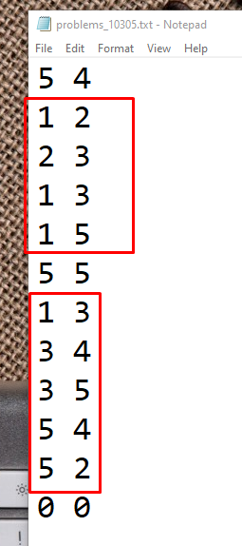
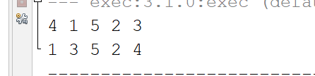
Sample Input And Output
7
1
3
1
2
4
4
3
5
5
2
Sample 1
Sample 2

Slide 9
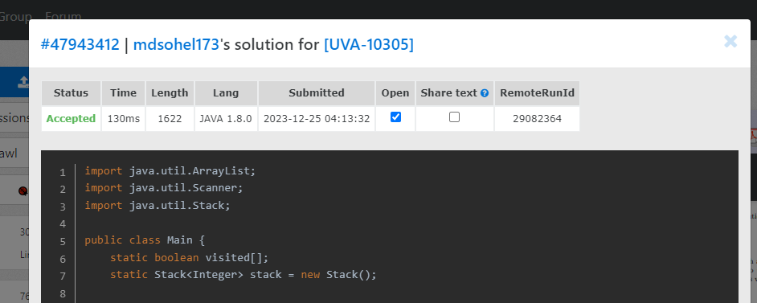
Submission Verdict
8

Slide 10

9
UV-908 :
100tk
80tk
55tk
M = number of lines = 5
50tk
20tk
N = Number of Computer = 4
120tk
They have selected a set 'T' of High-speed internet lines from the M lines to connect N computers with minimum cost.
After that, K high-speed lines have been added to the network.
Now we have to calculate -
The cost of the lines they have selected from the M lines
And the new minimum cost from the M + K lines for connecting N computers.

Slide 11
10
5
1
2
Cost:
+ 5
+ 5
+ 5
= 20
5
5
5
5
3
8
4
8
5

Slide 12
11
5
2 – 3 = 2
1 – 2 = 5
1 – 3 = 5
1 – 4 = 5
1 – 5 = 5
4 – 5 = 8
3 – 4 = 8
1
2
5
5
5
3
8
4
8
2
5
1 | 2 | 3 | 4 | 5
Leader:
1
2
2
3
1
4
5
1
1
1
Cost : 2 + 5 + 5 + 5 = 17

Slide 13
Algorithm
12
findCost():
newCost = 0
while edges is not empty:
e = edges.poll()
src = e.src
dest = e.dest
if leader[src] is not equal to leader[dest]:
newCost = newCost + e.cost
union(leader[src], leader[dest])
return newCost

Slide 14
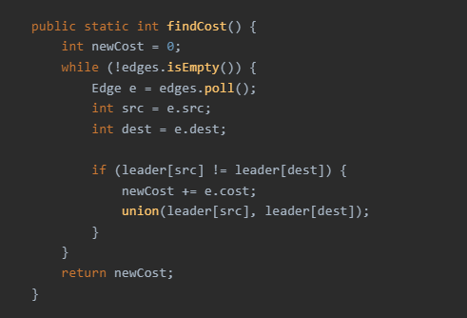
Code of the Main Logic
13

Slide 15
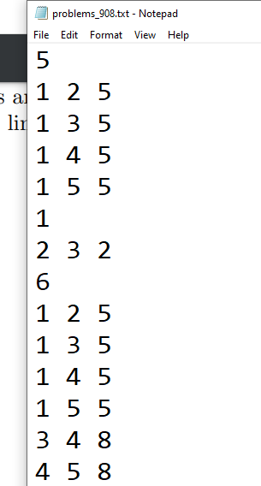
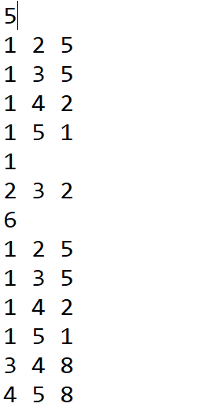
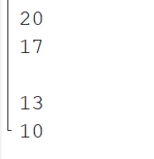
Sample Input And Output
1
4
Output
Input

Slide 16
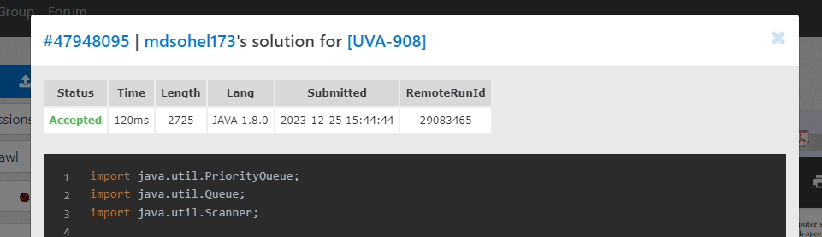
Submission Verdict
1
4

Slide 17
Thank You ☺

