Slide 1




Neighborhood Help Hub
Presented To
Kazi Hasnayeen Emad
Lecturer , Department Of CSE
Green University of Bangladesh
1
Notes:
Links:
https://pixabay.com/vectors/connection-internet-digital-network-4166469/

Slide 2


Our Team
Moriam Khatun
221002197
Md Sohel
221002173
2

Slide 3
Table of Contents
Introduction
Objective of the Project
Features of the System
We have done
Next Steps
Conclusion
3

Slide 4


Introduction
Lack of a localized platform for connecting neighbors needing help with those offering it.
4
Notes:
Links:
https://www.pexels.com/photo/photo-of-people-looking-on-laptop-3182801/

Slide 5

Objective of the Project
Facilitate Community Assistance
Promote Local Collaboration
Enhance Accessibility
Build Stronger Connections
Simplify Task Management
5
Notes:
Links:
https://www.pexels.com/photo/photo-of-people-looking-on-laptop-3182801/

Slide 6
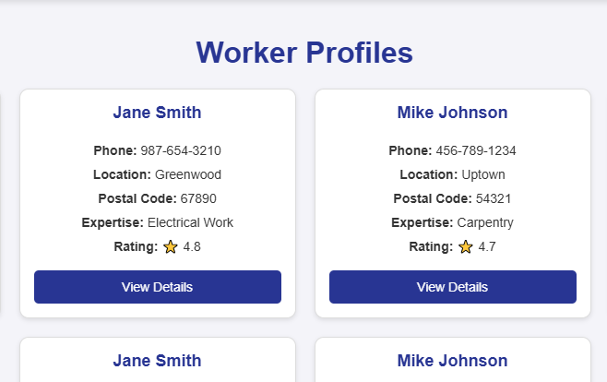
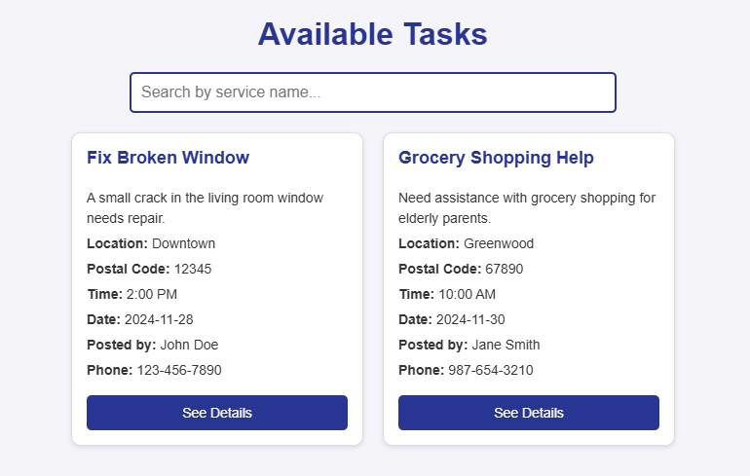
Features of the System
Post tasks easily
Search for services by title.
View task details and worker profiles.
User-friendly interface with responsive design.
6

Slide 7
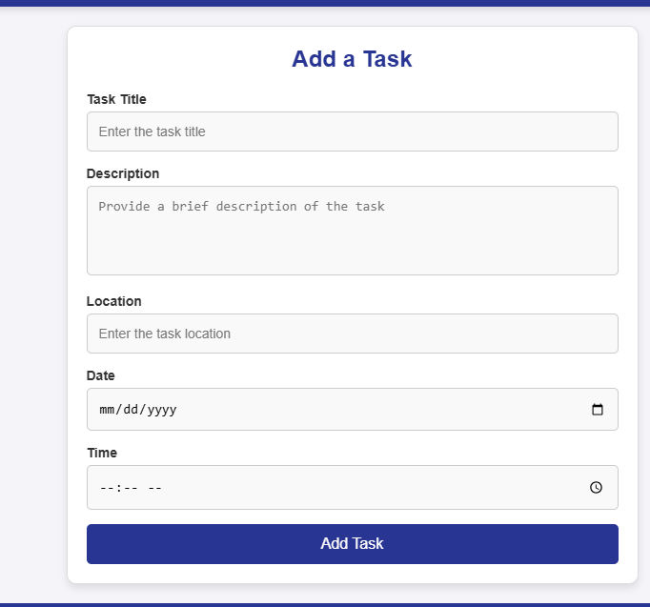
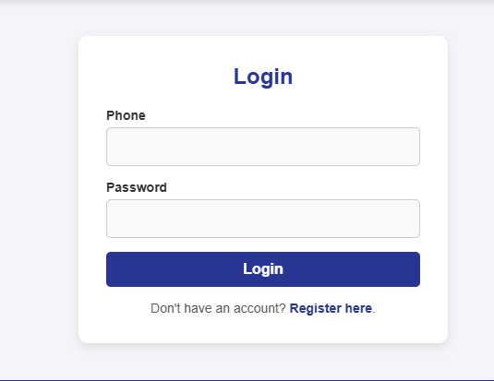
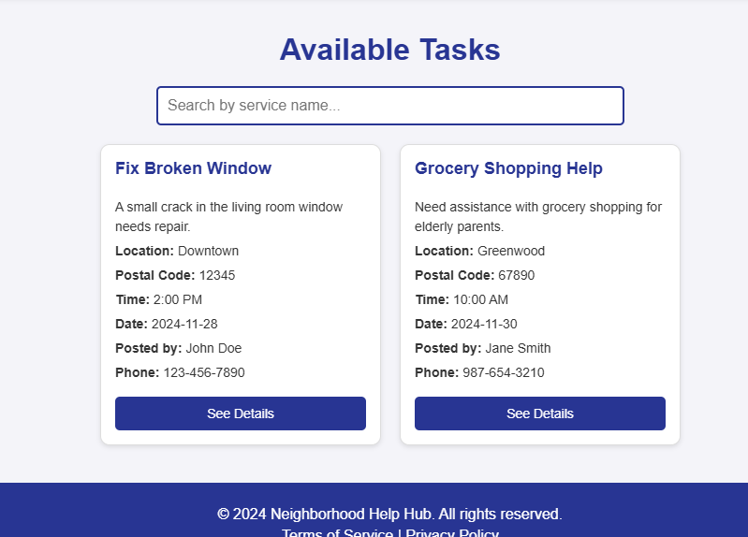
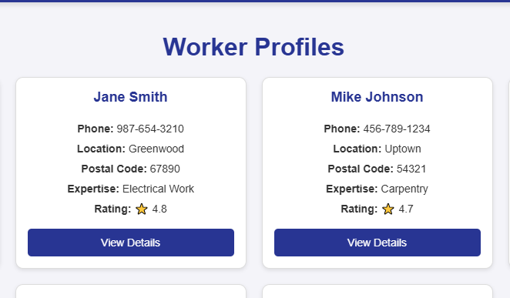
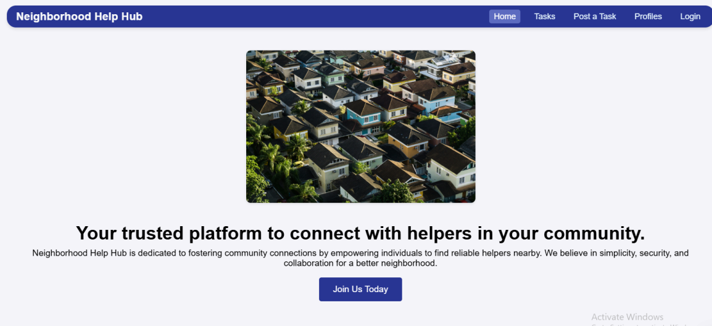
We have done
Home Page: Highlights platform overview and features.
Tasks Page: Lists tasks with filtering and search functionality.
Profiles Page: Shows worker profiles.
Login and Registration Pages: Enable user authentication.
Post Task Page: Allows users to add new tasks.
7

Slide 8
Next Steps
Backend Development:
Seting up Express.js server
Integrattion MongoDB for data storage.
Functionality Implementation:
Linking frontend forms to the backend.
Adding real-time updates for tasks.
.
8

Slide 9
Conclusion
Frontend development is nearly completed.
Backend integration is the next focus.
9
Notes:
Links:
https://www.pexels.com/photo/photo-of-people-looking-on-laptop-3182801/

Slide 10
Thank You!
Any Question?
10
Notes:
Links:
https://pixabay.com/vectors/connection-internet-digital-network-4166469/

