Slide 1

ECSE 436: Lempel-Ziv COMPRESSION ALGORITHMS for INFROMATION SOURCES
AUTHORS:
CHROUK KASEM: 260 512 917
MUHAMMAD TAHA: 260 505 597
PROJECT SUPEVISOR: PROFESSOR JAN BAJCSY

Slide 2
Overview
Introduction
Background
Project Objectives
Lempel-Ziv Compression Algorithm
Theory
Extension
Implementation and Results
Implementation
Results
Conclusion
References

Slide 3
1. Introduction: Background
In 2011, EMC cloud computing company estimated that the data in the world is[1]:
1.8 Zettabytes 1.8 × 10 ²¹
A survey in 2014 concluded that every minute, 72 hours of video content is uploaded on YouTube and Google receives over 4 million search queries[2].
Compression:
- Saves Bandwidth - Saves disk storage space
- Lowers transmission time -Improves transmission efficiency

Slide 4
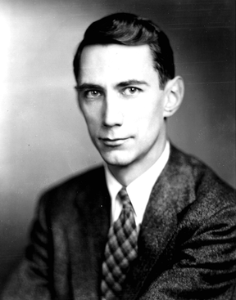
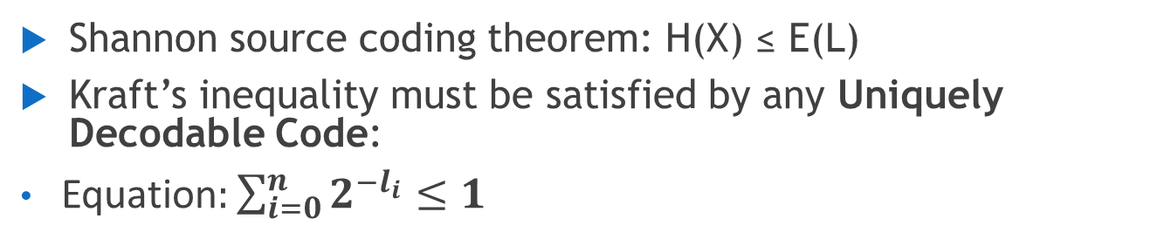
1. Introduction: Background
The modern data compression is based on Claude Shannon’s paper “A Mathematical Theory of Communication” published in 1948. [1]
Shannon source coding theorem: H(X) ≤ E(L)
Kraft’s inequality must be satisfied by any Uniquely Decodable Code:
Equation$:\sum_{i=0}^{n}{2^{−l_{i}}≤1}$
Huffman | Run-Length | Lempel-Ziv | Turbo Compression
JPEG | Black and white scans | GIF | 3G/4G mobile communications
MP3 | Fax Machines | ZIP | Satellite Communications
Claude Elwood Shannon (1916–2001) [4]
Applications of compression codes [5]

Slide 5
1. Introduction: Project Objectives
Main Objective: Implement, evaluate and test Lempel-Ziv data compression algorithm
Identified the following algorithms for designing:
Adaptive fixed window with fixed length match encoder and decoder
Adaptive sliding window with fixed length match encoder and decoder
Adaptive sliding window with variable length match encoder and decoder
Simulations with different
sizes of windows/matches
input sizes
Sources: i.i.d. and Markov Sources

Slide 6
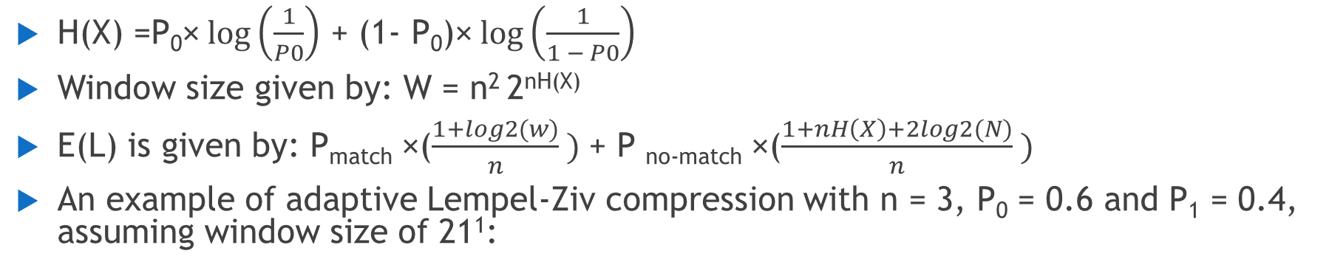
2.1 Lempel-Ziv Algorithm
H(X) =P₀×$log\left(\frac{1}{P0}\right)$ + (1- P₀)×$log\left(\frac{1}{1 − P0}\right)$
Window size given by: W = n² 2^{nH(X)}
E(L) is given by: P_{match} ×($\frac{1+log2(w)}{n} )$+ P _{no-match} ×($\frac{1+nH\left(X\right)+2log2(N)}{n} )$
An example of adaptive Lempel-Ziv compression with n = 3, P₀ = 0.6 and P₁ = 0.4, assuming window size of 21¹:
0 0 0 1 0 1 1 0 1 0 1 1 1 0 1 1 0 0 0 1 0 1 1 0 0 1 0 1 1 0 1 1 1
Flag = 1 Pointer = 5 (01001)
Flag = 1 Pointer = 1 (00001)
Encoded output = 1 0 1 0 0 1 1 0 0 0 1 1 0 0 0 1 1 0 1 1 1
1. The window size using the formula W = n² 2^{nH(X)} with P₀ = 0.6 and P₁ = 0.4 gives W = 70; it’s not used in the example for illustrative reasons.

Slide 7
2.2 Lempel-Ziv Algorithm Extension
Sliding window implementation extended from version 3 implementation
Find matches beyond or below size of match(n):
Captures evolving source statistics
0 0 0 1 0 1 1 0 1 0 1 1 1 0 1 1 0 0 0 1 0 1 1 0 0 1 0 1 1 0 1 1 1
length = 3
length = 2
Encode codeword to : [Flag, Pointer, Length]

Slide 8
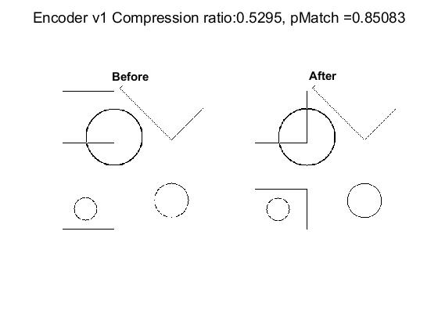
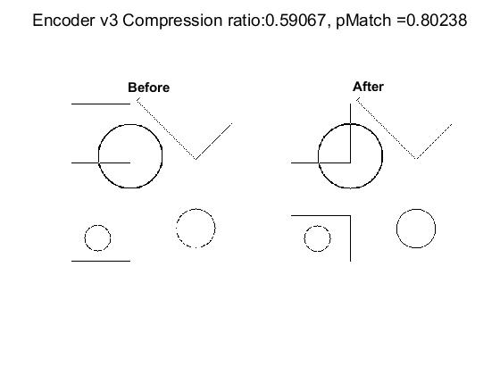
3. Implementation and Test Results
LZ Encoder
LZ Decoder
Input Data
Error Free Channel
Decompressed lossless data

Slide 9
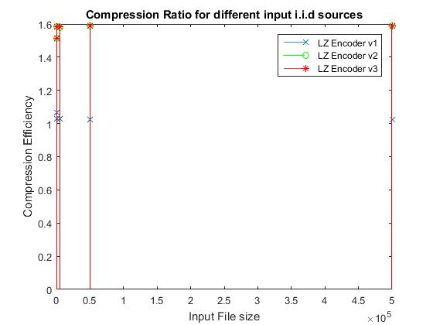
3.2 Testing Results
Running simulations for i.i.d source with P₀ = 0.95 for different input sizes: 50, 500, 5000, 50000, 500000
9

Slide 10
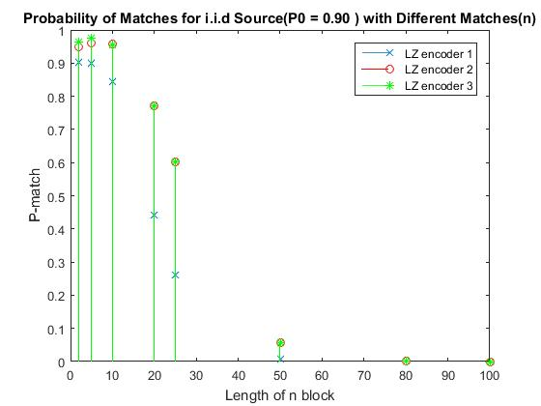
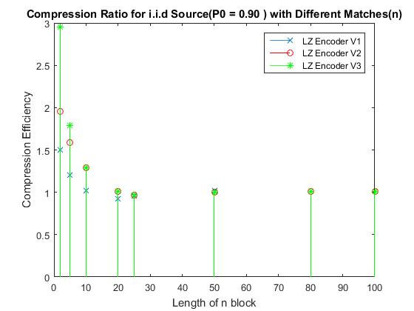
3.2 Testing Results
Running simulations for i.i.d source with P₀ = 0.90 for different matches of n = 2, 5, 10, 20, 25, 50, 80, 100 with input file size 10⁴
Observation: Although the probability of matches is high for n= 2, 5, 10, the pointer is larger than the original symbol size
10

Slide 11
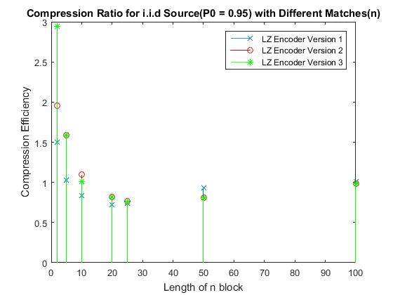
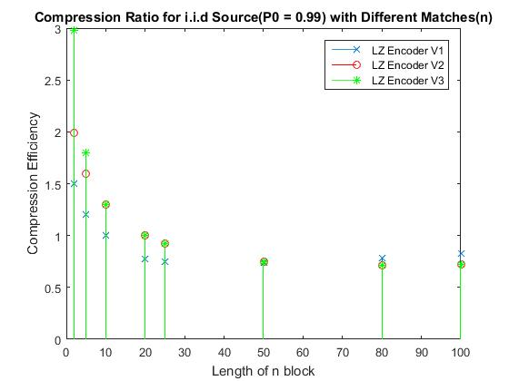
3.2 Testing Results
Running simulations for i.i.d source with P₀ = 0.99, 0.95, 0.90 for different matches of n = 2, 5, 10, 20, 25, 50, 80, 100 with input file size 10⁴
Observation: This i.i.d source performs slightly better than the last one with probability of 0 of 0.99
11

Slide 12
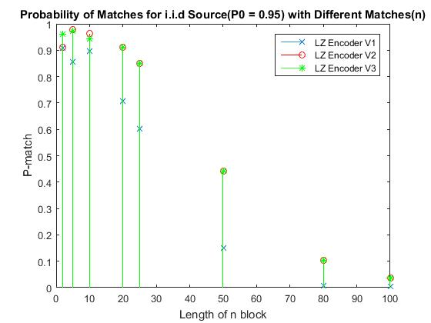
3.2 Testing Results
Running simulations for i.i.d source with P₀ = 0.99, 0.95, 0.90 for different matches of n = 2, 5, 10, 20, 25, 50, 80, 100 with input file size 10⁴
Observation: This i.i.d source has more matches probability of 0(bias) increases from 0.9 to of 0.99
12

Slide 13
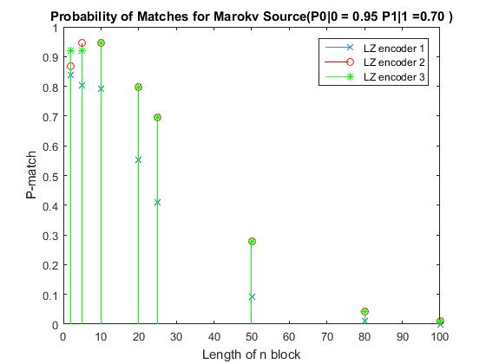
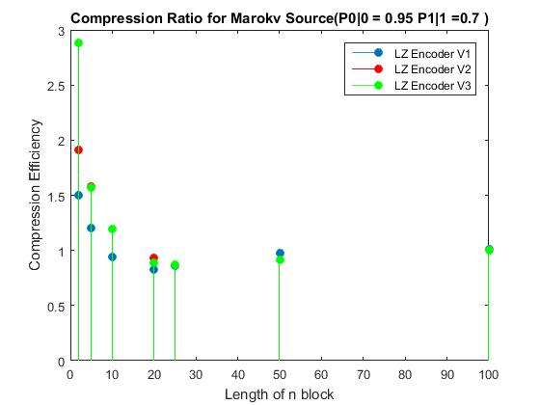
3.2 Testing Results
Running simulations for Markov source with P₀ = 0.95 for different matches of n = 2, 5, 10, 20, 25, 50, 80, 100 with input file size 10⁴
Observation: Markov sources aren’t compressed using Lempel-Ziv although there is a very large probability of match, which generally implies that source should ideally compress to entropy H(X) for an infinitely large n
13

Slide 14
4. Conclusion
Learnt and implemented adaptive Lempel-Ziv compression
The size of the pointer plays a huge role in compression; optimal size of match(n) was found to be around 25 for large source files.
Further implementation includes done into extending this algorithm to variable length matches.

Slide 15
5. References
[1] S. W. 2002, "Historical notes: History [of data compression]," 2002. [Online]. Available: https://www.wolframscience.com/reference/notes/1069b.
[2] R. T. Snodgrass, Radio Receiving for Beginners, V. F. Camp, Ed. New York: The MacMillan Company, 1992.
[3] A-Read, "Satellite communication systems," in A Read. [Online]. Available: http://www.a-read.com/satellite-communication-systems/.
[4] Bell Labs, "Claude Elwood Shannon 1916-2001," in wikipedia.com, 2011. [Online]. Available: http://it-science.net/images/shannon.small.jpg.
[5] J. G. Proakis, Communication Systems Engineering, M. Salehi, Ed., 2nd ed. Pearson, 2001.
Thank You!

Slide 16
Backup Slides

Slide 17
Software Used
Used MATLAB to code these functions.
Reason for choosing MATLAB:
It’s extensive Math Library.
Easy to deal with vectors and matrices
Implementation on other programming languages, for example C or JAVA, will be very simple after coding on MATLAB.

Slide 18
Source Encoder/Decoder

Slide 19
Channel Encoder/Decoder

Slide 20
Universal Communication Systems Architecture

Slide 21
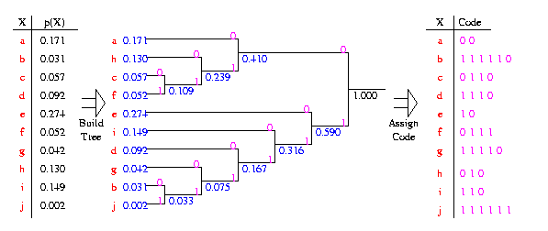
Huffman Encoding: Practical Example

Slide 22
Semester’s Timeline

