Slide 1

Machine Learning
Week 6: Bayes Classifiers

Slide 2
Outline
Bayesian classification
Bayes theorem
Estimating probabilities from data
Naïve Bayes classifier
Bayesian belief network

Slide 3
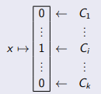
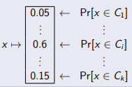
Bayesian Classification
Statistical classifier: Performs probabilistic prediction (predicts class membership probabilities)
Based on Bayes Theorem
Classic Classifier Formulation For each data point x, find the class C_{i} it best fits in.
Statistical Probability Formulation For each data point x and class Ci find the probability that x ∈ Ci.
If we treat the class C and data point x as (hopefully dependent) random variables, we can consider the probabilities Pr[x ∈ C_{i} ] as the conditional probabilities P(C|x).

Slide 4
Probability Theory
Predicting how likely it is that something will happen
Sample space S is listing of all possible outcomes of an experiment
Example: A fair coin is tossed 3 times
S = {HHH, HHT, HTH, HTT, THH, THT, TTH, TTT}
Event A is a subset of S (first toss is head)
A = {HHH, HHT, HTH, HTT}, P(A) = 4/8 = 0.5
Probability function (or distribution)
P: S → [ 0, 1 ]

Slide 5
Conditional Probability
Conditional probability of an event A is the probability event A will occur given the knowledge that an event B has already occurred
P(A | B): Notation for the probability of A given B
P(A | B) = P(A and B) / P(B)

Slide 6
Conditional Probability
Example: A fair coin is tossed 3 times. Given that the first toss is a head, what is the chance of getting 2 heads?
S = {HHH, HHT, HTH, HTT, THH, THT, TTH, TTT}
Event A – Getting 2 heads
Event B – First toss is a head
P(A) = {HHT, HTH, THH}
P(B) = {HHH, HHT, HTH, HTT}
A and B = {HHT, HTH}
P (A | B) = P(A and B) / P(B) = (2/8)/(4/8) = 1/2 = 0.5

Slide 7
Bayes Theorem
P(A | B) = P(A and B) / P(B)
P(B | A) = P(B and A) / P(A)
P(A | B) = ( P(B | A) * P(A) ) / P(B)

Slide 8
Bayes Theorem
P(A | B) = (P(B | A) * P(A)) / P(B)
Named after Thomas Bayes
Two types of probabilities
Posterior Probability [e.g., P(A | B)]: Probability an event will happen after all evidence or background information has been taken into account
Prior Probability [e.g., P(A)]: Probability an event will happen before taking any new evidence into account

Slide 9
Bayes Theorem
Suppose that we have two events
A: stiff neck, B: meningitis
If I have a stiff neck, should I worry that I have meningitis?
A doctor knows that meningitis causes a stiff neck 50% of the time [P(A | B) = 0.5]
Prior probability of a patient have meningitis is 1/50000 [P(B) = 0.00002]
Prior probability of a patient having a stiff neck is 1/20 [P(A) = 0.05]
P(A | B) = 0.5, P(B) = 0.00002, P(A) = 0.05
P ( B | A) = P(A | B) P(B) / P(A) = 0.5 * 0.00002 / 0.05 = 0.0002

Slide 10
Bayes Classification
P(A | B) = ( P(B | A) * P(A) ) / P(B)
P(C | A) = (P(A | C) * P(C)) / P(A)
P(C|A) is the probability of class C given the attribute(s) A. This is called
the posterior probability.
P(A|C) is the probability of attribute(s) A given that the class C was true.
P(C) is the probability of class C being true (regardless of the attribute(s)). This is called the prior probability of C.
P(A) is the probability of the attribute(s) (regardless of the class).

Slide 11
Bayes Classification
Consider each attribute and class label as random variables
Given a record with attributes (A₁, A₂, …, A_{n})
Goal is to predict class C
Specifically, we want to find the value of C that maximizes P(C | A₁, A₂, …, A_{n})
Can we estimate P(C | A₁, A₂, …, A_{n}) directly from data?

Slide 12
Bayes Classification
Compute the posterior probability P(C | A₁, A₂, …, A_{n}) for all values of the class labels C using the Bayes theorem
𝑃(𝐴₁, 𝐴₂, … , 𝐴_{𝑛}|𝐶)𝑃(𝐶)
𝑃(𝐶 | 𝐴₁, 𝐴₂, … , 𝐴_{𝑛}) =
𝑃(𝐴₁, 𝐴₂, … , 𝐴_{𝑛})
Choose value C that maximizes P(C | A₁, A₂, …, A_{n})
Equivalent to choosing value of C that maximizes P(A₁, A₂, …, A_{n} | C) P(C)
How to estimate P(A1, A2, …, An | C )?

Slide 13
Bayes Classification
Assume independence among attributes A_{i} when class is given:
P(A₁, A₂, …, A_{n} | C) = P(A₁ | C_{j}) P(A₂ | C_{j})… P(A_{n} | C_{j})
Can estimate P(A_{i} | C_{j}) for all A_{i} and C_{j}
New point is classified to C_{j} if P(C_{j}) P(A_{i} | C_{j}) is maximal

Slide 14
Estimate Probabilities From Data
TID | Refund | MaritalStatus | TaxableIncome | Evade
1 | Yes | Single | 125000 | No
2 | No | Married | 100000 | No
3 | No | Single | 70000 | No
4 | Yes | Married | 120000 | No
5 | No | Divorced | 95000 | Yes
6 | No | Married | 60000 | No
7 | Yes | Divorced | 220000 | No
8 | No | Single | 85000 | Yes
9 | No | Married | 75000 | No
10 | No | Single | 90000 | Yes
Class: P(C) = N_{C} / N
P(No) = 7/10 P(Yes) = 3/10
For discrete attributes:
P(A_{i} | C_{k}) = |A_{ik}| / N_{C}
where A_{ik} is number of instances having attribute A_{i} and belongs to the class C_{k}.
Examples:
P(Status=Married | No) = 4/7 P(Refund=Yes | Yes) = 0
Discrete attributes
Class
label

Slide 15
Estimate Probabilities From Data
TID | Refund | MaritalStatus | TaxableIncome | Evade
1 | Yes | Single | 125000 | No
2 | No | Married | 100000 | No
3 | No | Single | 70000 | No
4 | Yes | Married | 120000 | No
5 | No | Divorced | 95000 | Yes
6 | No | Married | 60000 | No
7 | Yes | Divorced | 220000 | No
8 | No | Single | 85000 | Yes
9 | No | Married | 75000 | No
10 | No | Single | 90000 | Yes
For continuous attributes:
Discretize the range into bins
Two-way split: (A < v) or (A > v)
Choose only one of the two splits as new attribute
Continuous
attribute
Class
label

Slide 16
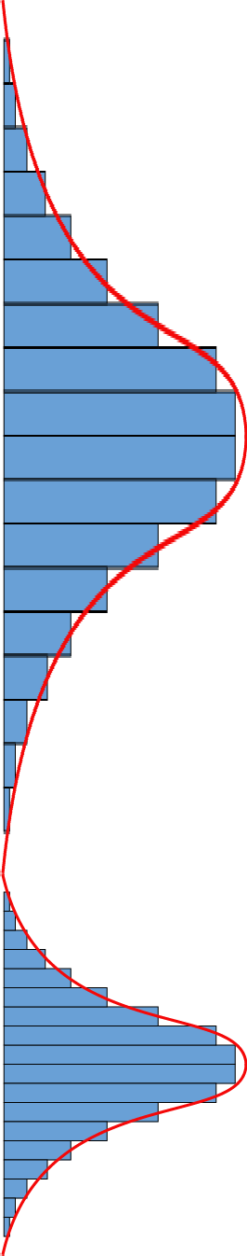
Estimate Probabilities From Data
TID | Refund | MaritalStatus | TaxableIncome | Evade
1 | Yes | Single | 125000 | No
2 | No | Married | 100000 | No
3 | No | Single | 70000 | No
4 | Yes | Married | 120000 | No
6 | No | Married | 60000 | No
7 | Yes | Divorced | 220000 | No
9 | No | Married | 75000 | No
5 | No | Divorced | 95000 | Yes
8 | No | Single | 85000 | Yes
10 | No | Single | 90000 | Yes
For continuous attributes:
Probability density estimation
Assume attribute follows a normal distribution
Use data to estimate parameters of distribution (e.g., mean and standard deviation)
Once probability distribution is known, can use it to estimate the conditional probability P(A_{i} | C_{k})
Continuous
attribute
Class
label

Slide 17
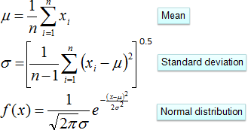
Estimate Probabilities From Data
TID | Refund | MaritalStatus | TaxableIncome | Evade
1 | Yes | Single | 125000 | No
2 | No | Married | 100000 | No
3 | No | Single | 70000 | No
4 | Yes | Married | 120000 | No
6 | No | Married | 60000 | No
7 | Yes | Divorced | 220000 | No
9 | No | Married | 75000 | No
5 | No | Divorced | 95000 | Yes
8 | No | Single | 85000 | Yes
10 | No | Single | 90000 | Yes
Probability density estimation
P(A_{i} | C_{k}) = f(x)
Continuous
attribute
Class
label

Slide 18
Estimate Probabilities From Data
TID | Refund | MaritalStatus | TaxableIncome | Evade
1 | Yes | Single | 125000 | No
2 | No | Married | 100000 | No
3 | No | Single | 70000 | No
4 | Yes | Married | 120000 | No
6 | No | Married | 60000 | No
7 | Yes | Divorced | 220000 | No
9 | No | Married | 75000 | No
5 | No | Divorced | 95000 | Yes
8 | No | Single | 85000 | Yes
10 | No | Single | 90000 | Yes
Probability density estimation
P(Income, Class=No):
If Class = No
sample mean (μ) = 110
sample sd (σ) = 54.54
𝑃 (𝐼𝑛𝑐𝑜𝑚𝑒 = 120000 | 𝑁𝑜)
1
− 120−110 ²
=
𝑒
2(2975)
2𝜋 (54.54)
Continuous
attribute
Class
label
= 0.0072

Slide 19
Naïve Bayes Classifier
Given a test instance:
X = (Refund=No, MaritalStatus=Married, Income = 120000)
P(Refund=Yes | No) = 3/7
P(Refund=No | No) = 4/7 P(Refund=Yes | Yes) = 0 P(Refund=No | Yes) = 1 P(MaritalStatus=Single | No) = 2/7 P(MaritalStatus=Divorced | No) = 1/7 P(MaritalStatus=Married | No) = 4/7 P(MaritalStatus=Single | Yes) = 2/3 P(MaritalStatus=Divorced | Yes) = 1/3 P(MaritalStatus=Married | Yes) = 0
P(X | Class=No) = P(Refund=No | Class=No)
× P(Married | Class=No)
× P(Income=120000 | Class=No)
= 4/7 × 4/7 × 0.0072 = 0.0024
P(X | Class=Yes) = P(Refund=No | Class=Yes)
× P(Married | Class=Yes)
× P(Income=120000 | Class=Yes)
= 1 × 0 × 0.0000000012 = 0
For taxable income:
If Class=No: sample mean = 110, sample sd = 54.54 If Class=Yes: sample mean = 90, sample sd = 5

Slide 20
Naïve Bayes Classifier
Given a test instance:
X = (Refund=No, MaritalStatus=Married, Income = 120000)
P(Refund=Yes | No) = 3/7
P(Refund=No | No) = 4/7 P(Refund=Yes | Yes) = 0 P(Refund=No | Yes) = 1 P(MaritalStatus=Single | No) = 2/7 P(MaritalStatus=Divorced | No) = 1/7 P(MaritalStatus=Married | No) = 4/7 P(MaritalStatus=Single | Yes) = 2/3 P(MaritalStatus=Divorced | Yes) = 1/3 P(MaritalStatus=Married | Yes) = 0
P(X | Class=No) P(No) = 0.0024 * 0.7 = 0.00168
P(X | Class=Yes) P(Yes) = 0 * 0.3 = 0
P(No) = 7/10 = 0.7 P(Yes) = 3/10 = 0.3
Since P(X | No) P(No) > P(X | Yes) P(Yes) Therefore P(No|X) > P(Yes|X)
=> Class = No
For taxable income:
If Class=No: sample mean = 110, sample sd = 54.54 If Class=Yes: sample mean = 90, sample sd = 5

Slide 21
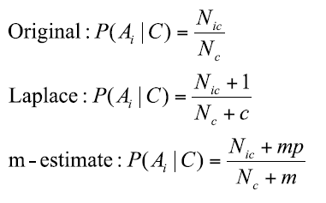
Naïve Bayes Classifier
If one of the conditional probability is zero, then the entire expression becomes zero
P(A₁, A₂, …, A_{n} | C) =
P(A₁ | C_{j}) P(A₂ | C_{j})… P(A_{n} | C_{j})
Probability estimation should replace these zero probabilities with a smoothing algorithm (e.g., Laplace or m-estimate)
c: number of classes p: prior probability m: parameter

Slide 22

Bayesian Belief Network
Allows class conditional independencies to be defined between subsets of variables
Probabilistic graphical model (directed graph)
Naïve Bayes
GRASSWET
SPRINKLER RAIN
Bayesian Belief Network

Slide 23
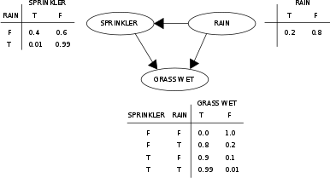
Bayesian Belief Network
Two components that define a Bayesian Belief Network
Directed acyclic graph
A set of conditional probability tables

Slide 24
Strengths and Weaknesses
Robust to isolated noise points
Handle missing values by ignoring the instance during probability estimate calculations
Robust to irrelevant attributes
Independence assumption may not hold for some attributes
Use other techniques such as Bayesian Belief Networks (BBN) or AODE (averaged one-dependence estimator)

