Slide 1

Machine Learning
Week 10: Dimensionality Reduction / Feature Selection

Slide 2
ML Pipeline
Data Collection
Data Preprocessing
Train/ Test Split
Train Model
Predict

Slide 3
Outline
Curse of dimensionality
Dimensionality reduction techniques
Subset selection
Principal component analysis
Factor analysis

Slide 4
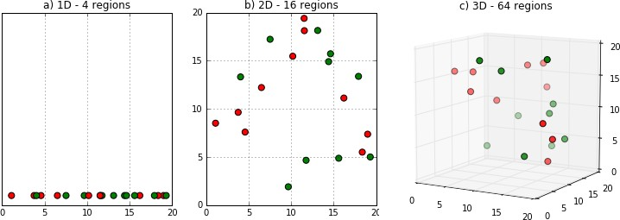
Curse of Dimensionality
Efficiency of many algorithms depends on number of dimensions d (input attributes/features)
Hard to visualize data in large dimensions

Slide 5
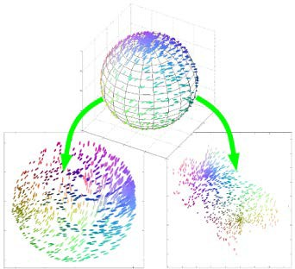
Why reduce dimensionality?
Fewer dimensions → lower complexity → reduced computations and memory
Save cost of extracting unnecessary input
Simpler models (less susceptible to noise and outliers)
Can better explain the data

Slide 6
Methods
Feature selection
Finding a subset (k) of the dimensions (d) that give us the most information
Feature extraction
Finding a new set of k dimensions that are combinations of the original d dimensions

Slide 7
Methods
Feature selection
Subset selection
attendance | test1 | test2 | project | outcome
14 | 80 | 60 | 87 | A
12 | 76 | 66 | 55 | B
3 | 43 | 55 | 45 | D
… | … | … | … | …
F = {attendance, test1, test2, project}
d = 4
Selecting a subset of features
{attendance, test1, project}
{test1, project}

Slide 8
Methods
Feature extraction
Principal component analysis, factor analysis, multidimensional scaling (unsupervised)
Linear discriminant analysis (supervised)
F = {attendance, test1, test2, project}
Extracting new features
{avgTest, project}
{attendance, cwTotal}
attendance | test1 | test2 | project | outcome
14 | 80 | 60 | 87 | A
12 | 76 | 66 | 55 | B
3 | 43 | 55 | 45 | D
… | … | … | … | …

Slide 9
Subset Selection
Find the best subset of the set of features
The least number of dimensions that most contribute to accuracy
Given d input features (Dimensions)
Possible subsets = 2^{d}

Slide 10
Subset Selection
What are the number of possible subsets given the following number of dimensions d?
a) d = 3 b) d = 10
Possible subsets
= 2³
= 8
Possible subsets
₌ ₂10
= 1024

Slide 11
Subset Selection
Wrapper approach: Measure the “usefulness” of features based on the classifier performance
Forward selection
Backward selection
Filter approach: Pick up the intrinsic properties of the features regardless of the model
Correlation coefficient
Information gain

Slide 12
Wrapper Approach
Forward selection
Start with no variables
Add variable one by one (add the one that decreases error the most)
Stop when further addition does nor decrease error

Slide 13
Wrapper Approach
Backward selection
Start with all variables
Remove variable one by one (remove the one that decreases error the most)
Stop when further removal increases error significantly

Slide 14
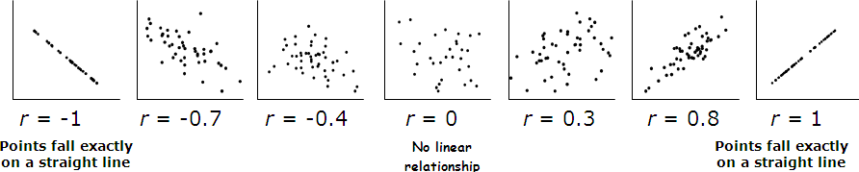
Filter Approach
Correlation coefficient
Evaluates the correlation (Pearson's) between each attribute and the class

Slide 15
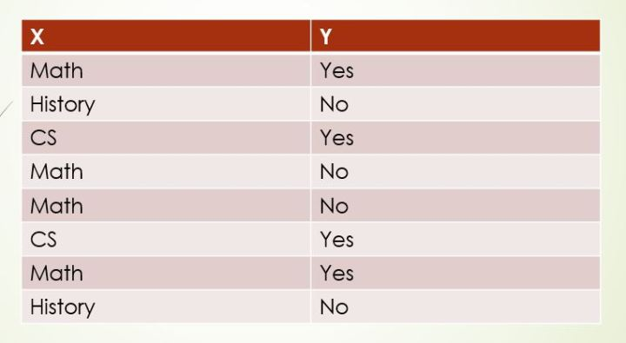
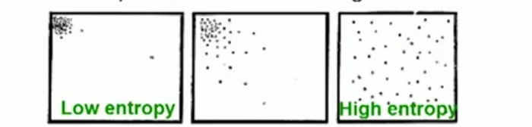
Filter Approach
Information gain
Evaluates the worth of an attribute by measuring the information gain with respect to the class
Base on Entropy calculation
InfoGain(Class, Attribute) = H(Class) - H(Class | Attribute)

Slide 16
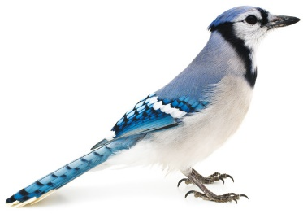
Principal Component Analysis
Example: Blue Jays' dataset
bird_id | sex | bill_depth_mm | bill_width_mm | bill_length_mm | head_length_mm | body_mass_g | skull_size_mm
0000-00000 | M | 8.26 | 9.21 | 25.92 | 56.58 | 73.30 | 30.66
1142-05901 | M | 8.54 | 8.76 | 24.99 | 56.36 | 75.10 | 31.38
1142-05905 | M | 8.39 | 8.78 | 26.07 | 57.32 | 70.25 | 31.25
1142-05907 | F | 7.78 | 9.30 | 23.48 | 53.77 | 65.50 | 30.29
1142-05909 | M | 8.71 | 9.84 | 25.47 | 57.32 | 74.90 | 31.85
1142-05911 | F | 7.28 | 9.30 | 22.25 | 52.25 | 63.90 | 30.00
1142-05912 | M | 8.74 | 9.28 | 25.35 | 57.12 | 75.10 | 31.77
1142-05914 | M | 8.72 | 9.94 | 30.00 | 60.67 | 78.10 | 30.67
1142-05917 | F | 8.20 | 9.01 | 22.78 | 52.83 | 64.00 | 30.05
1142-05920 | F | 7.67 | 9.31 | 24.61 | 54.94 | 67.33 | 30.33
1142-05930 | M | 8.78 | 8.83 | 25.72 | 56.54 | 76.40 | 30.82
… | … | … | … | … | … | … | …

Slide 17
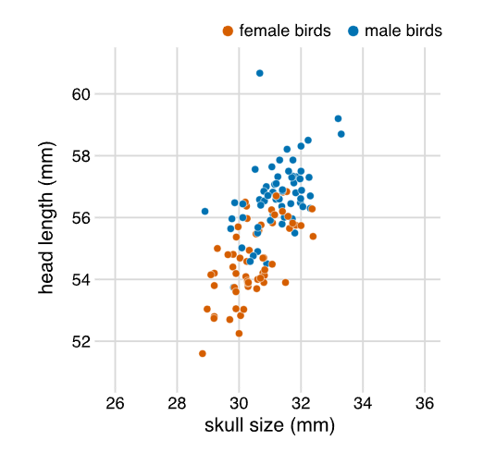
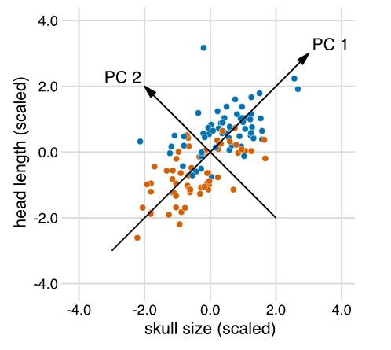
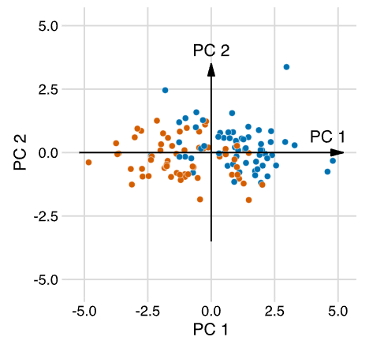
Principal Component Analysis

Slide 18
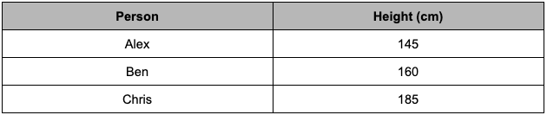
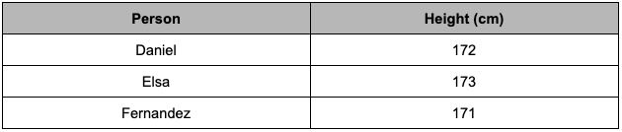
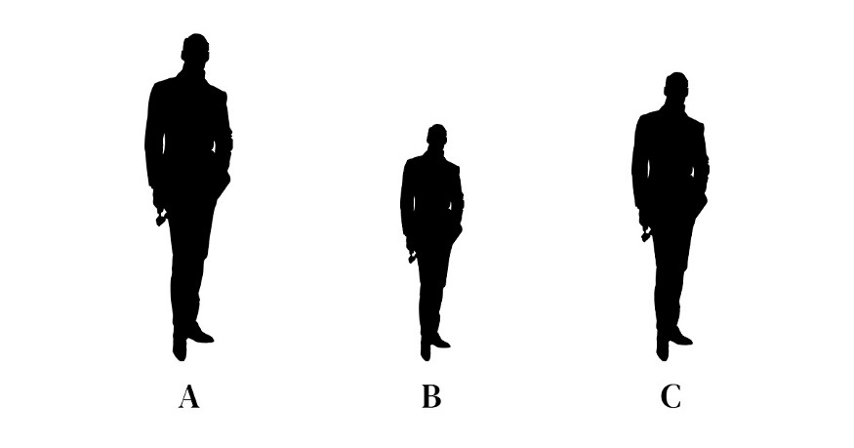
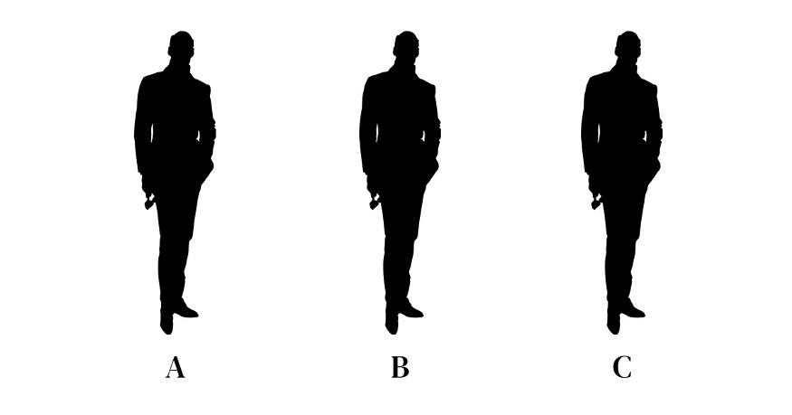
Principal Component Analysis

Slide 19
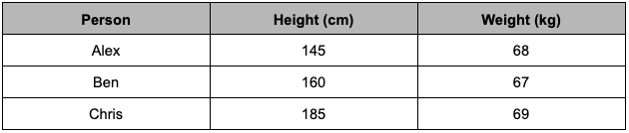
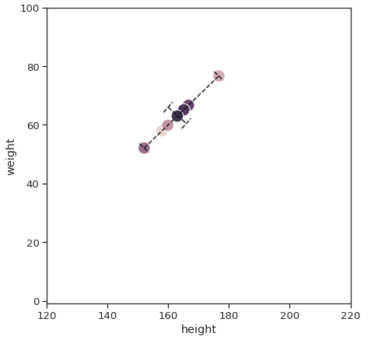
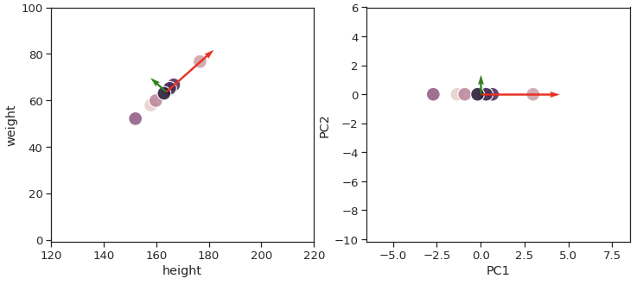
Principal Component Analysis

Slide 20

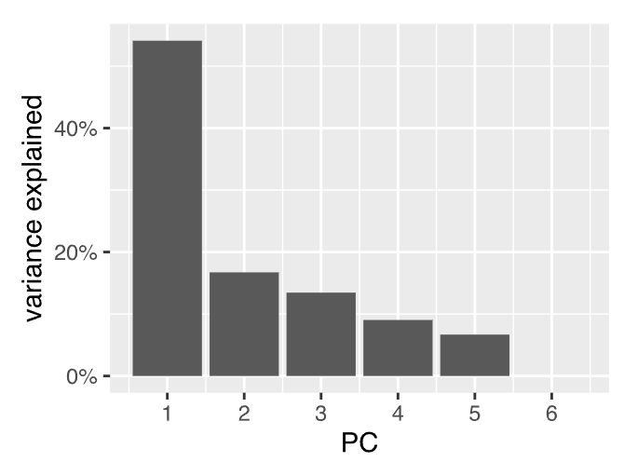
Principal Component Analysis
Calculate Variance of PC1 and PC2
 | PC1 | PC2
 | 2.2 | 0.1
Percentages | 95.5% | 4.5%

Slide 21
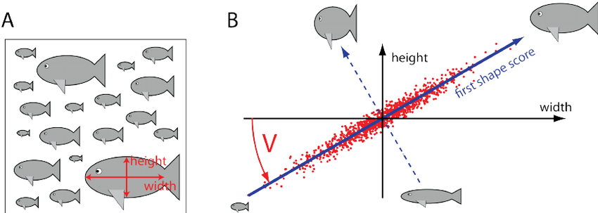
Principal Component Analysis

Slide 22
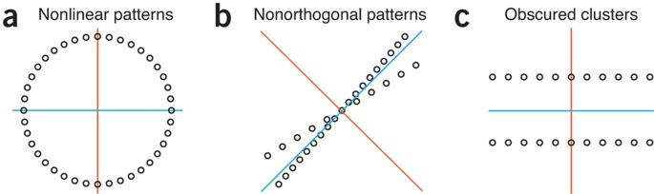
Principal Component Analysis
PCA Limitations

Slide 23
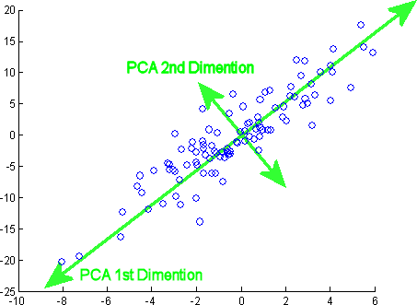
Principal Component Analysis
Reduce many variables to a smaller set of linearly uncorrelated variables (principal components) maximizing variance in the original data
https://setosa.io/ev/principal-component-analysis
PC 1 explains the largest part of variance
PC 2 explains the second largest part of variance and be orthogonal

Slide 24
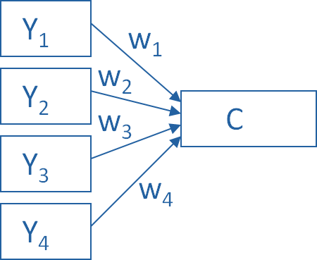
Principal Component Analysis
Use linear combination (weighted average) of a set of variables
Example
Combine 4 measured (Y) variables into a single component, C
Direction of the arrows shows Y variables contribute to the component variable
Weights allow this combination to emphasize some Y variables more than others
Model equation:
C = w₁(Y₁) + w₂(Y₂) + w₃(Y₃) + w₄(Y₄)

Slide 25
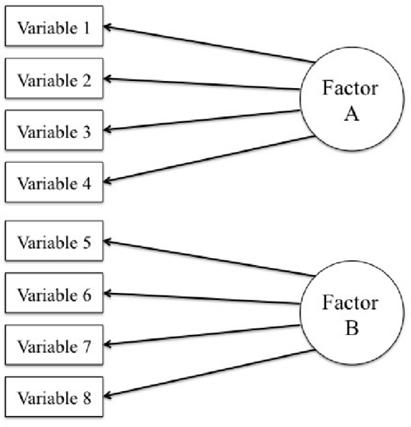
Factor Analysis
Unsupervised method
Find a smaller number of interpretable factors that explain the maximum amount variability in the data
Multiple variables have similar patterns of responses because they are all associated with a latent variable (i.e. factor)
Example: Income, Education and Occupation are associated with the latent variable Socioeconomic Status

Slide 26
Factor Analysis
Variables can be grouped by their correlations
All variables in a factor can be highly correlated among themselves but have low correlation with variables of other factor(s)

Slide 27
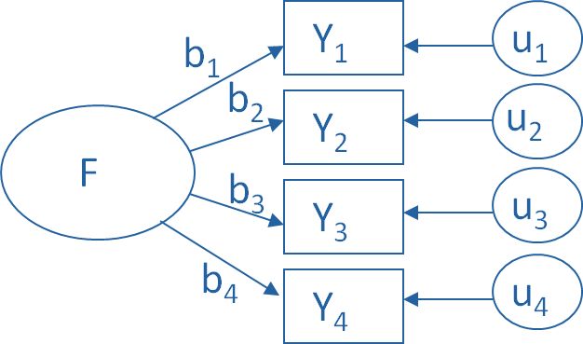
Factor Analysis
Measures total amount of variance of the original variables explained by each factor
Example (one-factor model):
F, the latent Factor, is causing the responses on the four measured Y variables
Direction of the arrows shows F contributes to the variables
Relationships between F and each Y are weighted (factor loadings)
Symbol u designates a set of error terms, the variance in each Y that is unexplained by the factor
Model equation: Y1 = b1*F + u1 Y2 = b2*F + u2 Y3 = b3*F + u3 Y4 = b4*F + u4

Slide 28
PCA & FA: Similarities
Both are unsupervised dimensionality reduction techniques
Capture the variance in variables in a smaller set

Slide 29
PCA & FA: Differences
PCA | FA
Linear combination of variables | Measurement model of a latent variable
Components are orthogonal linear combinations of original data that maximize total variance | Factors are linear combinations that maximize the shared portion of variance from the variables
All observed variances are analyzed | Only shared variances are analyzed

