Slide 1

Machine Learning
Week 12: Hierarchical Clustering

Slide 2
Outline
Formalizing hierarchical clustering
Methods
Linkage functions

Slide 3
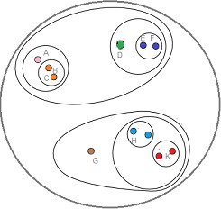
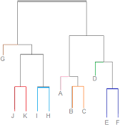
Hierarchical Clustering
Build a hierarchy of clusters
Repeated calculation of distance measures between objects and between clusters once objects begin to be grouped onto clusters
Outcome: Represented graphically as a dendrogram
Dendrogram

Slide 4
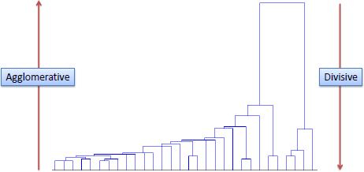
Methods
Divisive
Top-down
Assign all of the observations to a single cluster and partition the cluster to two least similar clusters
Proceed recursively on each cluster until there is one cluster for each observation
Agglomerative
Bottom-up
Assign each observation to its own cluster
Join the two most similar clusters until there is only a single cluster left

Slide 5
Initial Data
Given N objects
A set of N x (N-1) / 2 distances
A linkage function (how to compute distance between 2 clusters)

Slide 6
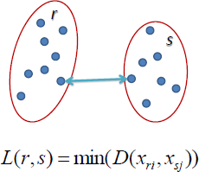
Linkage Functions
Single linkage
Nearest neighbor
Distance between the closest pair of objects (shortest link between the clusters)

Slide 7
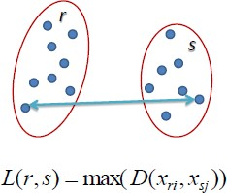
Linkage Functions
Complete linkage
Farthest neighbor
Distance between the most distant pair of object (longest link between the clusters)

Slide 8
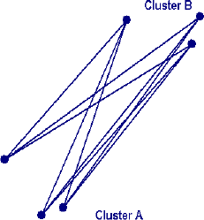
Linkage Functions
Average linkage
Distance between each point in one cluster to every point in the other cluster
D(r,s) = T_{rs} / ( N_{r} * N_{s})
T_{rs} = sum of all pairwise distances between cluster r and cluster s
N_{r} = size of the clusters r N_{s} = size of the clusters s

Slide 9
Example
Use single linkage agglomerative clustering to group the data described by the following distance matrix. Show the
dendrogram.
Distance Matrix
Agglomerative: Initially every point is a cluster of its own and we merge cluster until we end-up with one unique cluster containing all points
 | A | B | C | D
A | 0 | 1 | 4 | 5
B |  | 0 | 2 | 6
C |  |  | 0 | 3
D |  |  |  | 0
d | k | K | Comments
0 | 4 | {A} {B} {C} {D} | We start with each point being a cluster
Dendrogram

Slide 10

Example
Single linkage: Merge two clusters based on the shortest distance between a pair of elements from the two clusters
Distance Matrix
 | A | B | C | D
A | 0 | 1 | 4 | 5
B |  | 0 | 2 | 6
C |  |  | 0 | 3
D |  |  |  | 0
d | k | K | Comments
0 | 4 | {A} {B} {C} {D} | We start with each point being a cluster
1 | 3 | {A,B} {C} {D} | Merge {A} and {B} since A & B are the closest d(A,B) = 1
Dendrogram

Slide 11
Example
Compute new distance matrix
Distance Matrix (d = 0)
New Distance Matrix (d = 1)
 | A | B | C | D
A | 0 | 1 | 4 | 5
B |  | 0 | 2 | 6
C |  |  | 0 | 3
D |  |  |  | 0
Single linkage
Pick the shortest distance between
{A,B} and {C}
Pick the shortest distance between
{A,B} and {D}
 | A,B | C | D
A,B | 0 | 2 | 5
C |  | 0 | 3
D |  |  | 0

Slide 12

Example
Single linkage: Merge two clusters based on the shortest distance between a pair of elements from the two clusters
Distance Matrix
 | A,B | C | D
A,B | 0 | 2 | 5
C |  | 0 | 3
D |  |  | 0
d | k | K | Comments
0 | 4 | {A} {B} {C} {D} | We start with each point being a cluster
1 | 3 | {A,B} {C} {D} | Merge {A} and {B} since A & B are the closest d(A,B) = 1
2 | 2 | {A,B,C} {D} | Merge {A,B} and {C} since B & C are the closest
Dendrogram

Slide 13
Example
Compute new distance matrix
Distance Matrix (d = 1)
New Distance Matrix (d = 2)
 | A,B | C | D
A,B | 0 | 2 | 5
C |  | 0 | 3
D |  |  | 0
 | A,B,C | D
A,B,C | 0 | 3
D |  | 0

Slide 14

Example
Single linkage: Merge two clusters based on the shortest distance between a pair of elements from the two clusters
Distance Matrix
 | A,B,C | D
A,B,C | 0 | 3
D |  | 0
d | k | K | Comments
0 | 4 | {A} {B} {C} {D} | We start with each point being a cluster
1 | 3 | {A,B} {C} {D} | Merge {A} and {B} since A & B are the closest d(A,B) = 1
2 | 2 | {A,B,C} {D} | Merge {A,B} and {C} since B & C are the closest
3 | 1 | {A,B,C,D} | Merge D
Dendrogram

