Slide 1

Machine Learning
Week 11: Cluster Analysis (K-Means)

Slide 2
Outline
Formalizing unsupervised learning
Clustering
Distance measures
Clustering techniques
K-means clustering

Slide 3
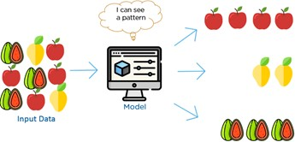
Unsupervised Learning
Have input data and no corresponding output variable (unlabeled data)
Goal: Model underlying structure or distribution in data to learn more about the data
No correct answers
Learning algorithm discovers and presents interesting structure in data
Customer Data
Age | # Purchases Per Year | Amount Per Purchase (RM)
25 | 3 | 3000
40 | 2 | 5000

Slide 4
Unsupervised Learning
Dimensionality reduction: Compress the data while maintaining its structure and usefulness
Clustering: Cluster data into groups by similarity
Example: Group customers by purchasing behavior
Association rule mining: Discover rules describing large portions of the data
Example: People that buy X also tend to buy Y

Slide 5
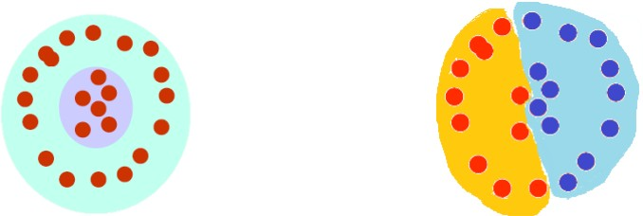
What is clustering?
Organization of unlabeled data into similarity groups called clusters
Cluster: A collection of data items which are “similar” between them, and “dissimilar” to data items in other clusters

Slide 6
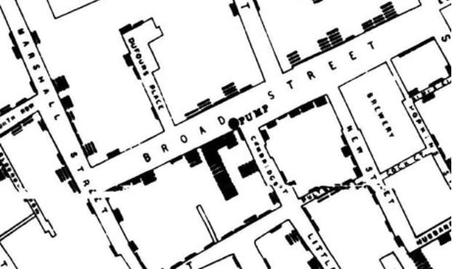
Historic Application of Clustering
John Snow plotted the location of cholera deaths on a map during an outbreak in the 1850s
Locations indicated cases were clustered around certain intersections with polluted wells

Slide 7
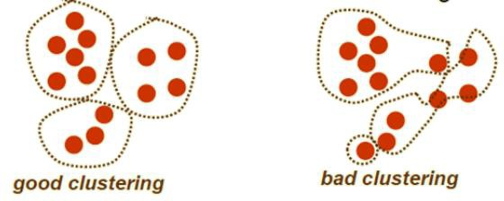
Clustering
What do we need for clustering?
Proximity measure
Similarity measure s(x_{i}, x_{k}): Large if x_{i}, x_{k} are similar
Dissimilarity (or distance) measure d(x_{i}, x_{k}): Small if x_{i}, x_{k} are similar
Criterion function to evaluate clustering
Algorithm to compute clustering
Example: Optimizing the criterion function

Slide 8

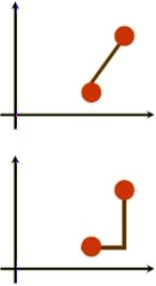

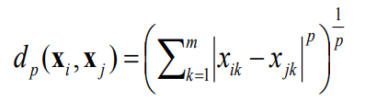
Distance (Dissimilarity) Measures
Numeric attributes
Euclidean distance
Translation invariant
Manhattan distance
Approximation to Euclidean distance
Cheaper to compute
Special cases of Minkowski distance
When p = 1, the distance is known as the
Manhattan distance
When p = 2, the distance is known as the Euclidean distance

Slide 9
Distance (Dissimilarity) Measures
Binary attributes
A contingency table for the binary data: Gives the number of attributes for each pair of values
 | Object j
Object i |  | 1 | 0 | Sum
 | 1 | a | b | a + b
 | 0 | c | d | c + d
 | Sum | a + c | b + d | p

Slide 10
Distance (Dissimilarity) Measures
Binary attributes
Distance measure for symmetric binary attributes (where 0 or 1 is equally likely)
 | Object j
Object i |  | 1 | 0 | Sum
 | 1 | a | b | a + b
 | 0 | c | d | c + d
 | Sum | a + c | b + d | p
Distance measure for asymmetric binary attributes (where having a 0 value (typically the absence of a property) is not as important as 1 value
Symmetric
𝑏 + 𝑐
𝑑 𝑖, 𝑗 =
𝑎 + 𝑏 + 𝑐 + 𝑑
Asymmetric
𝑏 + 𝑐
𝑑 𝑖, 𝑗 =
𝑎 + 𝑏 + 𝑐

Slide 11
Class Activity
Name | Fever | Cough | Test1 | Test2 | Test3 | Test4
Jack | Y | N | Y | N | N | N
Mary | Y | N | Y | N | Y | N
Jim | Y | Y | N | N | N | N
 | Mary
Jack |  | 1 | 0 | Sum
 | 1 | 2 | 0 | 2
 | 0 | 1 | 3 | 4
 | Sum | 3 | 3 | 6
All attributes are asymmetric binary
Let value Y be set to 1, and value N to be set to 0, and compute the asymmetric distance for all attributes
Asymmetric
𝑏 + 𝑐
𝑑 𝑖, 𝑗 =
𝑎 + 𝑏 + 𝑐
0 + 1
𝑑 𝐽𝑎𝑐𝑘, 𝑀𝑎𝑟𝑦 =
= 0.33
2 + 0 + 1
Compute d(Jack, Jim) and d(Mary, Jim).

Slide 12
Class Activity
Name | Fever | Cough | Test1 | Test2 | Test3 | Test4
Jack | Y | N | Y | N | N | N
Mary | Y | N | Y | N | Y | N
Jim | Y | Y | N | N | N | N
 | Jim
Jack |  | 1 | 0 | Sum
 | 1 | 1 | 1 | 2
 | 0 | 1 | 3 | 4
 | Sum | 2 | 4 | 6
All attributes are asymmetric binary
Let value Y be set to 1, and value N to be set to 0, and compute the asymmetric distance for all attributes
Asymmetric
𝑏 + 𝑐
𝑑 𝑖, 𝑗 =
1 + 1
𝑎 + 𝑏 + 𝑐
𝑑 𝐽𝑎𝑐𝑘, 𝐽𝑖𝑚 =
= 0.67
1 + 1 + 1

Slide 13
Class Activity
Name | Fever | Cough | Test1 | Test2 | Test3 | Test4
Jack | Y | N | Y | N | N | N
Mary | Y | N | Y | N | Y | N
Jim | Y | Y | N | N | N | N
 | Mary
Jack |  | 1 | 0 | Sum
 | 1 | 1 | 2 | 3
 | 0 | 1 | 2 | 3
 | Sum | 2 | 4 | 6
All attributes are asymmetric binary
Let value Y be set to 1, and value N to be set to 0, and compute the asymmetric distance for all attributes
Asymmetric
𝑏 + 𝑐
𝑑 𝑖, 𝑗 =
𝑎 + 𝑏 + 𝑐
2 + 1
𝑑 𝑀𝑎𝑟𝑦, 𝐽𝑖𝑚 =
= 0.75
1 + 2 + 1

Slide 14
Distance (Dissimilarity) Measures
Nominal attributes
Attributes that can take more than 2 states (e.g., red, yellow, blue, green)
Method 1: Simple matching
𝑝 − 𝑚
m = number of matches
𝑑 𝑖, 𝑗 =
Age | CM | CS | CT | Salary
25 | 1 | 0 | 0 | 3000
40 | 0 | 1 | 0 | 5000
21 | 0 | 1 | 0 | 3200
35 | 0 | 0 | 1 | 6000
55 | 0 | 0 | 1 | 8000
𝑝
Age | CM | Salary
25 | Mini | 3000
40 | SUV | 5000
21 | SUV | 3200
35 | Truck | 6000
55 | Truck | 8000
p = total number of variables
Method 2: Use a large number of binary variables
Create a new binary variable for each nominal state

Slide 15
Cluster Evaluation
Intra-cluster cohesion (compactness)
Cohesion measures how near the data points in a cluster are to the cluster centroid
Sum of squared error (SSE) is a commonly used measure
Inter-cluster cohesion (isolation)
Separation means that different cluster centroids should be far away from one another
Expert judgments are still the key in most applications

Slide 16
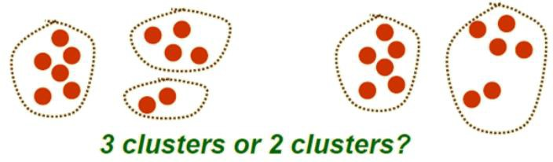
How many clusters?
Possible approaches
Fix the number of clusters to k
Find the best clustering according to criterion function (number of clusters may vary)

Slide 17
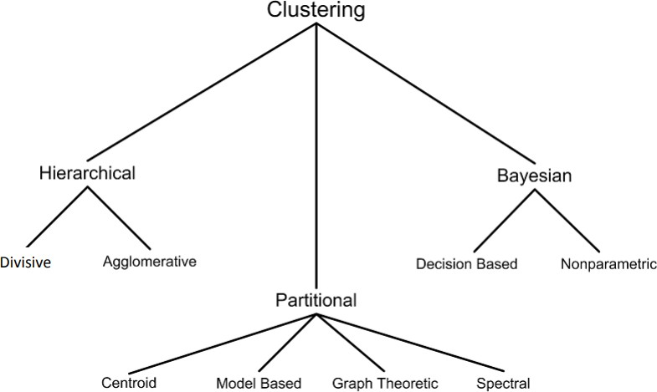
Clustering Techniques

Slide 18
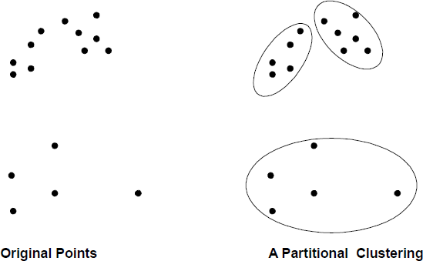
Clustering Techniques
Partitional
Algorithms typically determine all clusters at once

Slide 19
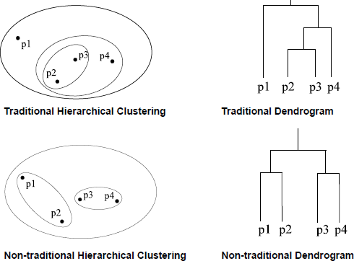
Clustering Techniques
Hierarchical
Algorithms find successive clusters using previously established clusters
Agglomerative algorithms (bottom-up): Begin with each element as a separate cluster and merge them into successively larger clusters
Divisive algorithms (top-down): Begin with the whole set and proceed to divide it into successively smaller clusters

Slide 20
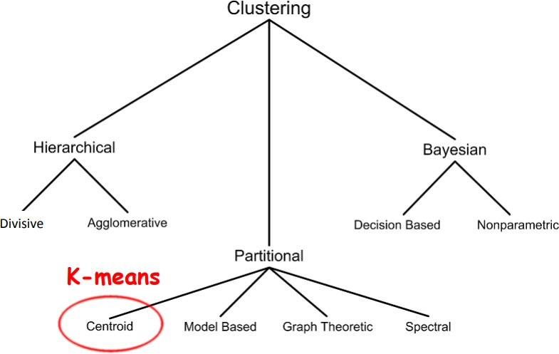
Clustering Techniques

Slide 21
K-Means Clustering
Partitional clustering algorithm
The k-means algorithm partitions the given data into k
clusters
Each cluster has a cluster center, called centroid
Value of k is specified by the user

Slide 22
Cluster Centroid
Centroid
“Middle” of a cluster
Pseudo instance of data where each attribute is the “mean” of all attribute values in the cluster
Compute mean for numerical variables
Example: (A₁₁, A₁₂), (A₂₁, A₂₂), (A₃₁, A₃₂) belongs to the same cluster
Centroid: ((A₁₁ + A₂₁ + A₃₁)/3, (A₁₂ + A₂₂ + A₃₂)/3)
Use majority rules for binary or nominal variables
A1 | A2
A11 | A12
A21 | A22
A31 | A32

Slide 23
K-Means Algorithm
Given k
Choose k (random) data points (seeds) to be the initial
centroids, cluster centers
Assign each data point to the closest centroid
Re-compute the centroids using the current cluster memberships
If a convergence criterion is not met, repeat steps 2 and 3

Slide 24

K-Means Convergence Criterion
When to stop?
No or minimum re-assignments of data points to different clusters
OR
No or minimum change of centroids
OR
Minimum decrease in the sum of squared error (SSE)
C_{j} is the j^{th} cluster
m_{j} is the centroid of cluster C_{j} (the mean vector of all the data points in C_{j})
d(x, m_{j}) is the (Euclidean) distance between data point x and centroid m_{j}

Slide 25
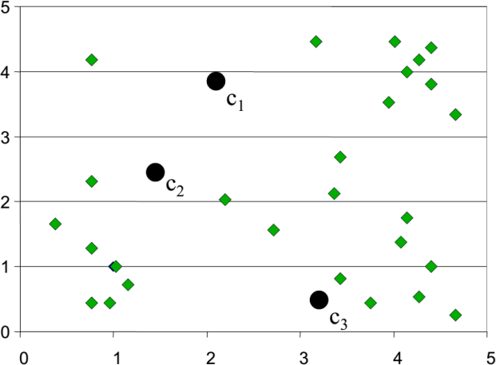
K-Means Clustering: Example
Step 1: Randomly initialize the cluster centers (initial centroids)

Slide 26
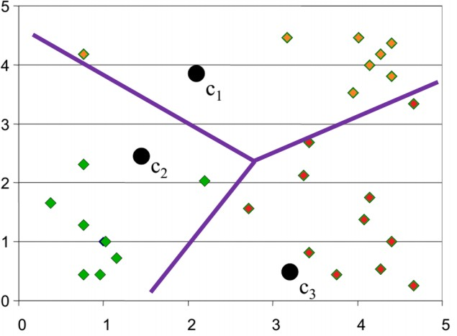
K-Means Clustering: Example
Step 2: Determine cluster membership for each input data point
Compute the (Euclidean) distance between each data point to each centroid
Each data point is assigned to the nearest centroid’s cluster

Slide 27
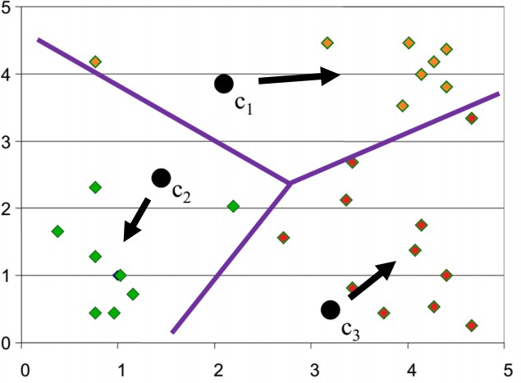
K-Means Clustering: Example
Step 3: Re-estimate cluster centers (centroids)
Move the centroids to the center of their clusters

Slide 28
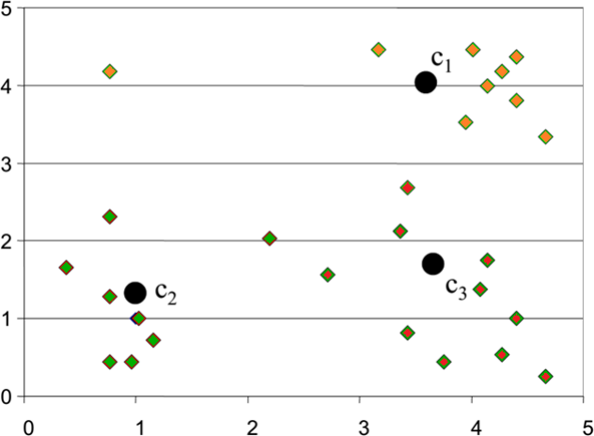
K-Means Clustering: Example
Result of the FIRST
iteration

Slide 29
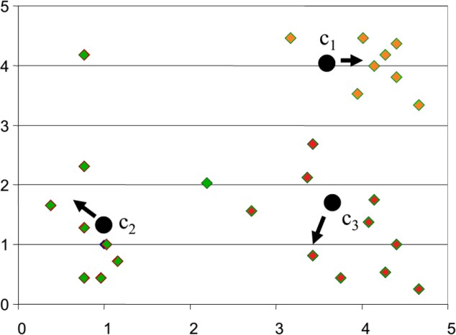
K-Means Clustering: Example
SECOND iteration

Slide 30
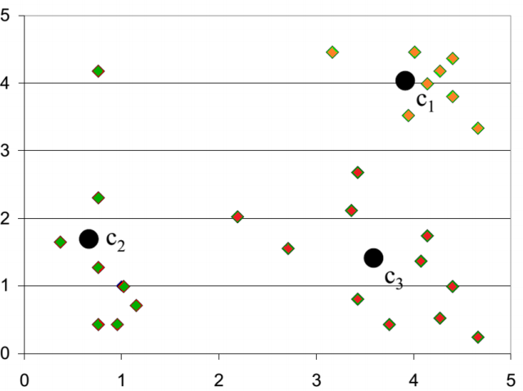
K-Means Clustering: Example
Result of the SECOND
iteration

Slide 31
Example
Suppose we have 4 types of medicine and each medicine has 2 attributes/features: weight index (X) and pH (Y). Our goal is to group these objects into 2 groups of medicine based on the 2 features.
Medicine | X: Weight Index | Y: pH
A | 1 | 1
B | 2 | 1
C | 4 | 3
D | 5 | 4

Slide 32
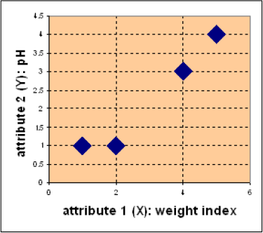
Example
Each medicine represents one point with two attributes (X, Y) represented as a coordinate in an attribute space
D
C
Medicine | X: Weight Index | Y: pH
A | 1 | 1
B | 2 | 1
C | 4 | 3
D | 5 | 4
A
B

Slide 33
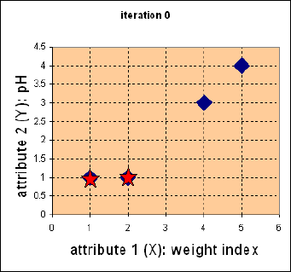
Example: Step 1
Pick initial value of centroids
(K = 2)
Medicine A = C1 = (1, 1)
Medicine B = C2 = (2, 1)
Iteration 0

Slide 34
Example: Step 2
Calculate the distance between each object to the centroids
(Euclidean distance)
Iteration 0: Distance Matrix
 | A | B | C | D
C1 = A | 0 | 1 | 3.61 | 5
C2 = B | 1 | 0 | 2.83 | 4.24
A(1,1), B(2,1), C(4,3), D(5,4) C1 = (1,1), C2 = (2,1)
Distance C1 to each object
Distance C2 to each object
D(C1,A) =
D(C1,B) =
D(C1,C) =
D(C1,C) =
(1 − 1)²+(1 − 1)² = 0
(2 − 1)²+(1 − 1)² = 1
(4 − 1)²+(3 − 1)² = 3.61
(5 − 1)²+(4 − 1)² = 5
D(C2,A) =
D(C2,B) =
D(C2,C) =
D(C2,C) =
(1 − 2)²+(1 − 1)² = 1
(2 − 2)²+(1 − 1)² = 0
(4 − 2)²+(3 − 1)² = 2.83
(5 − 2)²+(4 − 1)² = 4.24

Slide 35
Example: Step 3
Assign each object based on the minimum distance
 | A | B | C | D
C1 = A | 0 | 1 | 3.61 | 5
C2 = B | 1 | 0 | 2.83 | 4.24
Cluster | Object(s)
C1 | A
C2 | B, C, D

Slide 36
Example: Step 4
Compute new centroids
A(1,1), B(2,1), C(4,3), D(5,4)
Cluster | Object(s)
C1 | A
C2 | B, C, D
New centroid C1 = A(1,1)
Cluster 1 has only 1 member
New centroid C2 = (
2+4+5
,
1+3+4 11 8
) = ( , ) = (3.67,2.67)
Cluster 2 now has 3 members – centroid is average coordinate among the 3 members
3
3
3 3

Slide 37
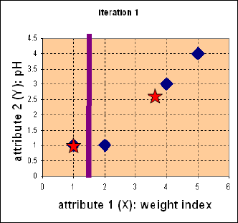
Example
Iteration 1

Slide 38
Example: Step 2
Calculate the distance between each object to the new
centroids (Euclidean distance)
Iteration 1: Distance Matrix
 | A | B | C | D
C1 = A | 0 | 1 | 3.61 | 5
C2 = B | 3.14 | 2.36 | 0.47 | 1.89
A(1,1), B(2,1), C(4,3), D(5,4) C1 = (1,1), C2 = (3.67,2.67)
Distance C1 to each object
Distance C2 to each object
D(C1,A) =
D(C1,B) =
D(C1,C) =
D(C1,C) =
(1 − 1)²+(1 − 1)² = 0
(2 − 1)²+(1 − 1)² = 1
(4 − 1)²+(3 − 1)² = 3.61
(5 − 1)²+(4 − 1)² = 5
D(C2,A) =
D(C2,B) =
D(C2,C) =
D(C2,C) =
(1 − 3.67)²+(1 − 2.67)² = 3.14
(2 − 3.67)²+(1 − 2.67)² = 2.36
(4 − 3.67)²+(3 − 2.67)² = 0.47
(5 − 3.67)²+(4 − 2.67)² = 1.89

Slide 39
Example: Step 3
Assign each object based on the minimum distance
 | A | B | C | D
C1 = A | 0 | 1 | 3.61 | 5
C2 = B | 3.14 | 2.36 | 0.47 | 1.89
Cluster | Object(s)
C1 | A, B
C2 | C, D

Slide 40
Example: Step 4
Compute new centroids
A(1,1), B(2,1), C(4,3), D(5,4)
Cluster | Object(s)
C1 | A, B
C2 | C, D
1+2 1+1
New centroid C1 = ( , ) = ( , ) = (1.5,1)
3 2
2 2 2 2
4+5 3+4 9 7
New centroid C2 = ( , ) = ( , ) = (4.5,3.5)
2 2 2 2

Slide 41
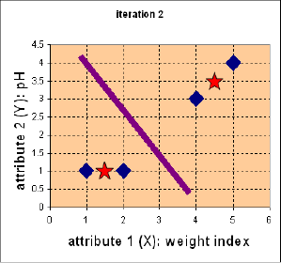
Example
Iteration 2

Slide 42
Example: Step 2
Calculate the distance between each object to the new
centroids (Euclidean distance)
Iteration 2: Distance Matrix
 | A | B | C | D
C1 = A | 0.5 | 0.5 | 3.2 | 4.61
C2 = B | 4.3 | 3.54 | 0.71 | 0.71
A(1,1), B(2,1), C(4,3), D(5,4) C1 = (1.5,1), C2 = (4.5,3.5)
Distance C1 to each object
Distance C2 to each object
D(C1,A) =
D(C1,B) =
D(C1,C) =
D(C1,C) =
(1 − 1.5)²+(1 − 1)² = 0.5
(2 − 1.5)²+(1 − 1)² = 0.5
(4 − 1.5)²+(3 − 1)² = 3.2
(5 − 1.5)²+(4 − 1)² = 4.61
D(C2,A) =
D(C2,B) =
D(C2,C) =
D(C2,C) =
(1 − 4.5)²+(1 − 3.5)² = 4.3
(2 − 4.5)²+(1 − 3.5)² = 3.54
(4 − 4.5)²+(3 − 3.5)² = 0.71
(5 − 4.5)²+(4 − 3.5)² = 0.71

Slide 43
Example: Step 3
Assign each object based on the minimum distance
 | A | B | C | D
C1 = A | 0.5 | 0.5 | 3.2 | 4.61
C2 = B | 4.3 | 3.54 | 0.71 | 0.71
Objects in C1 and C2 are the same as the previous iteration
Objects do not move cluster anymore
Reached convergence
No more iteration is needed
Cluster | Object(s)
C1 | A, B
C2 | C, D

Slide 44
Strengths
Simple: Easy to understand and implement
Efficient in terms of time complexity
Considered a linear algorithm since both number of clusters and number of iterations are small
The most popular clustering algorithm

Slide 45
Weaknesses
Only applicable if the mean is defined
For categorical data, k-mode - centroid is represented by the most frequent values
User needs to specify k
Sensitive to outliers
Outliers are data points that are very far away from other data points
Outliers could be errors in the data recording or some special data points with very different values

Slide 46
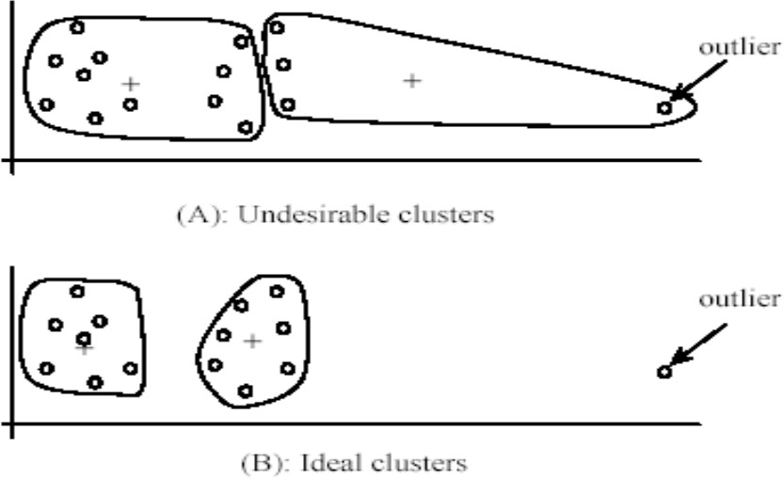
Weaknesses
Dealing with
outliers
Remove some data points that are much further away from the centroids than other data points
outlier
(A): Undesirable clusters
outlier
(B): Ideal clusters

Slide 47
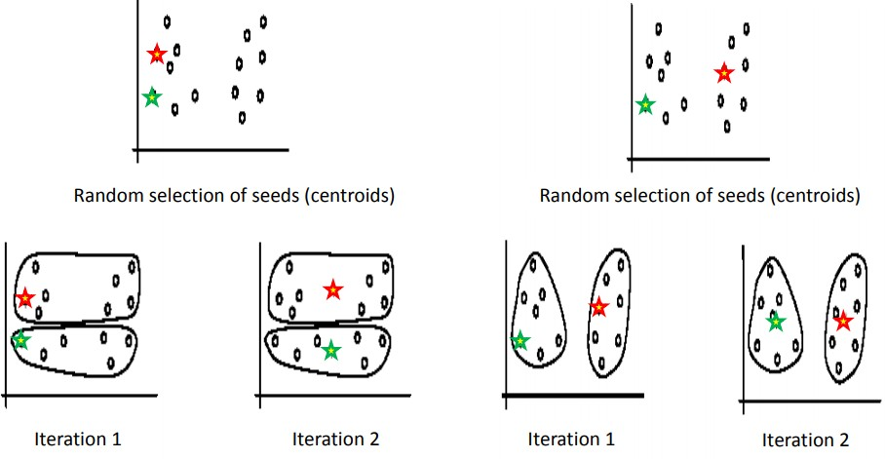
Weaknesses
Sensitivity to initial seeds (initial centroids)
Terminates at a local optimum if SSE is used
Global optimum is hard to find due to complexity

Slide 48
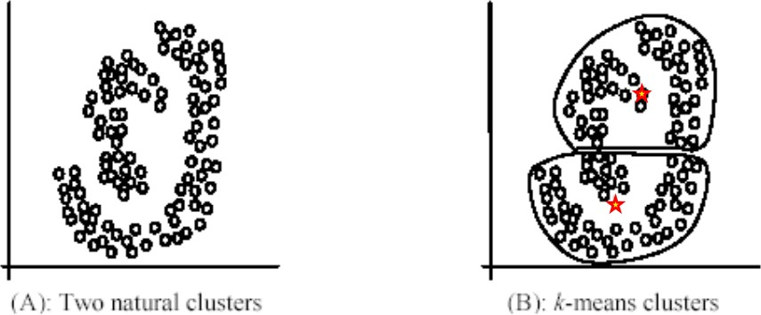
Weaknesses
Not suitable for discovering clusters that are not hyper- ellipsoids or hyper-spheres
(A): Two natural clusters
(B): k-means clusters

Slide 49
Summary
K-means is still the most popular clustering algorithm due to its simplicity and efficiency
Comparing different clustering algorithms is a difficult task
Why?
No one knows the correct clusters!

