Slide 1

Machine Learning
Week 7: Support Vector Machines (SVM)

Slide 2
Outline
SVM basic concepts and representation
Linear SVM
Nonlinear SVM
SVM kernel functions
SVM parameters
Strengths and weaknesses

Slide 3
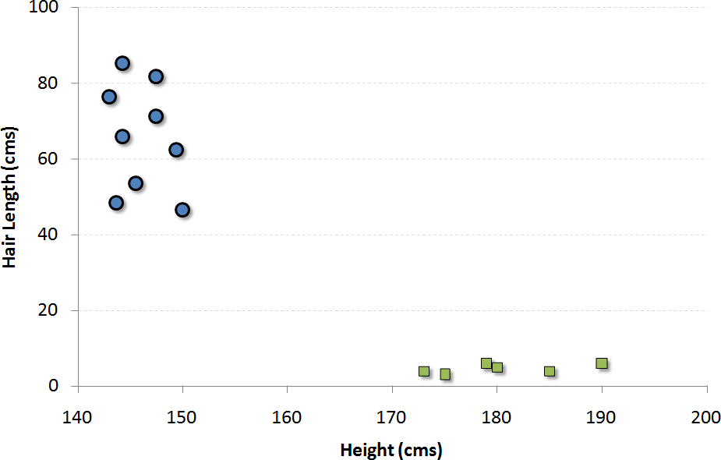
SVM Representation
Example: Classify the population into female or male based on two variables: height of the individual and hair length
Instances as points in n- dimensional space (e.g., 2 variables form a two dimensional space)
(145,64)
Height | Hair length | Class
144 | 48 | Female
145 | 64 | Female
173 | 2 | Male
… | … | …
(144,48)
(173,2)

Slide 4
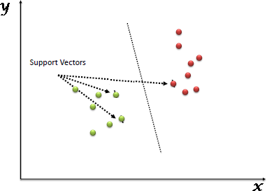
SVM Representation
Hyperplane: Line that splits the input variable space by their class
Support vectors: Data points nearest to the hyperplane (support or define the hyperplane)
Support vector machine: A hyperplane which best segregates the two classes
Hyperplane

Slide 5
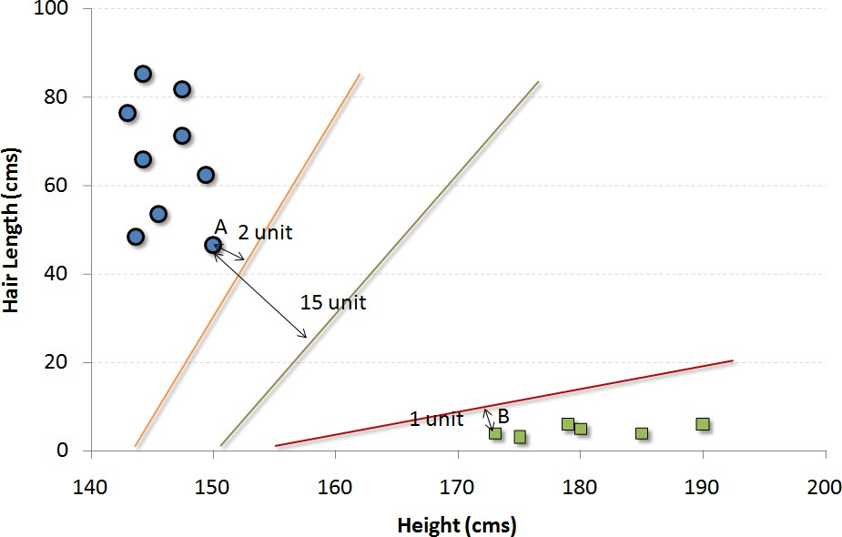
Find the SVM
How do we decide which is the best hyperplane?
Best hyperplane
Rule of thumb: Select the hyper- plane which segregates the two classes better
Choose the hyperplane with the maximum distance (from the closest support vector)

Slide 6
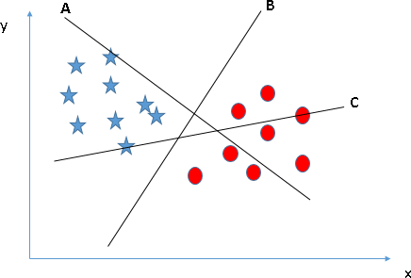
Find the SVM
Identify the right hyperplane
Hyperplane B is the best at segregating the 2 classes

Slide 7
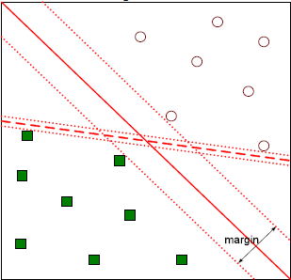
Find the SVM
How do we decide which is the best hyperplane?
B1
Find a hyperplane (the support vector) that maximizes the margin (maximal margin hyperplane)
Hyperplane with larger margin is more robust (low margin hyperplane leads to high chance of misclassification)
B1 is better than B2 (more distance between the points from 2 classes)
B2

Slide 8
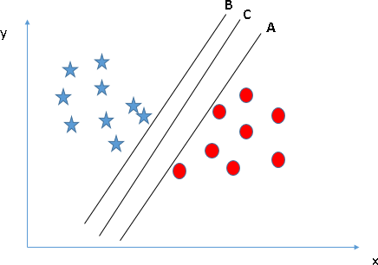
Find the SVM
Identify the right hyperplane
Hyperplane C has the
maximum margin

Slide 9
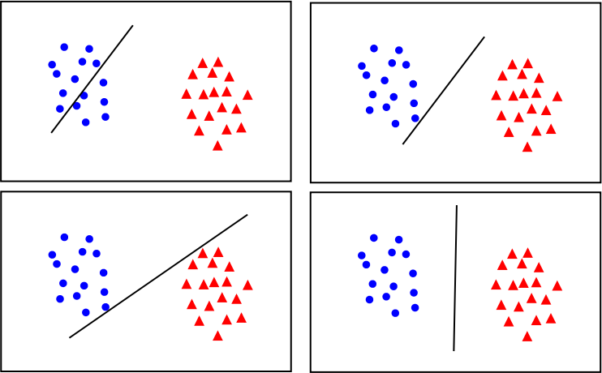
Class Activity
Which is the best hyperplane?
A
B
C
D

Slide 10
Class Activity
Which is the best hyperplane?
Solution: D
Find a hyperplane (the support vector) that maximizes the margin
Most stable under perturbations of inputs
A
B
C
D

Slide 11
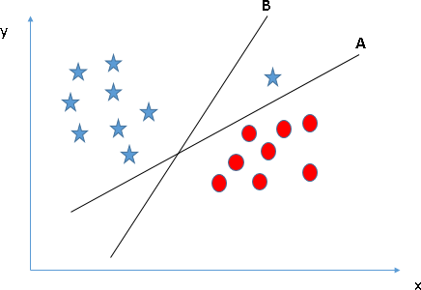
Find the SVM
Identify the right hyperplane
Hyperplane A
SVM selects the hyper- plane which classifies the classes accurately prior to maximizing margin

Slide 12
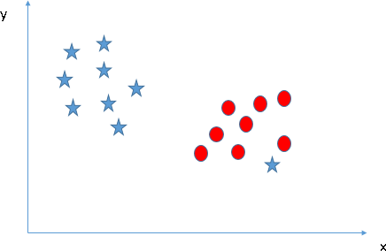
Find the SVM
Identify the right hyperplane
Unable to segregate the 2 classes using a straight line
1 star is an outlier

Slide 13
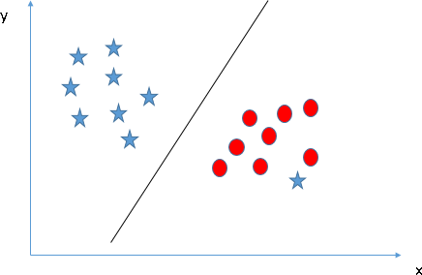
Soft Margin Classifier
Relax the constraint of maximizing the margin that separates the classes
Allow some points in the training data to violate the separating line
Introduce a set of coefficients called “slack variables” that give the margin wiggle room

Slide 14
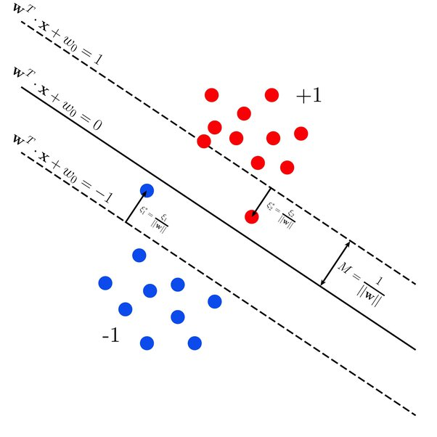
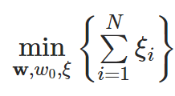
Slack Variables
Target:

Slide 15
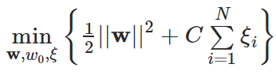
Soft Margin Classifier
Introduce a tuning parameter called “C” (defines the magnitude of wiggle or amount of margin violation allowed)
Slack Variables:

Slide 16
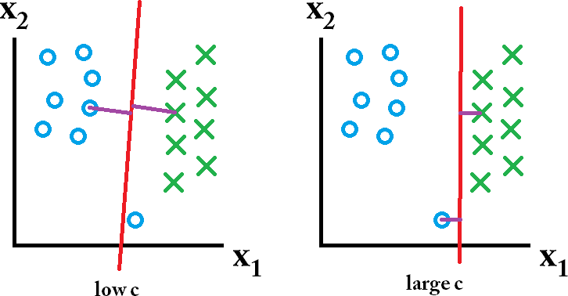
Soft Margin Classifier
Introduce a tuning parameter called “C” (defines the magnitude of wiggle or amount of margin violation allowed)
Large C makes constraints hard to ignore → narrow margin
C = ∞ enforces all constraints: hard margin
Small C allows constraints to be easily ignored → large margin

Slide 17
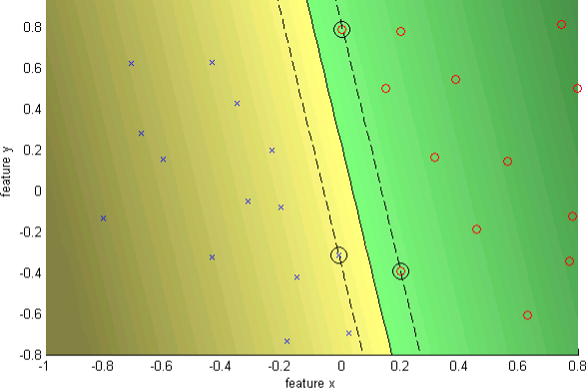
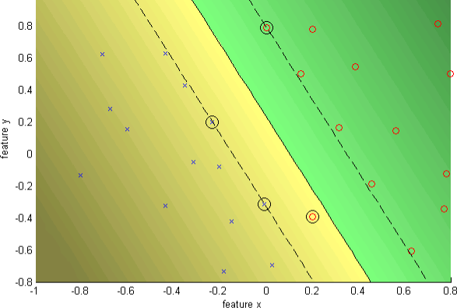
Soft Margin Classifier
C
Regularization
parameter
C = ∞ (hard margin)
C = 10
(soft margin)

Slide 18
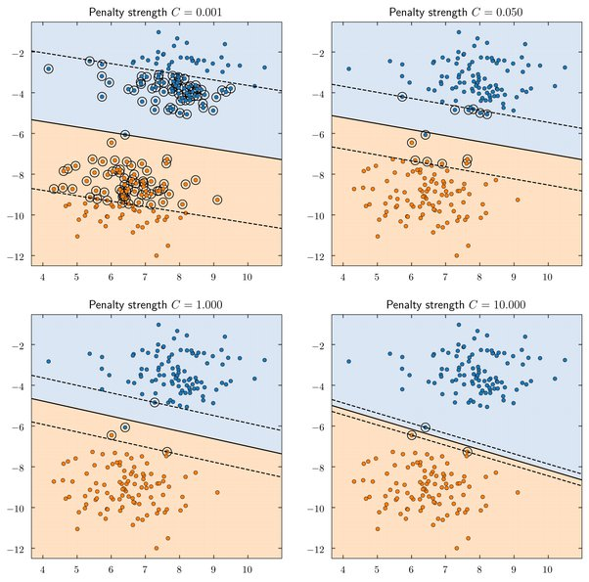
Soft Margin Classifier

Slide 19
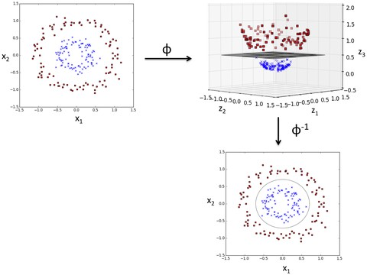
Nonlinear SVM
What if the data is not linearly separable?
“Kernel trick”: Transform data into higher dimensional space
Uplift samples onto a higher- dimensional feature space where a linear decision boundary can be used to separate the classes

Slide 20
SVM Kernel Functions
Linear Kernel Function
Dot-product is called the kernel: K(Xi, Xj)
= sum(Xi ⋅ Xj)
Kernel defines the similarity or a distance measure between new data and support vectors
Example: Dot-product of vectors A [2, 3] and B [5, 6]
K(A, B) = (2 * 5) + (3 * 6)
= 10 + 18 = 28

Slide 21
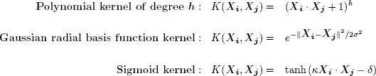
SVM Kernel Functions
Nonlinear Kernel Functions

Slide 22
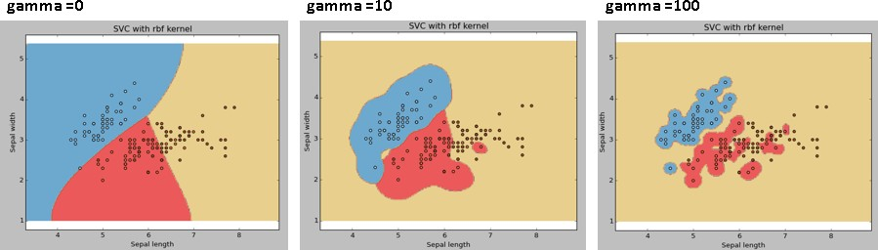
Nonlinear SVM Parameters
Gamma: Kernel coefficient for ‘RBF’, ‘Polynomial’ and ‘Sigmoid’
Higher the value of gamma will try to exact fit the training data (generalization error and cause over-fitting problem)

Slide 23
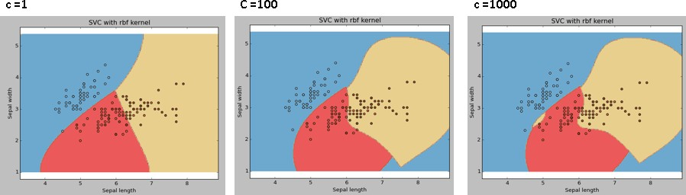
Nonlinear SVM Parameters
C: Controls the trade off between smooth decision boundary and classifying the training points correctly
c

Slide 24
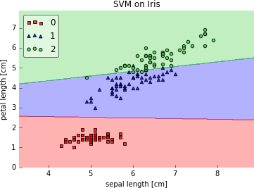
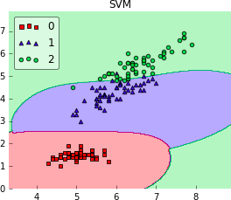
Discussion
Which kernel works better?
A: Linear kernel
B: RBF kernel

Slide 25
Discussion
Which kernel works better?
Both linear and RBF kernel SVM would work equally well on this dataset
Pick A: linear kernel
(simpler hypothesis)
Occam's Razor: A simple model would generalize better than a complex model
A: Linear kernel
B: RBF kernel

Slide 26
Strengths and Weaknesses
Strengths
High tolerance to noisy data
Ability to classify untrained patterns
Effective in high dimensional spaces
Effective in cases where number of dimensions is greater than the number of samples
Memory efficient: Uses a subset of training points in the decision function
(called support vectors)

Slide 27
Strengths and Weaknesses
Weaknesses
Long training time
Require a number of parameters for each kernel type
Poor interpretability: Difficult to interpret the symbolic meaning behind
the model
Less effective on noisier datasets with overlapping classes

