Slide 1

Machine Learning
Week 13: Association Rule Mining

Slide 2
Outline
Problem framing
Association measures
Apriori algorithm
Limitations

Slide 3
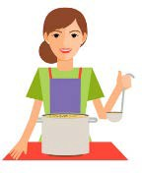

Problem: Origin
A housewife tends to buy healthy ingredients for a family dinner
A bachelor tends to buy beer and chips
Understanding buying patterns can help increase sales
Finding out a pair of item (X and Y) that are frequently bought together
Place X and Y on the same shelf
Apply promotional discounts to just one of the 2 items
Advertise X targeted at buyers who purchase Y
X and Y could be combined into a new product (have Y in flavors of X)

Slide 4
Problem Framing
Association rule mining
Uncover how items are associated to each other
Find rules that will predict the occurrence of an item based on the occurrences of other items in the transaction
Example: {A} → {D}
People who bought A also often bought D
Unsupervised learning (unlabeled data)

Slide 5
Itemset
A collection of one or more items
Example: {Milk, Bread, Diaper}
K-itemset contains K items
1-itemset: {Bread}, {Milk}
2-itemset: {Bread, Milk}, {Diaper, Beer}
3-itemset: {Milk, Bread, Diaper}
TID | Items
1 | Bread, Milk
2 | Bread, Diaper, Beer, Egg
3 | Milk, Diaper, Beer, Coke
4 | Bread, Milk, Diaper, Beer
5 | Bread, Milk, Diaper, Coke

Slide 6
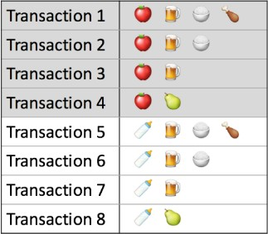
Association Measures
Measure 1: Support
How popular an itemset is
Measured by the proportion of transactions in which an itemset appears
support {apple} = 4/8 = 50%
support {apple, beer, rice} = ?
= 2/8 = 25%

Slide 7
Association Measures
Frequent itemset
An itemset with support >= minimum support threshold
Can set a minimum support threshold

Slide 8
Association Measures
Association rule
X → Y (X and Y are itemsets)
Example: {apple, beer} → {rice}
Support: Fraction of transactions that contain both X and Y
support {apple, beer → rice}
= support {apple, beer, rice}
= 2/8 = 25%

Slide 9
Association Measures
Measure 2: Confidence
How likely item Y is purchased when item
X is purchased (X → Y)
Proportion of transactions with item X, in which item Y also appears
confidence {apple → beer}
= support {X, Y} / support {X}
= support {apple, beer} / support {apple}
= 3/8 / 4/8
= 3/4 = 75%

Slide 10
Association Measures
Measure 2: Confidence
Drawback: May misrepresent the importance of an association rule
Only accounts for how popular apples are but not beers
If beers are also very popular in general, there will be a larger chance a transaction containing apples will also contain beers (inflate confidence measure)
Use lift to account for the base popularity of both constituent items

Slide 11
Association Measures
Measure 3: Lift
How likely item Y is purchased when item X is purchased, while controlling or how popular item Y is
Lift > 1 means that item Y is likely to be bought if item X is bought
Lift <= 1 means that item Y is unlikely to be bought if item X is bought
lift {apple → beer}
= support {X, Y} / (support {X} * support{Y})
= support {apple, beer} / (support {apple} * support {beer})
= 3/8 / (4/8 * 6/8)
= 1 (implies no association between items)

Slide 12
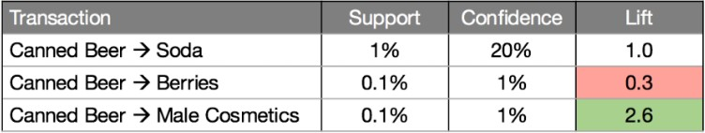
Association Measures
Compare 3 association rules related to beer
How to decide the importance of a rule?

Slide 13
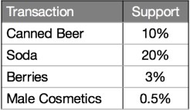
Association Measures
Compare 3 association rules related to beer
Support of individual items
The {beer → soda} rule has the highest confidence at 20 but both beer and soda appear frequently across all transactions (see support of individual items), so their association could simply be a fluke. This is confirmed by the lift value of {beer → soda}, which is 1, implying no association between beer and soda.
The {beer → male cosmetics} rule has a low confidence, due to few purchases of male cosmetics in general but
whenever someone does buy male cosmetics, he is very likely to buy beer as well, as inferred from a high lift value of 2.6.
The converse is true for {beer → berries}. With a lift value below 1, we may conclude that if someone buys berries,
he would likely be averse to beer.

Slide 14
Association Rule Mining
Goal: Given a set of transactions T, find a complete list of frequent itemsets
List all possible association rules
Calculate the support values for every possible configuration of items
Shortlist the itemsets that meet the minimum support threshold
Problem: In a store with just 10 items, the total number of possible configurations to examine would be a whopping 1023 (this number increases exponentially in a store with hundreds of items) → Computationally expensive!
Is there a way to reduce the number of item configurations to consider?

Slide 15
Apriori Algorithm
Apriori principle
If an itemset is infrequent, then all its supersets must also be infrequent
If {beer} was found to be infrequent, we can expect {beer, pizza} to be equally or even more infrequent
Any subset of a frequent itemset must be frequent
If {beer, diaper, nuts} is frequent, so is {beer, diaper}

Slide 16
Apriori Algorithm
Prune and list frequent itemsets
Step 0: Start with itemsets containing just a single item, such as
{apple} and {pear}.
Step 1: Determine the support for itemsets. Keep the itemsets that meet your minimum support threshold, and remove itemsets that do not.
Step 2: Using the itemsets you have kept from Step 1, generate all the possible itemset configurations.
Step 3: Repeat Steps 1 & 2 until there are no more new itemsets.

Slide 17
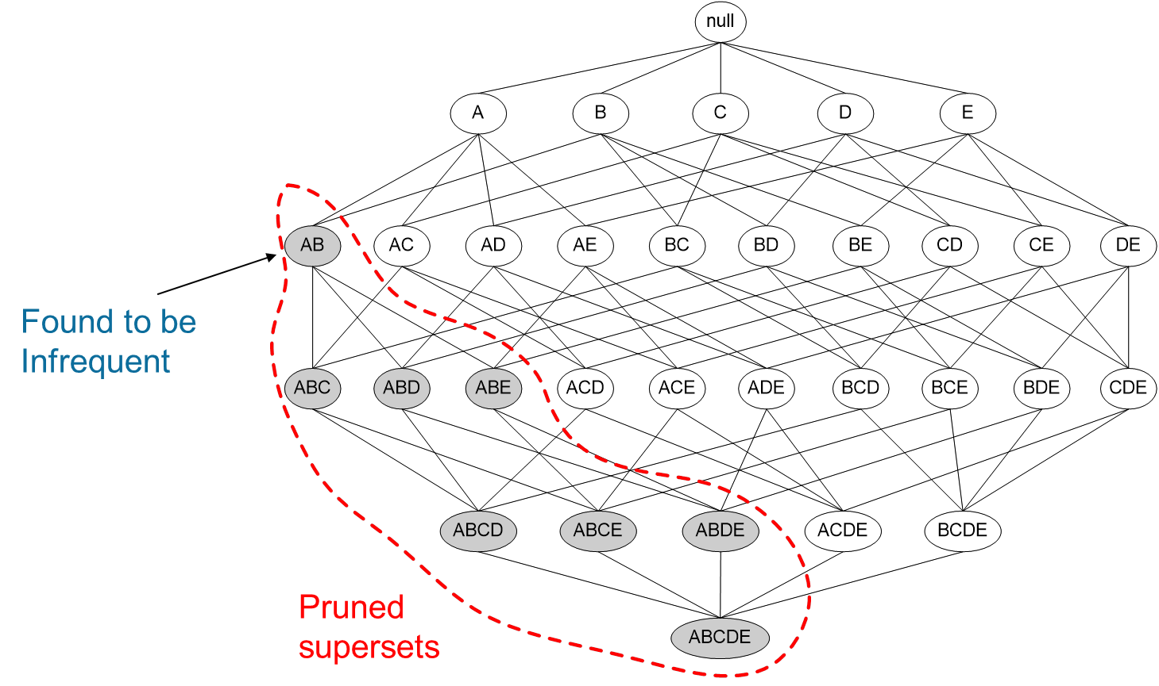
Apriori Algorithm
Itemset {A, B} was determined to have low support so it was removed
All other itemset configurations that contain {A, B} need not be considered
This reduced the number of itemsets to consider by about a quarter

Slide 18
Limitations
Computationally expensive: Number of association rules could still be huge when number of items is large or when the support threshold is low
Spurious (false) associations: Lowering the support threshold might also increase the number of spurious associations

