Slide 1
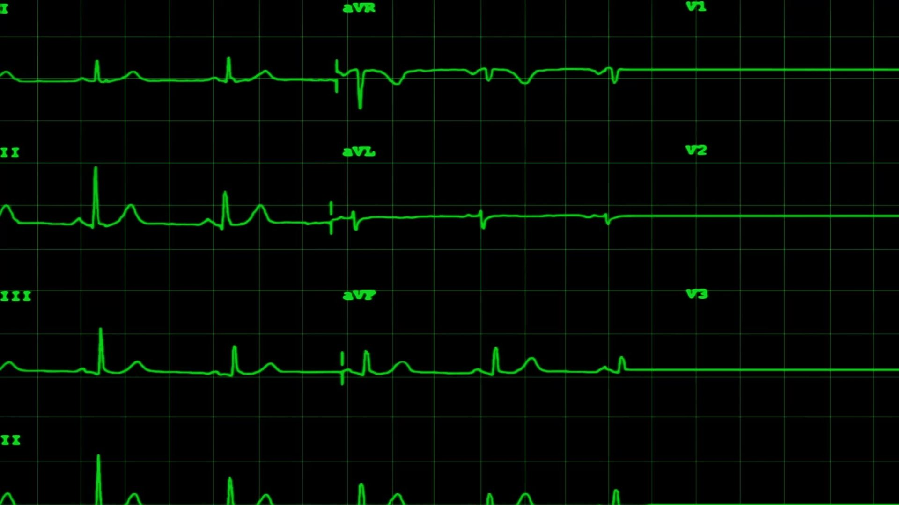
HEART DISEASE CLASSIFICATION USING MACHINE LEARNING TECHNIQUES

Slide 2

Title Slide
Title: Predicting Heart Disease Using Machine Learning Algorithms
Subtitle: Enhancing Accuracy in Medical Diagnoses
Presented By: Sana Afzal (SP24/RAI/012)
Tahnees Sheraz (SP24/RAI/016)
Date: 23 May 2024

Slide 3

Introduction to Heart Disease
Key Points
Heart disease is a leading cause of death worldwide
Symptoms: chest pain, shortness of breath, palpitations, swelling, weakness, cyanosis
Risk factors: age, sex, genetics, lifestyle, high blood pressure, diabetes, high cholesterol, etc.
Accurate diagnosis is crucial for timely treatment

Slide 4

Role of Machine Learning
Key Points
Predictive modeling based on existing data
Algorithms identify patterns in data to predict outcomes
Classification algorithms vary in accuracy

Slide 5

Machine Learning Algorithms Used
Algorithms
K-Nearest Neighbor
Support Vector Machine
Naïve Bayes
Logistic Regression
Decision Tree
Random Forest

Slide 6
Introduction to the Study
Objective
Improve heart disease prediction accuracy
Compare performance of various ML algorithms
Dataset
UCI heart disease dataset
14 attributes and 303 instances

Slide 7
Data Pre-processing
Steps
Data cleaning
Transformation
Handling missing values
Normalization
Feature selection
Importance
Quality data is crucial for accurate predictions

Slide 8

Performance Evaluation Metrics
Performance Evaluation Metrics
Accuracy
Precision
Sensitivity
F-Measure
ROC Curve

Slide 9

Performance Evaluation Metrics
Formula
Accuracy = (TP+TN) / (TP+TN+FP+FN)
Precision = TP / (TP+FP)
Sensitivity = TP / (TP+FN)
F-Measure = (2*PRECISION*RECALL) / (PRECISION+RECALL)
ROC CURVE, Y= P/(P+N)

Slide 10
Applying ML Algorithms
Logistic Regression
Predicts probability of an outcome
Dichotomous dependent variable
K-Nearest Neighbour
Classifies based on nearest data points
Effective for both classification and regression
Support Vector Machine
Finds the best boundary to separate classes

Slide 11
Applying ML Algorithms
Naïve Bayes
Based on Bayes' Theorem
Assumes independence between features
Decision Tree
Uses tree-like model for decisions
Suitable for both regression and classification
Random Forest
Ensemble method using multiple decision trees
Improves accuracy and reduces overfitting

Slide 12
Model Performance Comparison
Results
Logistic Regression: 86.89%
KNN: 88.52%
SVM: 88.11%
Naïve Bayes: 86.89%
Decision Tree: 77.05%
Random Forest: 88.52%
Best Performers
KNN and Random Forest with 88.52% accuracy

Slide 13
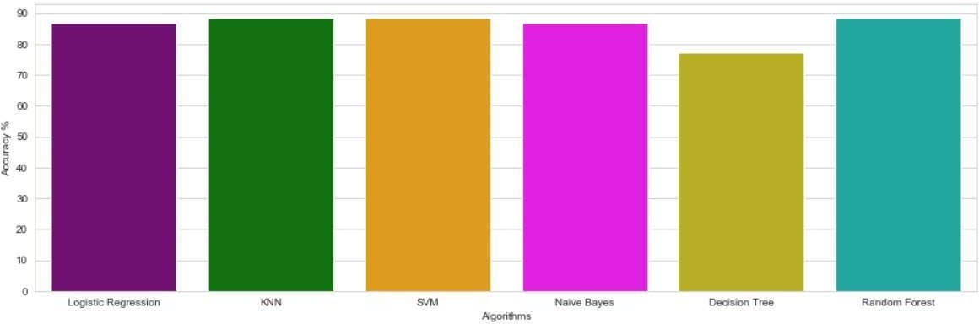
Model Performance Comparison

Slide 14

Confusion Matrix Analysis
Confusion Matrix
Visual representation of performance
Comparison of true positives, true negatives, false positives, and false negatives

Slide 15
Conclusion
Summary
Machine learning significantly enhances heart disease prediction
KNN and Random Forest algorithms provided the highest accuracy
Future Work
Further research with larger datasets
Incorporate more advanced algorithms
Ensemble methods

Slide 16

References
Citations
List of key references from the study.
https://iopscience.iop.org/article/10.1088/1742-6596/1937/1/012047/meta

Slide 17
Acknowledgements
Thanks
Acknowledge contributions from Classfellows, mentors, and institution.

