Slide 1
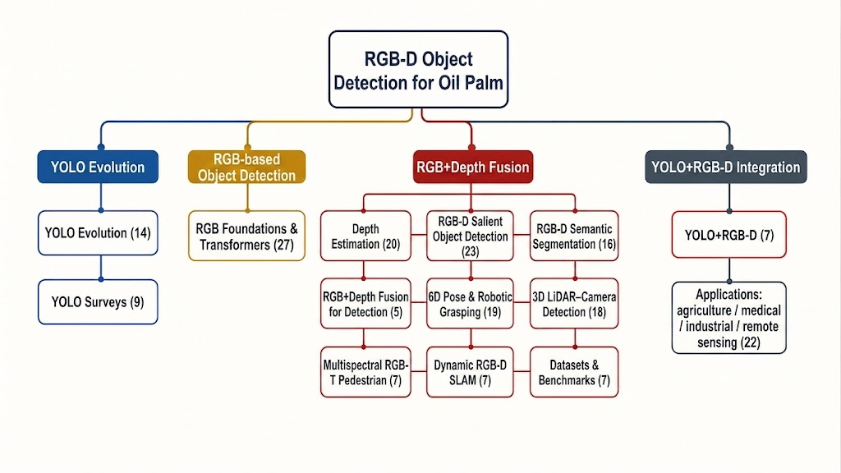
STRUCTURED EVIDENCE-MAPPING REVIEW
YOLO and RGB-D Fusion for Oil-Palm FFB Counting and Maturity Classification
A structured evidence-mapping review
182 verified primary sources | 2012-2026 | English presentation
01
Notes:
[Sources]
- artifacts/papers/main-elsarticle.pdf, 77-page evidence-mapping review.
- Title and abstract.

Slide 2
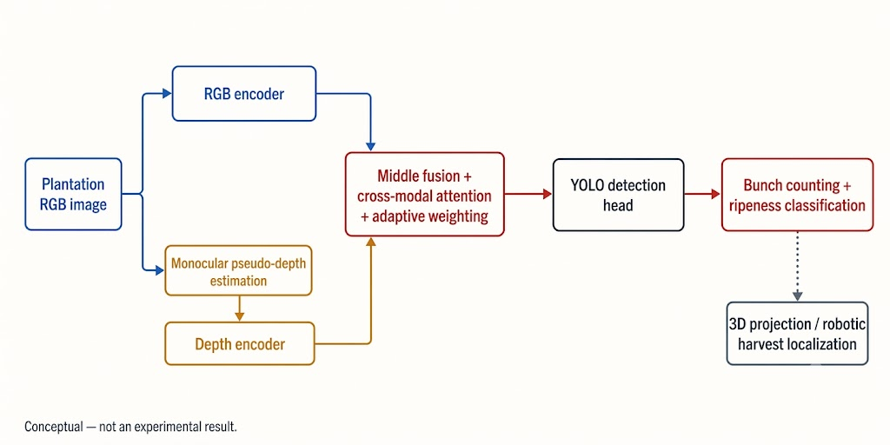
THE FIELD PROBLEM
The operational target is a sequence-level inventory, not a per-image score.
Separate crowded bunches
Occlusion, scale change, fronds, shadows.
Attach maturity to the right instance
A correct class on the wrong bunch is still an operational error.
Prevent repeated observations
Moving cameras must preserve identity across views.
02
Notes:
[Sources]
- artifacts/papers/main-elsarticle.pdf, 77-page evidence-mapping review.
- Introduction; Figure F08.

Slide 3
EVIDENCE BOUNDARIES
The review separates what is known from what must still be tested.
Direct evidence
Transferable evidence
Design hypotheses
Agricultural or fruit studies. Relevant deployment context, but not an FFB benchmark unless FFB data are used.
Mechanism evidence from vision domains such as RGB-D segmentation, 3D perception, and tracking.
Proposed FFB experiments. Never reported as achieved field results.
The paper also reports a clearly bounded pilot. It updates the agenda but is not evidence from the 182-source corpus.
03
Notes:
[Sources]
- artifacts/papers/main-elsarticle.pdf, 77-page evidence-mapping review.
- PDF Section 2.2, pp. 6-7; pilot framing in Section 14, p. 46.

Slide 4
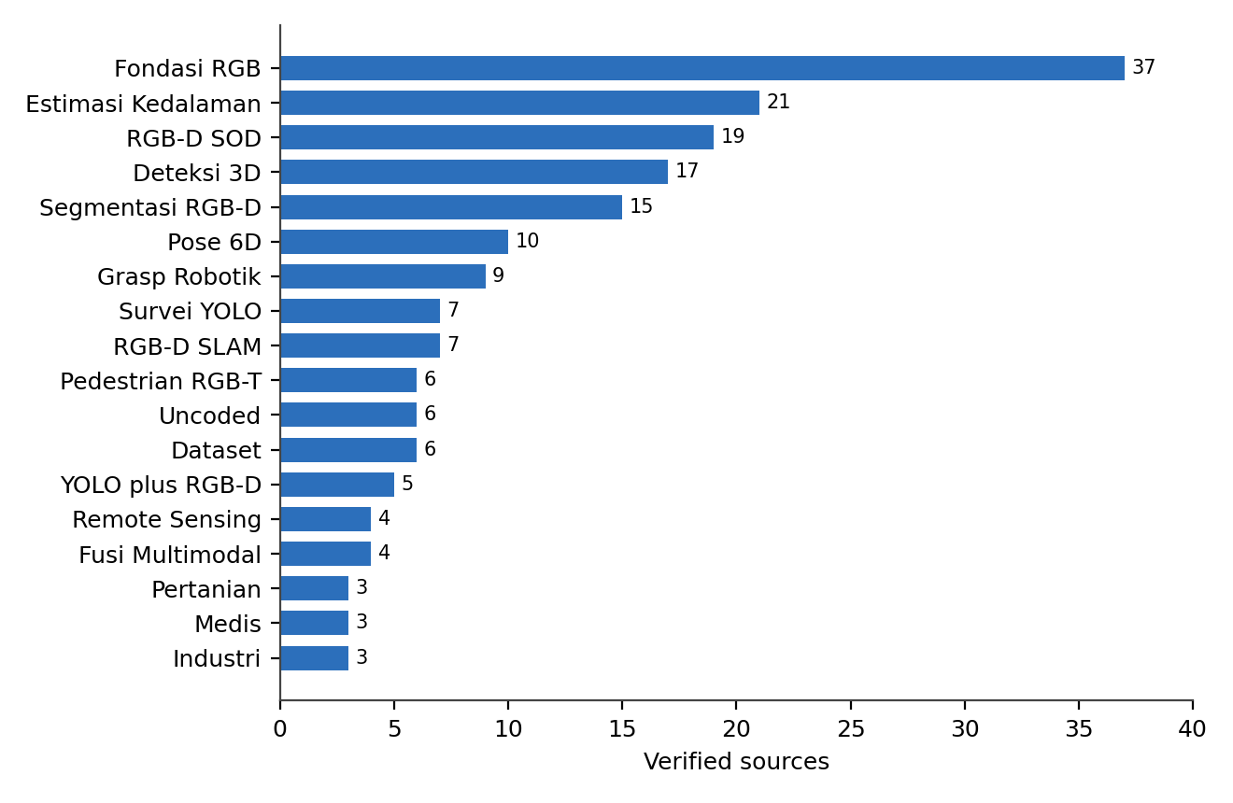
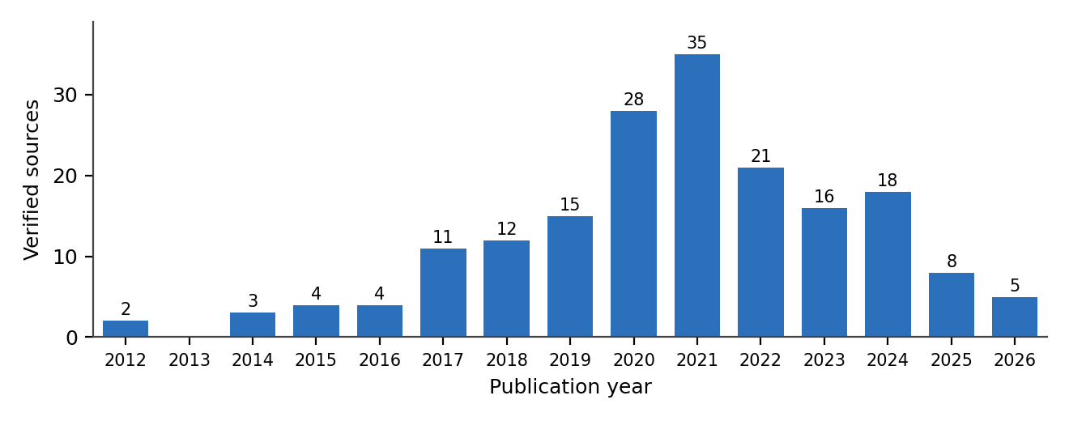
VERIFIED CORPUS
A broad verified corpus reveals a large transfer gap.
182
17
4
0
verified primary sources
coded research areas
direct agricultural systems
paired FFB field trials
04
Notes:
[Sources]
- artifacts/papers/main-elsarticle.pdf, 77-page evidence-mapping review.
- Review protocol and verified corpus; Figures corpus-year and corpus-theme.

Slide 5
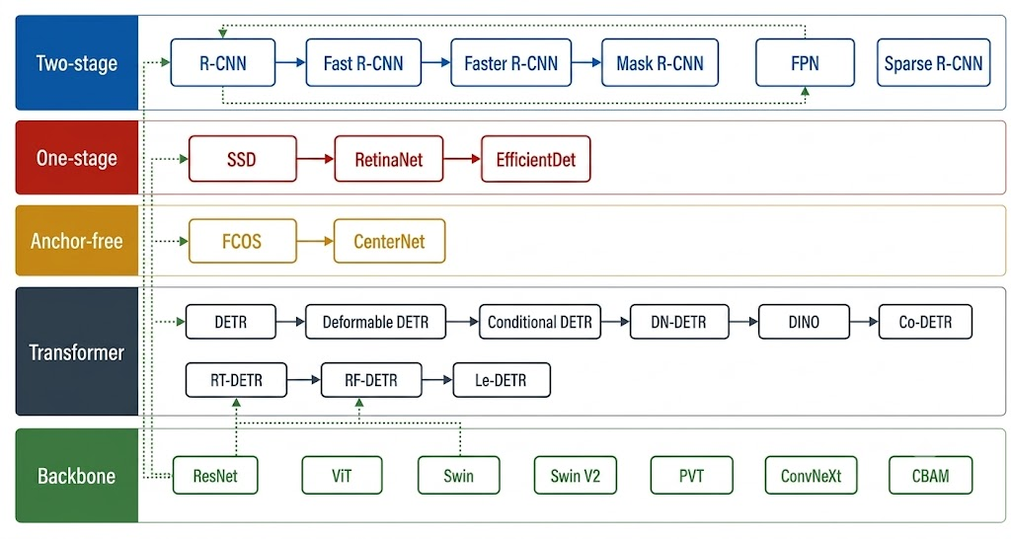
DETECTOR FOUNDATIONS
Detection progressed by solving localization, scale, imbalance, and speed.
1
Two-stage models remain the high-capacity occlusion reference.
2
One-stage models establish the real-time deployment baseline.
3
Anchor-free and transformer designs simplify instance prediction and NMS.
05
Notes:
[Sources]
- artifacts/papers/main-elsarticle.pdf, 77-page evidence-mapping review.
- RGB detection foundations; Figure F03.

Slide 6
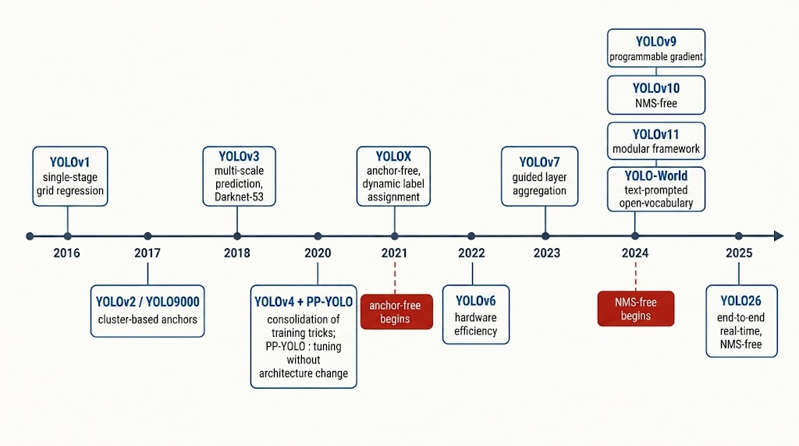
YOLO LINEAGE
YOLO is an engineering frontier, not a leaderboard to inherit.
v1 to v3
v4 to v8
Later selected models
Single-pass detection evolved toward multi-scale prediction.
Training recipes, re-parameterization, and anchor-free heads improved efficiency.
YOLOv10 and YOLO26 use NMS-free inference; that property is not shared by every YOLO model.
06
Notes:
[Sources]
- artifacts/papers/main-elsarticle.pdf, 77-page evidence-mapping review.
- PDF Section 3.3, pp. 13-16; Figure F02.

Slide 7
DETECTOR SELECTION
FFB model selection must be driven by field failure modes.
Can small and occluded bunches be found?
AP and recall by size and occlusion stratum.
Does the detector separate instances?
Split, merge, duplicate, and per-tree count errors.
Can it run on the target platform?
Latency, memory, power, and throughput.
Does maturity remain attached correctly?
Per-instance accuracy and calibration.
07
Notes:
[Sources]
- artifacts/papers/main-elsarticle.pdf, 77-page evidence-mapping review.
- Detector comparison table in RGB detection foundations.

Slide 8
DEPTH
Depth is a conditional geometric cue, not an automatic fourth channel.
Registered sensor depth
Stereo reconstruction
Monocular predicted depth
Can support metric range if calibration, synchronization, and valid depth are demonstrated.
Depth depends on baseline, texture, correspondence, and calibration.
Often relative or scale-ambiguous unless metric grounding is demonstrated.
Outdoor failure modes must be measured: missing values, noise, registration error, and sunlight sensitivity.
08
Notes:
[Sources]
- artifacts/papers/main-elsarticle.pdf, 77-page evidence-mapping review.
- Monocular depth and RGB-D fusion sections.

Slide 9
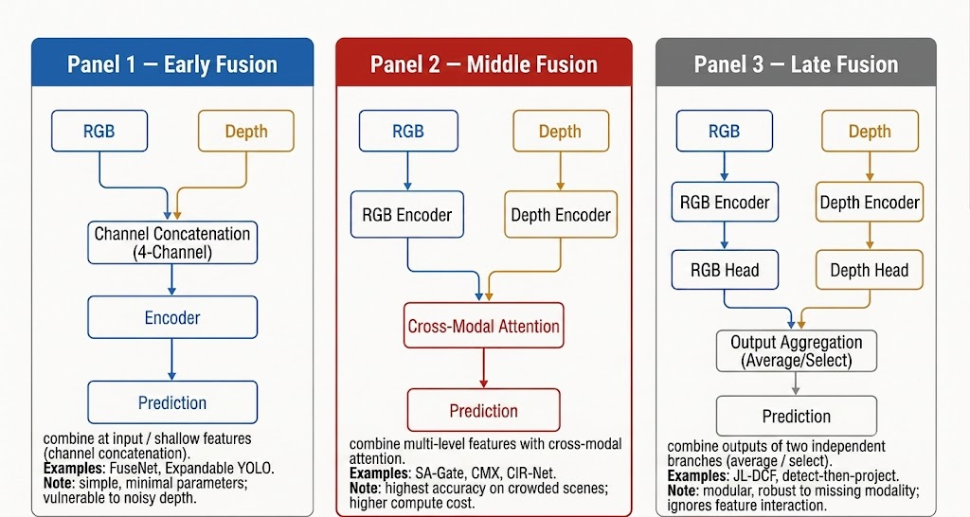
FUSION
The central fusion question is when to admit depth and when to fall back to RGB.
Early fusion
Depth enters as an input channel.
Feature fusion
Branches preserve modality-specific features before combining.
Late fusion
Predictions or scores are combined later.
Quality-aware gating
Depth quality controls whether and how it is used.
09
Notes:
[Sources]
- artifacts/papers/main-elsarticle.pdf, 77-page evidence-mapping review.
- RGB-D fusion sections; Figure F04.

Slide 10
GEOMETRY AND IDENTITY
Reliable counting requires geometry and temporal association beyond detection.
1
2
3
4
5
2D instance
Depth sample
Camera pose
Association
Inventory
→
→
→
→
Detect one bunch.
Sample only inside the instance.
Map views to one frame.
Link views and suppress duplicates.
Count each bunch once.
Per-frame AP cannot reveal repeated observations, false merges, or inventory bias.
10
Notes:
[Sources]
- artifacts/papers/main-elsarticle.pdf, 77-page evidence-mapping review.
- PDF Sections 7-8, pp. 26-31.

Slide 11
BENCHMARKS
Benchmark scores have meaning only within their acquisition and split design.
NYU Depth v2 / SUN RGB-D / ScanNet
Indoor RGB-D learning and annotation templates.
COCO
Detection pretraining and AP vocabulary.
KITTI / nuScenes
Calibrated outdoor multi-sensor sequencing.
Plantation benchmark
Still required: target size, maturity labels, trajectories, sensor failures, and deployment context.
11
Notes:
[Sources]
- artifacts/papers/main-elsarticle.pdf, 77-page evidence-mapping review.
- Benchmark datasets section.

Slide 12
AGRICULTURAL TRANSFER
Agricultural analogues motivate architecture, but none validate oil-palm FFB RGB-D performance.
Apple harvesting
SSD plus stereo depth shows detect-then-localize.
Apple inventory
Mask R-CNN plus multi-view geometry improved F1 from 0.816 to 0.881.
Orchard multi-output perception
Detection, instance segmentation, and branch outputs can share a backbone.
Field robotics
Perception, geometric localization, and action have separate failure modes.
These results are transferable mechanisms, not expected FFB metrics.
12
Notes:
[Sources]
- artifacts/papers/main-elsarticle.pdf, 77-page evidence-mapping review.
- PDF Section 12, pp. 37-38; apple-inventory F1 result.

Slide 13
TRANSFER MECHANISMS BEYOND RGB-D
Pose, grasping, and other modalities supply mechanisms, not plantation performance claims.
Pose and grasping
Instance-level pose, confidence, and action planning clarify the geometry required after detection.
RGB-thermal
Illumination-aware weighting shows why modality reliability should change with conditions.
Remote sensing
Small-object heads, resolution choices, and attention are candidates for distant bunches.
Medical and industrial inspection
Domain-specific adaptation shows why generic benchmark scores cannot be carried into a canopy.
13
Notes:
[Sources]
- artifacts/papers/main-elsarticle.pdf, 77-page evidence-mapping review.
- PDF Sections 7, 9, and 10, pp. 26-35.

Slide 14
PILOT EXPERIMENTAL FINDINGS
The paper adds a narrow pilot, separate from the 182-source evidence corpus.
Material
SawitMVC public multi-view oil-palm images. No depth sensor was used.
Scale
953 trees, 18,540 boxes, 9,823 distinct bunches, four maturity classes.
Protocol
Tree-level split: 716 train, 96 validation, 141 test trees.
Depth status
Monocular pseudo-depth was predicted from the same RGB images, so its errors are correlated with RGB.
14
Notes:
[Sources]
- artifacts/papers/main-elsarticle.pdf, 77-page evidence-mapping review.
- PDF Section 14, p. 46.

Slide 15
PILOT: PSEUDO-DEPTH RESULT
Pseudo-depth did not provide useful per-bunch separation in this pilot.
0.26
0.608
0.600
0.5041
real-to-control contrast ratio
box-vs-ring AUC
control-box AUC
early-fusion validation mAP50
RGB baseline
0.5218 validation mAP50.
Interpretation
The result falsifies pixel-level separation for pseudo-depth, not calibrated sensor depth.
Boundary
One failed early-fusion pseudo-depth configuration does not test feature, late, or real-depth fusion.
15
Notes:
[Sources]
- artifacts/papers/main-elsarticle.pdf, 77-page evidence-mapping review.
- PDF Section 14, pp. 47-48; Table 4.

Slide 16
PILOT: REVISED AGENDA
The pilot moves the bottleneck toward maturity treatment and high-resolution localization.
Class-agnostic detection
0.7730 validation mAP50, compared with 0.5218 for four-class detection.
Best four-class pilot
RT-DETR-L test: 0.5794 mAP50 and 0.2694 mAP50-95. Both prespecified targets remain unmet.
Maturity diagnosis
B4 is more camouflaged than overlapped; adjacent-class confusions indicate an ordinal-label mismatch.
Next tests
Master-resolution detection, capacity plus ordinal objective, and a separately calibrated depth-sensor study.
16
Notes:
[Sources]
- artifacts/papers/main-elsarticle.pdf, 77-page evidence-mapping review.
- PDF Section 14, pp. 49-51; Table 4.

Slide 17
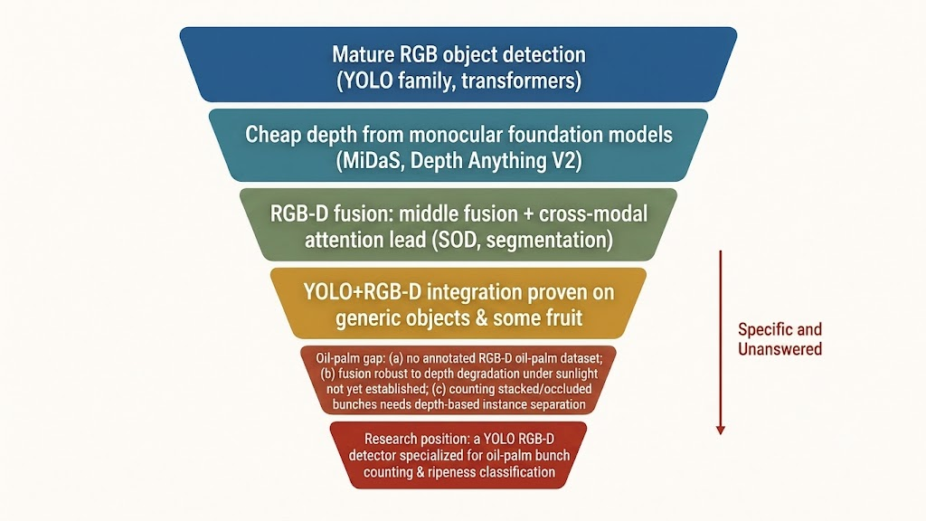
SYNTHESIS
Mature component evidence narrows to an unfilled paired FFB field benchmark.
General RGB detection: 39 sources
Monocular depth: 21 sources
RGB-D SOD + segmentation: 34 sources
Paired FFB field trials: zero
The corpus maps mechanisms to hypotheses. It does not pool a single accuracy.
17
Notes:
[Sources]
- artifacts/papers/main-elsarticle.pdf, 77-page evidence-mapping review.
- PDF Section 13, pp. 38-40; Figure F07.

Slide 18
MEASUREMENT HIERARCHY
One AP score cannot validate an RGB-D FFB inventory.
Evaluation level | Required measurement
Detection | AP, precision, recall by size, occlusion, illumination.
Maturity | Per-instance class metrics, calibration, confusion matrix.
Geometry | Coordinate frame, range or position error, valid-depth rate.
Association and count | Count error, bias, duplicate rate, false merges, association quality.
Deployment | Latency, throughput, memory, hardware, depth availability.
18
Notes:
[Sources]
- artifacts/papers/main-elsarticle.pdf, 77-page evidence-mapping review.
- PDF Table 3, p. 40.

Slide 19
FALSIFIABLE AGENDA
The evidence map becomes a staged experiment, not a premature architecture claim.
1. Dataset
Paired RGB-D, calibration metadata, instance, maturity, and sequence identity labels.
2. Baselines
RGB YOLO plus a high-capacity comparison.
3. Fusion ablations
Early, feature, late, and quality-gated RGB fallback.
4. Failure tests
Depth loss, noise, misalignment, illumination, stationary and moving sequences.
19
Notes:
[Sources]
- artifacts/papers/main-elsarticle.pdf, 77-page evidence-mapping review.
- PDF Section 13, pp. 40-42; Figure F08.

Slide 20
CAUSAL COMPARISON
The core experiment asks whether depth improves a named failure mode enough to justify its cost.
RGB-only baseline
Same split, resolution, annotation policy, and hardware.
Fusion candidate
Change only the declared fusion design and depth source.
Quality-gated fallback
Test depth absence, low quality, noise, and misalignment.
Decision
Compare measured error reduction against latency and sensor burden.
20
Notes:
[Sources]
- artifacts/papers/main-elsarticle.pdf, 77-page evidence-mapping review.
- PDF Section 13, pp. 40-42; Section 14, p. 51.

Slide 21
BOUNDED CONCLUSIONS
The corpus supports three conclusions and rejects several stronger claims.
✓
A multi-scale, real-time RGB detector is an appropriate baseline family.
✓
Depth can assist separation and geometry when reliability and meaning are controlled.
✓
Feature, late, and quality-aware fusion are justified alternatives with RGB fallback.
Not established: the best YOLO generation, the best depth model, the best fusion point, or a validated real-depth FFB gain.
21
Notes:
[Sources]
- artifacts/papers/main-elsarticle.pdf, 77-page evidence-mapping review.
- PDF Section 15, pp. 51-52.

Slide 22
CLOSING IMPLICATION
Progress requires a calibrated paired RGB-D FFB benchmark and an evaluation protocol that measures the whole inventory.
Detection • maturity • geometry • duplicate suppression • count error • latency
The pilot informs a revised agenda, but it does not validate real sensor RGB-D fusion for oil-palm FFBs.
22
Notes:
[Sources]
- artifacts/papers/main-elsarticle.pdf, 77-page evidence-mapping review.
- PDF Sections 14-16, pp. 46-53.

