Slide 1
EVIDENCE-AUDITED RESEARCH RECORDS
2 AUGUST 2026
Fresh-Fruit-Bunch Detection,
Maturity Classification, and RGB-D Fusion
A complete evidence-led research story from E-001 to E-032
Muhammad Zainal Muttaqin and Fatma Indriani
Best observed RGB benchmark: RF-DETR-L.
Audited physical depth: no reliable detection benefit in the tested regime.
Notes:
[Sources]
- reports.pdf, pp. 1-2: title, authors, abstract, and headline findings.
- reports.tex, current working-tree source.
[Interpretation boundary]
- The deck preserves the report's conditional language and does not convert a development result into a deployment claim.

Slide 2
EVIDENCE-AUDITED RESEARCH RECORDS
RGB benchmark set; depth unconfirmed.
BEST OBSERVED RGB CONTROL
AUDITED PHYSICAL DEPTH
FIELD INVENTORY
RF-DETR-L
No reliable benefit
Still open
Corrected controls and multi-seed evidence
SawitMVC, one pycocotools protocol
One-count-per-bunch is not validated
This is not a universal claim about depth. It is a tested-regime conclusion with explicit sensor, split, seed, training, and evaluator boundaries.
REPORTS / E-001-E-032
02
Notes:
[Sources]
- reports.pdf, p. 2: abstract conclusions.
- reports.pdf, pp. 88-93: synthesis, limitations, and conclusion.
[Interpretation boundary]
- RF-DETR-L and the physical-depth branch use different datasets and must not be merged into one absolute ranking.

Slide 3
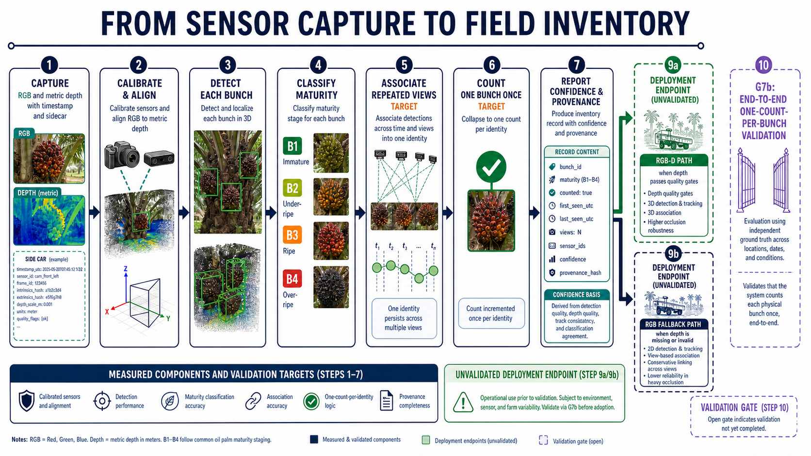
EVIDENCE-AUDITED RESEARCH RECORDS
The field objective is an inventory, not a classifier demo.
1
Detect each bunch
Measure object presence without collapsing maturity into a single score.
2
Assign B1-B4 maturity
Keep ordinal maturity confusion distinct from localization.
3
Associate repeated views
Use an independent cross-side denominator, not a circular proxy.
4
Count one physical bunch
This endpoint remains unvalidated in the completed report.
5
Keep an RGB fallback
RGB is the fallback path when depth is missing or fails quality control.
REPORTS / E-001-E-032
03
Notes:
[Sources]
- reports.pdf, pp. 3 and 92-93: operational research question and unvalidated inventory endpoint.
- docs/manuscript/figures/N17-field-inventory-gpt-image-2.png: explanatory field-inventory figure.
[Interpretation boundary]
- Detection, maturity, identity, and one-count-per-bunch are separate estimands in this report.

Slide 4
EVIDENCE-AUDITED RESEARCH RECORDS
Two branches define two different evidence boundaries.
Branch | Dataset and records | What can be compared | What must stay separate
A. RGB pilot | SawitMVC E-001 to E-021 | One protocol and split for the RGB benchmark | Not an independent holdout or RGB-D leaderboard
B. Physical depth | SawitMVC-Depth E-022 to E-032 | Paired RGB vs registered-depth contrasts | Absolute scores cannot be ranked against Branch A
Record accounting | 32 numbered records 30 executed | E-008 is reserved; E-023 is counted under E-032 | Provenance does not turn aliases into extra evidence
Absolute scores stay within a branch. Cross-branch claims require paired deltas, audit outcomes, or decision gates.
REPORTS / E-001-E-032
04
Notes:
[Sources]
- reports.pdf, pp. 2-4: record accounting, evidence boundary, and two research branches.
- reports.pdf, pp. 106-107: dataset contracts.
[Interpretation boundary]
- The report retains E-008 and E-023 for provenance without inflating the count of independent executed measurements.

Slide 5
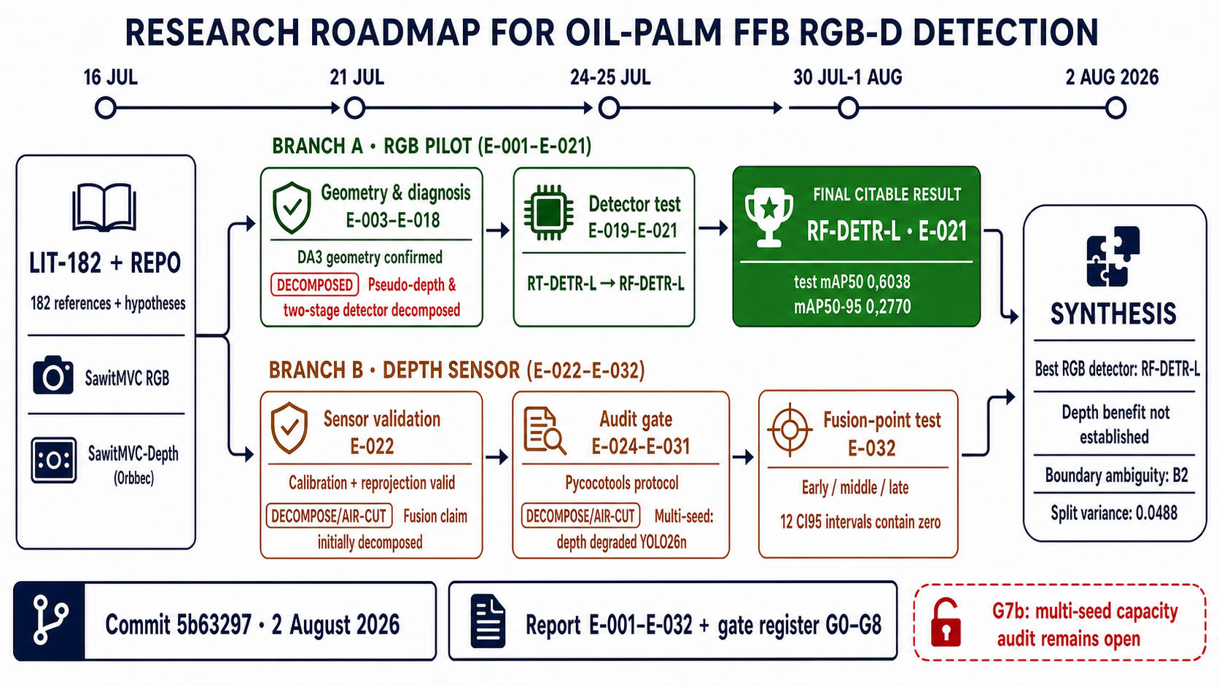
EVIDENCE-AUDITED RESEARCH RECORDS
Literature frames the question, not the answer.
202
literature records
182
verified local PDFs
ROLE
Detector, geometry, and fusion literature motivates a falsifiable research design.
Concept figures and prior studies are context. The results deck takes scores, intervals, and verdicts from the audited records.
REPORTS / E-001-E-032
05
Notes:
[Sources]
- reports.pdf, p. 4: 202 literature records and 182 verified local PDFs.
- reports.tex, current working-tree source.
[Interpretation boundary]
- Literature frames the research question; audited experiment records supply the results.

Slide 6
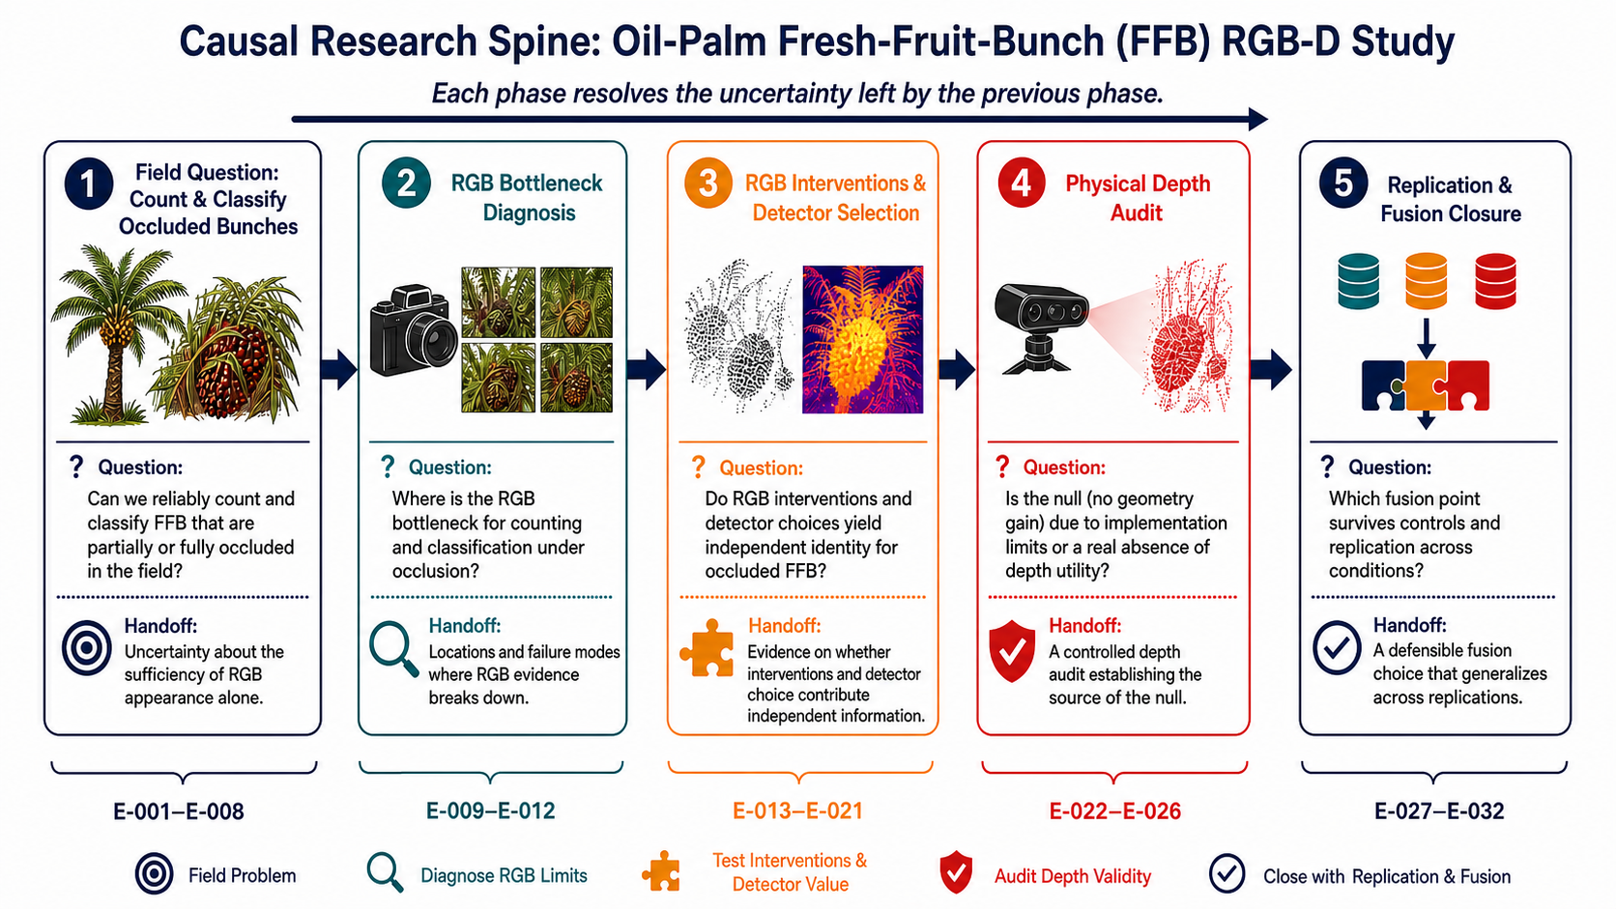
EVIDENCE-AUDITED RESEARCH RECORDS
Five phases turn an intuition into a falsifiable programme.
Each phase removes one confound before the next claim.
A
Measurement
E-001 to E-002: reject circular metrics and unsafe provenance.
B
Relative geometry
E-003 to E-008: retain tree-level ordering, leave bunch identity open.
C
RGB diagnosis
E-009 to E-012: identify the visible error structure.
D
RGB benchmark
E-013 to E-021: create a fair RGB control.
E
Depth audit and replication
E-022 to E-032: repair, replicate, and bound the conclusion.
REPORTS / E-001-E-032
06
Notes:
[Sources]
- reports.pdf, pp. 12-18: causal spine, research design, and full research storyline.
- docs/manuscript/figures/N03-causal-spine-gpt-image-2.png: causal research-phase figure.
[Interpretation boundary]
- The numbered records are a dependency graph, not a list of interchangeable experiments.

Slide 7
PHASE A / MEASUREMENT AND PROVENANCE
Phase A rejected circular evidence before model selection.
E-001
E-002
Class mismatch was circular
Master-image reuse was unsafe
The proxy and comparison used the same association graph.
Freeze source correspondence before using it as evidence.
Stable predictions need stable measurements and provenance.
REPORTS / E-001-E-032
07
Notes:
[Sources]
- reports.pdf, pp. 19-22: E-001 class-mismatch audit and E-002 provenance audit.
- reports.pdf, pp. 57-60: record-level interpretation checklist.
[Interpretation boundary]
- These records are negative findings about the validity of a measurement path, not detector-training failures.

Slide 8
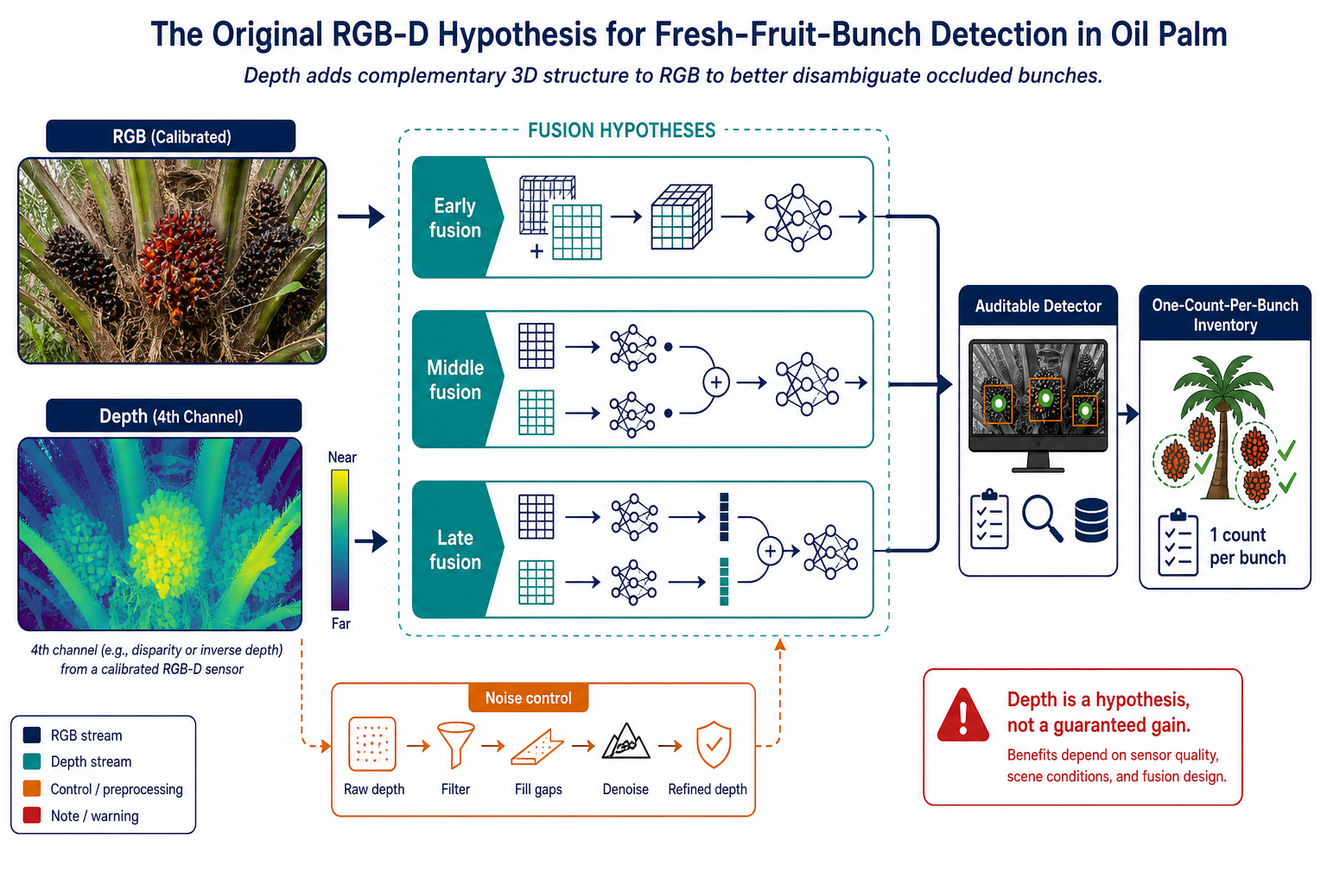
PHASE A / RELATIVE GEOMETRY
Relative depth orders views, not individual bunches.
E-003 TO E-005
Relative depth organized tree-level view order in declared orbit and photograph samples.
E-006
Pseudo-depth failed the local bunch-versus-background separation test.
E-007 TO E-008
No reliable cross-side bunch link was established; E-008 remains a visible reserved record.
A visually smooth relative map is not a metric sensor and is not evidence of one-count-per-bunch.
REPORTS / E-001-E-032
08
Notes:
[Sources]
- reports.pdf, pp. 22-32: E-003 to E-008 relative-geometry and bunch-identity records.
- docs/manuscript/figures/N02-rgbd-hypothesis-gpt-image-2.png: RGB-D hypothesis translation.
[Interpretation boundary]
- Tree-level ordering is retained as contextual geometry; it does not transfer automatically to individual partially occluded bunches.

Slide 9
PHASE B / RGB ERROR DIAGNOSIS
Phase B shows that RGB errors are heterogeneous.
E-009 TO E-011
E-012
IMPLICATION
B4 is not mainly crowding
B2-B3 is an ordinal boundary
One global fix is unlikely
B4 is low-contrast and texture-rich, not merely crowded.
Errors cluster at adjacent maturity stages.
Use texture-aware, ordinal modelling.
Sensor results do not answer maturity, identity, or inventory questions.
REPORTS / E-001-E-032
09
Notes:
[Sources]
- reports.pdf, pp. 33-45: E-009 to E-012 RGB bottleneck diagnosis.
[Interpretation boundary]
- The report separates a remaining limitation, such as B4 appearance difficulty, from an implementation defect that changes an experiment's estimand.

Slide 10
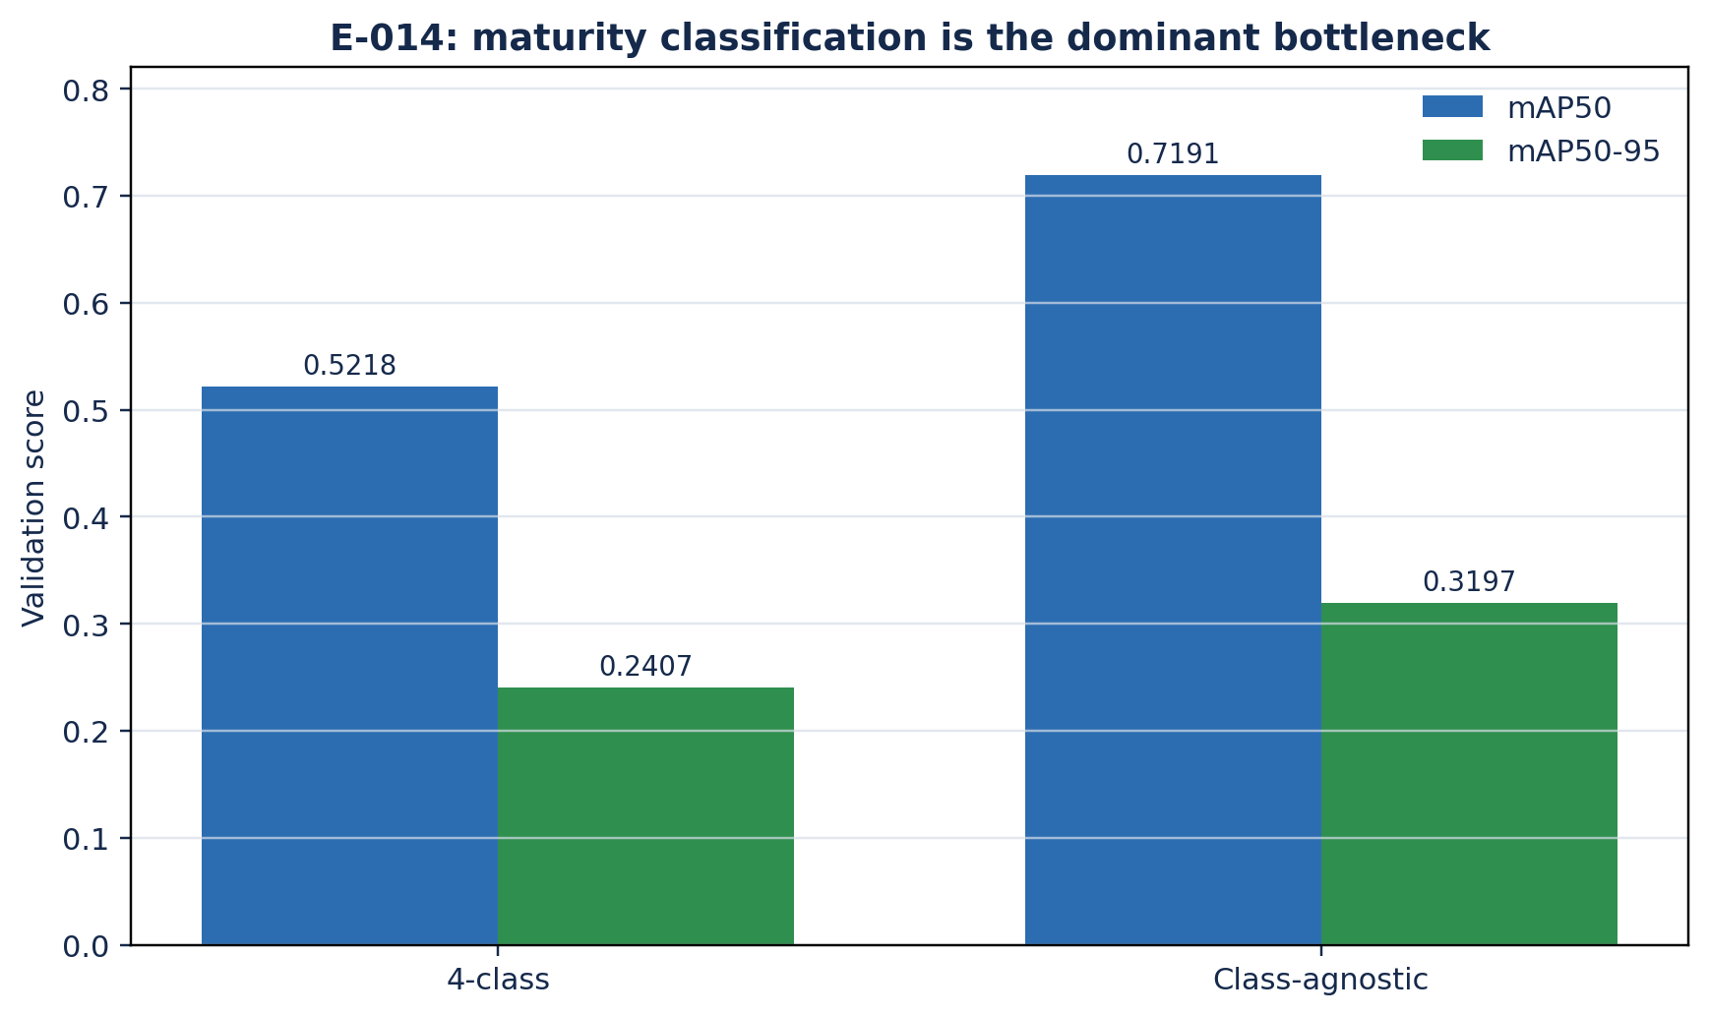
PHASE C / RGB CONTRACT AND DIAGNOSIS
Maturity assignment may cost more than localization.
E-014: provisional maturity-assignment diagnostic
FOUR-CLASS mAP50
0.5218
Metric | mAP50 | Interpretation
Four-class | 0.5218 | Localization and maturity required
Class-agnostic | 0.7191 | Localization-only diagnostic
Localization and maturity required
CLASS-AGNOSTIC mAP50
0.7191
Localization-only diagnostic
The gap is consistent with a maturity-assignment cost, but it is not a proven decomposition.
Provisional: prediction JSON identity has not been independently demonstrated.
REPORTS / E-001-E-032
10
Notes:
[Sources]
- reports.pdf, p. 47: E-014 comparison and provisional status.
- reports.tex, lines 2014-2030: prediction-JSON identity boundary.
[Interpretation boundary]
- The gap is a provisional diagnostic, not a causal decomposition.

Slide 11
PHASE C / RGB INTERVENTIONS
Phase C tested RGB interventions before selecting a control.
1
E-013: freeze the depth contract
Channel order, invalid depth, fallback, calibration, and evaluator are explicit before benefit is claimed.
2
E-015 to E-019: test fixes
Mapping, a withdrawn ceiling, two-stage separation, localization envelope, and more pixels do not close the target.
3
E-020: shortlist a transformer
RT-DETR-L is an engineering direction, not a component-level causal result.
4
E-021: compare models fairly
YOLO26, RT-DETR-L, and RF-DETR-L share one split and one evaluator.
Only a strong, bounded RGB control makes a later physical-depth comparison meaningful.
REPORTS / E-001-E-032
11
Notes:
[Sources]
- reports.pdf, pp. 46-62: E-013 to E-021 RGB contract, interventions, and model comparison.
[Interpretation boundary]
- A detector-family comparison changes several architecture factors together, so it supports a shortlist decision rather than a single-component attribution.

Slide 12
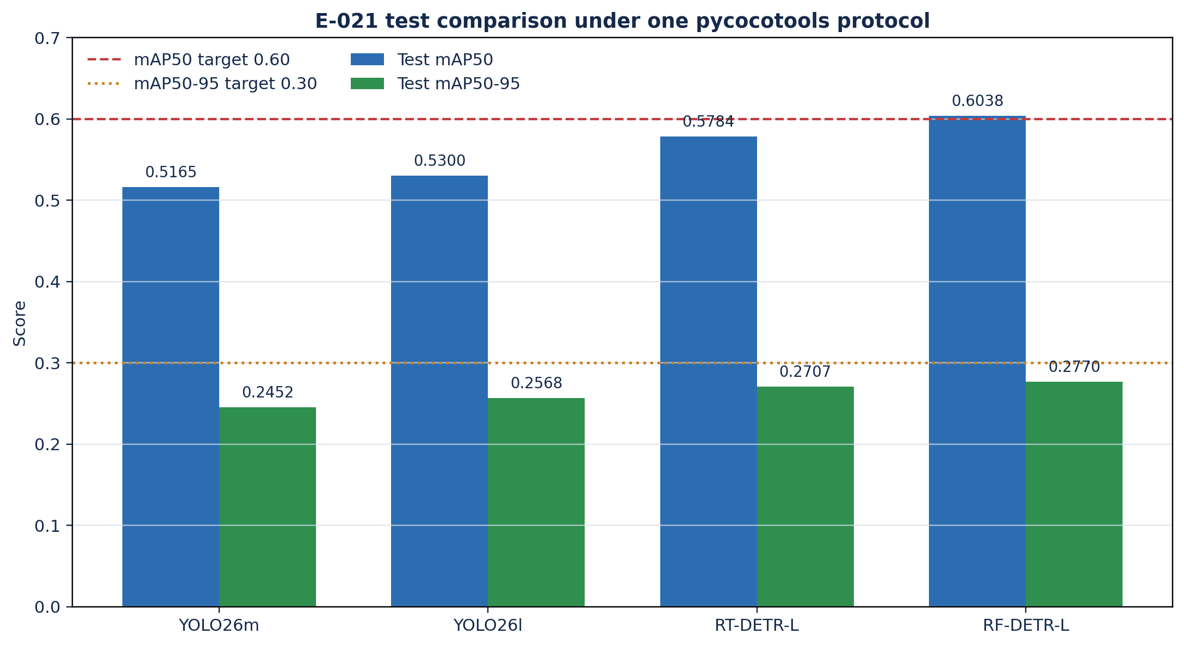
PHASE C / E-021 RGB BENCHMARK
RF-DETR-L is the best observed RGB control.
TEST mAP50
0.6038
RF-DETR-L on SawitMVC
TEST mAP50-95
0.2770
RF-DETR-L on SawitMVC
PAIRED VS RT-DETR-L
+0.0255
95% CI [0.0104, 0.0408]
Repeated test-set exposure and image-level bootstrap make this a bounded development benchmark, not an independent holdout estimate.
REPORTS / E-001-E-032
12
Notes:
[Sources]
- reports.pdf, pp. 61-62, Table 17: E-021 model comparison and paired bootstrap.
- docs/manuscript/figures/R03-e021-model-comparison.png: deterministic E-021 plot.
[Interpretation boundary]
- RF-DETR-L is RGB-only here and its absolute score is not comparable to the physical-depth branch's absolute scores.

Slide 13
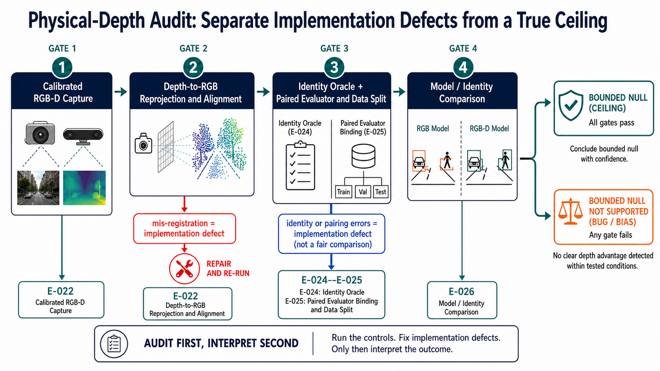
PHASE D / PHYSICAL-DEPTH AUDIT
Phase D starts by withdrawing the historical sensor win.
E-022
The audit checks calibration, reprojection, invalid values, paired files, range, donor selection, and evaluator binding.
WITHDRAWAL
The original positive-looking seed-42 delta is not retained as a current sensor result.
WHY
Registration, donor, range, and RNG defects changed the quantity that the original run measured.
E-023 is a redesigned execution alias counted once under E-032, not a second independent result.
REPORTS / E-001-E-032
13
Notes:
[Sources]
- reports.pdf, pp. 64-68: E-022 physical-depth audit and E-023 execution alias.
- reports.pdf, p. 90: physical-depth failure attribution and withdrawn seed-42 interval.
- docs/manuscript/figures/N05-physical-depth-audit-gpt-image-2.png: physical-depth audit figure.
[Interpretation boundary]
- Repairing an implementation defect changes the estimand; the old positive-looking observation remains audit history, not current evidence of sensor benefit.

Slide 14
PHASE D / IDENTITY AND EVALUATION
Identity and evaluation close more shortcuts.
E-024
E-025
E-026
Independent identity graph
One comparison contract
Identity stabilization is inconclusive
Fix evaluator, matching, maximum detections, and paired bootstrap before interpreting deltas.
Use annotation-derived pairs and an explicit visible-pair denominator.
Denominators differ; the interval includes zero.
More identity pairs add power context, not detection benefit or inventory validation.
REPORTS / E-001-E-032
14
Notes:
[Sources]
- reports.pdf, pp. 69-74: E-024 cross-side identity graph, E-025 evaluator binding, and E-026 identity result.
[Interpretation boundary]
- Identity evidence and detection evidence have distinct denominators and cannot be substituted for one another.

Slide 15
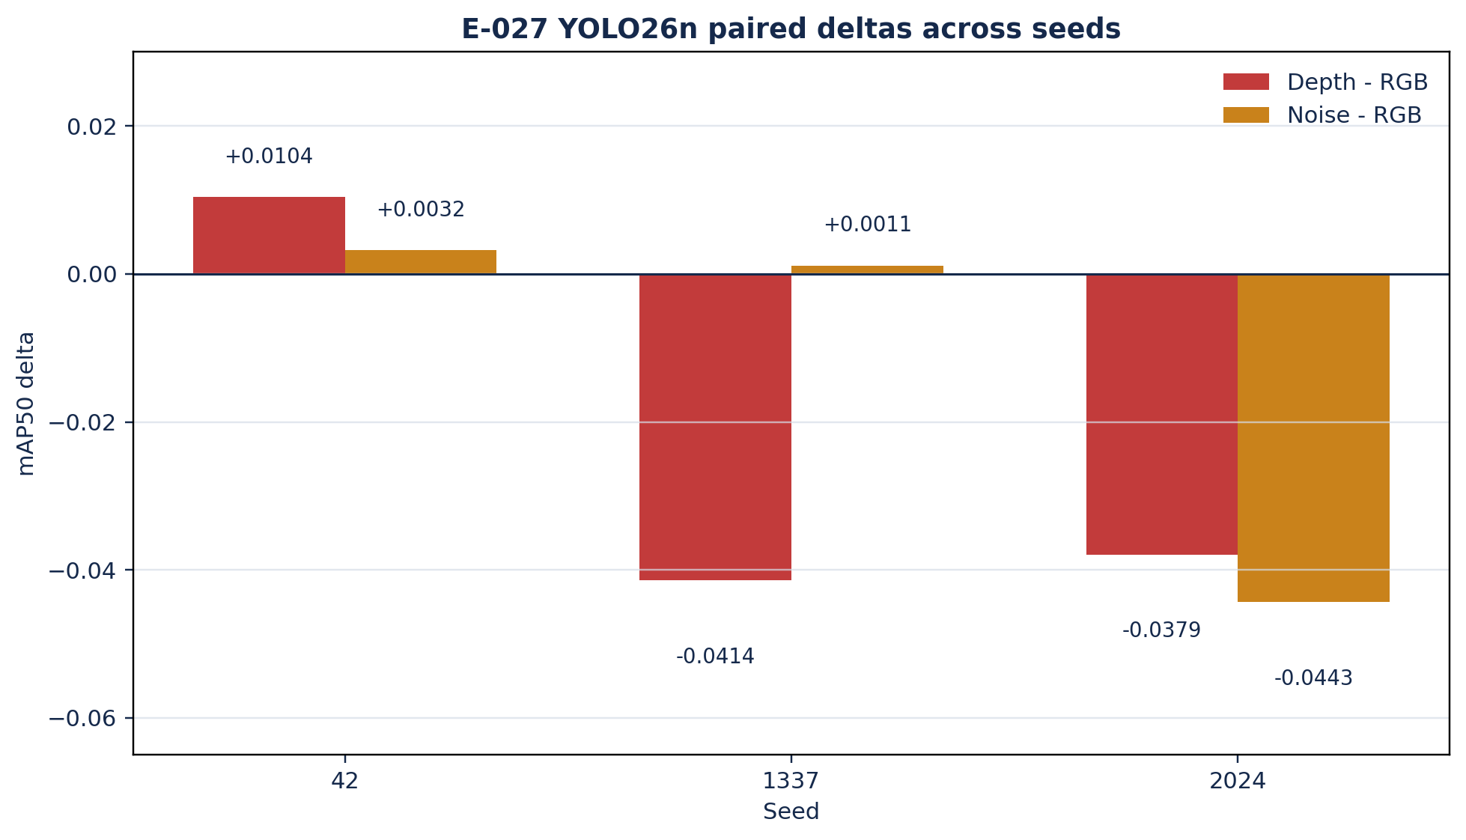
PHASE E / E-027 REPLICATION
Three seeds overturn the early-fusion rescue story.
SEED 42
+0.0104
Depth minus RGB mAP50
SEEDS 1337 AND 2024
-0.0414 / -0.0379
Harmful direction in two tested seeds
MEAN DEPTH MINUS RGB
-0.0230
Benefit criterion falsified
RGB, registered depth, random noise, and swapped-tree controls are paired within the audited protocol. This is not a universal harm claim.
REPORTS / E-001-E-032
15
Notes:
[Sources]
- reports.pdf, pp. 75-77, Table 22: E-027 three-seed paired contrasts.
- docs/manuscript/figures/R04-e027-multiseed-deltas.png: deterministic E-027 plot.
[Interpretation boundary]
- The report's verdict is that the benefit criterion is falsified in this tested regime, while universal harm remains unsupported.

Slide 16
PHASE E / E-028 IDENTITY POWER
E-028 builds identity power, not depth evidence.
E-028
POWER GAIN
1,404 physical bunches
6.2x more measured bunches
511 measured across sides, up from 82 in SawitMVC-Depth.
The rate difference is indistinguishable; the gain is measurement power.
No physical depth. Detector record conflicts: PDF names RF-DETR-L; reports.tex specifies YOLO26n. Reconcile before model-specific interpretation.
REPORTS / E-001-E-032
16
Notes:
[Sources]
- reports.pdf, p. 78: E-028 power comparison.
- reports.tex, lines 3426-3491: 1,404 physical bunches, 511 measured bunches, no physical-depth test.
- reports.tex, lines 3433-3439: YOLO26n configuration; RF-DETR-L not used.
[Provenance conflict]
- The PDF names RF-DETR-L, while reports.tex specifies YOLO26n. The deck records the conflict and makes no model-specific E-028 conclusion.

Slide 17
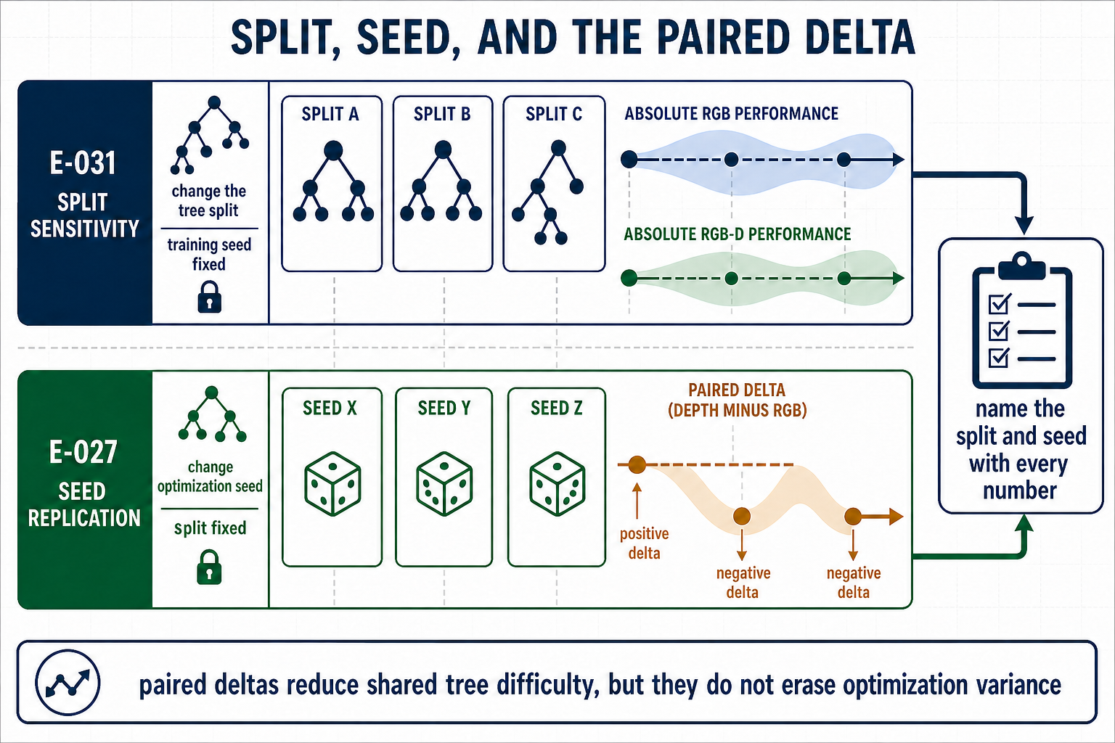
PHASE E / CAPACITY AND SPLIT CONTROLS
No capacity or split rescue has been established.
E-029
Three seeds retract the high-capacity rescue.
E-030
One-seed sign change is only a hypothesis.
E-031
Split movement can exceed selected seed movement.
G7b remains open; more parameters do not prove useful geometry.
REPORTS / E-001-E-032
17
Notes:
[Sources]
- reports.pdf, pp. 81-84: E-029 to E-031 and their limits.
- reports.tex, lines 3533-3680: E-029 and E-030 evidence.
- reports.tex, lines 4075-4081: G7b remains an open, prespecified capacity sequence.
[Interpretation boundary]
- No capacity or split rescue has been established; E-030 remains exploratory.

Slide 18
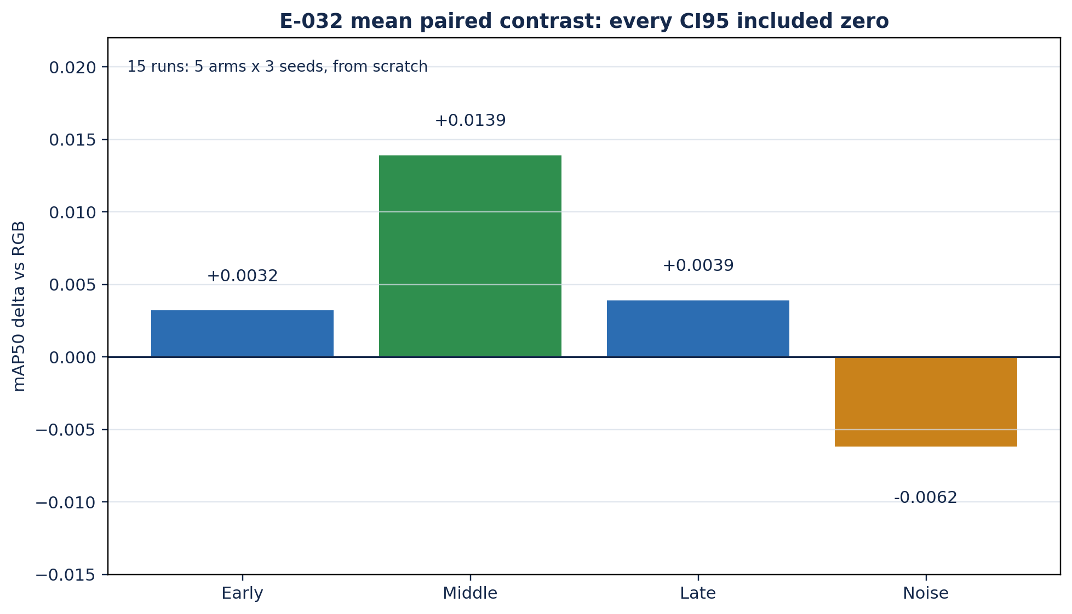
PHASE E / E-032 FUSION PLACEMENT
Fusion placement remains inconclusive in the final matrix.
Paired mAP50 delta vs same-seed RGB
EXECUTION
All twelve paired confidence intervals include zero.
15 runs
Arm | Seeds 42 / 1337 / 2024 | Mean | Decision
Early | -0.0120 / +0.0234 / -0.0017 | +0.0032 | Includes 0
Middle | +0.0096 / +0.0212 / +0.0110 | +0.0139 | Includes 0
Late | -0.0056 / +0.0070 / +0.0102 | +0.0039 | Includes 0
Noise | -0.0130 / +0.0025 / -0.0081 | -0.0062 | Includes 0
Five placements across three seeds.
LARGEST OBSERVED MEAN
+0.0139
Largest mean, indication only.
PAIRED INTERVALS
12 / 12 include zero
Equivalence was not tested.
YOLO26n, one split, 640 px, 150 epochs, from-scratch topologies, and the fixed E-025 evaluator define the tested regime.
REPORTS / E-001-E-032
18
Notes:
[Sources]
- reports.pdf, pp. 86-87: E-032 final fusion matrix.
- reports.tex, lines 3824-3854: seed deltas, all 12 CIs include zero, and the tested-regime boundary.
[Interpretation boundary]
- Middle fusion has the largest observed mean but is an indication only; equivalence was not tested.

Slide 19
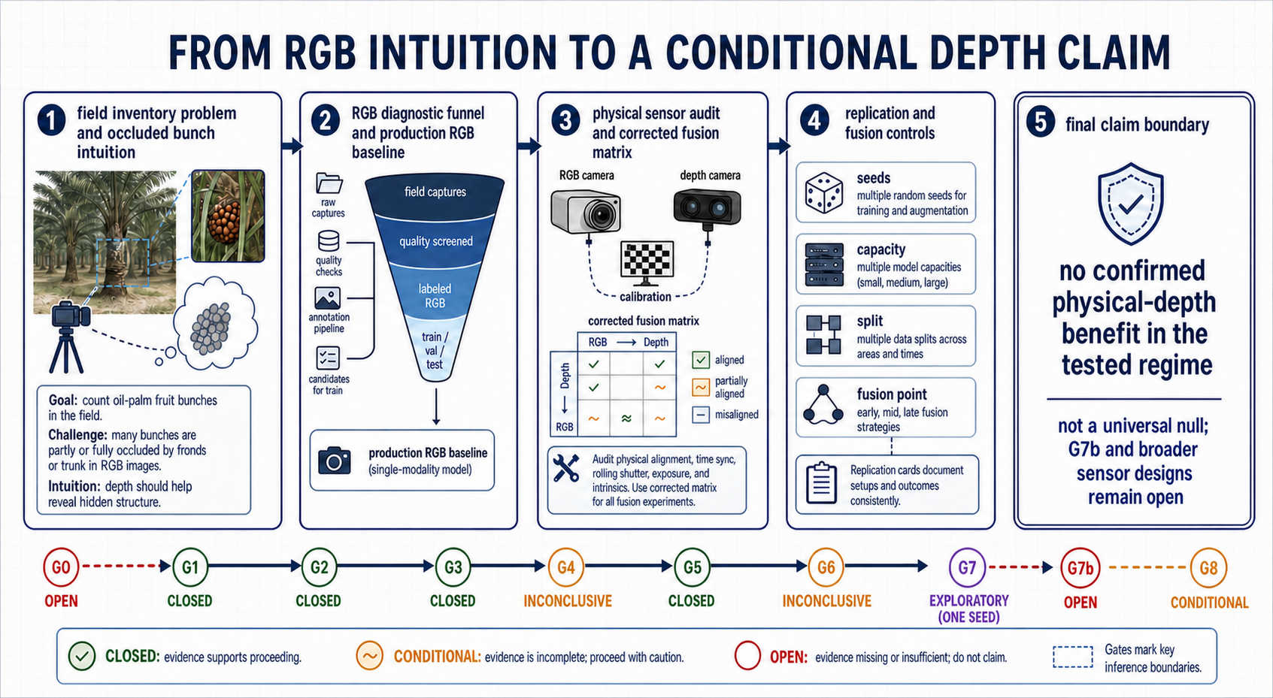
SYNTHESIS / CLAIM LEDGER
The full record supports a conditional conclusion.
SUPPORTED
- RF-DETR-L is the best observed RGB control.
- B4 is low-contrast and texture-rich; B2-B3 confusion is ordinal.
- Pseudo-depth does not separate bunches in E-006.
- Physical depth has no reliable replicated detection benefit in the tested regime.
NOT SUPPORTED
- Depth never helps.
- A universal RGB-D null or equivalence claim.
- End-to-end one-count-per-bunch inventory.
- A capacity law from one seed.
REPORTS / E-001-E-032
19
Notes:
[Sources]
- reports.pdf, pp. 87-93: cross-record synthesis, claim-boundary ledger, limitations, and conclusion.
- docs/manuscript/figures/N29-claim-boundary-gpt-image-2.png: claim-boundary figure.
[Interpretation boundary]
- The report rejects both overclaims: a defective run is not a positive sensor result, and a conditional null is not a universal statement about RGB-D.

Slide 20
NEXT / DEPLOYMENT AND G7b
Use an RGB-first research baseline.
Keep inventory validation open.
1
Deployment boundary
G7b MUST FREEZE
RF-DETR-L is a research baseline only if 8.5 FPS on L4 is acceptable. Preserve RGB fallback.
YOLO26n/m/l
RGB + registered depth + noise
At least 3 named seeds
Fixed split, evaluator, and tree bootstrap
Per-file depth contract
Predefined monotonicity rule
2
Priorities beyond depth
Prioritize ordinal maturity, external RGB holdouts, and sensor-aware capture.
G7b cannot validate one-count-per-bunch by itself.
Notes:
[Sources]
- reports.pdf, pp. 92-93: deployment consequences and G7b.
- reports.tex, lines 4119-4127: RGB-first research baseline and reversible depth capture branch.
[Interpretation boundary]
- The end-to-end one-count-per-bunch inventory remains unvalidated.

