Slide 1
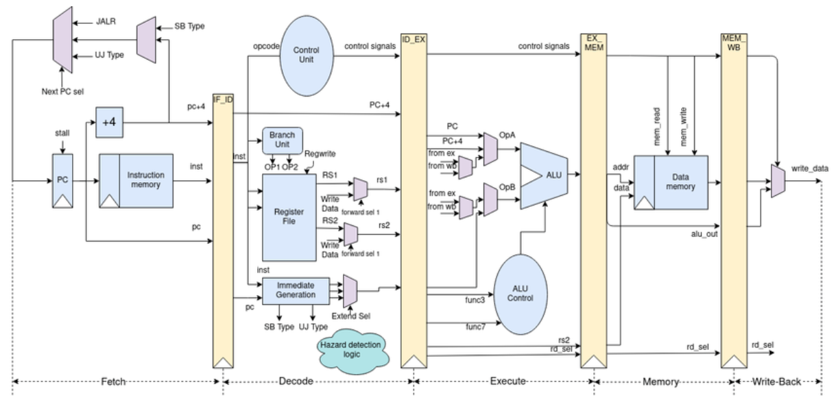






RISC-V
SPRAM
DATA
SPRAM
Instructions

