Slide 1


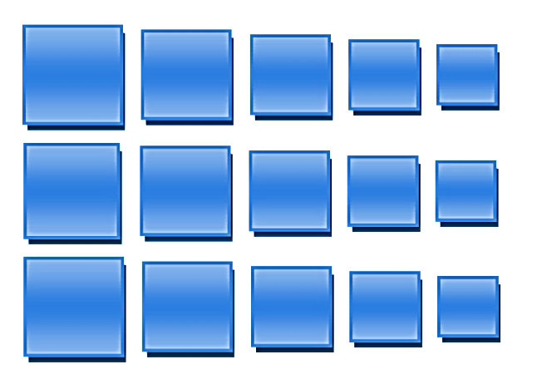
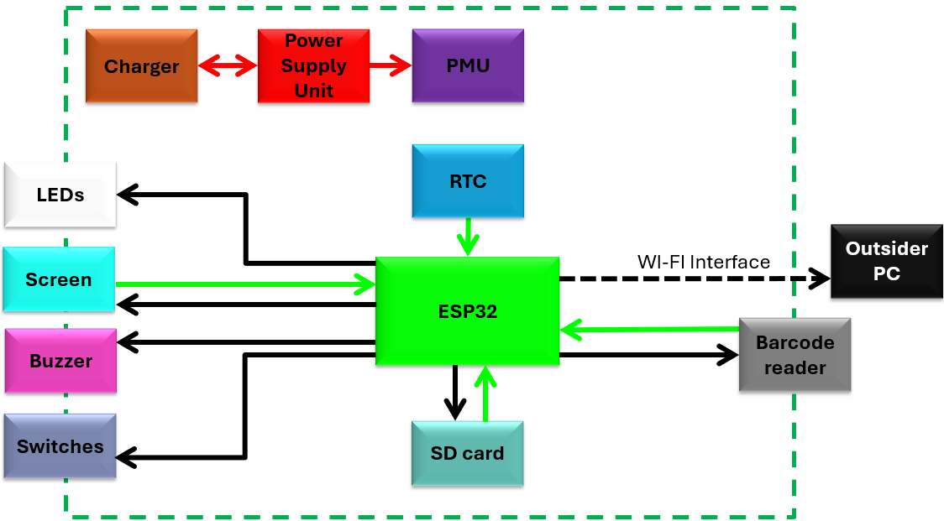
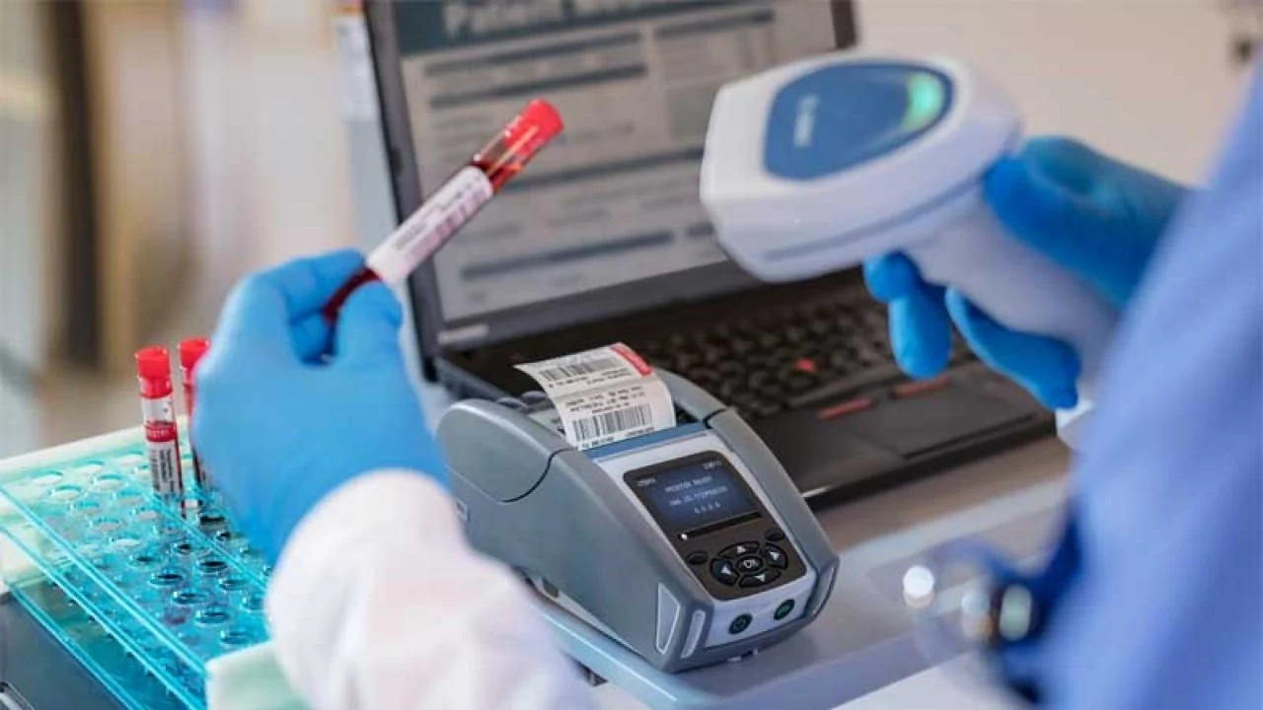
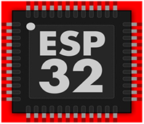

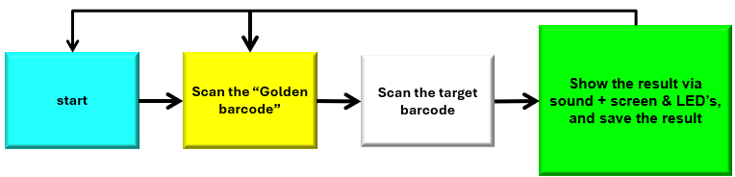
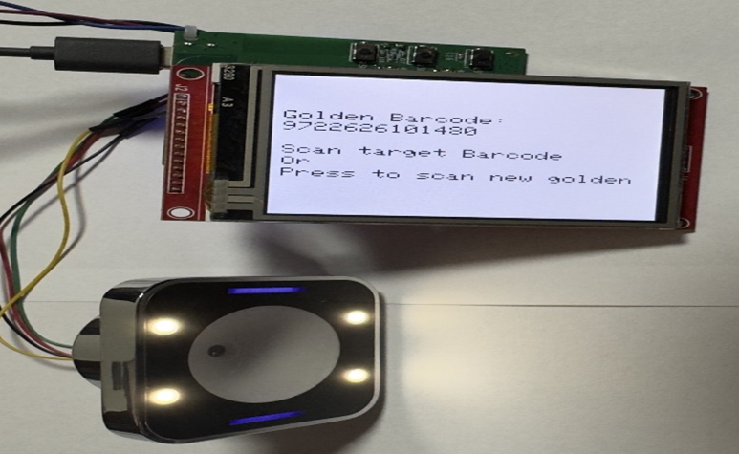
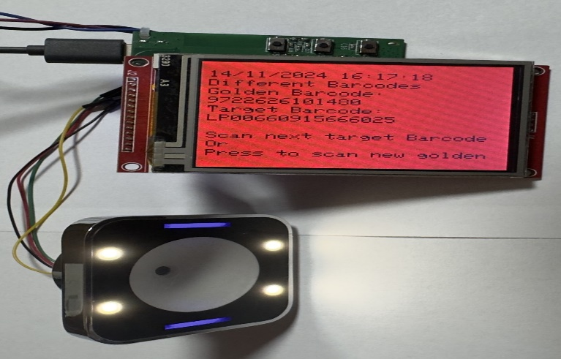
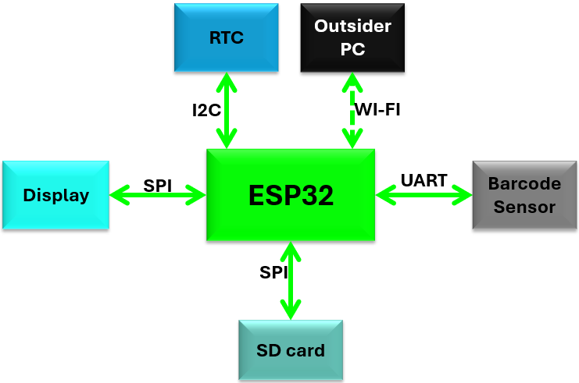
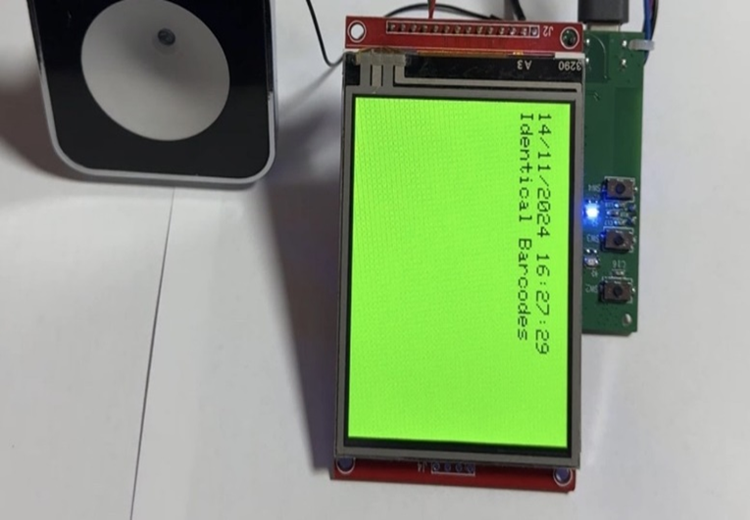
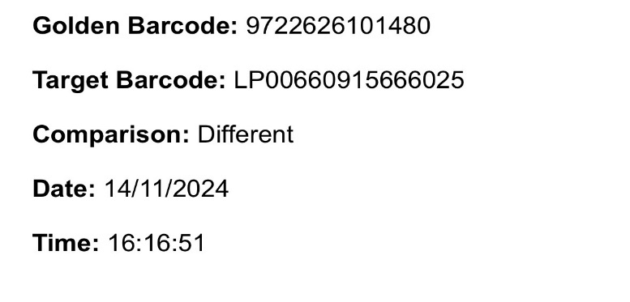

The Andrew & Erna Viterbi Faculty of
Electrical Engineering
Electronics
Computers
Communications
IOT-Barcode checker
Omar Sharafi & Muhammad Biadsy
Supervised by: Mony Orbach
Project goals
Block Diagram
This project, in collaboration with Bnai Zion Medical Center, addresses the mismanagement of patient samples in hospital laboratories.
Patient samples are barcoded, but manual handling of multiple samples can cause mix-ups. Reliable verification is needed to ensure accuracy at every stage.
To avoid this problem, we want to develop A Compact And Portable Device that :
Compare between barcodes and give us a clear result.
Provide a log with all the scanning results.
Communicatee via Wi-Fi with a computer.
Mobile, compact and Re-chargeable.
Flow Chart
Device Screen & Wi-fi page
Communication Map
Results
After all, with the project expectations, almost all the project requirement were achieved:
Create a user-friendly device that Compare between barcodes and give us a clear result.
Provide a log with all the scanning result via Wi-Fi with a real-time stamp.
Mobile, compact and Re-chargeable.
Easy to understand code.

