Slide 1

Rowi Alfata

Slide 2
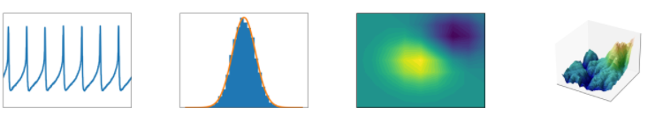
What is Matplotlib?
Matplotlib is a comprehensive library for creating static, animated, and interactive visualizations in Python.

Slide 3
What is Matplotlib?
It has a module named pyplot that makes things easy for plotting by providing feature to control line styles, font properties, formatting axis, etc.
It support a wide variety of graph and plot, such as histogram, bar chart, power spectra, error chart, etc.

Slide 4
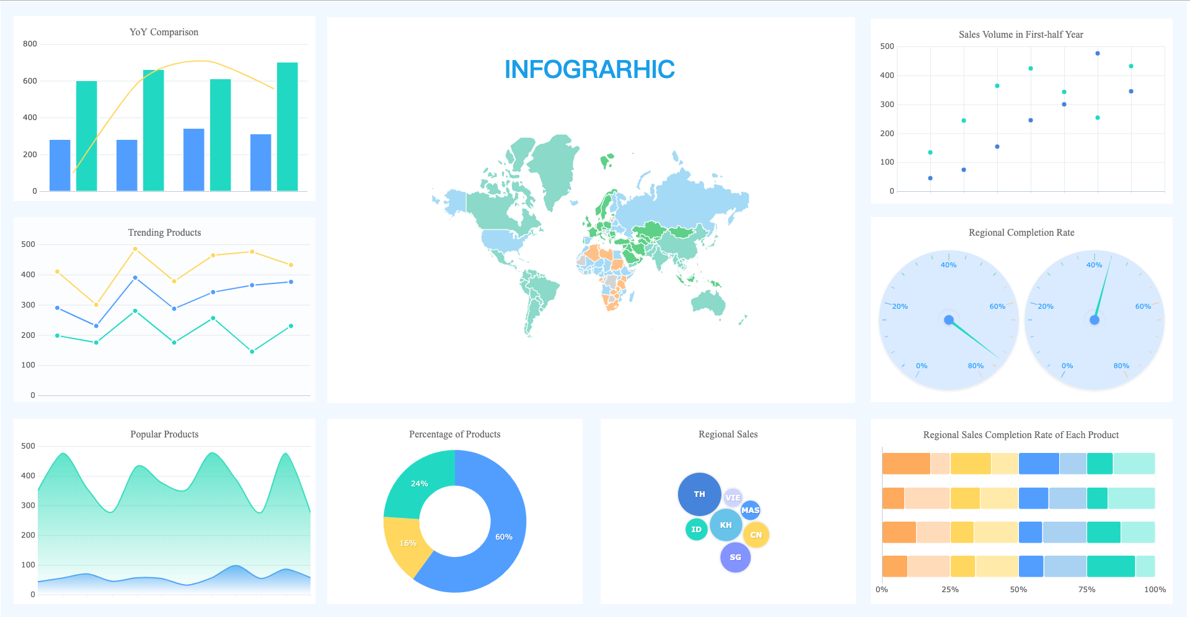
Why data visualization is important?
Human brain naturally understand information much easier and faster when in it is visualize properly.

Slide 5
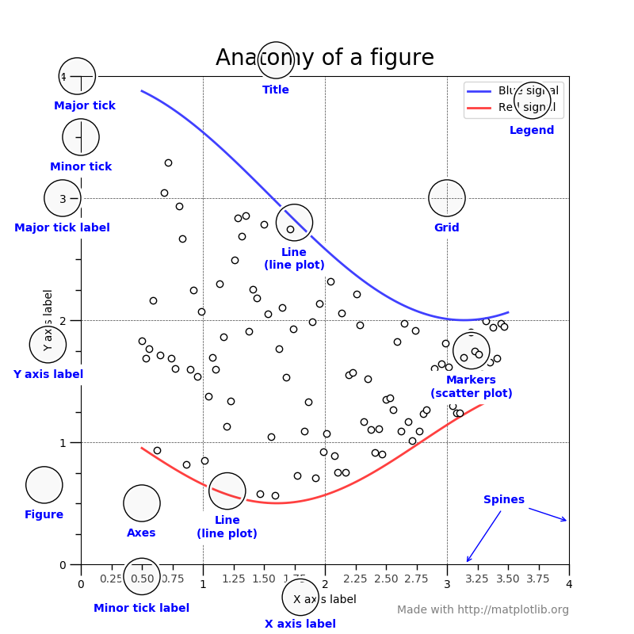
Anatomy of a figure

Slide 6
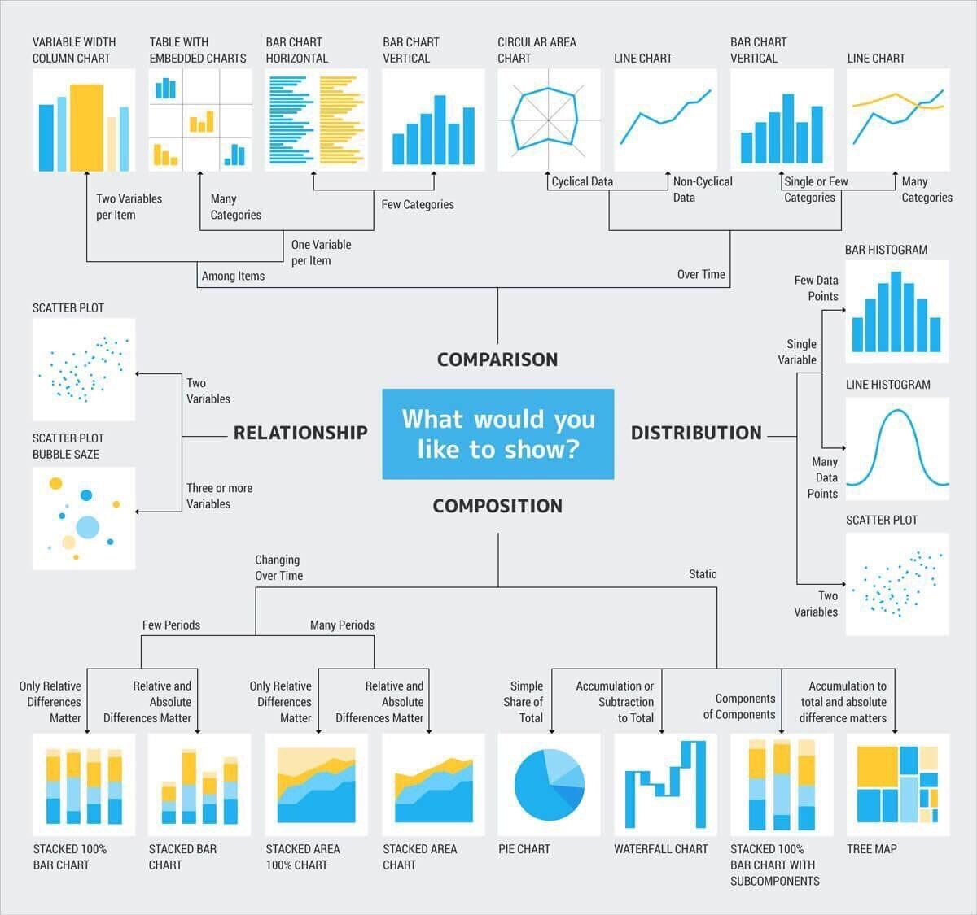
chart suggestions - a thought starter

Slide 7
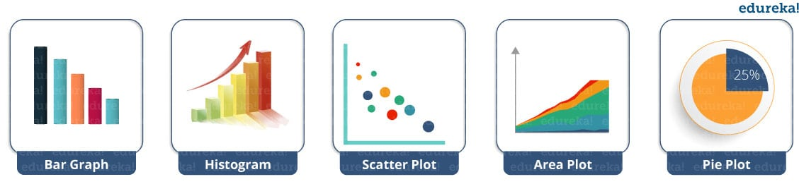
Chart

Slide 8
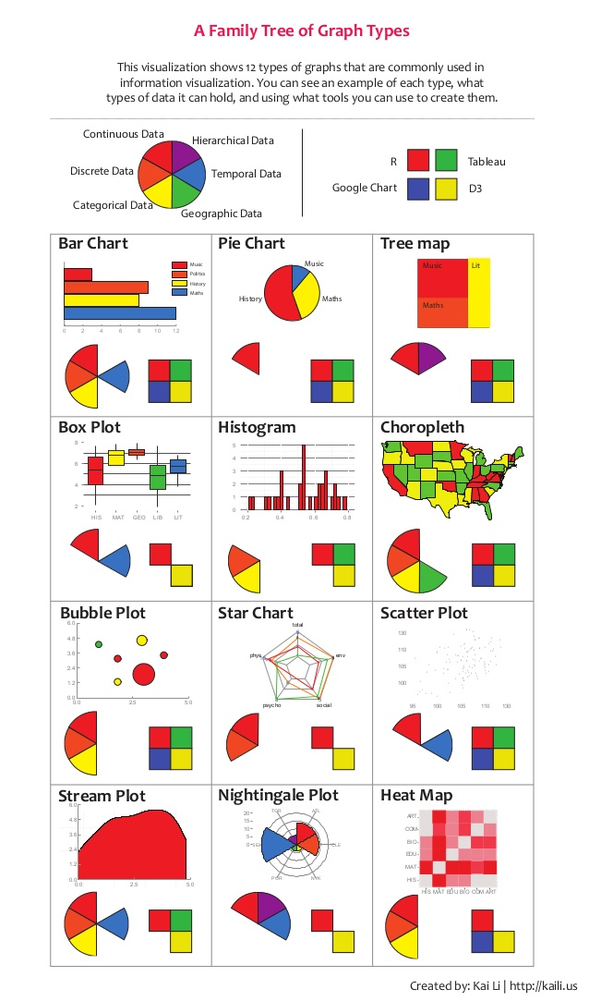
Chart

Slide 9
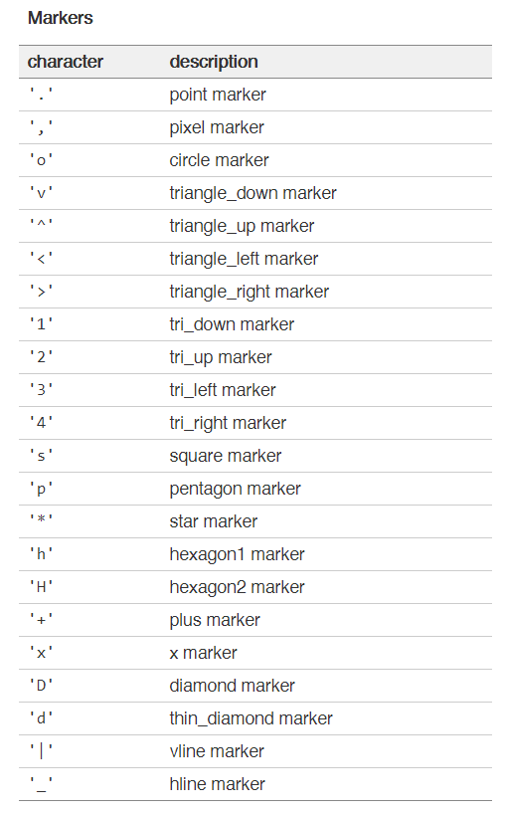
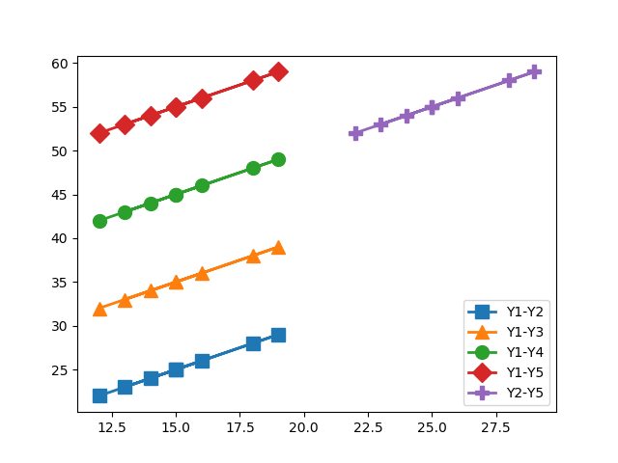
Format strings
A format string consists of a part for color, marker and line:
fmt = '[marker][line][color]'

Slide 10
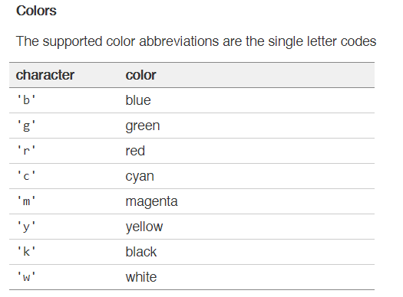
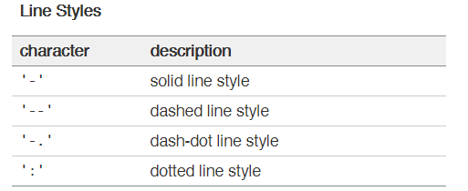
Format strings
If the color is the only part of the format string, you can additionally use any matplotlib.colors spec, e.g. full names ('green') or hex strings ('#008000').

