Slide 1
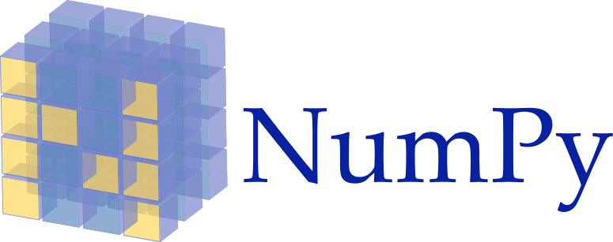
Rowi Alfata

Slide 2
What is NumPy?
NumPy is the fundamental package needed for scientific computing with Python.
It contains:
a powerful N-dimensional array object
basic linear algebra functions
basic Fourier transforms
sophisticated random number capabilities
tools for integrating Fortran code
tools for integrating C/C++ code

Slide 3
Why NumPy?
Lists ok for storing small amounts of one-dimensional data
>>> a = [1,3,5,7,9]
>>> print(a[2:4])
[5, 7]
>>> b = [[1, 3, 5, 7, 9], [2, 4, 6, 8, 10]]
>>> print(b[0])
[1, 3, 5, 7, 9]
>>> print(b[1][2:4])
[6, 8]
>>> a = [1,3,5,7,9]
>>> b = [3,5,6,7,9]
>>> c = a + b
>>> print c
[1, 3, 5, 7, 9, 3, 5, 6, 7, 9]
But, can’t use directly with arithmetical operators (+, -, *, /, …)
Need efﬁcient arrays with arithmetic and better multidimensional tools

Slide 4
Why NumPy?
Size – NumPy data structures take up less space
Performance – Faster than lists
Functionality – SciPy and NumPy have optimized functions such as linear algebra operations built in

Slide 5
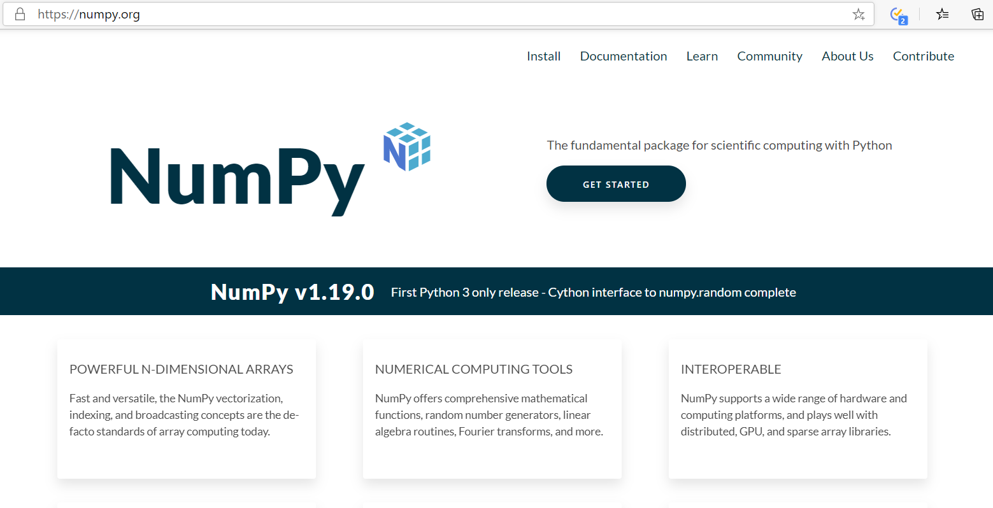

Slide 6
NumPy Ecosystem
OpenCV
PySAL
numexpr
astropy
PyTables
statsmodels
BioPython
Scikit-image
Scikit-learn
Numba
Scipy
Pandas
Matplotlib
NumPy

Slide 7
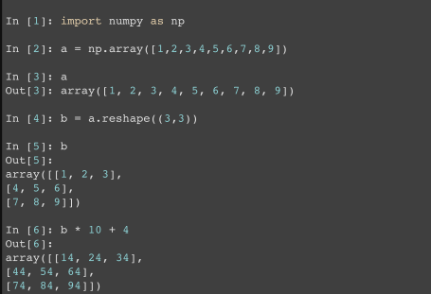
Quick Start

Slide 8
Array Shape
One dimensional arrays have a 1-tuple for their shape
1 | 2 | 3 | 4 | 5 | 6 | 7 | 8
Shape: (8,)

Slide 9
2 dimensional arrays
1 | 2 | 3 | 4
5 | 6 | 7 | 8
9 | 10 | 11 | 12
Shape: (3, 4)

Slide 10
And so on…
1 | 2 | 3 | 4
5 | 6 | 7 | 8
9 | 10 | 11 | 12
1 | 2 | 3 | 4
5 | 6 | 7 | 8
1 | 2 | 3 | 4
5 | 6 | 7 | 8
1 | 2 | 3 | 4
5 | 6 | 7 | 8
Shape: (3, 4, 4)

