Slide 1


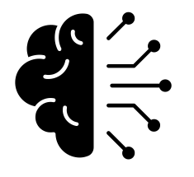
What is Agentic AI?
LLMs
LLMs are AI models that recognise and generate human-like text
The Problem with LLMs
They can only generate text, they can't interact with anything in the real world
Agentic AI
Connect LLMs to third-party tools, enabling them to take actions on your behalf
Notes:
- LLMs = AI models that have been trained on massive amounts of text so that they can understand and generate human-like language (think ChatGPT, Microsoft Copilot, etc.)
- LLMs are great, but the big problem with them is that they can only output text (you put text in, you get text out). Alone, they can't interact with anything in the real world
- This is where agentic AI comes in, instead of just generating text, they can take actions on your behalf
- Agentic AI connects LLMs to tools, APIs, and external systems so that it can plan, reason, and execute tasks (e.g., book a meeting in your calendar, query a database, send an email for you, etc.)
- Key takeaway:
- LLMs = chatbots (just talk)
- AI Agents = assistants, they can actually do things for you (can carry out actions)

Slide 2



MCP Servers
Challenges with Agentic AI
N tools × M models = Integration nightmare
MCP (Model Context Protocol)
Standardises the way that LLMs and third-party tools communicate
Growing Industry Adoption
An increasing number of companies and open-source communities provide MCP implementations
Notes:
- The problem with agentic AI is that you have hundreds of different LLM models (and we haven't even talked about training your own models here), with new ones constantly coming out, and you have an infinite amount of external tools and APIs
- Traditionally, if you wanted to connect an AI model to a tool, you'd have to write a custom integration for each specific model-tool combination
- As you can imagine, this gets out of hand very quickly (10 different AI providers + 10 different tools = 100 integrations)
- This is where MCP (or Model Context Protocol) comes in. MCP is a protocol that standardises the way that LLMs and external tools communicate, so that any LLM and any external tool can communicate with each other, as long as they both implement MCP.
- The big benefit is that each tool needs a single MCP integration written for it, and then any LLM should be able to communicate with it.
- More and more companies are now shipping official MCP implementations for their products (e.g., Google, Teams, AWS), so you don’t even have to write your own integrations.
- And for tools that don’t yet have official support, there are often community-built open-source MCP servers available. This makes MCP very “plug-and-play”: you just connect an LLM to the MCP server, and the model can start using the tool right away.

Slide 3





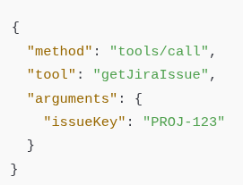
MCP Flow
LLM connects to MCP server
No need for custom integration, just connects using MCP spec
Server advertises its capabilities
Server provides a list of the tools and resources it exposes
LLM requests tool use
When solving a user request, the LLM decides on some external action
Server executes the request
MCP server translates the request into an actual API call
LLM consumes the response
LLM parses the response, reasons over it, and decides on the next step
Notes:
- LLM connects to the MCP server
- No need for a custom integration, it just connects to the server using the MCP spec
- The server advertises its capabilities
- I.e., the server provides a list of tools and resources (essentially capabilities) it exposes.
- E.g., a Jira MCP server might expose tools like `getJiraIssue`, `transitionJiraIssue`, `editJiraIssue`, etc.
- LLM requests tool use
- When solving a user request, the LLM decides it needs an external action
- It calls a tool using the standard MCP schema (basically: tool name + structured parameters)
- Example here...
- Server executes the request
- MCP server translates the request into an actual API call
- It then returns the response in a standard format
- LLM consumes the response
- LLM reads the response, reasons over it, and either continues the conversation or decides on the next action

Slide 4



Tech Stack
LangChain
Agentic AI framework already in use within Vanguard
Flask
Web server framework, chosen for quick and easy development for a PoC
Streamlit
Frontend Python framework, allows you to write beautiful UIs with minimal lines of code
Notes:
LangChain:
Already in use at Vanguard
Has a Python and JavaScript flavour, reducing learning time
Built-in monitoring system called LangSmith, excellent for debugging and fine tuning the models

Slide 5
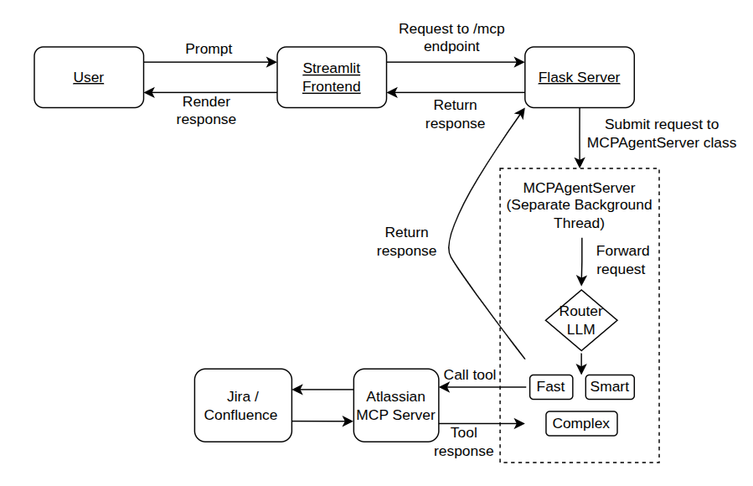
Architecture Diagram

Slide 6



Development Challenges
Restricted Development Environment
Lots of barriers with regards to accessing APIs + applications
Writing MCP client
Lots of prebuilt clients exist, however writing your own can be
Choosing LLMs + Prompt Engineering
Choosing the correct LLMs and modifying system prompts
Notes:
- Biggest challenge = couldn't develop the PoC on my work laptop
- Lots of barriers in terms of accessing APIs and softwares that I needed
- E.g., OpenAI and Google Gemini APIs were blocked
- E.g., didn't have access to AWS Bedrock
- E.g., had to write own MCP client to connect to the MCP server, but wanted to test
agentic capabilities with pre-existing MCP clients before I wrote my own, but
couldn't download those applications
- AI = amazing tech, but race to find best applications for it
- Way forward is to allow people to tinker with things and be creative
- Some people wanted to do so, but were put off by the fact that it was blocked on
work laptops

Slide 7



Next Steps
Port application
Port application to work with Vanguard systems
Port to AWS
Replace the Flask server with AWS services,
Implement reporting system
Allow users to report when the system behaves incorrectly
Notes:
Porting the application to Vanguard systems will give us a better understanding of its capabilities in a real environment, Confluence example
“Porting the project to AWS would align it with Vanguard’s fully cloud-based infrastructure, ensuring scalability, security, and easier integration with existing systems.”
“Implementing a reporting system would let users flag incorrect behavior, helping us quickly identify issues and improve the system’s reliability.”

