Slide 1
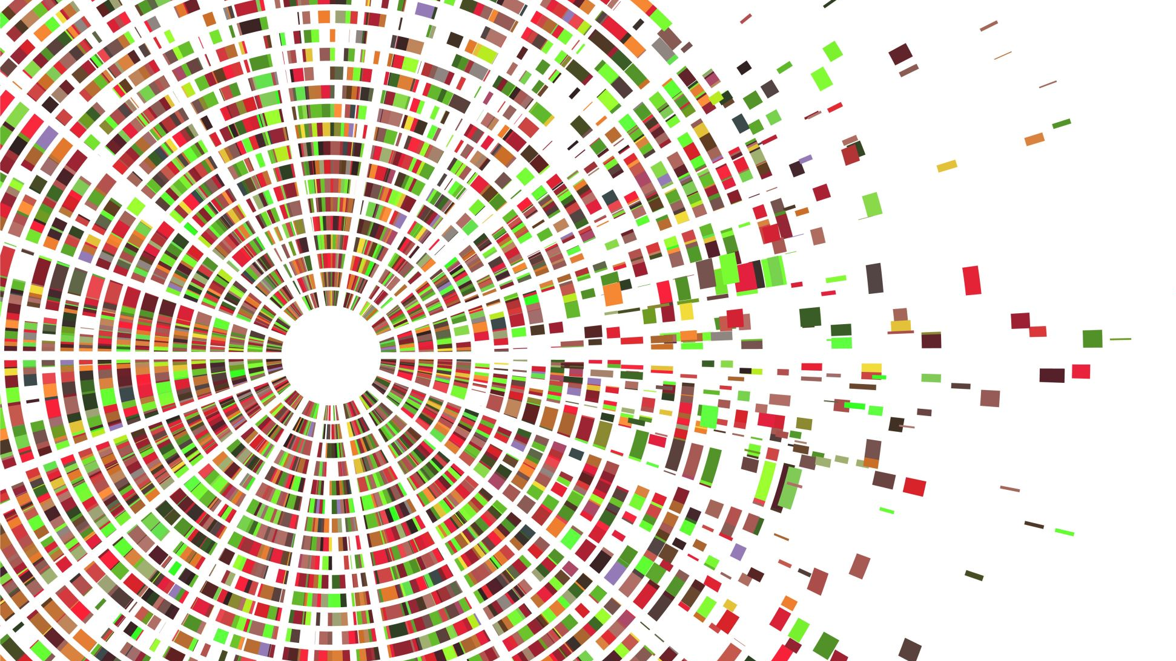
Data analysis on leads quality

Slide 2
Table of contents
Introduction
Data Cleaning
Clustering The Noisy Data
Plotting The Relationship Between
Extra Cleaning On The Messages
Feature Engineering And Getting Correlation
Model Training (Handling Unbalanced Dataset) and Evaluation Metrics
Deployment
Conclusion

Slide 3
Introduction
What is a Lead?
A sales lead refers to a person or business entity that is currently not a client but may eventually become one.
Sales lead also refers to the data that identifies an entity as a potential buyer of a product or service.
In other words Leads are just Data, what kind of analysis can we do on them?

Slide 4
Introduction cont.
Let’s take a look at the Dataset that we are going to work with
Nawy Dataset:
Nawy initiating targeting campaigns on a daily basis to generate Real estate leads.
The main pain is generating qualified leads.So we need to build a model to classify the received leads into two categories: low qualified and high qualified leads.

Slide 5
What columns we got?
Column Name | Description
lead_id | Is unique id representing customer (customer my reach more than one time)
customer_name | Name of the customer
lead_mobile_network | To differentiate between local and international customers
message | Message left by the customer
lead_time | Time of receiving the lead
method_of_contact | Contact method used to reach us
ad_group | Include information of target audience used in the campaign
lead_source | Channel used to reach us
campaign | Name of the targeting campaign
Location | The location which the customer is searching for
Low_qualified | Define if the lead is low or high qualified

Slide 6
Data cleaning
Let’s take a look at the Dataset that we are going to work with
Removing repetitive and meaningless words for columns such as (lead_source, location, ad_group, method_of_contact) but thar wasn’t enough!
Some columns have a lot of noise such as (lead_source, location, ad_group, method_of_contact)

Slide 7
Data cleaning
I used a package that I have created, it’s called PyGhaseel.
I does text cleaning for Arabic and English languages.
Please check it out : https://github.com/ATWltd/pyghaseel
Note: it’s still under development, and the released version is a beta version.
The version used in this project is a local version with some unreleased improvements.

Slide 8
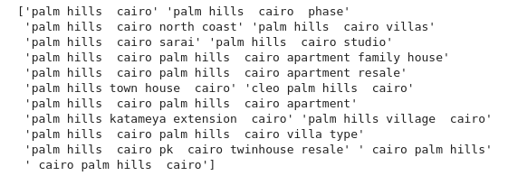
Data cleaning
For Location column:
All of the following entered locations almost refers to the same place
And the same for the other columns!

Slide 9
clustering the noisy data
For Location column:
I used a famous machine learning technique called Kmeans clustering.
It is used to cluster similar values into groups.
This is how I reduced the unique number of values dramatically

Slide 10
Plotting the relationships
After cleaning the data then doing clustering, it’s time to use what I did to find the relationship between the values of the columns and the quality of the lead, so I did 2 bar plot of each column:
The first one has 2 bars (count of good leads and count of all leads) categorized by each cluster
The second one has a single bar (the percentage of count of good leads to the total number of the leads)

Slide 11
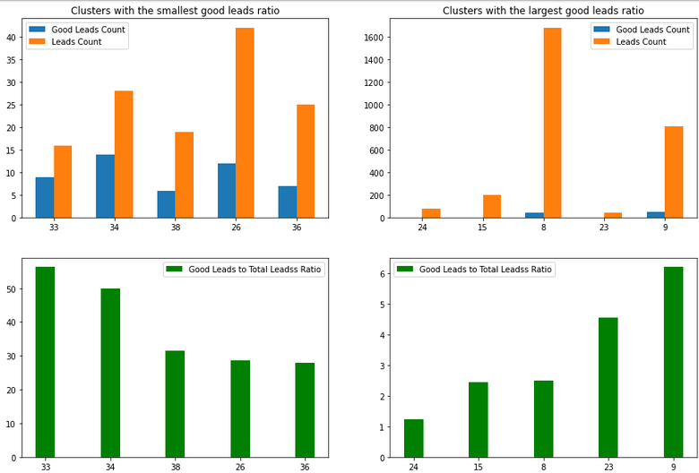
Plotting lead source column

Slide 12
Notes:
Note that we are need to look both to the counts and the ratio, as we need both, we don't care for high ration while count is almost 0 On the other hand we cant look to a high good leads count without looking to its ratio We need to look at both of them.
So we can say
Cluster 34 and 33 has a great ration and leads count (almost 50%)

Slide 13
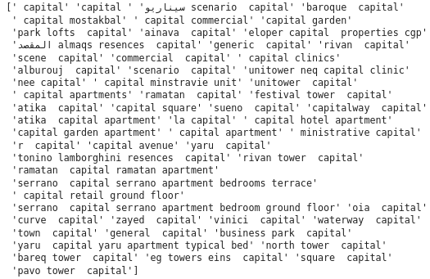
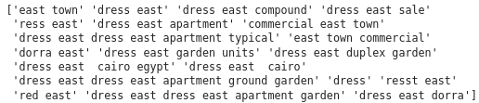
Notes:
Cluster 34 is about “type form”
Cluster 33 is about “linkedin”
The opposite for cluster 9, it has a lot of leads but the count of good leads is very bad (about whatsapp)

Slide 14
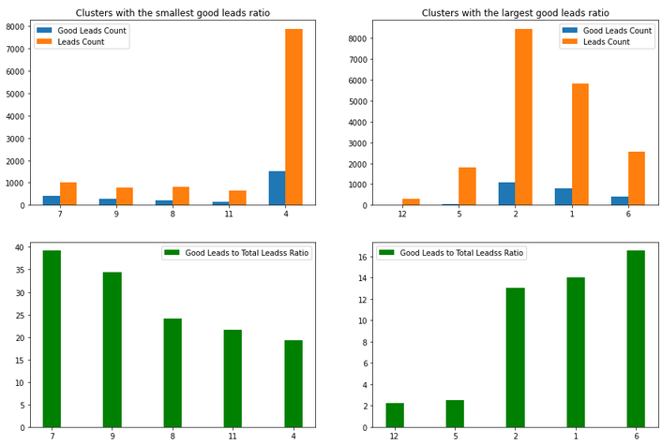
Plotting contact methods

Slide 15

Notes:
Cluster 2 and 1 is looks promising, we should invest more in them (whatsapp and top compounds form)
The opposite for cluster 4 and 5, they have a lot of leads but the count of good leads is very bad, the are about (personal and phone)

Slide 16
Notes:
This means we can rely on whatsapp as a communication method, but not as a lead source
And the same goes for the rest of the columns

Slide 17
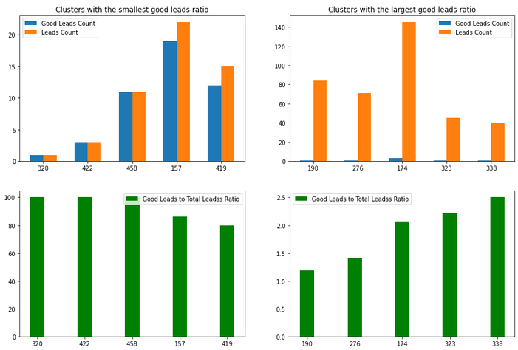
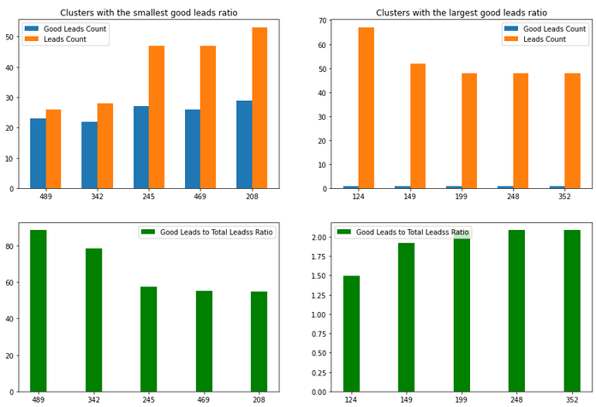
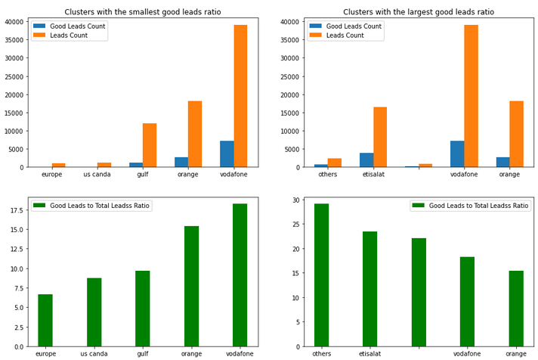

Slide 18
Notes:
We can spend more time on clustering the data to increase its quality, and this will provide
A better understanding for the data
A better data for the model to operate on

Slide 19
Extra cleaning on messages:
Now what about the message column?, at the first glance it looks promising?
Lets try to clean it and see if we can do word count analysis on them.

Slide 20
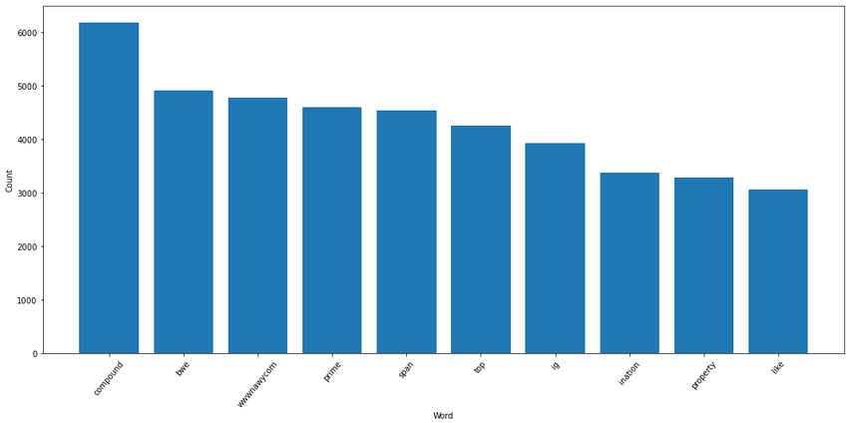
Words analysis on counts of low quality leads

Slide 21
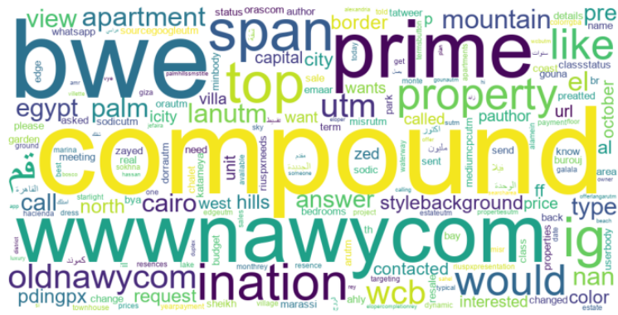
Words analysis on counts of low quality leads

Slide 22
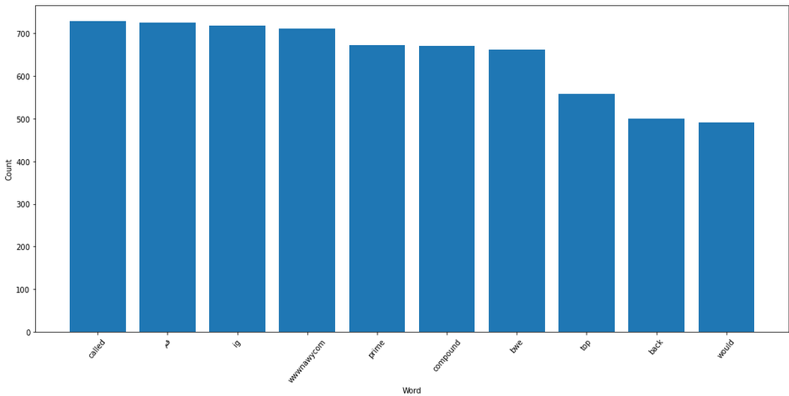
Words analysis on counts of High quality leads

Slide 23
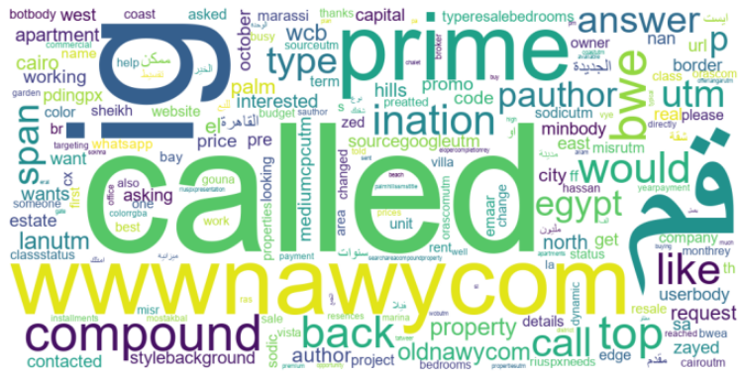
Words analysis on counts of high quality leads

Slide 24
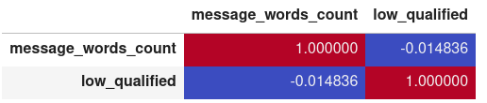
Feature Engineering And Getting Coorelation
What about finding the correlation between the message length and the quality of the lead?
So unfortuantily, it looks that the correlation is weak, so we will proceed with the words while training the model (as a trial)

Slide 25
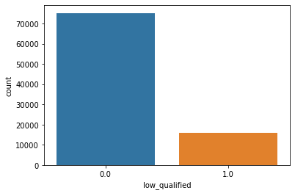
Model training (unbalanced dataset)
Let’s take a look at the balance of our 2 classes (low and high quality)

Slide 26
Model training (unbalanced dataset)
So let’s choose the best model for our case, and since our problem is just a simple binary classification, we can choose:
Support Vector Classifier
Linear regression
Simple Vanilla ANN (feed forward network)

Slide 27
Model training (unbalanced dataset)
I trained on three different situations
Used the clusters ids as a categorical features
I used words in the messages (after the cleaning steps)
I used all the words inside all the columns (after cleaning and before clustering)
But we must not forget about the unbalanced data problem, so we will try to use these aproches:
Use balanced weight to the classes (instead of giving each class the same weight)
Move our threshold to give a better

Slide 28
Model training (unbalanced dataset)
This model is so simple and straight, and it gave us the best values till now
Now let’s look at the classification report and the confusion matrix

Slide 29
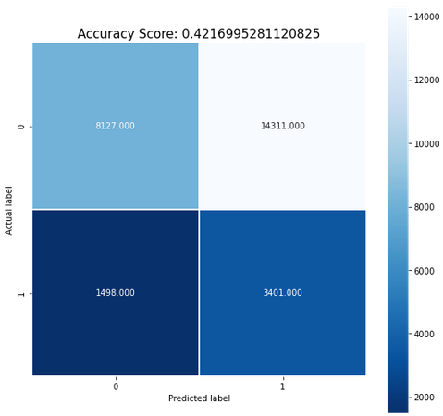
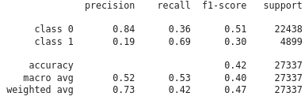
Clusters ids as a categorical features
Model training (unbalanced dataset)

Slide 30

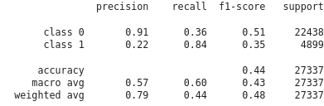
words in the messages (after the cleaning steps)
Model training (unbalanced dataset)

Slide 31
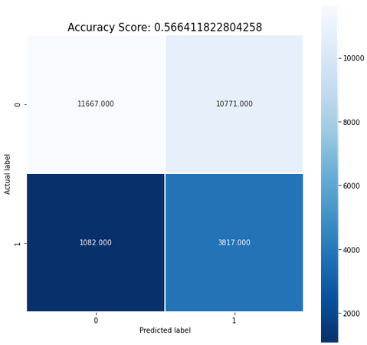
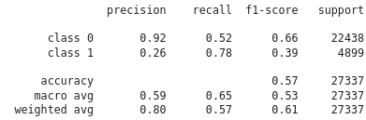
words inside all the columns (after cleaning and before clustering)
Model training (unbalanced dataset)

Slide 32
Model training (unbalanced dataset)
So we can see that the approach of using the words inside all the columns (after cleaning and before clustering) is the better, it gave us:
Better precision
Better f1 score
And they are the main two evaluation metrics we seek, because we care about good leads being mis-classified as bad lead than bad leads gets mis-classified as good leads

Slide 33
Model training (unbalanced dataset)
The 2 other 2 models didn’t do as good as the simple logistic regression did:
The ANN had precision of 17
The SVM consumed a lot of time and gave a result a tiny bit lower than the logistic regression
So I’ll not bring them here for evaluation

Slide 34
Model training (unbalanced dataset)
To improve the quality of our model we can do:
Extra cleaning the data by studying the nature of the data more.
Spending more time upgrading the clusters’ quality
Trying new types and architectures of models
More studying to the nature of the data

Slide 35
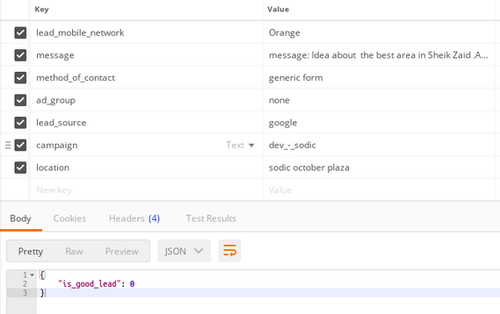
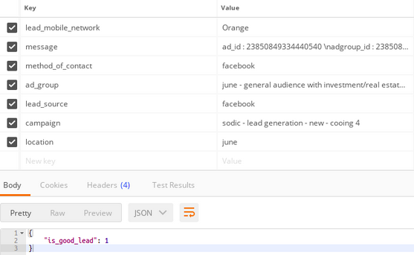
Deployment
The model artifacts are saved and imported to flask to be deployed as an API.
on the left, lead 22 which is a low quality lead
On the right, lead 91582 which is a high quality lead

Slide 36

Thank you!

