Slide 1
CSC 418 – DevOps for Cloud Computing
Instructor: Dr. M. Hasan Jamal
Lecture# 03: Introduction to Virtualization

Slide 2
The Traditional Server Concept
A single OS image per machine
Software and Hardware tightly coupled
Running multiple applications on same machine often creates conflicts
Underutilized resources
Inflexible and costly infrastructure
App 1
App 2
App 3
App N
Host Operating System
Physical Infrastructure
(Processor, RAM, Memory, Network, Chipset, Storage ...)

Slide 3
What is Virtualization?
Virtualization abstracts the underlying physical structure of various technologies. Virtualization, in computing, is the creation of a virtual (rather than actual) version of something, such as a hardware platform, operating system, a storage device or network resources.
Server virtualization
Creates multiple isolated environments
Allows multiple OS’s and workloads to run on the same physical hardware
Solves the problem of tight coupling between OS’s and hardware

Slide 4
Virtualization Basics
A virtual machine is a software computer that, like a physical computer, runs an operating system and applications.
Each virtual machine contains its own virtual, or software-based, hardware, including a virtual CPU, memory, hard disk, and network interface card.
Virtualization is a technique of how to separate a service from the underlying physical delivery of that service. It is the process of creating a virtual version of something like computer hardware.
With the help of Virtualization, multiple operating systems and applications can run on same machine and its same hardware at the same time, increasing the utilization and flexibility of hardware.
One of the main cost effective, hardware reducing, and energy saving techniques used by cloud providers is virtualization

Slide 5
Virtualization Basics
Virtualization allows to share a single physical instance of a resource or an application among multiple customers and organizations at one time.
It does this by assigning a logical name to a physical storage and providing a pointer to that physical resource on demand.
The term virtualization is often synonymous with hardware virtualization, which plays a fundamental role in efficiently delivering Infrastructure-as-a-Service (IaaS) solutions for cloud computing.
Moreover, virtualization technologies provide a virtual environment for not only executing applications but also for storage, memory, and networking.
The machine on which the virtual machine is going to be built is known as Host Machine and that virtual machine is referred as a Guest Machine.

Slide 6
The Virtual Server Concept
Hardware-independence of operating system and applications
Virtual machines can be provisioned to any system
Can manage OS and application as a single unit by encapsulating them into virtual machines
App 1
App 2
App 3
App N
VMs
Guest
OS
Guest
OS
Guest
OS
Guest
OS
Hypervisor (Xen, KVM, VMware…)
Host Operating System
Physical Infrastructure
(Processor, RAM, Memory, Network, Chipset, Storage ...)

Slide 7
Virtual Machines
Virtual machines provide:
Hardware Independence – Guest VM sees the same hardware regardless of the host hardware
Isolation – VM’s operating system is isolated from the host operating system
Encapsulation – Entire VM encapsulated into a single file

Slide 8
Hypervisor
Also known as virtual machine monitor or VMM, is a small software layer that enables multiple operating systems to run alongside each other, sharing the same physical computer resources.
A hypervisor logically isolates virtual machines, allocating each its own share of computing power, memory, and storage to prevent interference.
🗸
🗸
🗸
App 1
App 2
App 3
App N
VMs
Guest
OS
Guest
OS
Guest
OS
Guest
OS
Hypervisor (Xen, KVM, VMware…)
Host Operating System
Physical Infrastructure
(Processor, RAM, Memory, Network, Chipset, Storage ...)

Slide 9
Benefits of Virtualization
More flexible and efficient allocation of resources through server consolidation.
Enhance development productivity.
It lowers the cost of IT infrastructure.
Remote access and rapid scalability.
High availability and disaster recovery.
Pay peruse of the IT infrastructure on demand.
Enables running multiple operating systems.
Hardware independence/portability
Improved security
Simplified administration

Slide 10
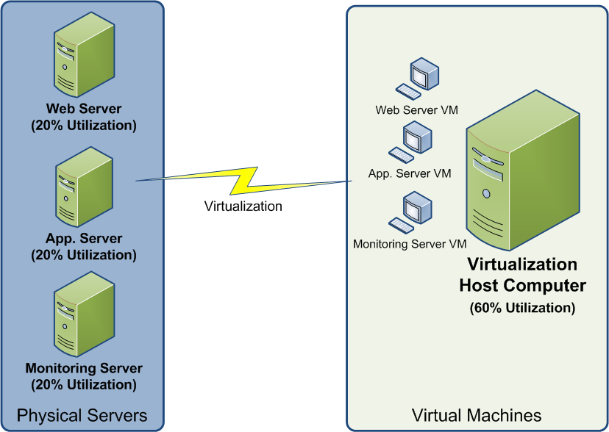
Server Consolidation

Slide 11
Types of Virtualization
Application Virtualization
Network Virtualization
Desktop Virtualization
Storage Virtualization
Server Virtualization
Data Virtualization

Slide 12
Application Virtualization
Application virtualization helps a user to have remote access of an application from a server.
The server stores all personal information and other characteristics of the application but can still run on a local workstation through the internet.
Application virtualization software allows users to access and use an application from a separate computer than the one on which the application is installed.
Using application virtualization software, IT admins can set up remote applications on a server and deliver the apps to an end user’s computer.
For the user, the experience of the virtualized app is the same as using the installed app on a physical machine.

Slide 13
Network Virtualization
The ability to run multiple virtual networks with each has a separate control and data plan.
It co-exists together on top of one physical network. It can be managed by individual parties that potentially confidential to each other.
Network virtualization provides a facility to create and provision virtual networks—logical switches, routers, firewalls, load balancer, Virtual Private Network (VPN), and workload security within days or even in weeks.
Network Virtualization is a process of logically grouping physical networks and making them operate as single or multiple independent networks called Virtual Networks.

Slide 14
Desktop Virtualization
Desktop virtualization allows the users’ OS to be remotely stored on a server in the data center.
It allows the user to access their desktop virtually, from any location by a different machine.
Users who want specific operating systems other than Windows Server will need to have a virtual desktop.
Main benefits of desktop virtualization are user mobility, portability, easy management of software installation, updates, and patches.
Desktop virtualization is technology that lets users simulate a workstation load to access a desktop from a connected device. It separates the desktop environment and its applications from the physical client device used to access it.

Slide 15
Storage Virtualization
Storage virtualization is an array of servers that are managed by a virtual storage system.
The servers aren’t aware of exactly where their data is stored and instead function more like worker bees in a hive. It makes managing storage from multiple sources to be managed and utilized as a single repository.
Storage virtualization is the pooling of physical storage from multiple storage devices into what appears to be a single storage device -- or pool of available storage capacity -- that is managed from a central console.
The technology relies on software to identify available storage capacity from physical devices and to then aggregate that capacity as a pool of storage that can be used by traditional architecture servers or in a virtual environment by virtual machines

Slide 16
Server Virtualization
Server virtualization is the process of dividing a physical server into multiple unique and isolated virtual servers by means of a software application. Each virtual server can run its own operating systems independently.
This is a kind of virtualization in which masking of server resources takes place.
Here, the central-server(physical server) is divided into multiple different virtual servers by changing the identity number, processors. So, each system can operate its own operating systems in isolate manner.
Where each sub-server knows the identity of the central server. It causes an increase in the performance and reduces the operating cost by the deployment of main server resources into a sub-server resource. It’s beneficial in virtual migration, reduce energy consumption, reduce infrastructural cost, etc.

Slide 17
Data Virtualization
This is the kind of virtualization in which the data is collected from various sources and managed that at a single place without knowing more about the technical information like how data is collected, stored & formatted then arranged that data logically so that its virtual view can be accessed by its interested people and stakeholders, and users through the various cloud services remotely.
Many big giant companies are providing their services like Oracle, IBM, etc.
It can be used to performing various kind of tasks such as:
Data-integration
Business-integration
Service-oriented architecture data-services
Searching organizational data

Slide 18
Components of Modern Virtualization
Three main components of modern virtualization come together to create the virtual machines and associated infrastructure that power the modern world.
Virtual Compute:
When we talk about virtualized compute resources, we mean the CPU – the “brain” of the computer.
In a virtualized system, the Hypervisor software creates virtual CPUs in software, and presents them to its guests for their use.
The guests only see their own virtual CPUs, and the Hypervisor passes their requests on to the physical CPUs

Slide 19
Components of Modern Virtualization
The benefits of Virtual Compute are immense.
Because the Hypervisor can create more virtual CPUs (often creating many more than the number of physical CPUs), the physical CPUs spend far less time in an idle state, making it possible to extract much more performance from them.
In a non-virtualized architecture, many CPU cycles (and therefore electricity and other resources) are wasted because most applications do not run a modern physical CPU at full tilt all the time.

Slide 20
Components of Modern Virtualization
Virtual Storage: In the beginning, there were disk drives.
Later, there was RAID (Redundant Array of Independent Disks). RAID allowed us to combine multiple disks into one, gaining additional speed and reliability.
Later still, the RAID arrays that used to live in each server moved into specialized, larger storage arrays which could provide virtual disks to any number of servers over a specialized high-speed network, known as a SAN (Storage Area Network).
All of these methods are simply different ways to virtualize storage.
Over the years, the trend has been to abstract away individual storage devices, consolidate them and distribute work across them. The ways we do this have gotten better, faster, and become networked – but the basic concept is the same

Slide 21
Components of Modern Virtualization
Virtual Networking: Network virtualization uses software to abstract away the physical network from the virtual environment.
The Hypervisor may provide its guest systems with many virtual network devices (switches, network interfaces, etc.) that have little to no correspondence with the physical network connecting the physical servers.
Within the Hypervisor’s configuration, there is a mapping of virtual to physical network resources, but this is invisible to the guests.
If two virtual computers in the same environment need to talk to each other over the network, that traffic may never touch the physical network at all if they are on the same host system.

Slide 22
Implementation Levels of Virtualization
Talking of the Implementation levels of virtualization in cloud computing, there are a total of five levels that are commonly used.
Instruction Set Architecture Level (ISA)
Hardware Abstraction Level (HAL)
Operating System Level
Library Level
Application Level

Slide 23
Instruction Set Architecture Level (ISA)
ISA virtualization can work through ISA emulation. This is used to run many legacy codes that were written for a different configuration of hardware.
These codes run on any virtual machine using the ISA. With this, a binary code that originally needed some additional layers to run is now capable of running on the x86 machines.
It can also be tweaked to run on the x64 machine.
For the basic emulation, an interpreter is needed, which interprets the source code and then converts it into a hardware format that can be read.
This then allows processing. This is one of the five implementation levels of virtualization in cloud computing.

Slide 24
Hardware Level Abstraction (HAL)
True to its name HAL lets the virtualization perform at the level of the hardware. This makes use of a hypervisor which is used for functioning.
At this level, the virtual machine is formed, and this manages the hardware using the process of virtualization. It allows the virtualization of each of the hardware components, which could be the input-output device, the memory, the processor, etc.
Multiple users will not be able to use the same hardware and also use multiple virtualization instances at the very same time. This is mostly used in the cloud-based infrastructure.
Virtualization at the HAL exploits the similarity in architectures of the guest and host platforms to cut down the interpretation latency. Virtualization technique helps map the virtual resources to physical resources and use the native hardware for computations in the VM.

Slide 25
Operating System Level
At the level of the operating system, the virtualization model is capable of creating a layer that is abstract between the operating system and the application.
This is an isolated container that is on the operating system and the physical server, which makes use of the software and hardware. Each of these then functions in the form of a server.
When there are several users, and no one wants to share the hardware, then this is where the virtualization level is used. Every user will get his virtual environment using a virtual hardware resource that is dedicated. In this way, there is no question of any conflict.
Operating system virtualization (OS virtualization) is a server virtualization technology that involves tailoring a standard operating system so that it can run different applications handled by multiple users on a single computer at a time

Slide 26
Library Level
The operating system is cumbersome, and this is when the applications make use of the API that is from the libraries at a user level.
These APIs are documented well, and this is why the library virtualization level is preferred in these scenarios.
API hooks make it possible as it controls the link of communication from the application to the system. API hooking is a technique by which we can instrument and modify the behavior and flow of API calls.

Slide 27
Application Level
The application-level virtualization is used when there is a desire to virtualize only one application and is the last of the implementation levels of virtualization in cloud computing. One does not need to virtualize the entire environment of the platform.
This is generally used when you run virtual machines that use high-level languages. The application will sit above the virtualization layer, which in turn sits on the application program.
It lets the high-level language programs compiled to be used in the application level of the virtual machine run seamlessly.
Application virtualization is a process that deceives a standard app into believing that it interfaces directly with an operating system's capacities when, in fact, it does not. This ruse requires a virtualization layer inserted between the app and the OS.

Slide 28
Virtualization Structures/Tools & Mechanisms
In general, there are three typical classes of VM architecture.
Before virtualization, the operating system manages the hardware.
After virtualization, a virtualization layer is inserted between the hardware and the operating system. In such a case, the virtualization layer is responsible for converting portions of the real hardware into virtual hardware.
Therefore, different operating systems such as Linux and Windows can run on the same physical machine, simultaneously.
Depending on the position of the virtualization layer, there are several classes of VM architectures, namely the full virtualization, para-virtualization, and host-based virtualization.

Slide 29
Virtualization Structures/Tools & Mechanisms
Full Virtualization, which uses binary translation or hardware-assisted virtualization for complete system emulation;
Para-Virtualization, where the guest operating system is modified to communicate more efficiently with the virtualization layer;
Host-Based Virtualization, which runs virtual machines as applications on top of a host operating system.
These mechanisms are managed by a hypervisor, which abstracts physical resources and allows multiple operating systems and applications to run in isolated virtual machines on a single physical server.

Slide 30
Virtualization Structures/Tools & Mechanisms
The hypervisor supports hardware-level virtualization on bare metal devices like CPU, memory, disk and network interfaces.
The hypervisor software sits directly between the physical hardware and its OS. This virtualization layer is referred to as either the VMM or the hypervisor. The hypervisor provides hypercalls for the guest OSes and applications.
Type-1 Hypervisor: The hypervisor runs directly on the underlying host system. It is also known as a “Native Hypervisor” or “Bare metal hypervisor”. It does not require any base server operating system. It has direct access to hardware resources.
Type-2 Hypervisor: A Host operating system runs on the underlying host system. It is also known as ‘Hosted Hypervisor”. Such kind of hypervisors doesn’t run directly over the underlying hardware rather they run as an application in a Host system (physical machine)

Slide 31
Binary Translation with Full Virtualization
Depending on implementation technologies, hardware virtualization can be classified into two categories: full virtualization and host-based virtualization.
Full virtualization does not need to modify the host OS. It relies on binary translation to trap and to virtualize the execution of certain sensitive, nonvirtualizable instructions.
The guest OSes and their applications consist of noncritical and critical instructions.
In a host-based system, both a host OS and a guest OS are used.
A virtualization software layer is built between the host OS and guest OS.

Slide 32
Binary Translation with Full Virtualization
Full Virtualization: With full virtualization, noncritical instructions run on the hardware directly while critical instructions are discovered and replaced with traps into the VMM to be emulated by software.
Both the hypervisor and VMM approaches are considered full virtualization.
Why are only critical instructions trapped into the VMM? This is because binary translation can incur a large performance overhead.
Noncritical instructions do not control hardware or threaten the security of the system, but critical instructions do.
Therefore, running noncritical instructions on hardware not only can promote efficiency, but also can ensure system security.

Slide 33
Binary Translation with Full Virtualization
Host-Based Virtualization: An alternative VM architecture is to install a virtualization layer on top of the host OS. This host OS is still responsible for managing the hardware.
The guest OSes are installed and run on top of the virtualization layer. Dedicated applications may run on the VMs.
This host-based architecture has some distinct advantages:
First, the user can install this VM architecture without modifying the host OS. The virtualizing software can rely on the host OS to provide device drivers and other low-level services. This will simplify the VM design and ease its deployment.
Second, the host-based approach appeals to many host machine configurations. Compared to the hypervisor/VMM architecture, the performance of the host-based architecture may also be low. When an application requests hardware access, it involves four layers of mapping which downgrades performance significantly. When the ISA of a guest OS is different from the ISA of the underlying hardware, binary translation must be adopted. Although the host-based architecture has flexibility, the performance is too low to be useful in practice.

Slide 34
Para-Virtualization with Compiler Support
Para-virtualization needs to modify the guest operating systems. A para-virtualized VM provides special APIs requiring substantial OS modifications in user applications.
Performance degradation is a critical issue of a virtualized system. No one wants to use a VM if it is much slower than using a physical machine.
The virtualization layer can be inserted at different positions in a machine software stack. However, para-virtualization attempts to reduce the virtualization overhead, and thus improve performance by modifying only the guest OS kernel.
The guest operating systems are para-virtualized. They are assisted by an intelligent compiler to replace the nonvirtualizable OS instructions by hypercalls

Slide 35
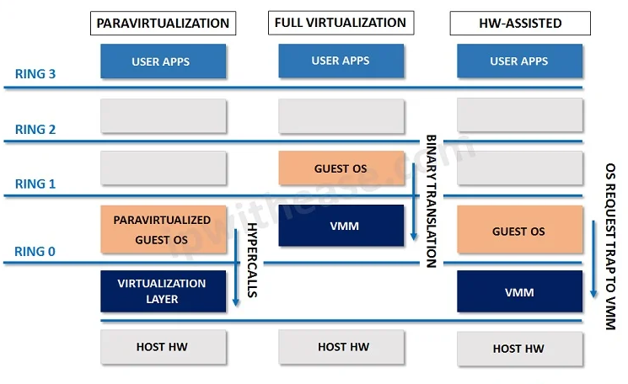
Virtualization Structures/Tools & Mechanisms

Slide 36
Performance Comparison
Aspect | Full Virtualization | Paravirtualization | Host-Based Virtualization
Guest OS Awareness | Guest OS is unaware of virtualization and runs as if on physical hardware. | Guest OS is aware of virtualization and modified to interact with the hypervisor. | Guest OS is unaware; runs on top of a host OS which manages hardware access.
Virtualization Layer | Hypervisor runs directly on hardware (bare-metal). | Modified guest OS communicates directly with hypervisor (bare-metal). | Hypervisor runs on top of a host operating system.
Hardware Emulation | Requires complete hardware emulation. | Avoids full emulation; uses hypercalls for direct communication. | Relies on host OS drivers and emulation for hardware access.
Performance Overhead | Moderate to high, due to hardware emulation. | Low overhead, as emulation is minimized. | Highest overhead, because of additional host OS layer.
I/O Performance | Slower I/O due to emulation. | Faster I/O with direct hypervisor calls. | Slower I/O due to double layer (guest → host OS → hardware).
Latency | Higher latency in system calls. | Low latency through hypercalls. | Highest latency due to extra software layer.

Slide 37
Performance Comparison
Aspect | Full Virtualization | Paravirtualization | Host-Based Virtualization
Guest OS Modification | Not required. | Required (guest OS must support hypercalls). | Not required.
Compatibility | Supports unmodified OSs (e.g., Windows, Linux). | Supports modified OSs only. | Supports any OS supported by the host OS.
Efficiency | High efficiency, but less than paravirtualization. | Most efficient due to reduced emulation. | Least efficient because of host OS overhead.
Security | More secure (direct hardware access). | Secure, with reduced complexity. | Less secure, as it depends on host OS stability.
Example Hypervisors | VMware ESXi, Microsoft Hyper-V | Xen (modified Linux kernel) | Oracle VirtualBox, VMware Workstation

Slide 38
Virtualization – Key Solutions / Use Cases
Server Consolidation and Containment – Eliminate server sprawl by deploying systems into virtual machines.
Infrastructure Provisioning – Reduce the time for provisioning new infrastructure to minutes with sophisticated automation capabilities.
Business Continuity – Reduce the cost and complexity of business continuity by encapsulating entire systems files that can be replicated and restored onto any target server.
Test and Development – Rapidly provision and re-provision test and development servers; store libraries of pre-configured test machines.
Enterprise Desktop – Secure unmanaged PCs. Alternatively, provide standardized enterprise desktop environments hosted on servers.
Legacy Application Re-hosting – Migrate legacy operating systems and software applications to virtual machines running on new hardware for better reliability.

Slide 39
Top 3 Economic Reasons For Virtualization
1
Reduce Physical Infrastructure Cost
Reduce Datacenter Operating Cost (e.g., Power & Cooling)
2
Minimize Lost Revenue Due to Downtime
3

Slide 40
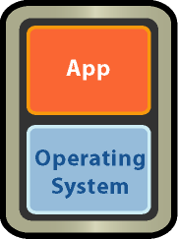
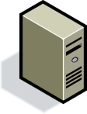
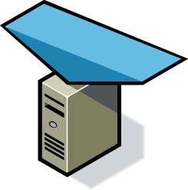
Server, Storage and Network Consolidation
Before
After
1,000 servers with DASD
200 racks
3000 network cables
400 power whips
50 servers with SAN and NAS
10 racks
300 network cables
20 power whips

Slide 41
Virtualization Delivers Tangible Business Outcomes
Reduction in Datacenter Capital Expense
Reduction in Datacenter Operating Expense
Reduction in Risk
$14,235
2.0-3.0
$30 MM
$5,694
0.3 – 1.0
$4 MM
Infrastructure Cost per App
Sys Admin per 100 Apps*
Business Loss Due to Datacenter Outage**
* Source: IDC and VMware TAM program
** Source: VMware customer – a $2bn insurance company. Estimates based on 40 hrs needed to recover before virtualizing and 4.5 hrs needed for the same recovery after virtualization.

Slide 42
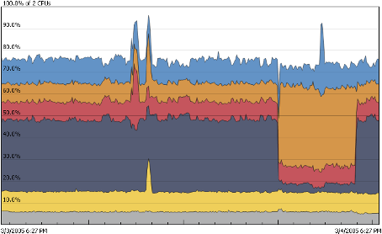
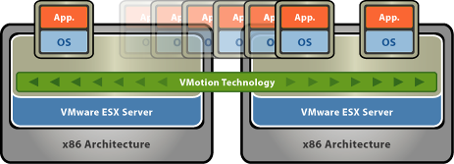



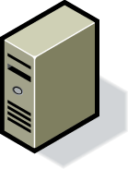

Virtualization Reduce Energy Consumption
Highest consolidation rates on most secure and reliable virtualization platform
Safely improve utilization rates
80% energy reduction
Dynamic server and storage migration
Power off unneeded servers in real-time
Migrate storage dynamically
25% energy reduction
Host desktop PCs in the datacenter
Use thin clients, double refresh cycle
Reduce storage for similar desktop images
70% energy reduction

Slide 43
What is Available Today
Hyper-V (Microsoft): A bare-metal hypervisor integrated into Windows Server and Windows, used for enterprise virtualization.
VMware vSphere (ESXi): A leading bare-metal hypervisor for enterprise environments, providing robust virtualization features.
KVM: A virtualization module for the Linux kernel, turning a standard Linux system into a hypervisor.
Xen: An open-source, bare-metal hypervisor used in various cloud environments and specialized systems.
Oracle VM Server: A bare-metal hypervisor from Oracle for virtualizing x86-based servers.
Nutanix AHV: A bare-metal hypervisor from Nutanix, used in its enterprise cloud platform.
Proxmox VE: An open-source, bare-metal virtualization platform that uses KVM and LXC to run VMs and containers.

