Slide 1
Chapter 1: Foundations of Human Resource Management
HRM 350
DeCenzo, Robbins & Verhulst (11th ed., Wiley, 2013)
Notes:
Introduce the course and explain that Chapter 1 lays the conceptual foundation of HRM. Emphasize its importance for understanding all subsequent chapters.

Slide 2
CLO–PLO Alignment (Chapter 1)
CLO-1 focuses on understanding the foundations, scope, and strategic importance of HRM.
Bloom’s Taxonomy Level: C2 – Understanding, emphasizing conceptual clarity.
Mapped to PLO-1 (Core Business Knowledge) for BBA graduates.
Chapter 1 develops essential HR vocabulary and strategic perspective.
Notes:
Explain CLOs and PLOs briefly so students understand learning expectations. Highlight that this chapter builds core business understanding rather than technical skills.

Slide 3
Introduction to Human Resource Management
Human Resource Management (HRM) is the managerial process of effectively utilizing people at work.
It involves attracting, developing, motivating, and retaining employees in organizations.
Modern HRM views employees as human capital and strategic assets.
The goal of HRM is to align employee performance with organizational objectives.
Notes:
Explain HRM as both a philosophy and a set of practices. Clarify how managing people differs from managing other organizational resources.

Slide 4
Evolution of Human Resource Management
Personnel Management emphasized administrative tasks such as payroll and record keeping.
The Human Relations approach highlighted employee motivation, morale, and social needs.
Human Resource Management introduced systematic training and performance management.
Strategic HRM integrates HR policies with organizational strategy and long-term goals.
Notes:
Walk students through each stage of evolution with examples. Stress why modern organizations need strategic HRM rather than traditional personnel management.

Slide 5
Scope of Human Resource Management
Human resource planning ensures availability of qualified employees for future needs.
Recruitment and selection focus on attracting and choosing the best candidates.
Training and development enhance employee skills, knowledge, and career growth.
Performance management and compensation motivate and retain employees.
Employee relations, ethics, and safety ensure a healthy work environment.
Notes:
Explain that HRM covers the entire employee lifecycle. Mention that each of these areas will be discussed in later chapters.

Slide 6
Strategic Importance of HRM
HRM aligns workforce capabilities with the organization’s mission and strategy.
Effective HR practices support innovation, quality, and productivity.
Human capital is difficult for competitors to imitate, creating competitive advantage.
Strategic HRM improves organizational performance and sustainability.
Notes:
Link HRM to business success and competitiveness. Give simple examples of how poor HR decisions can harm organizations.

Slide 7
Role of HR in Achieving Organizational Goals
HR ensures the organization has the right people with appropriate skills.
Training programs help employees contribute effectively to organizational objectives.
Performance appraisal and rewards encourage goal-oriented behavior.
HR builds organizational culture that supports commitment and teamwork.
Notes:
Explain how staffing, training, and rewards influence employee behavior. Relate HR decisions directly to organizational goal achievement.

Slide 8
HR Activities — Employee Lifecycle
Prepare job analyses & job descriptions
Attract applicants; select and hire
Orient, train, and develop employees
Evaluate performance and reward
Manage exits and retain institutional knowledge
Notes:
Frame HR work as lifecycle supporting employees from entry to exit.

Slide 9
HRM in Post-COVID Workplaces
The COVID-19 pandemic accelerated remote and hybrid work arrangements.
Employee health, safety, and mental well-being became HR priorities.
HR processes increasingly rely on digital platforms and virtual communication.
Post-COVID HRM emphasizes flexibility, resilience, and crisis preparedness.
Notes:
Discuss long-term changes caused by COVID-19. Highlight the expanding role of HR in employee well-being and work design.

Slide 10
Global Case Example: Strategic HRM
Google uses people analytics to enhance hiring quality and employee engagement.
Unilever aligns leadership development with long-term strategic objectives.
These organizations show how HRM contributes to innovation and competitiveness.
Notes:
Use global examples to show practical application of HRM concepts. Encourage students to think critically about HR practices in global firms.

Slide 11
Pakistan Case Example: HRM in Practice
Engro Corporation invests in leadership development and talent management.
HBL uses digital HR systems and performance-based management.
Pakistani organizations increasingly recognize HR as a strategic function.
Notes:
Relate HRM theory to the Pakistani context. Ask students for local examples from organizations they know.

Slide 12
Legal & Ethical Environment
Employment laws shape hiring, pay, and workplace practices
Common areas: anti-discrimination, wages/hours, safety, privacy
Ethical obligations: fairness, confidentiality, transparency
Notes:
Give examples: anti-discrimination laws, OSHA-type safety rules, ethical dilemmas in layoffs.

Slide 13
Diversity & Globalization
Workforce diversity: age, gender, ethnicity, abilities, cultures
Globalization expands talent pools and cross-cultural challenges
Inclusive practices improve performance and innovation
Notes:
Mention cultural competence, expatriate management, and diversity initiatives.

Slide 14
Technology & HRIS
HRIS for data management: recruitment, payroll, performance
Analytics and HR metrics enable data-driven decisions
Automation and AI affect recruiting, training, and forecasting
Notes:
Caution: ethical use of AI, biases in algorithms.

Slide 15
Chapter 1 – Key Takeaways
HRM is a foundational and strategic function in modern organizations.
The evolution of HRM reflects economic, technological, and social change.
Effective HRM directly supports organizational goals and performance.
Post-COVID realities require flexible, digital, and people-centered HR practices.
Notes:
Summarize the chapter and reinforce its relevance for the entire course. Prepare students for the next unit on human resource planning.

Slide 16


Slide 17
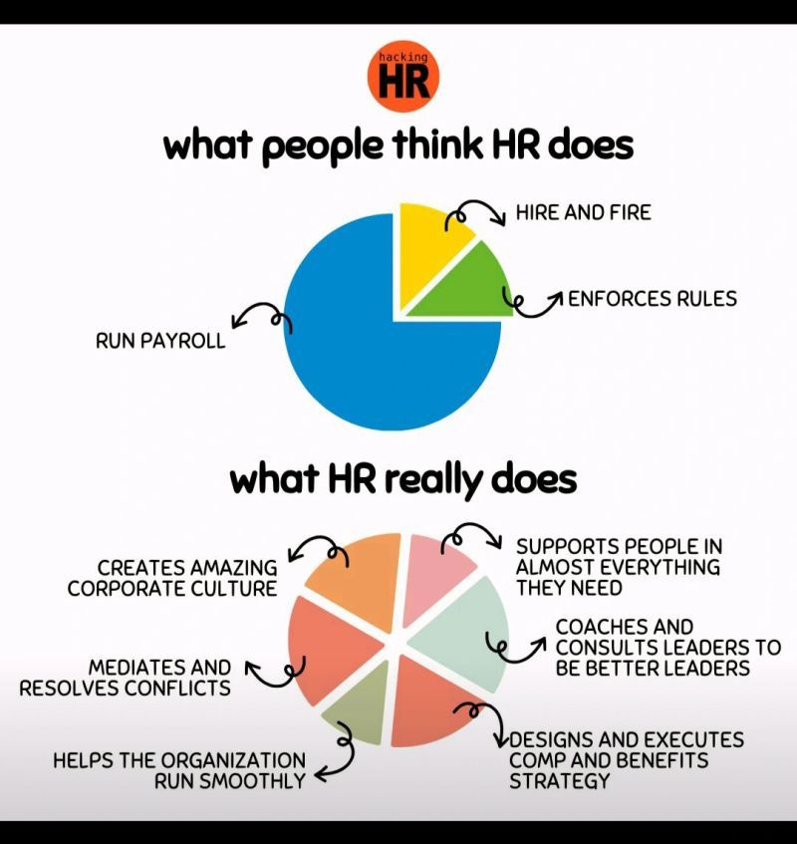

Slide 18
Short HR Story: Hiring Fast, Failing Faster
A startup hired 200 people rapidly without job analysis or onboarding.
Within a year, high turnover and low productivity hurt performance.
The failure was not technology—but weak HR foundations.
Notes:
Tell this story verbally. Pause and ask: Was this a business failure or an HR failure? Link back to Chapter 1 foundations and strategic HRM.

Slide 19
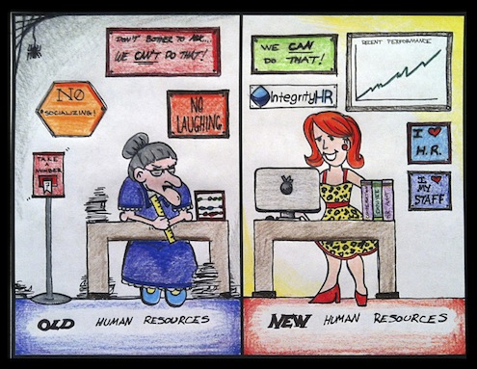

Slide 20
Visual Comparison: HR Then vs HR Now
Then: Personnel records, compliance, and routine administration.
Now: Talent strategy, analytics, culture, and employee experience.
Shift driven by globalization, technology, and post-COVID realities.
Notes:
Use icons or simple visuals: files vs people, clock vs graph. Ask students which model Pakistani firms mostly follow.

Slide 21
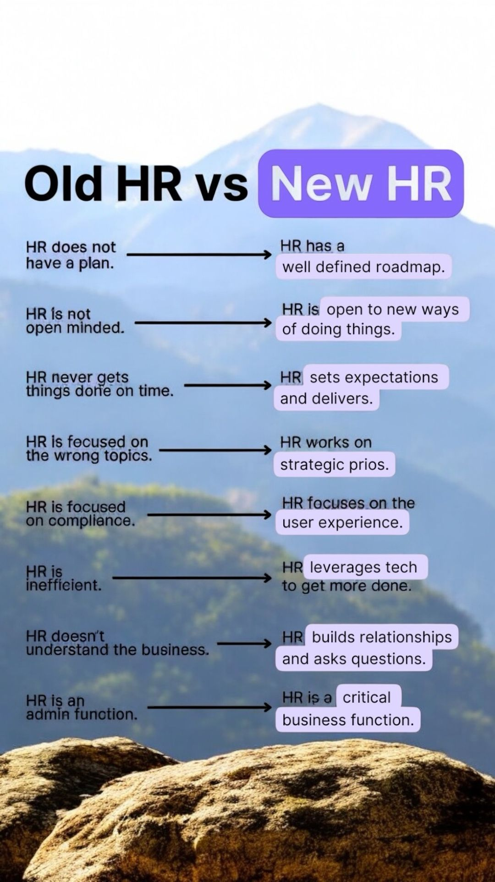

Slide 22
Contemporary HR Trends
Digital HR and HRIS improve efficiency and decision-making.
People analytics supports evidence-based HR decisions.
Diversity, equity, and inclusion promote fairness and innovation.
Flexible work arrangements and gig employment are increasingly common.
Notes:
Explain each trend briefly and relate it to modern organizations. Mention that these topics will be explored in detail in later units.

Slide 23
Emerging Trends & Challenges
Gig economy and flexible work arrangements
Remote work and hybrid models
Reskilling & continuous learning
Employee well-being and mental health focus
Notes:
Encourage discussion: how should HR adapt policies for hybrid work?

Slide 24
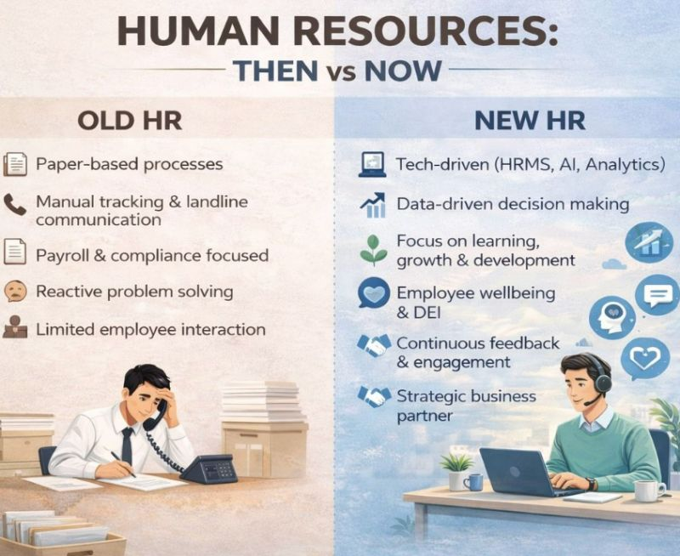

Slide 25
Class Activity: You Are the HR Manager
Scenario: Employees demand hybrid work; managers want full-time office work.
Question: What should HR recommend and why?
Link your answer to strategic HRM and post-COVID HR practices.
Notes:
Give students 2 minutes to discuss in pairs. Invite 2–3 responses and connect answers to CLO-1 concepts.

Slide 26
Pakistan Context Story: HR During COVID-19
Some firms reduced salaries abruptly; others communicated transparently.
Companies investing in employee well-being retained talent post-COVID.
HR decisions shaped trust, loyalty, and recovery.
Notes:
Encourage students to share examples they observed. Highlight HR’s ethical and strategic role.

Slide 27
Reflection Question (Closing)
If HR disappeared tomorrow, would organizations survive one year?
Is HR mainly for employees, management, or both?
How should HR add value in modern organizations?
Notes:
End the class with reflection instead of summary. Let students think before responding.

Slide 28
HR Meme Break 😄
“Employees are our greatest asset”
💸 Training Budget: Rs. 0
➡ Why strategy must match HR actions
Notes:
Light moment. Use humor to reset attention, then link to strategic HRM.

