Slide 1


Slide 2
GROUP MEMBERS
MUHAMMAD AAMIR 16-NTU-1051
SAIM ALI 16-NTU-1075
MUSSARAT SHAH 16-NTU-1063

Slide 3
STUDENT COURSE REGISTERATION SYSTEM

Slide 4

INTRODUCTION
The STUDENT COURSE REGISTRATION SYSTEM is Dot Net Application which contains several modules as per university, school or other institute required for student
• Student
• Faculty
• Department
• Course

Slide 5
OBJECTIVES
The main objective of this project is that to maximum reduce the manual work and manage the information about Students, Courses, Faculty and Departments. The Project is totally built at administrative end and thus only the administrator is guaranteed the access.

Slide 6
FUNCTIONALITIES
Search Facilities (such as courses, teachers, registration etc.)
It tracks all the information of students, faculty, courses and departments
Show the description of the courses, teachers
Manage the information of course
Editing, Adding and Updating of records
Manage the information of registrations

Slide 7
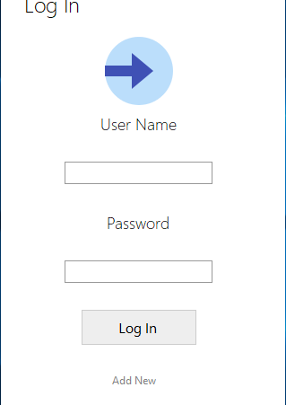
LOG IN FORM
If your User Name and Password exist then you enter into the text box otherwise go to the ADD NEW option to sign up yourself.

Slide 8
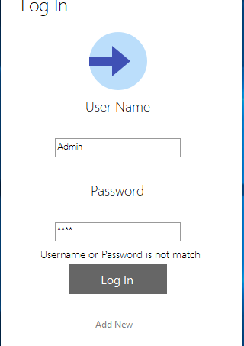
WRONG PASSWORD
When you entering the wrong password then it shows the message that your user name and password is not correct.

Slide 9
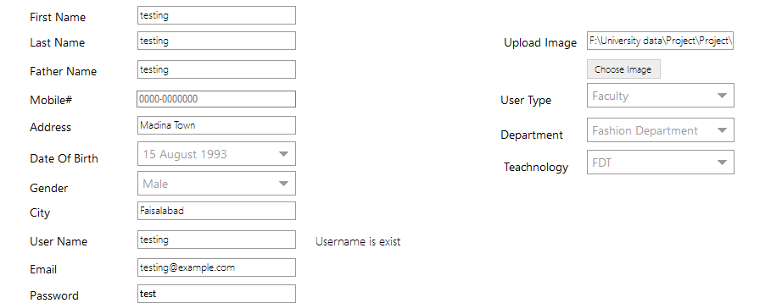
SIGN UP FORM FOR FACULTY
This is the signup form for the faculty. Enter the information and click the submit button. Then the message is show that you are successfully registered.

Slide 10
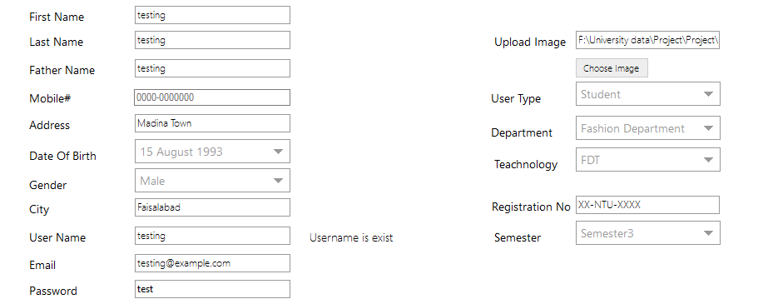
SIGN UP FORM FOR THE STUDENTS
The student carefully enter your information in the form and click the submit button then he is successfully registered.

Slide 11
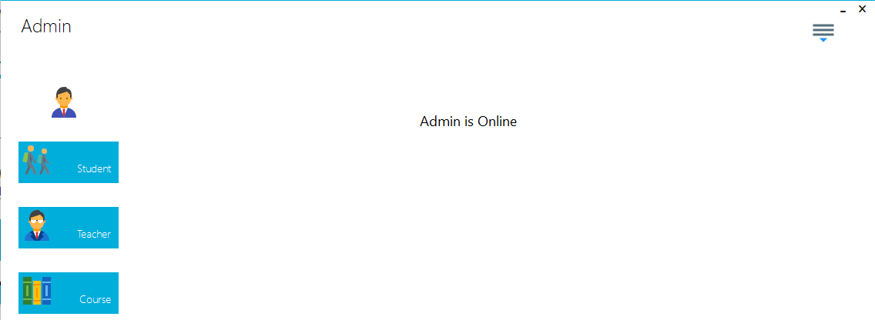
ADMIN MAIN MENU
The main menu of Admin contains the information of all students, teachers and courses. It also has a drop down menu to logout or reset your password.

Slide 12
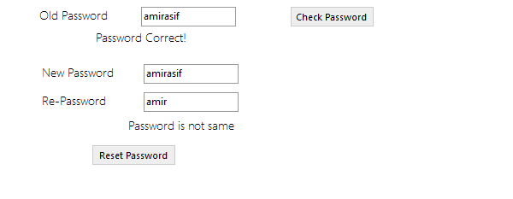
PASSWORD RESET
To reset the password first you open the Admin main menu. Click on the dropdown button and select the password reset. There you give your previous password and then enter your new password.

Slide 13
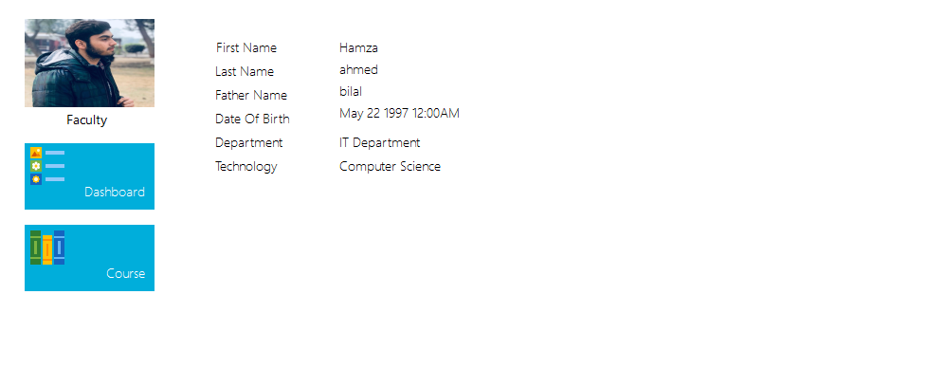
TEACHER DATA TABLE
When the teacher log in then the teacher data table will open as given above.

Slide 14
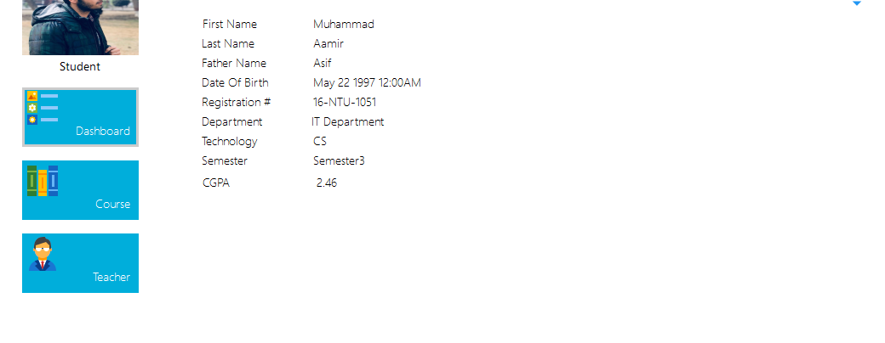
STUDENT DATA TABLE
When the Student log in then the Student data table will open as given above.

Slide 15
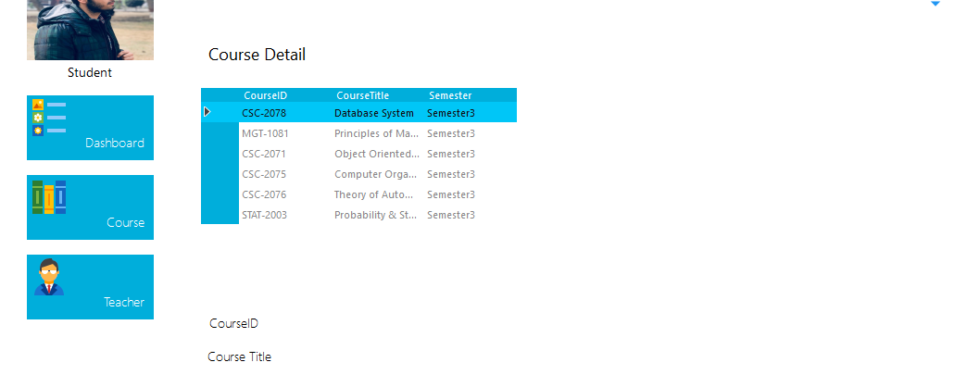
STUDENT COURSE DETAIL
STUDENT COURSE DETAIL
In student data table when you enter on the course button then student courses detail will display on the screen as given above.
In student data table when you enter on the course button then student courses detail will display on the screen as given above.

Slide 16
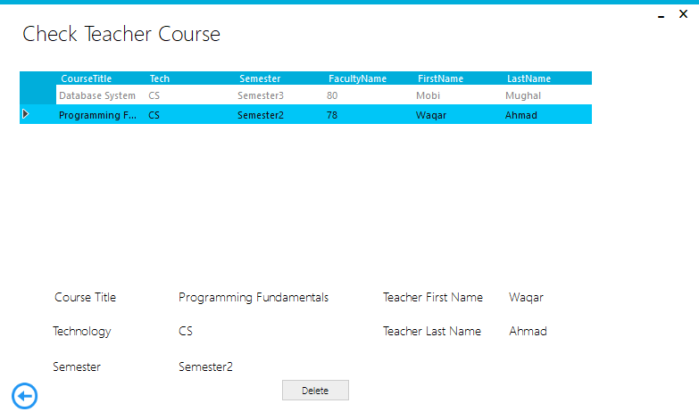
TEACHER COURSE DETAIL
In teacher data table when you enter on the course button then teacher courses detail will display on the screen as given above.

Slide 17
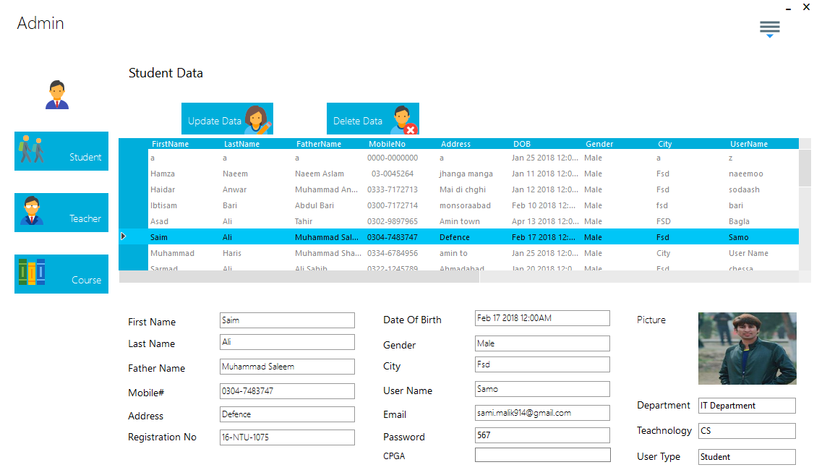
ADMIN STUDENT DATA
Admin has data of all students of different departments.

Slide 18
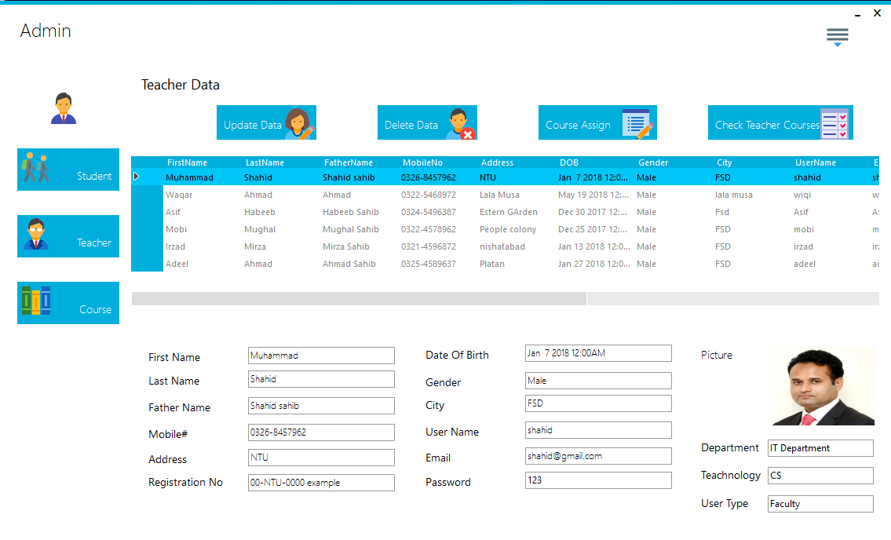
ADMIN TEACHER DATA
Admin has data of all teachers of different departments.

Slide 19
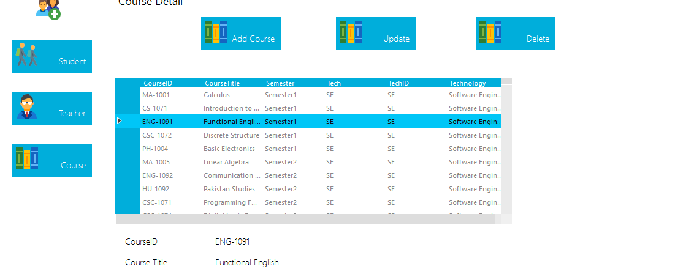
ADMIN COURSE DATA
Admin has data of all courses of different departments.

Slide 20
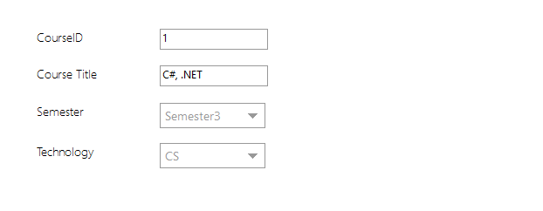
ADMIN ADDING NEW COURSE
Admin can add the new course. For adding the new course the following info is required as given above in the form.

Slide 21
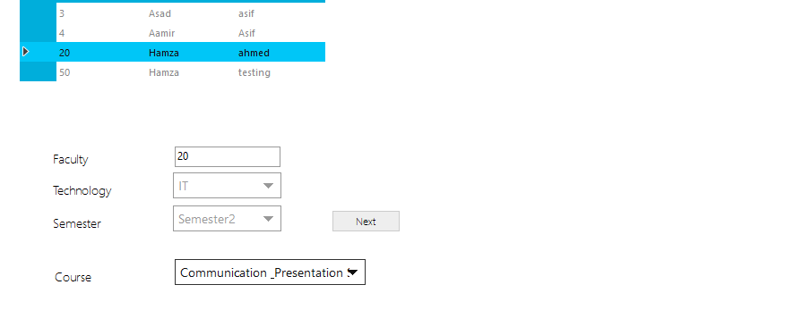
ADMIN ASSIGNING THE COURSE
Admin has data of all teachers of different departments.

Slide 22
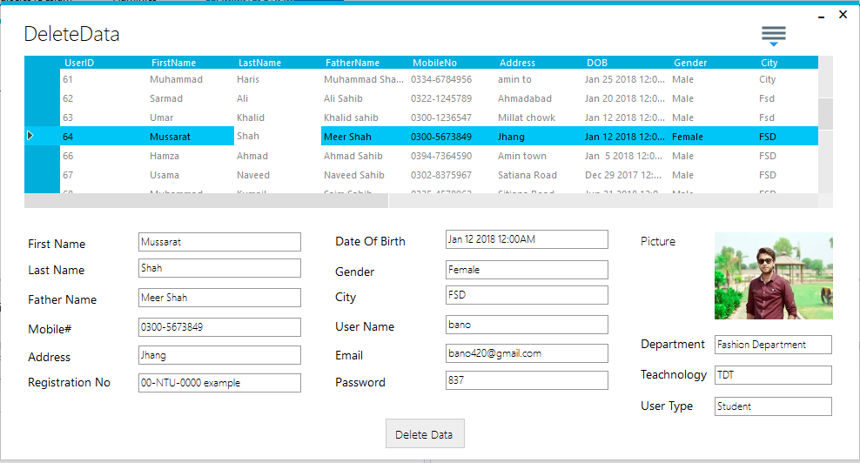
ADMIN DELETE STUDENT
If the Admin wants to delete any Student then in student menu he will enter the delete button and will give the info of that student. And press the delete button the student info will has been successfully deleted.

Slide 23
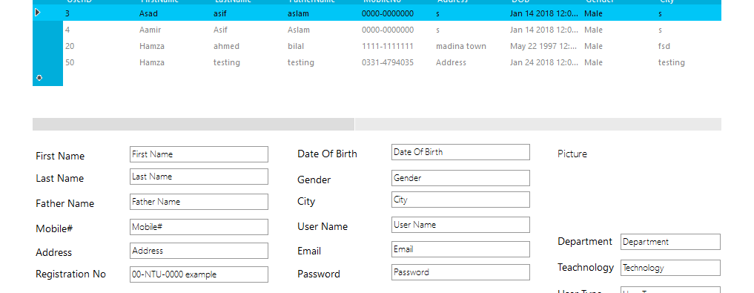
ADMIN DELETE TEACHER
If the Admin wants to delete any teacher info then in teacher menu he will enter the delete button and will give the info of that teacher. And press the delete button the teacher info will has been successfully deleted.

Slide 24
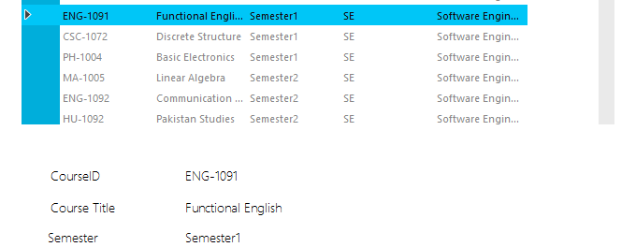
ADMIN DELETE COURSE
If the Admin wants to delete any course info then in course menu he will enter the delete button and will give the info of that course. And press the delete button the course info will has been successfully deleted.

Slide 25
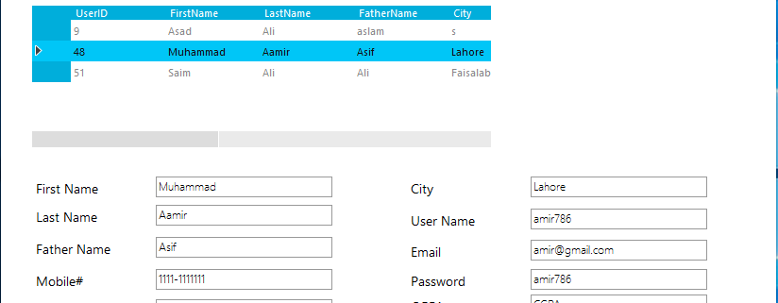
ADMIN UPDATE STUDENT
If the Admin wants to update any Student info then in student menu he will enter the update button and will give the info of that student. And press the update button the student info will has been successfully updated.

Slide 26
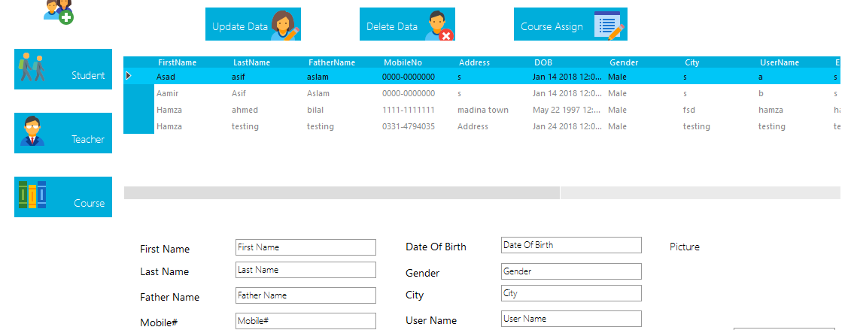
ADMIN UPDATE TEACHER
If the Admin wants to update any teacher info then in Teacher menu he will enter the update button and will give the info of that teacher. And press the update button the teacher info will has been successfully updated.

Slide 27
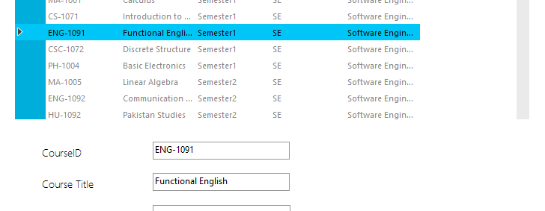
ADMIN UPDATE COURSE
If the Admin wants to update any course info then in course menu he will enter the update button and will give the info of that course. And press the update button the course info will has been successfully updated.

Slide 28


