Slide 1
SDA Semester Project
Group Members:
Section: B
FA17-BSE-014 Hafiz Muhammad Abdullah
FA17-BSE-116 Ali Javed
FA17-BSE-023 Haziq Majeed

Slide 2
Architecture recovery
Software architecture recovery is a set of methods for the extraction of architectural information from lower level representations of a software system, such as source code.
Architecture recovery is motivated by the fact that the systems do not often have an architectural documentation or it is out of synchronization with the implemented system.

Slide 3
Approaches
In object-oriented software, which employs a lot of polymorphism and dynamic binding mechanisms, dynamic analysis becomes an essential technique to comprehend the system behavior, object interactions, and hence to reconstruct its architecture.
Reverse engineering, the process of analyzing a subject system to identify the system's components and their interrelationships and to create representations of the system in another form or at a higher level of abstraction

Slide 4
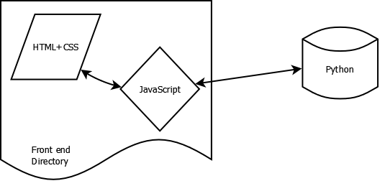
Design of our application

Slide 5
Design of our application
For Frontend we are using following technologies:
Html/ CSS
JavaScript
For Backend we are using following technologies:
Python
Python eel for connecting server-side to frontend
GraphViz & PyDot for plotting graphs

Slide 6
Design of our application
Key Features:
It can take single or multiple files as input for Python and Java programming language
It has an easy to use interface.
The code is developed to be very modular so extensibility and adding new programming languages is very easy
Without the hassle of making major changes
It tries to make a higher level visualization of the system. Similar to class diagram

Slide 7
Design of our application
The basic flow of the application:
We input the file/files
We check the extensions of files to determine which programming language file it is
We read the file line by line
We check for classes, methods/ functions and variables and their relations with classes
We maintain lists and draw graphs.
Finally, we display the results on the GUI interface.

Slide 8
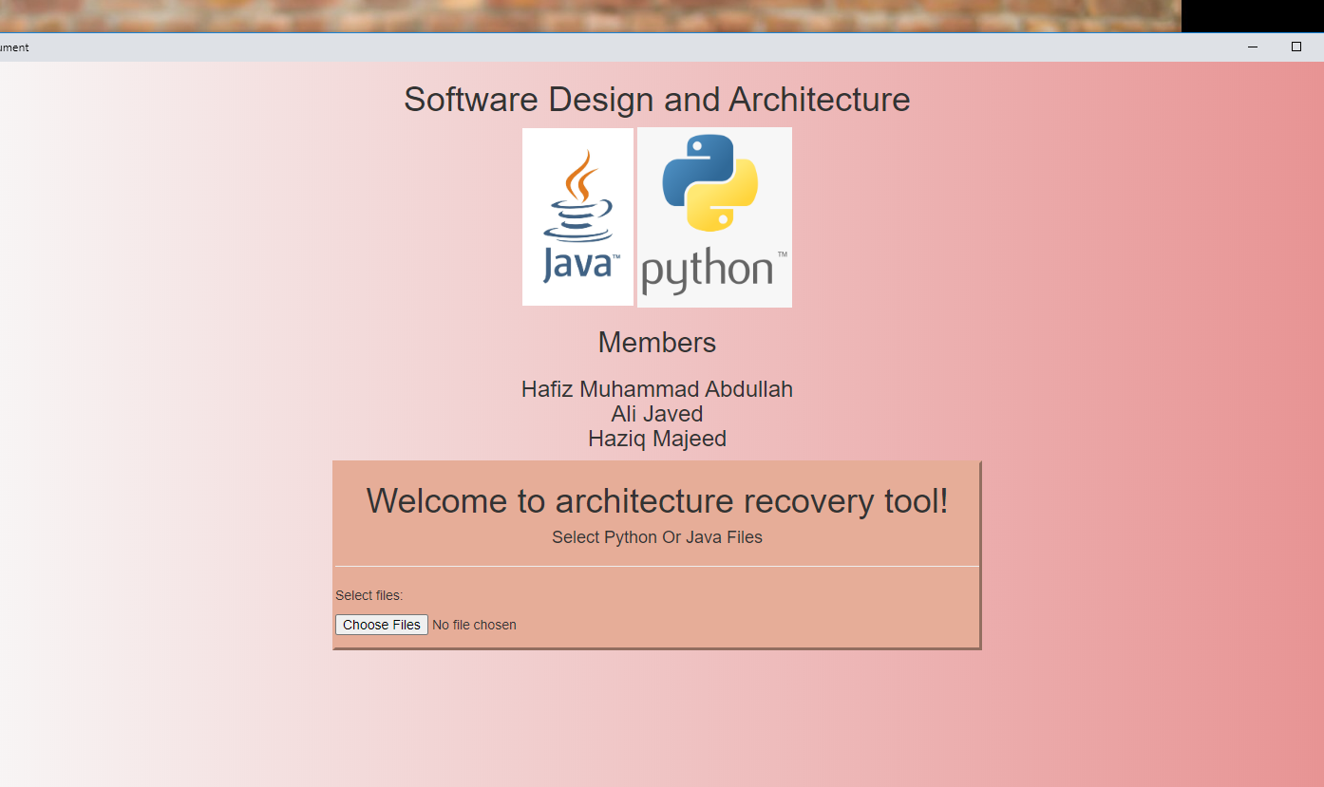
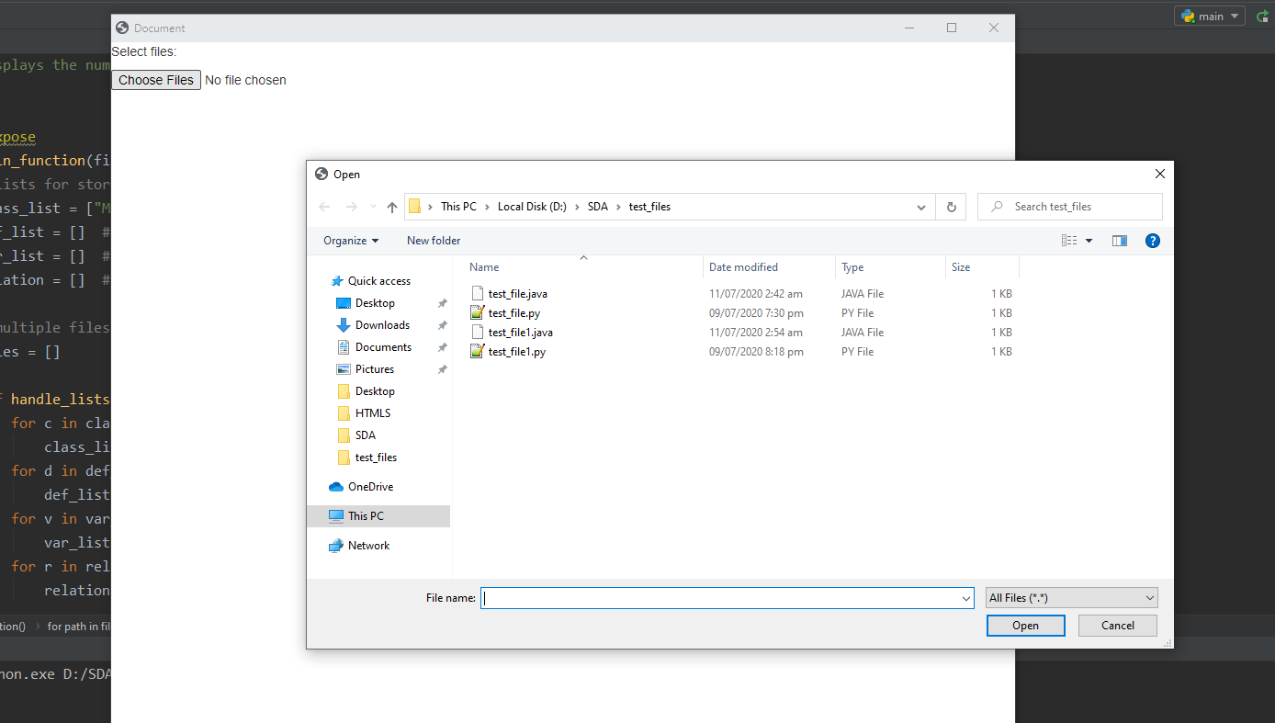

Slide 9
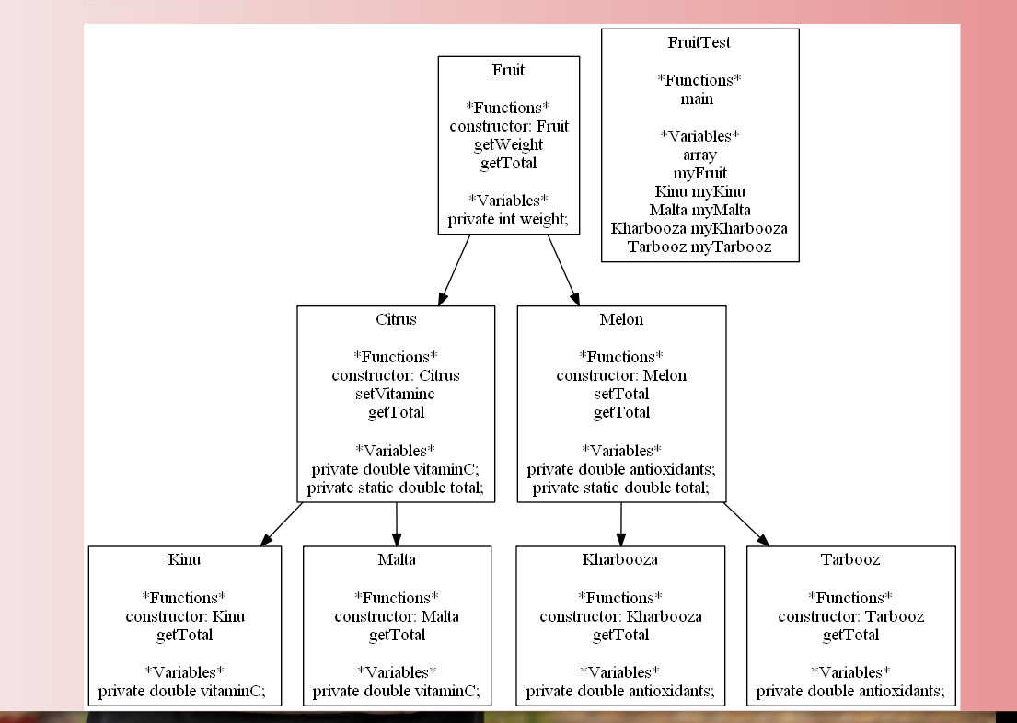
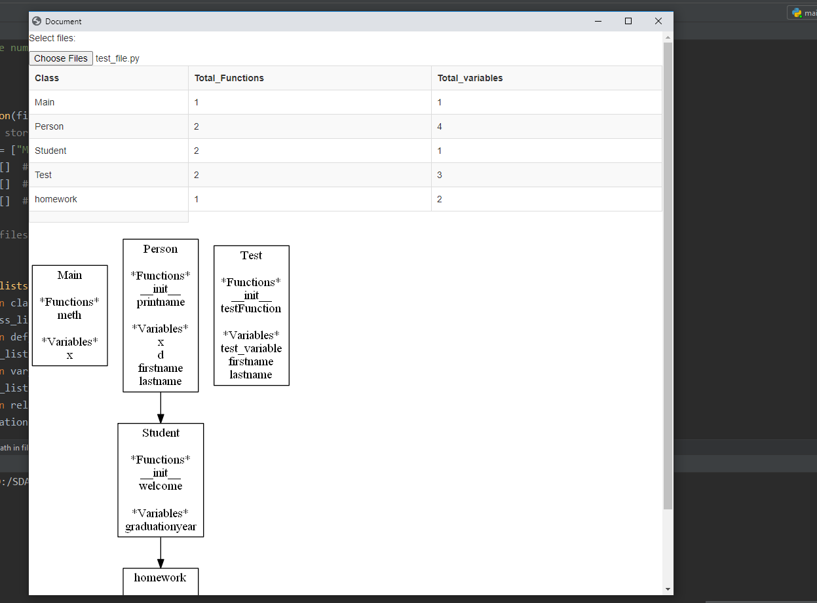

Slide 10
Thank YOU!

