Slide 1
Graph-Based Classification
2021-CS-82 Muhammad Abdullah

Slide 2
Agenda
Introduction
Objectives
Data Collection
Data Preparation
Graph Construction
KNN Classification
Challenges

Slide 3
Introduction
What is Document Classification?
Limitations of Traditional Models (TF-IDF, BoW)
Why Graphs?
Project Goal
Project Benefits

Slide 4
Objectives
- Data collection and preparation
- Graph construction
- Feature extraction via common subgraphs
- Classification with KNN
- Evaluation of classification performance

Slide 5
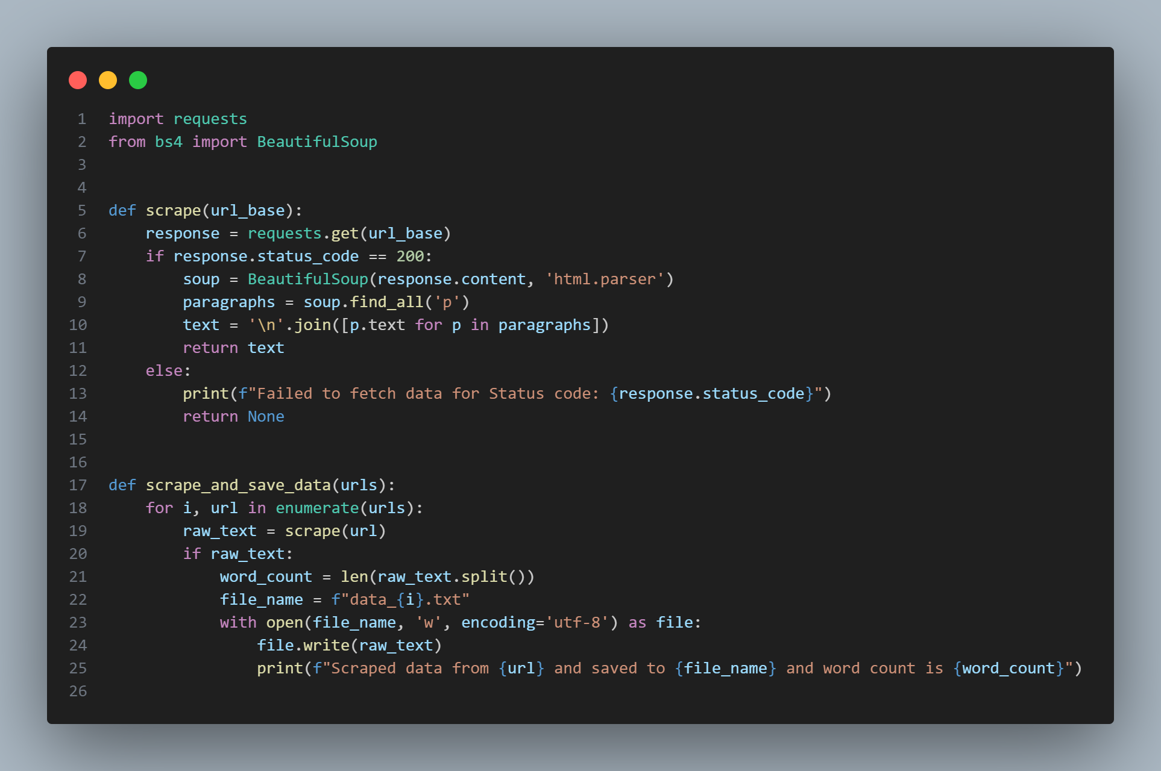
Data Collection
Data Collection Strategy
Targeted Topics: Travel, Fashion, Diseases (15 pages each, ~300 words/page)
Method: Web Scraping with Python Librariesrequests for fetching HTML content from URLsBeautifulSoup for parsing HTML and extracting text

Slide 6
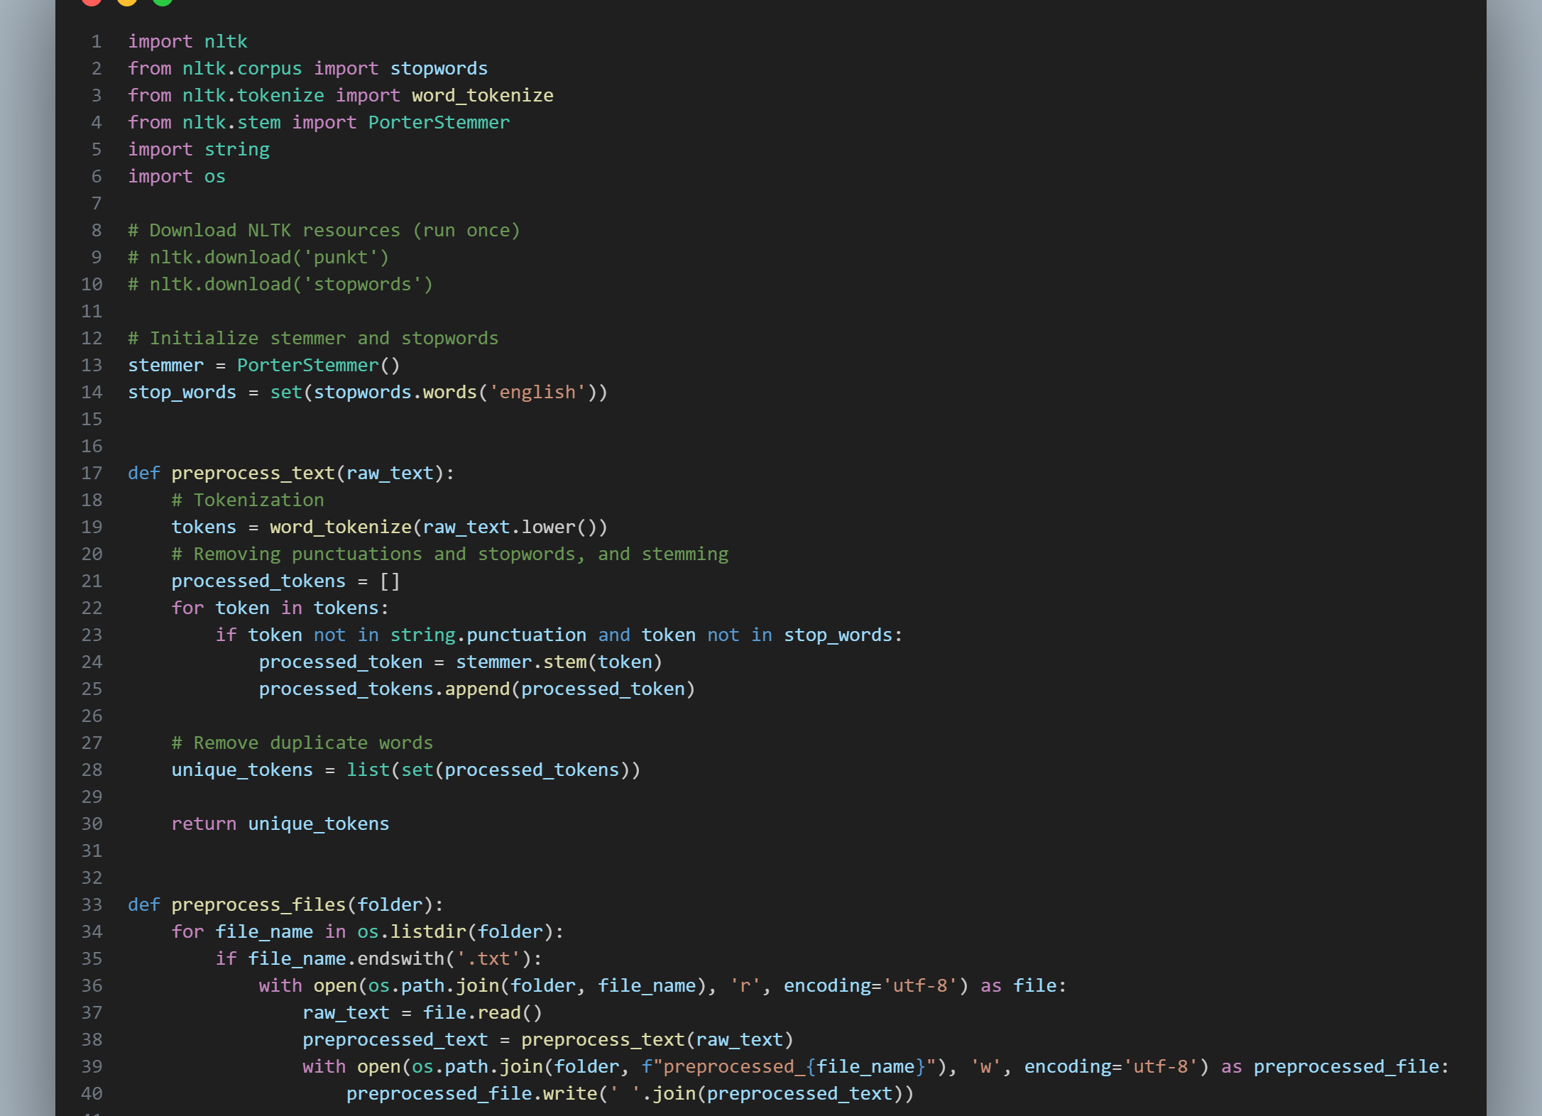
Data Preparation
- Tokenization: Breaking the text into individual words or tokens using the `nltk.tokenize.word_tokenize` function.
- Stopword Removal: Removing common stopwords (e.g., "the", "is", "and") using the `nltk.corpus.stopwords` module.
- Stemming: Reducing words to their root

Slide 7
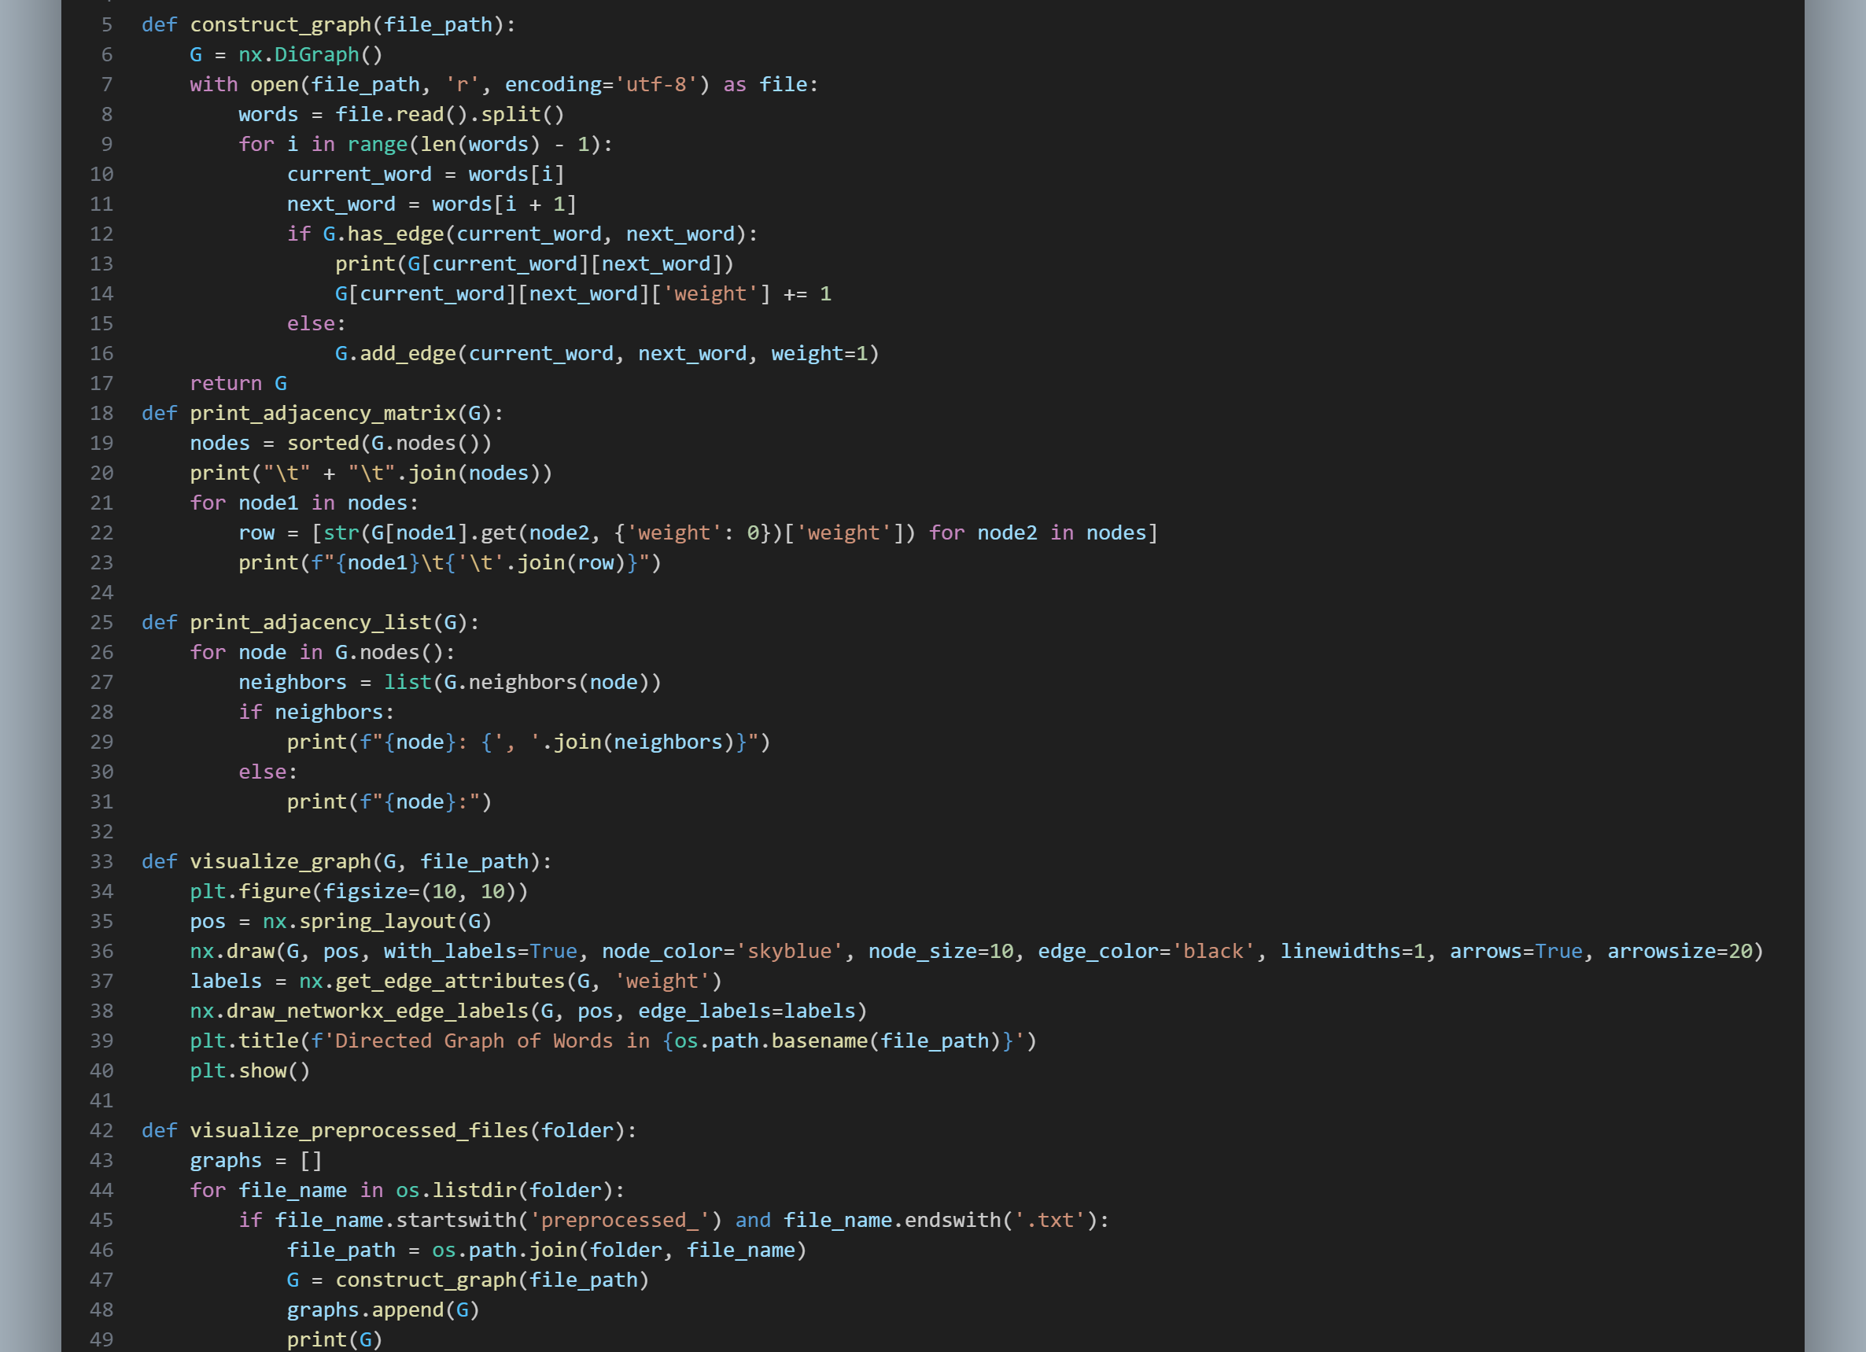
Graph Construction
- Reading the preprocessed text data from each document.
- Splitting the text into individual words to create nodes in the graph.
- Connecting adjacent words in the text with directed edges to represent the sequential order of terms.

Slide 8
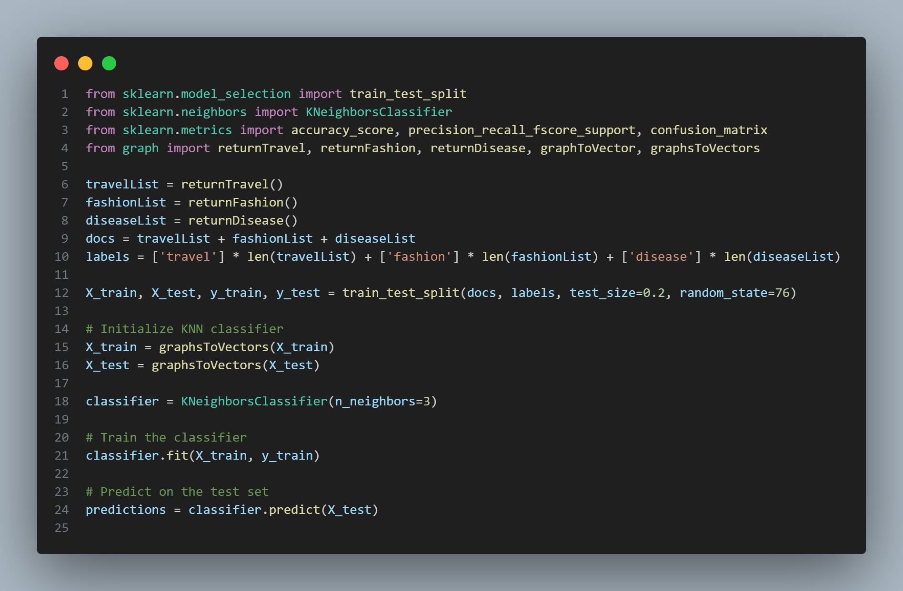
KNN Classification
1. Data Preprocessing
2. KNN Model Creation
3. Model Training
4. Prediction on Test Set
5. Evaluation

Slide 9
Results and Challenges
Balanced Dataset: Achieved 15 pages (~300 words/page) for each topic (travel, fashion, diseases).
Creative Approach: Utilized graph theory by representing documents as graphs and extracting common subgraphs, leading to a more nuanced understanding of document content.
Clear Methodology: Defined steps including data collection, preprocessing, graph representation, and feature extraction using common subgraphs.
Challenges Acknowledged: Potential difficulties like managing large data, data collection limitations, and finding maximum common subgraphs are recognized for future improvements.

Slide 10
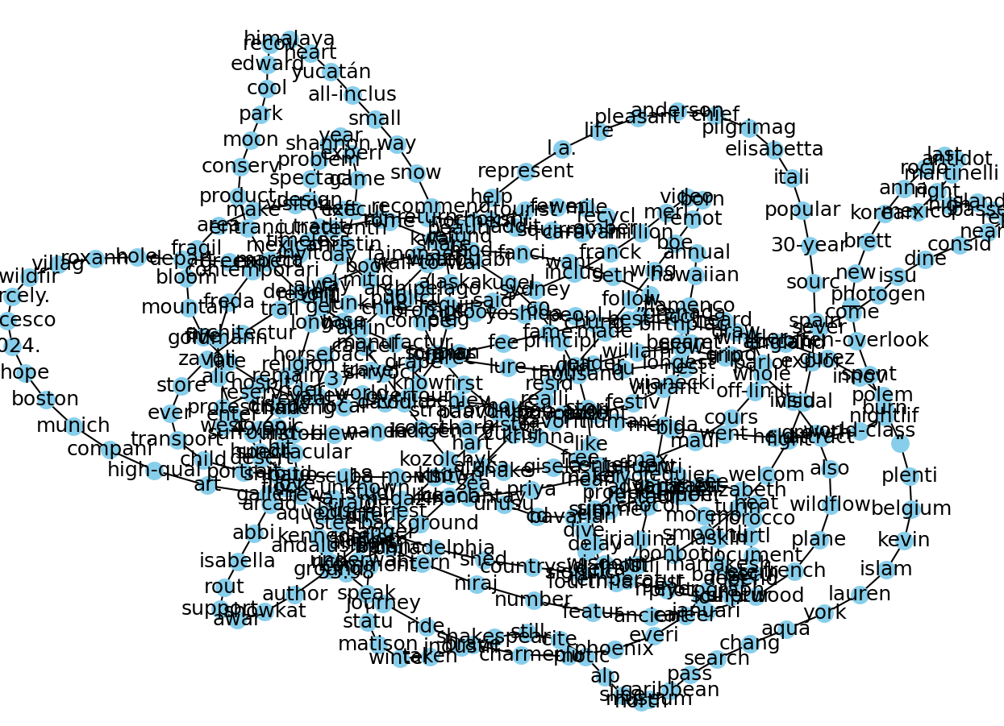
Graph Visualization

Slide 11
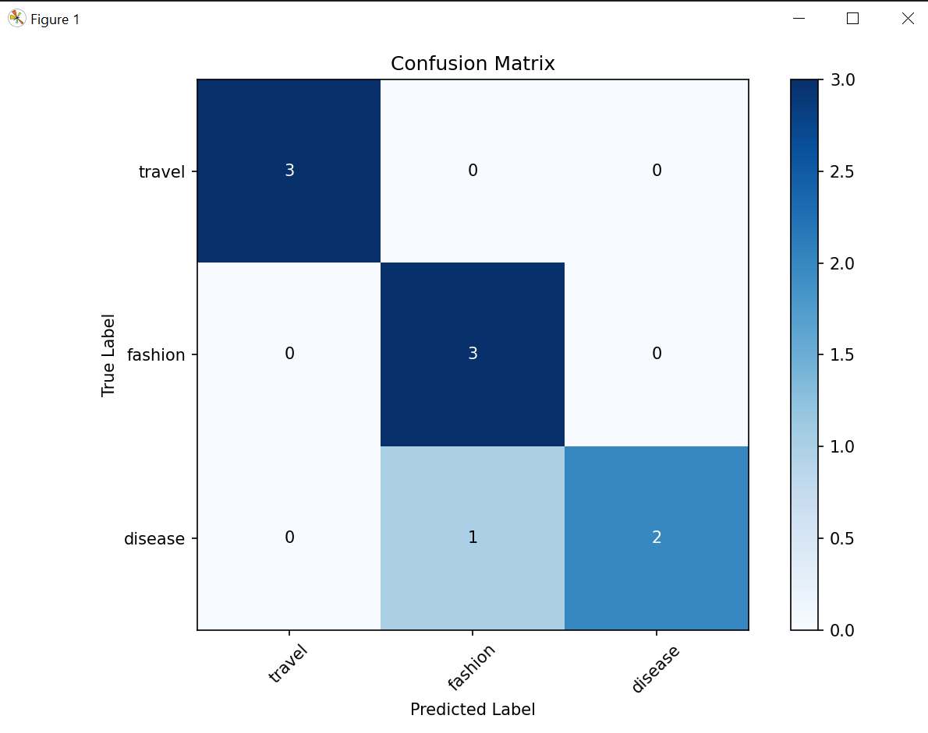
Confusion Matrix

Slide 12
THANK YOU
Muhammad Abdullah
92 303 7283993
muhammadabdullahtalib@gmail.com

