Slide 1
Graph-Based Classification
2021-CS-82 Muhammad Abdullah

Slide 2
Agenda
Introduction
Objectives
Data Collection
Data Preparation
Graph Construction
KNN Classification
Challenges

Slide 3
Introduction
What is Document Classification?
Limitations of Traditional Models (TF-IDF, BoW)
Why Graphs?
Project Goal
Project Benefits

Slide 4
Objectives
- Data collection and preparation
- Graph construction
- Feature extraction via common subgraphs
- Classification with KNN
- Evaluation of classification performance

Slide 5
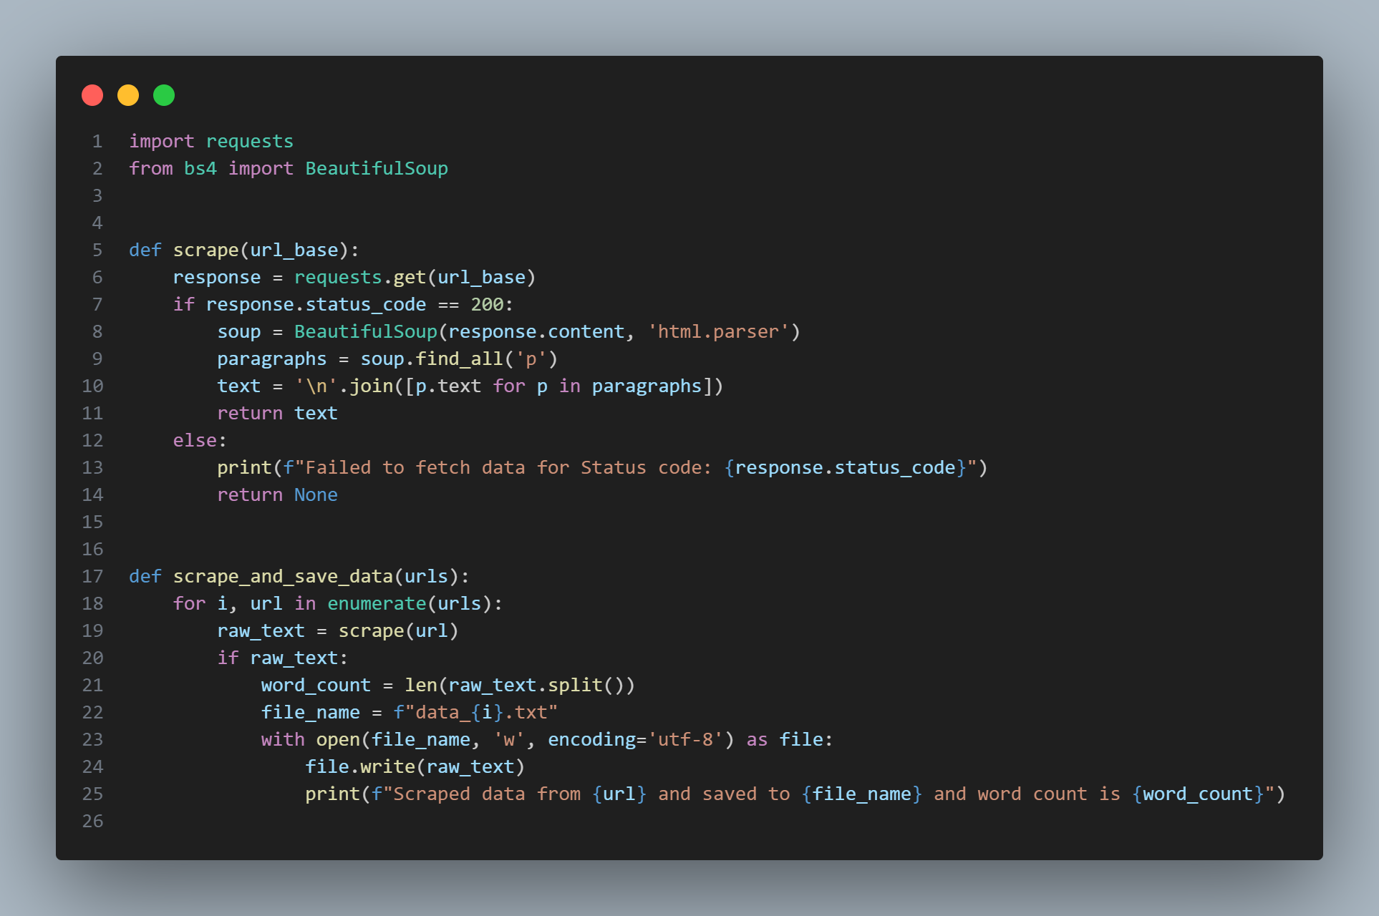
Data Collection
Data Collection Strategy
Targeted Topics: Travel, Fashion, Diseases (15 pages each, ~300 words/page)
Method: Web Scraping with Python Librariesrequests for fetching HTML content from URLsBeautifulSoup for parsing HTML and extracting text

Slide 6
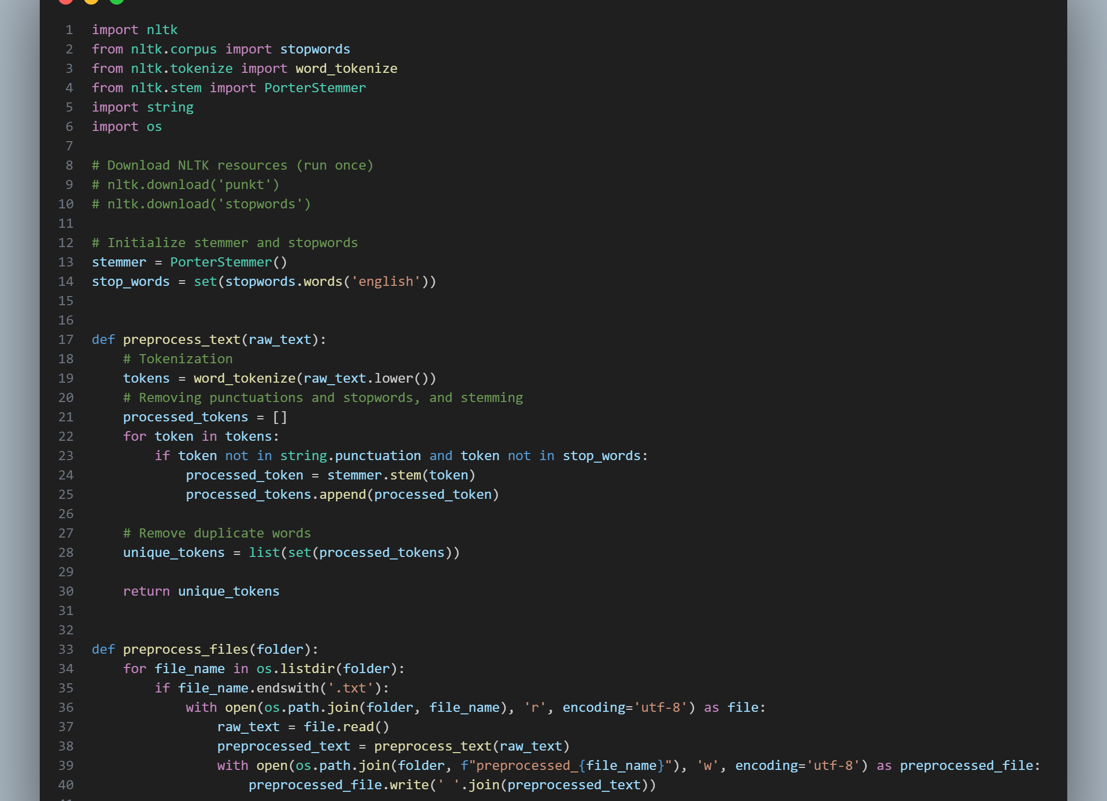
Data Preparation
- Tokenization: Breaking the text into individual words or tokens using the `nltk.tokenize.word_tokenize` function.
- Stopword Removal: Removing common stopwords (e.g., "the", "is", "and") using the `nltk.corpus.stopwords` module.
- Stemming: Reducing words to their root

Slide 7
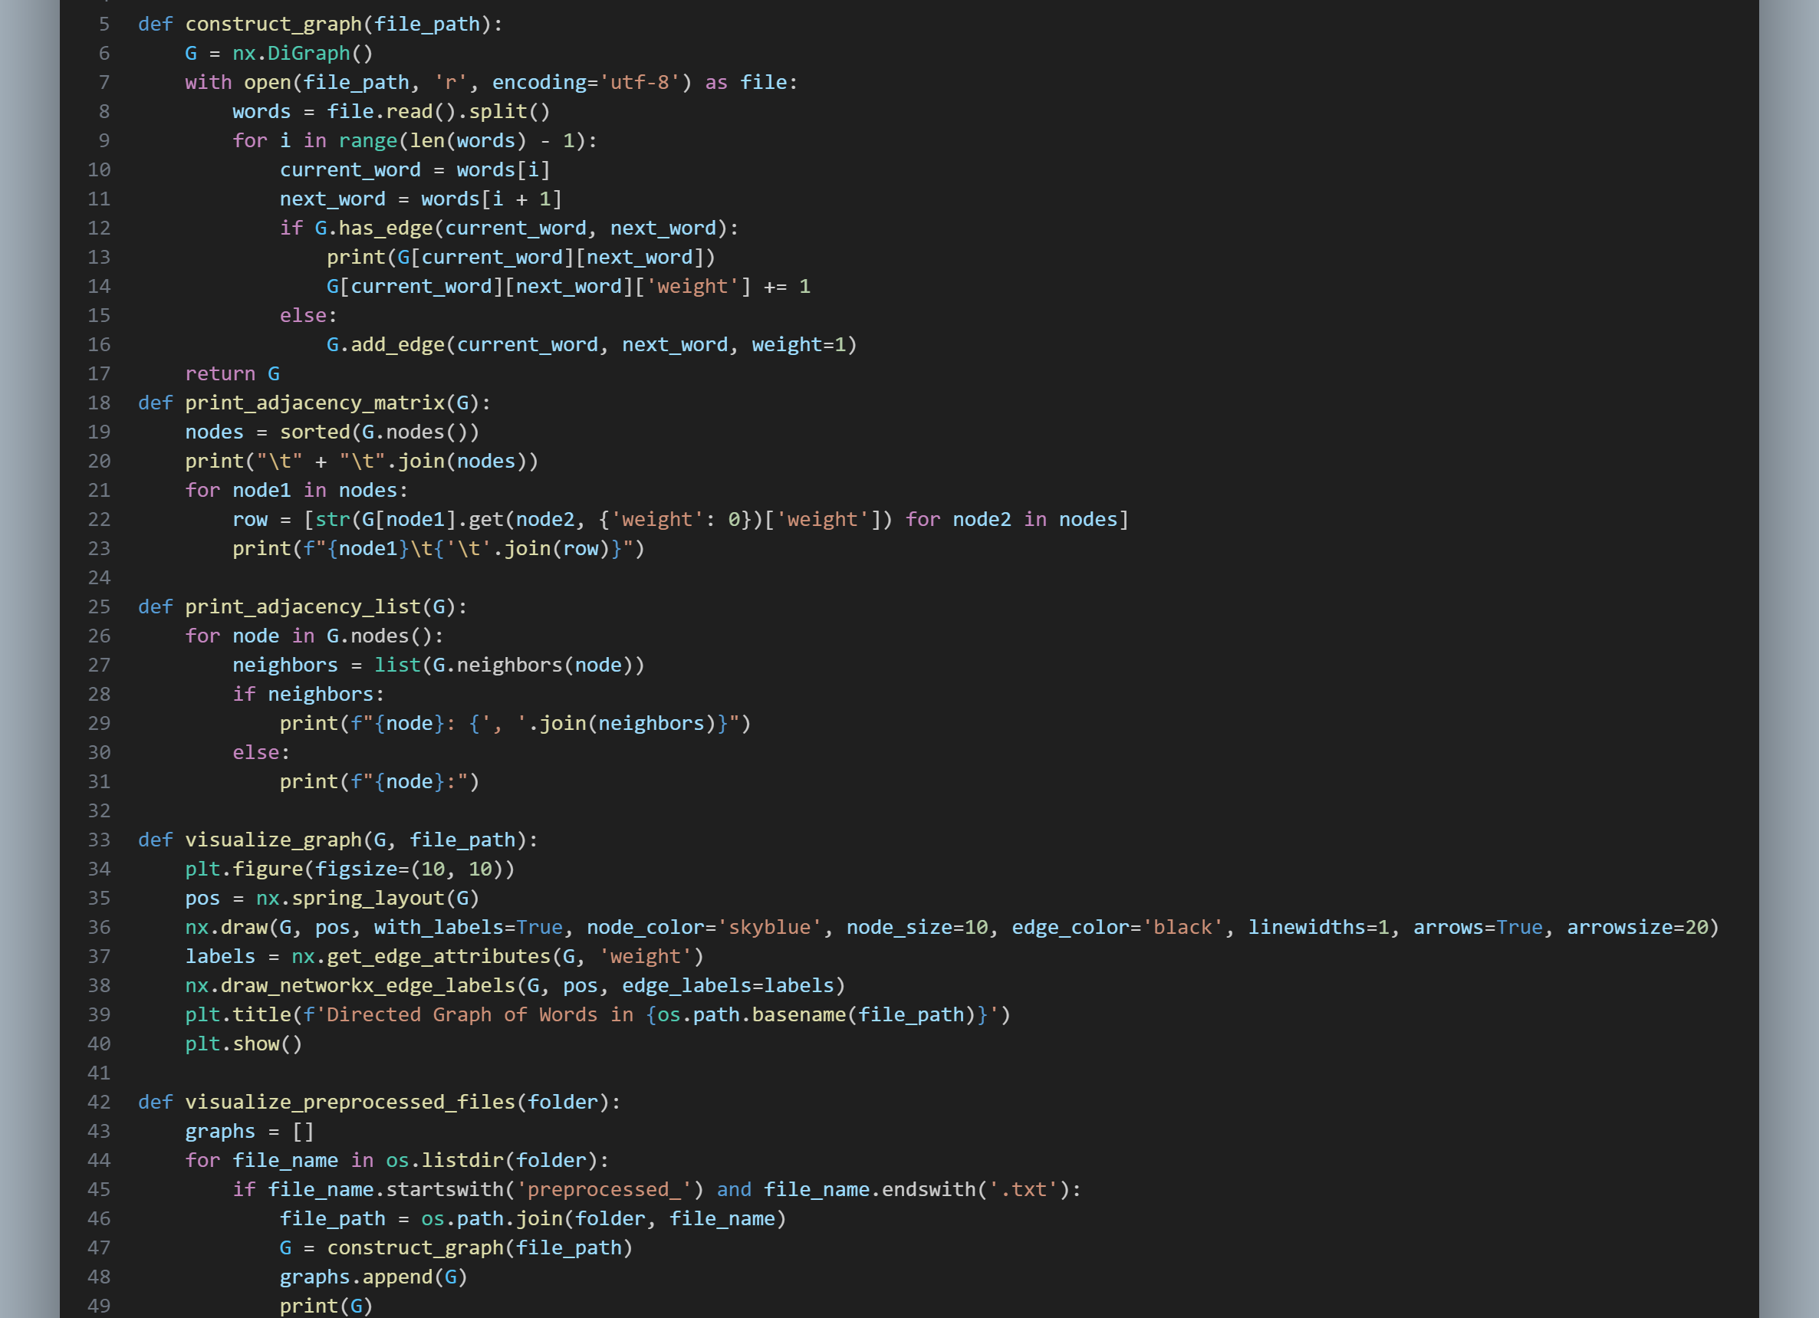
Graph Construction
- Reading the preprocessed text data from each document.
- Splitting the text into individual words to create nodes in the graph.
- Connecting adjacent words in the text with directed edges to represent the sequential order of terms.

Slide 8
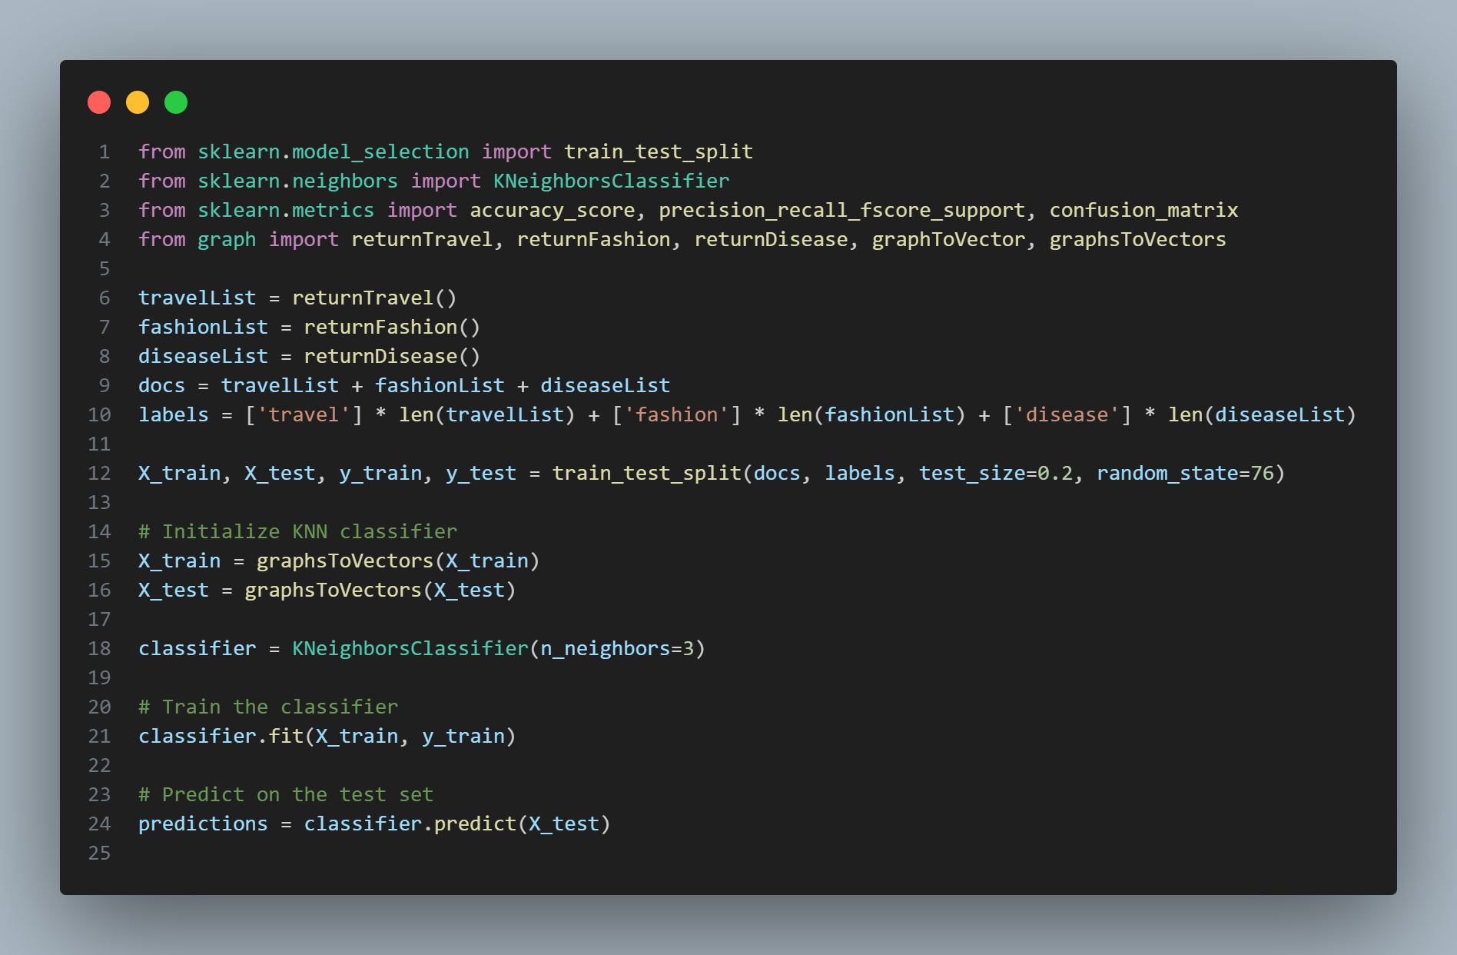
KNN Classification
1. Data Preprocessing
2. KNN Model Creation
3. Model Training
4. Prediction on Test Set
5. Evaluation

Slide 9
Results and Challenges
Balanced Dataset: Achieved 15 pages (~300 words/page) for each topic (travel, fashion, diseases).
Creative Approach: Utilized graph theory by representing documents as graphs and extracting common subgraphs, leading to a more nuanced understanding of document content.
Clear Methodology: Defined steps including data collection, preprocessing, graph representation, and feature extraction using common subgraphs.
Challenges Acknowledged: Potential difficulties like managing large data, data collection limitations, and finding maximum common subgraphs are recognized for future improvements.

Slide 10
THANK YOU
Muhammad Abdullah
92 303 7283993
muhammadabdullahtalib@gmail.com

