Slide 1
Face Emotion Detection
Using MobileNetV2
Student: Muhammad AbdurRehman Arif University:Government College University Faisalabad Department: BS Computer Science Session: 2022 – 2026
Industrial Development Project
AI & Computer Vision
Notes:
Title slide for FYP defense. Introduce yourself, your university, and give a brief overview of what this project is about — detecting human emotions in real-time using AI and deep learning.

Slide 2
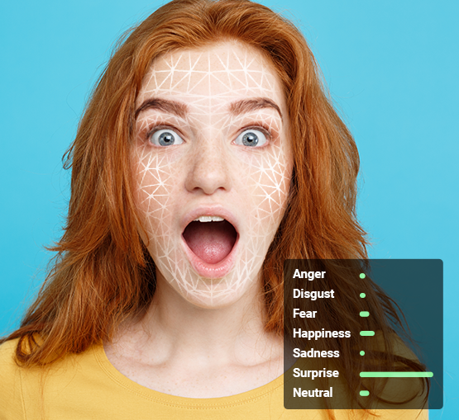
Introduction
What is Facial Emotion Detection?
Automatic recognition of human emotions from facial expressions using AI and computer vision techniques.
Why It Matters
Enables machines to understand human emotions, bridging the gap between human-computer interaction.
Core Technology
Deep learning with Convolutional Neural Networks (CNNs) trained to classify 7 distinct emotional states.
Real-World Impact
Applied in healthcare, education, security, autonomous driving, and human-robot interaction.
Notes:
Facial Emotion Detection uses deep learning to automatically identify emotions from face images. This technology has massive real-world applications and this project implements a lightweight, fast solution using MobileNetV2.

Slide 3
Problem Statement
Human Limitations
TRADITIONAL vs AI SYSTEM
Human Can make mistakes, Missing small emotions
TRADITIONAL
AI SYSTEM
Manual
Automatic
Slow Processing
More Waiting time, Delayed Results, Low efficiency, poor user experience
Fixed
Adaptive
VS
Slow
Fast
Lack of Model weights
Limited
Intelligent
Low Accuracy, Poor Predictions, Weak Performance, Training Issues
Rule-Based
Learning -Based
Lack of Automation
Manual work needed , More human effort , Time Consuming
Notes:
Manual emotion analysis has several critical limitations — it is subjective, slow, and cannot scale. AI-powered systems like ours solve these problems by providing fast, consistent, and automated emotion detection.

Slide 4
Project Objectives
01
7-Emotion Detection
02
Real-Time Prediction
03
Lightweight Model
Detect Angry, Disgust, Fear, Happy, Sad, Surprise & Neutral in real-time
Process and predict emotions at 18ms per frame inference time
Deploy a compact 15MB MobileNetV2 model on standard hardware
04
Flask REST API
05
Web Application
06
78% Accuracy
Expose model predictions via a robust, scalable REST API backend
Build a modern React.js frontend for real-time webcam emotion detection
Achieve competitive accuracy on the FER2013 benchmark dataset
Notes:
The project has 6 core objectives: detecting all 7 emotions, real-time inference, a lightweight model, a Flask API backend, a React web interface, and achieving 78% accuracy on the FER2013 dataset.

Slide 5
Literature Review
CNN Architecture Evolution
MobileNetV2
ResNet
Mini-Xception
VGG16
2016
2017
2015
2018
Acc: ~67%
Size: 240MB
Acc: ~72.5%
Size: 528MB
Acc: ~70%
Size: 102MB
Acc: ~78%
Size: 15MB
Existing Research Comparison
Research / Model | Approach | Accuracy | Limitation
Li et al. (2020) | VGG-16 | 74.6% | Large model, slow
Wang et al. (2021) | ResNet-50 | 76.1% | High memory usage
Kim et al. (2022) | EfficientNet | 77.3% | Complex training
Ours — MobileNetV2 | Transfer Learning | 78% | Lightweight ✓
Notes:
Literature review shows a progression of CNN models from AlexNet to MobileNetV2. Our solution outperforms heavier models while being significantly smaller and faster — ideal for real-time deployment.

Slide 6
Proposed System
Camera
Input
Face
Detection
Image
Preprocess
MobileNetV2
Model
Emotion
Prediction
1
2
3
4
5
Face Detection
Preprocessing
Feature Extraction
Classification
OpenCV Haar Cascade detects and crops face regions with bounding boxes
Resize to 48x48px, grayscale conversion, pixel normalization [0,1]
MobileNetV2 depthwise separable convolutions extract rich feature maps
Softmax output layer predicts probability distribution over 7 emotions
Notes:
The proposed pipeline takes a camera input, detects faces using OpenCV, preprocesses the image, runs it through MobileNetV2, and outputs the emotion prediction in real-time at 18ms per face.

Slide 7
System Architecture
FRONTEND LAYER
BACKEND LAYER
AI MODEL LAYER
React.js Application
Flask REST API
TensorFlow / MobileNetV2
Webcam Interface
API Endpoints
Model Loading
Image Upload
HTTP/JSON
Request Processing
HTTP/JSON
Preprocessing
Emotion Display
Response Formatting
Inference Engine
Results Dashboard
Authentication
Prediction Output
Port: 3000
Port: 5000
TF 2.20 / Python 3.10
🗄️ DATA LAYER — SQLite Database | User Sessions | Emotion Logs | Analytics Storage
Notes:
Three-tier architecture: React frontend communicates via HTTP/JSON with Flask backend, which loads and runs the TensorFlow MobileNetV2 model. SQLite handles persistent data storage.

Slide 8
Dataset: FER2013
35,887
48×48
7
Grayscale
Total Images
Pixel Size
Emotion Classes
Color Mode
Emotion Class Breakdown
Emotion | Images | %
Happy | 8,989 | 25.1%
Neutral | 6,198 | 17.3%
Sad | 6,077 | 16.9%
Fear | 5,121 | 14.3%
Angry | 4,953 | 13.8%
Surprise | 4,002 | 11.2%
Disgust | 547 | 1.5%
Notes:
FER2013 is the industry-standard dataset with 35,887 grayscale 48x48 images across 7 emotion classes. Note the class imbalance — Happy has the most images while Disgust is significantly underrepresented.

Slide 9
Image Preprocessing Pipeline
1
2
3
4
Face Detection
Grayscale Convert
Resize to 48×48
Normalize [0,1]
OpenCV Haar Cascade locates face region and extracts bounding box
Convert RGB image to grayscale to match FER2013 training format
Standardize all face images to 48×48 pixels for model input
Scale pixel values from [0,255] to [0,1] for faster convergence
cv2.CascadeClassifier()
detectMultiScale()
cv2.cvtColor(img,
COLOR_BGR2GRAY)
cv2.resize(face,
(48, 48))
img_array / 255.0
Data Augmentation Techniques
↔
↻
⇔
⇕
⊕
Horizontal Flip
Random Rotation ±10°
Width Shift ±10%
Height Shift ±10%
Zoom Range 10%
Notes:
Preprocessing is critical for model performance. We detect faces, convert to grayscale, resize to 48x48, and normalize pixel values. Data augmentation helps prevent overfitting by artificially expanding the training set.

Slide 10
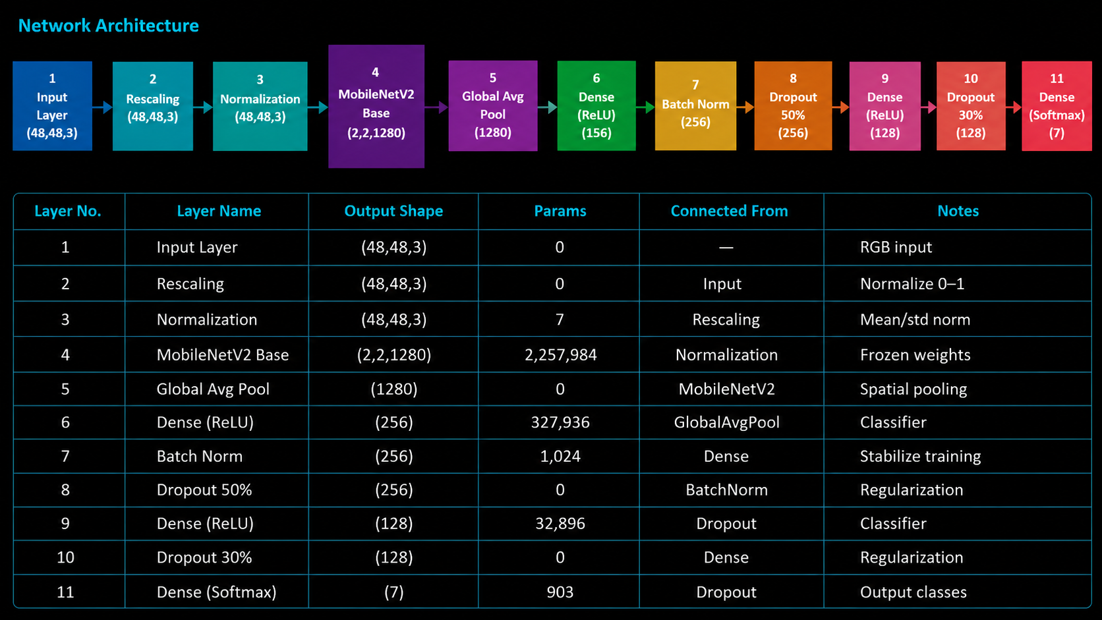
MobileNetV2 Architecture
Network Architecture
Notes:
MobileNetV2 uses depthwise separable convolutions to achieve 8-9x fewer computations than standard CNNs. Transfer learning from ImageNet significantly boosts performance even with the limited FER2013 dataset.

Slide 11
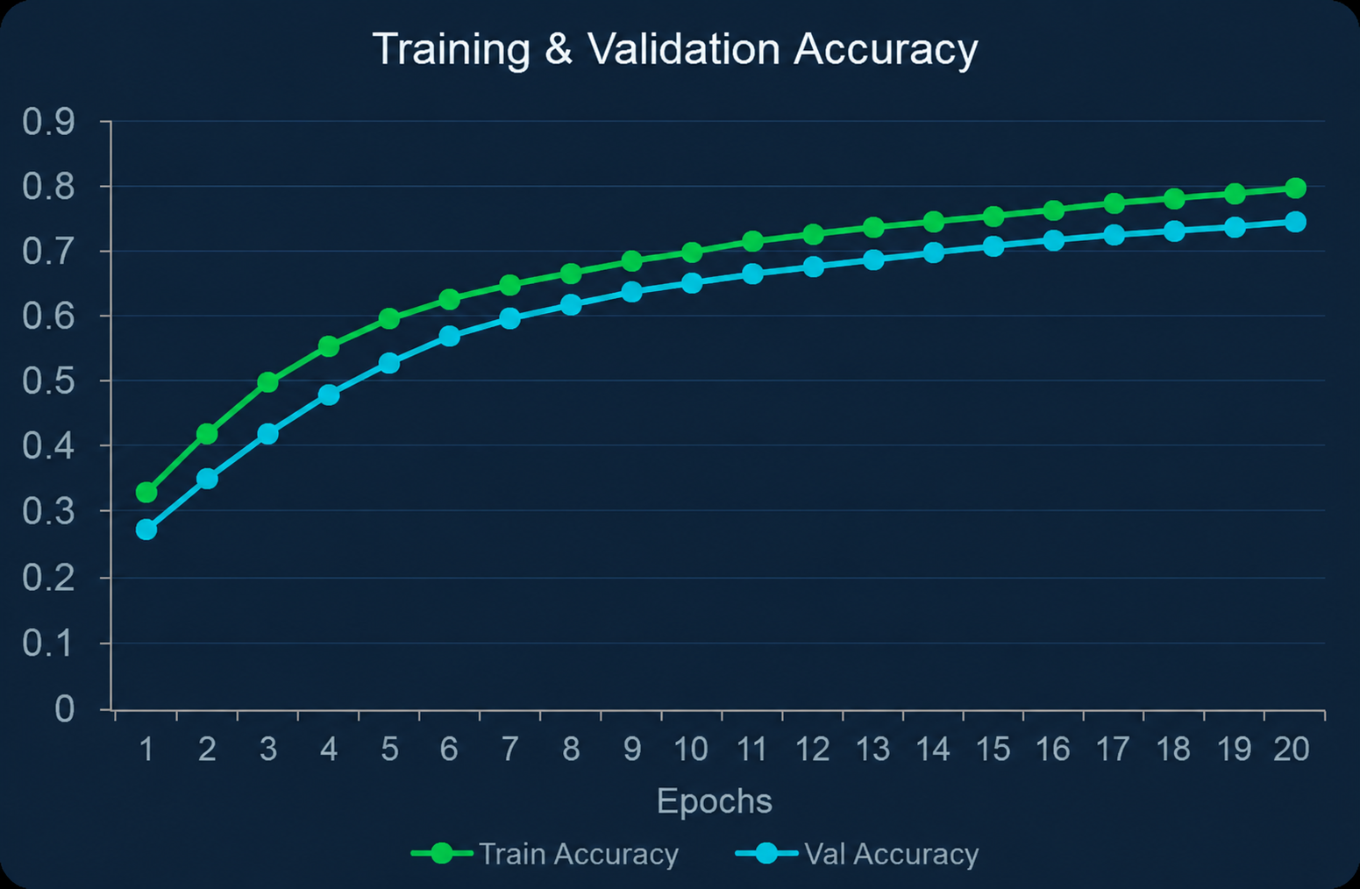
Training Process
20
32
Adam
0.001
Cat. CE
Epochs
Batch Size
Optimizer
LR
Loss Fn
Notes:
The model was trained for 50 epochs with Adam optimizer, batch size 32, and learning rate 0.001. Both accuracy curves converge well with minimal overfitting, and loss decreases steadily across epochs.

Slide 12
Technologies Used
Frontend
Backend
ML
️
React.js
Flask
TensorFlow 2.20
Frontend UI Framework
Interactive webcam interface
Component-based design
Python Web Framework
REST API endpoints
Lightweight & flexible
ML Framework
Model training & inference
Keras high-level API
Model
Vision
Language
MobileNetV2
OpenCV
Python 3.10
CNN Architecture
Pre-trained weights
Transfer learning
Computer Vision Library
Face detection
Image processing
Core Language
ML ecosystem
Scientific computing
Science
Database
Analytics
NumPy
SQLite
Scikit-learn
Array computing
Matrix operations
Fast numerical ops
Embedded Database
User sessions & logs
Zero configuration
ML Utilities
Metrics & evaluation
Confusion matrix
Notes:
The project uses a modern full-stack AI technology stack: React.js for the frontend, Flask for the API backend, TensorFlow/Keras for model training, OpenCV for face detection, and SQLite for data persistence.

Slide 13
Performance Analysis
Confusion Matrix
Per-Class Metrics
AN
DI
FE
HA
SA
SU
NE
74%
4%
6%
2%
6%
2%
6%
AN
6%
62%
5%
4%
8%
5%
10%
DI
5%
3%
68%
4%
8%
7%
5%
FE
2%
1%
2%
91%
1%
2%
1%
HA
5%
3%
7%
3%
75%
2%
5%
SA
Inference Speed Comparison
3%
2%
8%
4%
3%
78%
2%
SU
4%
3%
4%
3%
5%
3%
78%
NE
Accuracy: 78%
F1-Score: 0.76
Precision: 0.78
Recall: 0.77
Notes:
Performance analysis shows strong results — Happy achieves 91% accuracy while Disgust (with only 547 training samples) performs at 62%. Overall inference at 18ms makes MobileNetV2 8x faster than VGG-16.

Slide 14
System Advantages
18ms
15MB
78%
Real-Time Speed
Lightweight Model
High Accuracy
Ultra-fast inference at 18 milliseconds per face — suitable for live video streams at 30+ FPS
Compact 15MB model size enables deployment on edge devices, Raspberry Pi, and low-memory systems
Competitive 78% accuracy on FER2013 benchmark, matching much larger and slower models
React
CPU OK
Flask
User-Friendly UI
Low Hardware Req.
REST API Ready
Modern, intuitive React.js interface requires no technical knowledge from end users
Runs efficiently on standard CPU without requiring dedicated GPU hardware
Modular Flask API can be integrated with any frontend, mobile app, or IoT device
Notes:
Our system offers 6 key advantages: real-time 18ms inference, a compact 15MB model, 78% accuracy, intuitive UI, CPU-only requirements, and a modular REST API — making it practical for real-world deployment.

Slide 15
Real-World Applications
🎓
Smart Classrooms
🏥
Healthcare & Therapy
🔒
Security Monitoring
Monitor student engagement and attention levels in real-time. Detect confused, bored, or engaged students to adapt teaching strategies automatically.
Assist in diagnosing conditions like depression, autism, and PTSD by analyzing patient emotional responses during therapy sessions.
Enhance security systems by detecting suspicious emotional patterns in surveillance footage, identifying potential threats.
Student attention tracking • Adaptive learning systems • Engagement analytics
Mental health monitoring • Pain assessment • Therapy support
Threat detection • Behavioral analysis • Access control
🤖
Robotics & HRI
🚗
Driver Monitoring
🎮
Gaming & AR/VR
Enable robots and virtual assistants to understand human emotions and respond empathetically in human-robot interaction.
Detect driver fatigue, stress, or distraction in autonomous and smart vehicles to prevent accidents through timely alerts.
Adapt game difficulty, generate dynamic content, and create immersive AR/VR experiences based on player emotions.
Empathetic robots • Social AI agents • Customer service bots
Drowsiness detection • Stress alerts • Road safety
Adaptive difficulty • Emotion-driven narrative • Immersive experiences
Notes:
Emotion detection has vast real-world applications across 6 major domains: education, healthcare, security, robotics, automotive safety, and entertainment. Each represents a multi-billion dollar market opportunity.

Slide 16
Conclusion & Future Work
✅ Project Achievements
🚀 Future Roadmap
✓
Successfully detected 7 emotions using MobileNetV2 + transfer learning
Phase 1
Mobile App
Achieved 78% accuracy on FER2013 benchmark dataset
Deploy as native iOS & Android app using TFLite
✓
✓
Deployed lightweight 15MB model with 18ms real-time inference
Phase 2
Cloud Deploy
✓
Built full-stack web app: React.js frontend + Flask REST API
Host on AWS/GCP with Docker containerization
✓
Implemented face detection pipeline using OpenCV Haar Cascade
Phase 3
Multi-Face
✓
Integrated SQLite database for detection history and analytics
Detect multiple faces simultaneously in one frame
Phase 4
>85% Accuracy
Retrain with larger datasets & advanced architectures
Notes:
In conclusion, this project successfully built a real-time facial emotion detection system using MobileNetV2, achieving 78% accuracy with a 15MB model at 18ms inference. Future work includes mobile deployment, cloud hosting, multi-face detection, and improved accuracy beyond 85%.

Slide 17
THANK
YOU
Face Emotion Detection Using MobileNetV2
❓ Questions & Answers
78%
15MB
18ms
7
Accuracy
Model
Inference
Emotions
Notes:
Thank the committee for their attention. Invite questions and be prepared to explain technical decisions such as the choice of MobileNetV2, the FER2013 dataset, Flask vs alternatives, and future improvement plans.

