Slide 1

Introduction to Algorithms
by
Prof. Dr. Abdelmgeid Amin Ali
Computer Science Dept.

Slide 2
Problem Solving: Main Steps
Problem definition
Algorithm design / Algorithm specification
Algorithm analysis
Implementation
Testing
[Maintenance]

Slide 3
1. Problem Definition
What is the task to be accomplished?
  Calculate the average of the grades for a given student
  Understand the talks given out by people and translate them .
What are the time / space / speed / performance requirements ?

Slide 4
2. Algorithm Design / Specifications
Algorithm: is a well-defined list of steps for solving a particular problem.
An algorithm is thus a sequence of computational steps that transform the input into the output.
An algorithm is a Finite set of instructions that, if followed, accomplishes a particular task.

Slide 5
Algorithm Design / Specifications (cont’d)
Describe: in natural language / pseudo-code / diagrams / etc.
Criteria to follow:
  Input: Zero or more quantities (externally produced)
  Output: One or more quantities
  Definiteness: Clarity, precision of each instruction
  Finiteness: The algorithm has to stop after a finite (may be very large) number of steps
  Effectiveness: Each instruction has to be basic enough and feasible

Slide 6
4,5,6: Implementation, Testing, Maintenance
Implementation
  Decide on the programming language to use C, C++, Lisp, Java, Perl, Prolog, assembly, etc. , etc.
  Write clean, well documented code
Test
Integrate feedback from users, ensure compatibility across different versions → Maintenance

Slide 7
3. Algorithm Analysis
Space complexity
  How much space is required
Time complexity
  How much time does it take to run the algorithm
Often, we deal with estimates!

Slide 8
Space Complexity
Space complexity = The amount of memory required by an algorithm to run to completion
  [Core dumps = the most often encountered cause is “memory leaks” – the amount of memory required larger than the memory available on a given system]
Some algorithms may be more efficient if data completely loaded into memory
  Need to look also at system limitations
  E.g. Classify 2GB of text in various categories [politics, tourism, sport, natural disasters, etc.] – can I afford to load the entire collection?

Slide 9
Time Complexity
Often more important than space complexity
  space available (for computer programs!) tends to be larger and larger
  time is still a problem for all of us
The time complexity depends on :
  Computer type - Programming language
  Total execution time - Compiler and interpreter
Algorithms running time is an important issue

Slide 10
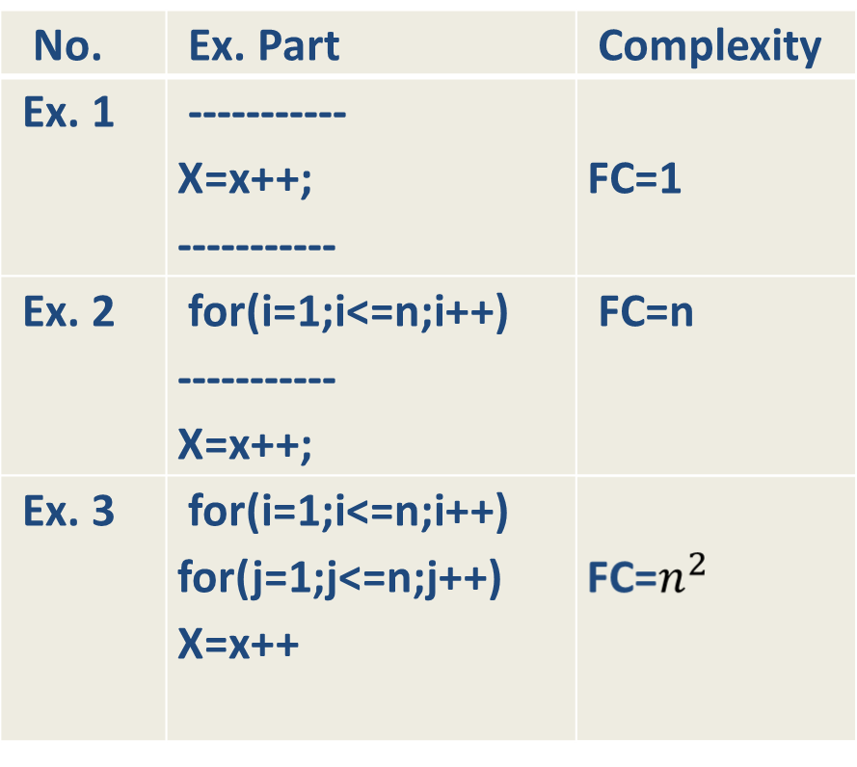
Time Complexity
  Ex: assume some program parts

Slide 11
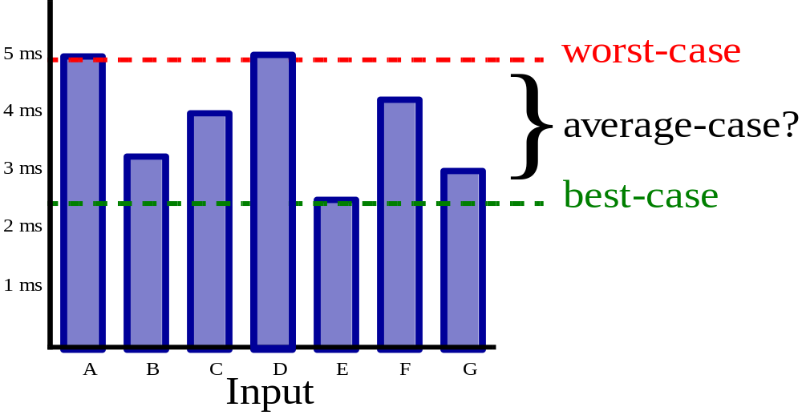
Running time
Suppose the program includes an if-then statement that may execute or not: → variable running time
Typically algorithms are measured by their worst case

Slide 12
Experimental Approach
Write a program that implements the algorithm
Run the program with data sets of varying size.
Determine the actual running time using a system call to measure time (e.g. system (date) );

Slide 13
Experimental Approach (Cont’d)
It is necessary to implement and test the algorithm in order to determine its running time.
Experiments can be done only on a limited set of inputs, and may not be indicative of the running time for other inputs.
The same hardware and software should be used in order to compare two algorithms. – condition very hard to achieve!

Slide 14
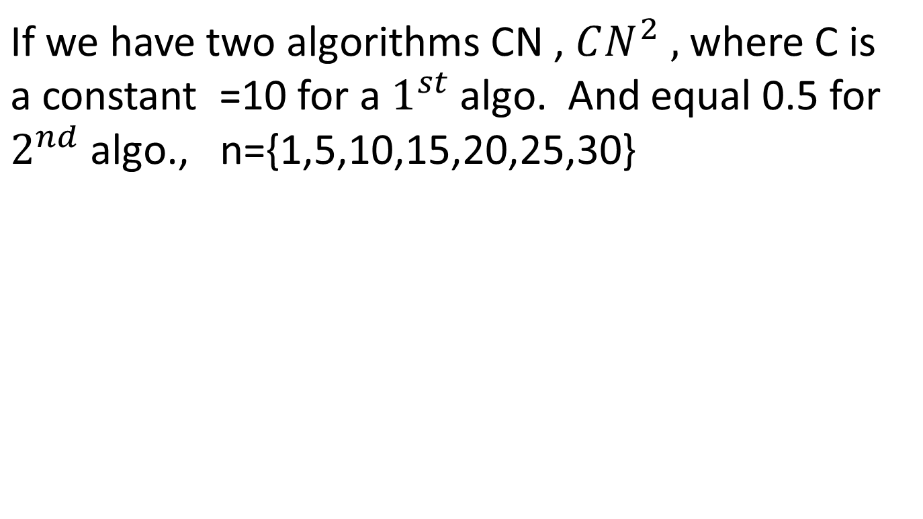
The comparison between two algorithms
N | CN | CN²
1 | 10 | 0.5
5 | 50 | 12.5
10 | 100 | 50
15 | 150 | 112.5
20 | 200 | 200
25 | 250 | 312.5
30 | 300 | 450

Slide 15
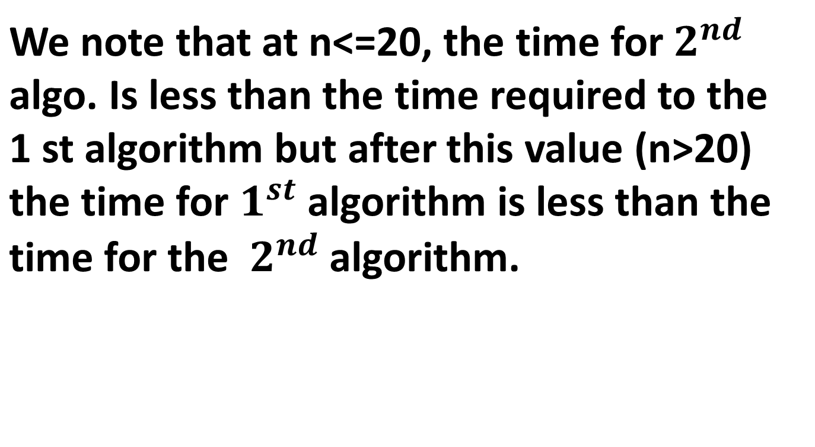
The comparison between two algorithms(cont’d)

Slide 16
Algorithm Description
How to describe algorithms independent of a programming language
Pseudo-Code = a description of an algorithm that is
  more structured than usual prose but
  less formal than a programming language
(Or diagrams)
Example: find the maximum element of an array.
  Algorithm arrayMax(A, n):
  Input: An array A storing n integers.
  Output: The maximum element in A.
  currentMax ← A[0]
  for i← 1 to n -1 do
  if currentMax < A[i] then currentMax ← A[i]
  return currentMax

Slide 17
Pseudo Code
Expressions: use standard mathematical symbols
  use ← for assignment ( ? in C/C++)
  use = for the equality relationship (? in C/C++)
Method Declarations: -Algorithm name(param1, param2)
Programming Constructs:
  decision structures: if ... then ... [else ..]
  while-loops while ... do
  repeat-loops: repeat ... until ...
  for-loop: for ... do
  array indexing: A[i]
Methods
  calls: object method(args)
  returns: return value
Use comments
Instructions have to be basic enough and feasible!

Slide 18
Problem1: Write an algo. To calculate the avg. of N values, and its complexity
Step no. | Instruction | No, of exec. times
1 | Read no. of values (N) | 1
2 | Set sum=0 | 1
3 | Let i=0 | 1
4 | While(i<=N) | N+1
5 | Read a value (x) | N
6 | Add the value to sum (sum=sum+x) | N
7 | Increasing the counter by 1 (i++) | N
8 | Compute the average by dividing (sum/N) | 1
 | Total | 4N+5

