Slide 1
Design and Analysis of Algorithms

Slide 2
ALGORITHMICS
ALGORITHMICS
Algorithms
It is the science that lets designers study and evaluate the effect of algorithms based on various factors so that the best algorithm is selected to meet a particular task in given circumstances. It is also the science that tells how to design a new algorithm for a particular job.

Slide 3
What is an algorithm?
An algorithm is a sequence of unambiguous instructions for solving a problem, i.e., for obtaining a required output for any legitimate input in a finite amount of time.
problem
algorithm
“computer”
input
output
3

Slide 4
What is an algorithm?(Cont’d)
An algorithm
is any well-defined computational procedure that takes some value, or set of values, as input and produces some value, or set of values, as output.
is thus a sequence of computational steps that transform the input into the output.
is a tool for solving a well - specified computational problem.
Any special method of solving a certain kind of problem

Slide 5
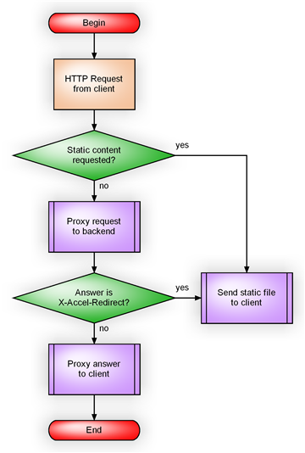
What is an algorithm?(Cont’d)
An algorithm?
a step-by-step procedure to solve a problem
every program is the instantiation of some algorithm

Slide 6
What is a program?
A program is the expression of an algorithm in a programming language
a set of instructions which the computer will follow to solve a problem

Slide 7
Why need algorithm analysis ?
writing a working program is not good enough
The program may be inefficient!
If the program is run on a large data set, then the running time becomes an issue

Slide 8
Design and Analysis of Algorithms
Analysis: predict the cost of an algorithm in terms of resources and performance
Design: design algorithms which minimize the cost

Slide 9
Types of Algorithms

Slide 10

PROBABILISITIC ALGORITHM
In this algorithm, chosen values are used
in such a way that the probability of chosen each value is known and controlled.
e.g. Randomize Quick Sort

Slide 11
HEURISTIC ALGORITHM
This type of algorithm is based largely on optimism and often with minimal theoretical support. Here error can not be controlled but may be estimated how large it is.
Notes:
Heuristic meaning : encouraging a person to learn, discover, understand, or solve problems on his or her own, as by experimenting, evaluating possible answers or solutions, or by trial and error: a heuristic teaching method.

Slide 12
APPROXIMATE ALGORITHM
In this algorithm, answer is obtained that is as précised as required in decimal notation. In other words it specifies the error we are willing to accept.
For example, two figures accuracy or 8 figures or whatever is required.

Slide 13
Greatest Common Divisor Algorithms
We will study 3 algorithms for GCD computation to illustrate the following:
The non-ambiguity requirement for each step of an algorithm cannot be compromised.
The range of inputs for which an algorithm works has to be specified carefully.
The same algorithm can be represented in several different ways.
There may exist several algorithms for solving the same problem.
Algorithms for the same problem can be based on very different ideas and can solve the problem with dramatically different speeds.
13

Slide 14
Alg 1: Euclid’s Algorithm
Problem: Find gcd(m,n), the greatest common divisor of two nonnegative, not both zero integers m and n
Examples: gcd(60,24) = 12, gcd(60,0) = 60, gcd(0,0) = ?
Euclid’s algorithm is based on repeated application of equality
gcd(m,n) = gcd(n, m mod n)
until the second number becomes 0, which makes the problem
trivial.
Example: gcd(60,24) = gcd(24,12) = gcd(12,0) = 12
14
Notes:
Euclid’s algorithm is good for introducing the notion of an algorithm because it
makes a clear separation from a program that implements the algorithm.
It is also one that is familiar to most students.
Al Khowarizmi (many spellings possible...) – “algorism” (originally) and then
later “algorithm” come from his name.

Slide 15
Two descriptions of Euclid’s algorithm
Step 1 If n = 0, return m and stop; otherwise go to Step 2
Step 2 Divide m by n and assign the value of the remainder to r
Step 3 Assign the value of n to m and the value of r to n. Go to Step 1.
ALGORITHM Euclid(m, n)
//Computes gcd(m, n) by Euclid’s algorithm
//Input: Two nonnegative, not-both-zero integers m and n
//Output: Greatest common divisor of m and n
while n ≠ 0 do
r ← m mod n
m← n
n ← r
return m
15

Slide 16
Alg 2: Minimum Iterating down to Zero
Consecutive integer checking algorithm
Step 1 Assign the value of min{m,n} to t
Step 2 Divide m by t. If the remainder is 0, go to Step 3; otherwise, go to Step 4
Step 3 Divide n by t. If the remainder is 0, return t and stop; otherwise, go to Step 4
Step 4 Decrease t by 1 and go to Step 2
16

Slide 17
Alg 3: Using Primes
Middle-school procedure:
Step 1 Find the prime factorization of m
Step 2 Find the prime factorization of n
Step 3 Find all the common prime factors
Step 4 Compute the product of all the common prime factors and return it as gcd(m,n)
Is this an algorithm?
^{60 = 2 . 2 . 3 . 5}
^{24 = 2 . 2 . 2 . 3}
^{gcd(60, 24) = 2 . 2 . 3 = 12.}
17

Slide 18
Correctness
How do you know an algorithm is correct?
produces the correct output on every input
Since there are usually infinitely many inputs, it is not trivial
Saying "it's obvious" can be dangerous
often one's intuition is tricked by one particular kind of input

Slide 19
Efficiency
Software is always outstripping hardware
need faster CPU, more memory for latest version of popular programs
Given a problem:
what is an efficient algorithm?
what is the most efficient algorithm?
does there even exist an algorithm?

Slide 20
How to Measure Efficiency
Machine-independent way:
analyze "pseudocode" version of algorithm
assume idealized machine model
one instruction takes one time unit
"Big-Oh" notation
order of magnitude as problem size increases
Worst-case analyses
safe, often occurs most often, average case often just as bad

Slide 21
Algorithm Complexity

Slide 22
O(1)
O(1) describes an algorithm that will always execute in the same time (or space) regardless of the size of the input data set.
Any assignment st. or arithmetic operations will take O(1)
ex:
int x = 5;
O(1)

Slide 23
Conditional Statement
Any conditional statement will be calculated as conditional execution +1
if(x>5) { y=20; h=15; } O(3)

Slide 24
If-else
Any double (if-else) is calculated by taking the largest case in the account
if(x>5) { y=20; h=15; } else { y=30; h=25; l=h; } O(1 + max(2,3) = O(1+3) = O(4))

Slide 25
Loops
In the case of loops, the value of Big Oh depends on the number of iterations n multiplied by the Oh value for the code which will be repeated.
for (i=0;i<n;I++) { sum+=i; } O(n * (1))=O(n)

Slide 26
Loops (cont’d)
for (i=0;i<n;i++) for (j=0;j<10;j++) { sum+=i*J; } O( n *(n * (1)) )=O(n*n) Finally remains to be seen that the parameters do not affect
O(1000n) = O(n+1000) = O(n)

Slide 27
Problem(1)
float f; scanf("%f",&f); int x=(int) f/2; if (x==f/2) printf("F is an even number\n"); else printf("F is an odd number\n"); *******************************
O(1+1+max(1,1))=O(3)=O(1)

Slide 28
Problem (2)
for (i=0;i<n;I++) for (j=0;j<10;j++) for (k=0;k<10;k++) { sum+=i*J*k; } *****************************
O(n*(n*(n*(1))) = O(n*n*n) O(n of the power 3)

Slide 29
Problem (3)
int n,x,i,sum=0,ar[100]; scanf("%d ",&n); for (i=0;i<n;i++) { scanf("%d",&x); sum+=x; } printf("The sum (using for) = %d\n",sum); sum=0;i=0; while (i<n) { scanf("%d",&x); sum+=x; i++; } printf("The sum (using while) = %d\n",sum); sum=0;i=0; do { scanf("%d",&x); sum+=x; i++; }

Slide 30
Problem (3) Cont’d
while (i<n); printf("The sum (using do while) = %d\n",sum); sum=0; for (i=0;i<n;i++) { scanf("%d",&ar[i]); sum+=ar[i]; } printf("The sum (using Array) = %d\n",sum);
O(1 + 1 + n * (2) + 1 + 2 + n * (3) + 1 + 2 + n * (3) + 1 + 1 + n * (2) + 1) = O(10n+11)=O(n)

Slide 31
Problem (4)
p = 1;
for(int i = 1; i <n; i++)
{
p = p * n;
}
Let the Program Part
Find the complexity in n؟

Slide 32
Problem (4) cont’d
p = 1;
for(int i = 1; i <n; i++)
{
p = p * n;
}
We have a one loop from 1 to n
At any iteration we execute multiplication operation for one time
The complexity as :

Slide 33
Problem(5)
int res = 1;
factor = x;
while (n>0)
{
if((n mod 2) == 1)
res = res * factor;
factor = factor * factor;
n = n / 2;
}
We assume the program Part:
Find the complexity in n

Slide 34
Problem (5) (Cont’d)
int res = 1;
factor = x;
while (n>0)
{
if((n mod 2) == 1)
res = res * factor;
factor = factor * factor;
n = n / 2;
}
Sol.
The loop start with n and at any iteration divided by 2
At first time is :
At second time is :
At third time is :
At i time is :

Slide 35
Problem (5) (Cont’d)
If we assume that j is last iteration in the loop :
So the value of n equal zero, to find the value J we solve the following eq.:
By using log for two sides

Slide 36
Problem (5) (Cont’d)
The value of j as:
There are three operations inside a loop (2 multiplication and 1 division ).
So the complexity is:

Slide 37
Problem (6)
for i = 1 to m
for j = 1 to q
for k = 1 to n
x = x * 2;
We assume the program Part
Find the complexity in n
Sol
The cost of inner loop:
The cost of the middle loop:
The cost of the outer ring:

Slide 38
Problem (6) cont’d
for i = 1 to m
for j = 1 to q
for k = 1 to n
x = x * 2;
If we assume m=q=n So the no. of operations =n*n*n

Slide 39
Asymptotic Notation
The difficulty of determining the number of steps that we needed to approximate formulas to determine it.
There are three asymptotic notation:
1- Big – oh (O)
2- Omega(Ω)
3- Theta (ϴ)

Slide 40
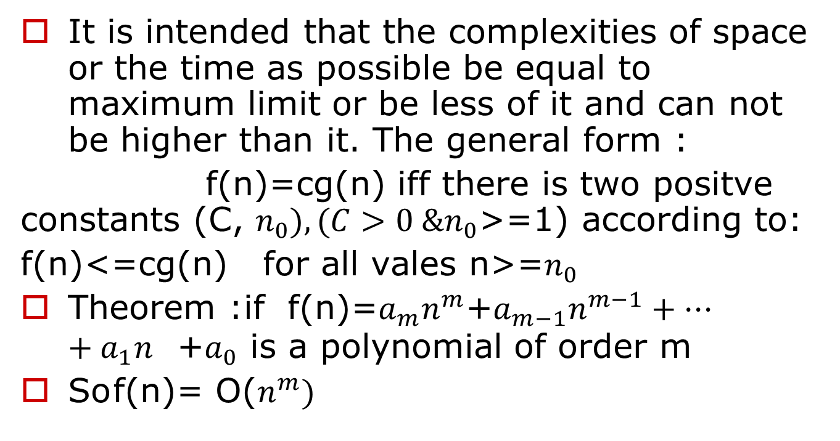
Big-Oh notation

Slide 41
Example(1)
If 3n+2 represent F(n) (complexity) for any program so,
3n+2=O(n)
We take the largest coefficient of n and add 1 for it to become 4
3n+2<=4n (f(n)<=C g(n))
for all values n>=2
Since the quantity (4n) represent the constants
i.e. n is g(n) , 4 for c

Slide 42
Problem (1)
Use a Big-O Notation to analyze the time efficiency of following C++ code of the integer n
For (int i=1;i<=n/2;i++)
{
-------
for (int j=1;j<=n*n;j++)
{-----------
-----------}
}

Slide 43
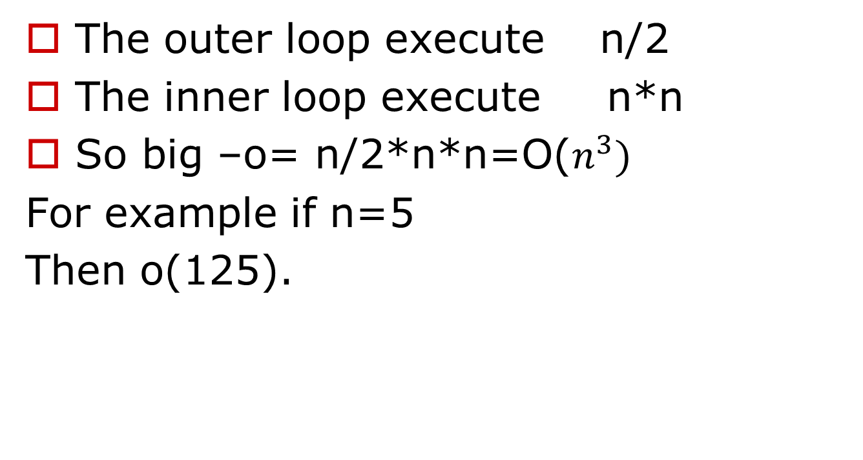
Problem (1) Cont’d

Slide 44
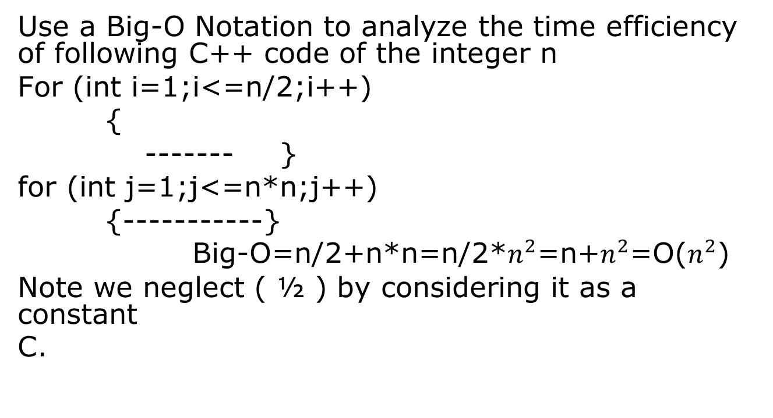
Problem (2)

Slide 45
Problem (2)Cont’d
If we assume that:
n=5;
For (int i=1;i<=2;i++)
for (int j=1;j<=n*n;j++)
{-----------}
We need to 27 iterations only for loops, and this means that the execution of this is the worst of the general situation.

Slide 46
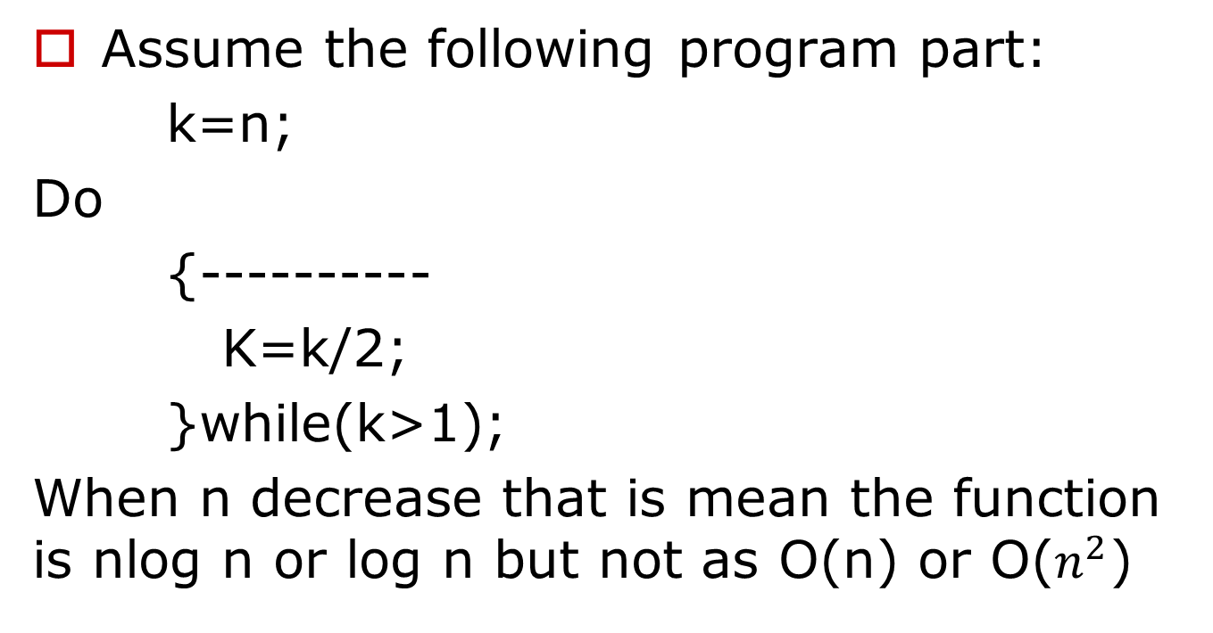
Problem(3)

Slide 47
Big-O (Cont’d)
Find an asymptotic notation for 3n+2<=4n
Where the eq. is less than or equal, so we used a big-O
Since the max power of n is 1, then the solution is : 3n+2=O(n)
3n+2<=4n
For all values n>=2

Slide 48
Big-O (Cont’d) From the following truth table, we note that the notation is verified for n>=2
Verification | 3n+2<=4n | R. H. S. | L. H. S | n
False | 5<=4 | 4 | 5 | 1
True | 8<=8 | 8 | 8 | 2
True | 11<=12 | 12 | 11 | 3
True | 14<=16 | 16 | 14 | 4

Slide 49
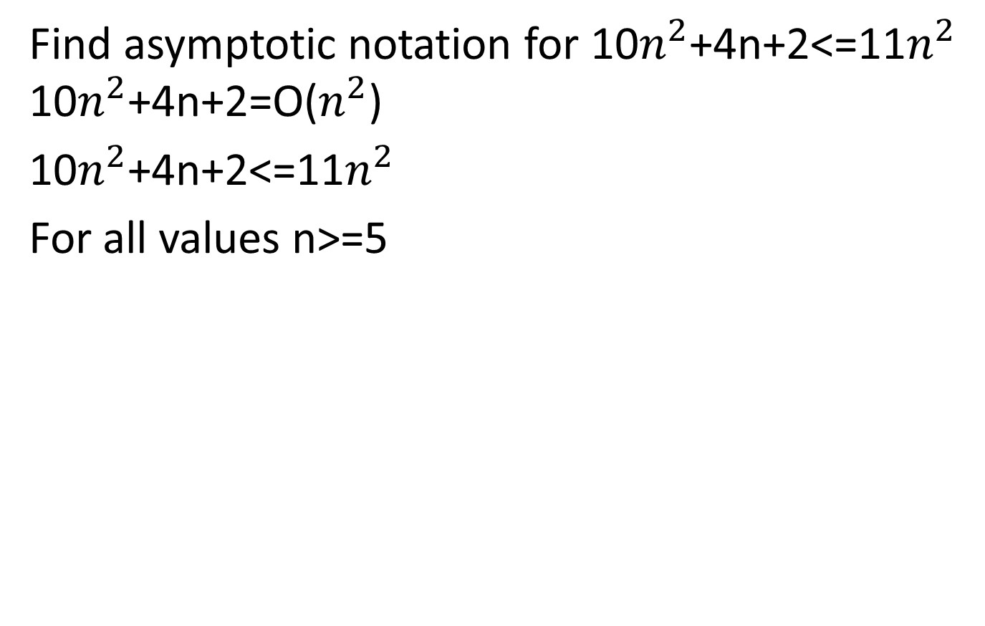
Big-O (Cont’d)
Verification | 10 n² +4 n +2 <= 11 n² | R. H. S. | L. H. S. | n
False | 16<=11 | 11 | 16 | 1
False | 50<=44 | 44 | 50 | 2
False | 104<=99 | 99 | 104 | 3
False | 178<=176 | 176 | 178 | 4
True | 272<=275 | 275 | 272 | 5
True | 386<=396 | 396 | 386 | 6
True | 520<=539 | 539 | 520 | 7

