Slide 1
The divide-and-conquer approach
Many useful algorithms are recursive in structure: to solve a given problem, they call themselves recursively one or more times to deal with closely related sub problems. These algorithms typically follow a divide-and-conquer approach: they break the problem into several sub problems that are similar to the original problem but smaller in size, solve the sub problems recursively, and then combine these solutions to create a solution to the original problem.
The divide-and-conquer paradigm involves three steps at each level of the recursion.

Slide 2
The divide-and-conquer approach
Cont’d
Divide-and-conquer paradigm steps:
Divide the problem into a number of sub problems.
Conquer the sub problems by solving them recursively. If the sub problem sizes are small enough, however, just solve the sub problems in a straightforward manner.
Combine the solutions to the sub problems into the solution for the original problem.

Slide 3
The merge sort algorithm closely follows the divide-and-conquer paradigm. Intuitively, it operates as follows.
Divide: Divide the n-element sequence to be sorted into two subsequences of n/2 elements each.
Conquer: Sort the two subsequences recursively using merge sort.
Combine: Merge the two sorted subsequences to produce the sorted answer.

Slide 4
Merge Sort
It has O(n log n) running time
Merge sort is based on the divide-and-conquer paradigm. Since we are dealing with subproblems, we state each subproblem as sorting a subarray A[p .. r]. Initially, p = 1 and r = n, but these values change as we recurse through subproblems.
To sort A[p .. r]:
1. Divide Step
If a given array A has zero or one element, simply return; it is already sorted.
Otherwise, split A[p .. r] into two subarraysA[p .. q] and A[q + 1 .. r], each containing about half of the elements of A[p .. r]. That is, q is the halfway point of A[p .. r].

Slide 5
Merge Sort (cont’d)
2. Conquer Step
Conquer by recursively sorting the two subarrays A[p .. q] and A[q + 1 .. r].
3. Combine Step
Combine the elements back in A[p .. r] by merging the two sorted subarraysA[p .. q] and A[q + 1 .. r] into a sorted sequence. To accomplish this step, we will define a procedure MERGE (A, p, q, r).
Note that the recursion bottoms out when the subarray has just one element, so that it is trivially sorted.

Slide 6
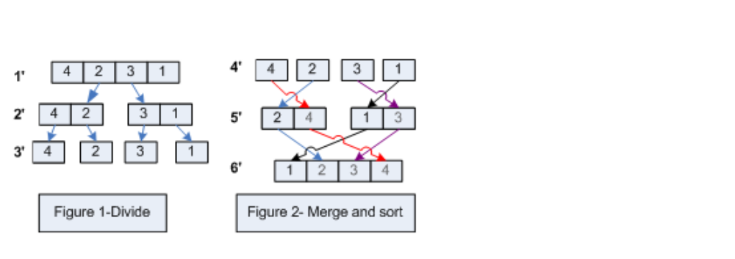
Merge Sort (cont’d)

Slide 7
Example. Sort {10, 4, 6, 3, 8, 2, 5, 7} using merge sort.
Partition into lists of size n/2
[10, 4, 6, 3, 8, 2, 5, 7]
[10, 4, 6, 3]
[8, 2, 5, 7]
[10, 4]
[6, 3]
[8, 2]
[5, 7]
[4] [10]
[3][6]
[2][8]
[5][7]

Slide 8
Example Cont’d
Merge
[2, 3, 4, 5, 6, 7, 8, 10 ]
[3, 4, 6, 10]
[2, 5, 7, 8]
[4, 10]
[3, 6]
[2, 8]
[5, 7]
[4] [10]
[3][6]
[2][8]
[5][7]

Slide 9

Merge Sort (Cont’d)
Pseudo Code:
- Input: Array A[1…N], indices p, q, r (p ≤ q <r).
A[p…r] is the array to be divided
A[p] is the beginning element and A[r] is the ending element
-Output: Array A[p…r] in ascending order
- MERGE-SORT(A,p,q,r)
1 if p <r
2 then q ← (r + p)/2
3 MERGE-SORT(A, p, q )
4 MERGE-SORT(A,q+1,r)
5 MERGE(A, p, q, r)

Slide 10

Merge Sort (cont’d)
MERGE(A, p, q, r)
6 n1←q-p+1
7 n2←r-q
8 create arrays L[1...N1+1] and R[1...N2+1]
9 for i←1 to N1
10 do L[i] ← A[p+i-1]
11 for j ← 1 to n2
12 do R[j] ← A[q+j]
13 L[N1+1] ← ∞
14 R[N2+1] ← ∞
15 i ← 1
16 j ← 1
17 for k ← p to r
18 do if L[i] ≤ R[j]
19 then A[k] ← L[i]
20 i ← i+1
21 else A[k] ← R[j]
22 j ← j+1

Slide 11
Merge Sort Program
#include <iostream.h>
#define size 100
int a[size];
void merge(int,int,int);
void merge_sort(int ,int );
void main()
{
int num,i;
cin>>num;
for(i=0;i<num;i++)
cin>>a[i] ;
merge_sort(0,num-1);
for(i=0;i<num;i++)
cout<<a[i]<<" ";
}

Slide 12
Merge Sort Program(Cont’d)
void merge_sort(int low,int high)
{ int mid;
if(low<high)
{
mid=(low+high)/2;
merge_sort(low,mid);
cout<<"first\n";
merge_sort(mid+1,high);
cout<<"second\n";
merge(low,mid,high);
cout<<"third\n";
}
}

Slide 13
Merge Sort Program(Cont’d)
void merge(int low, int mid, int high)
{ int h,i,j,b[50],k;
h=low; i=low; j=mid+1;
while((h<=mid)&&(j<=high))
{
if(a[h]<=a[j])
{ b[i]=a[h];
h++; }
else
{ b[i]=a[j];
j++; }
i++;
}
if(h>mid)
{
for(k=j;k<=high;k++)
{
b[i]=a[k]; i++; }
}
else
{
for(k=h;k<=mid;k++)
{ b[i]=a[k]; i++; }
}
for(k=low;k<=high;k++) a[k]=b[k];
}

Slide 14
Merge Sort Complexity
In sorting n objects, merge sort has an average and worst-case performance of O(n log n). If the running time of merge sort for a list of length n is T(n), then the recurrence T(n) = 2T(n/2) + n follows from the definition of the algorithm (apply the algorithm to two lists of half the size of the original list, and add the n steps taken to merge the resulting two lists)

Slide 15
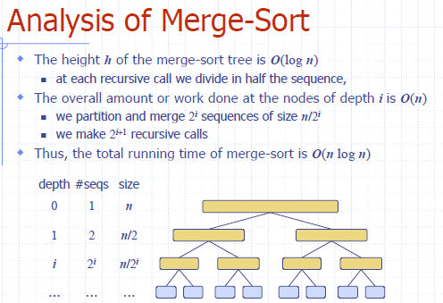

Slide 16
