Slide 1
Algorithm analysis & design Introduction to Algorithms
Presented By:
T.A. Asmaa Hamad El-saied
E-mail: eng.asmaa134@gmail.com
Lab 1
FCI, Minia University

Slide 2
Agenda
Introduction
Algorithm Design.
Examples

Slide 3
Introduction
What’s algorithm…?!
Why algorithm…?!
Is It Important?!
Goal
Before and After!

Slide 4
What’s Algorithm?
Set of finite steps to solve certain problem
any well-defined computational procedure that takes some value, or set of values, as input and produces some value, or set of values, as output.
a Finite set of instructions that, if followed, accomplishes a particular task.

Slide 5
Why Algorithm?
Save resources
Save time
Save money

Slide 6
Is It Worth?
Real examples…
Fibonacci: recursive vs. loop vs. Dynamic Pro.
(N = 30, 40, 50)
Median filter: quick sort vs. counting sort
(WinSize = 11 or 15)
String similarity: recursive vs. dynamic prog.
(S1 ="plynomialgood" S2 = "exponentialbad")

Slide 7
Is It Worth?
It's Crucial CS Course!
4 CS Crucial Courses (according to IEEE-ACM)
Theory of computation “What can be computed?”
Algorithms and data structures “Compute it efficiently”
Programming methodology and languages “Code it! different paradigms”
Computer elements and architecture “understand the destination”

Slide 8
Is It Worth?
It's Core Interview Question!
Ask your graduate colleagues!!

Slide 9
Goal
Think…
Design…
Analyze…

Slide 10


Before & After!
Before algorithm: Write code to solve problem
After algorithm: Write EFFICIENT code to solve problem
It’s a course!!
It’s a skill and attitude

Slide 11
RESOURCES
Textbook:-
Thomas Cormen, Charles Leiserson, Ronald Rivest, and Clifford Stein. Introduction to Algorithms. 3rd ed. MIT Press, 2009.
2. Anany Levitin, Introduction to the design and analysis of algorithms
2nd Edition, 2007.
Online Courses:-
[Stanford] Algorithms: Design and Analysis: Videos, Join the course
[MIT] Introduction to Algorithms: Videos

Slide 12
Problem Solving: Main Steps
Programming is a process of problem solving
Problem Solving: Main Steps
Problem definition
Algorithm design
Algorithm analysis
Implementation
Testing
Maintenance

Slide 13
Problem Solving: Main Steps
Problem Solving: Main Steps
Problem definition
Algorithm design
Algorithm analysis
Implementation
Testing
Maintenance

Slide 14
Algorithm design

Slide 15
Algorithm design: How to describe Algorithm?
Algorithm can be described/ represented in three ways.
Natural language like English:
Graphic representation called flowchart:
Pseudo-code Method:
In this method, algorithms are written in a format that is closely related to high level programming language structures.
From our Objectives is Design algorithms using Pseudo-code.
Notes:
Algorithms design techniques
Divide and conquer
Ex: Merge Sort, ….
Dynamic programming
Ex: Fibonacci Series
Greedy algorithm
Back Tracking
Brute Force

Slide 16
Pseudo-code conventions:
Comments begin with // and continue until the end of line.
Blocks are indicated with matching braces {and}.
An identifier begins with a letter. The data types of variables are not explicitly declared.
Assignment of values to variables is done using the assignment statement.
<Variable>:= <expression>; Or <Variable> ← <expression>;
5. There are two Boolean values TRUE and FALSE.
Logical Operators AND, OR, NOT
Relational Operators <, <=,>,>=, =, !=

Slide 17
Pseudo-code conventions:
6- The following looping statements are employed.
For, while and repeat-until
While Loop:
While < condition > do
<statement-1>
<statement-n>
End While

Slide 18
Pseudo-code conventions:
For Loop:
For variable: = value-1 to value-2 do
<statement-1>
<statement-n>
End For
repeat-until:
repeat
<statement-1>
.
<statement-n>
until<condition>

Slide 19
Pseudo-code conventions:
7- A conditional statement has the following forms.
If <condition> then <statement>
If <condition> then <statement-1>
Else <statement-1>
Case statement:
Switch (expression)
case 1 : <statement-1>
case n : <statement-n>
default : <statement-n+1>
End switch

Slide 20
Pseudo-code conventions:
8- Input and output are done using the instructions
read & write (print).
9- The heading of algorithm takes the form,
Algorithm Name (Parameter lists)

Slide 21
Algorithm Design: Examples
Example 1:
write a Pseudo Code for finding the maximum number of ‘n’ given numbers in array A.
algorithm Max(A,n)
// A is an array of size n
{
Max:= A[1]
for I ← 2 to n do
if A[I] > Max then
Max← A[I]
End if
End for
return Max
}

Slide 22
Algorithm Design: Examples
Example 2:
write a Pseudo Code to calculate the factorial of a number (N).
algorithm Factorial(N)
{
fact:= 1
for I ← 1 to N do
fact← fact * I
End for
return fact
}

Slide 23
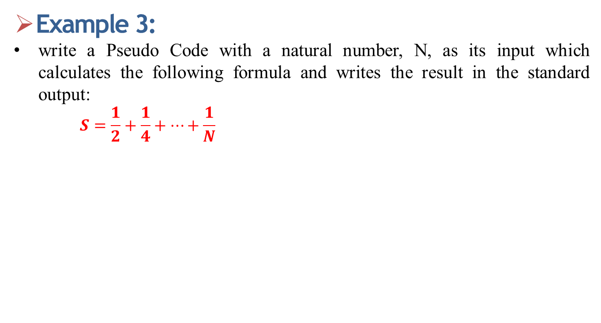
Algorithm Design: Examples
Example 3:
write a Pseudo Code with a natural number, N, as its input which calculates the following formula and writes the result in the standard output:
$$S=\frac{1}{2}+\frac{1}{4}+⋯+\frac{1}{N}$$
algorithm formula(N)
{
K:=2 and S:= 0
While K <=N do
S← S+ 1/K
K=K+2
End While
return S
}

Slide 24
Thanks

