Slide 1
Algorithm analysis & design Algorithm Analysis
Presented By:
T.A. Asmaa Hamad El-saied
E-mail: eng.asmaa134@gmail.com
Lab 2
FCI, Minia University

Slide 2
Agenda
Algorithm Analysis
Running Time
Example
Guiding Principles
Running Time vs. Order
How to calculate Order?
Examples

Slide 3
Algorithm Analysis
The main goal is to determine the cost of running an algorithm and how to reduce that cost. Cost is expressed as Complexity
Time Complexity
Space Complexity

Slide 4
Space & Time Complexities
Space complexity
How much space is required
Time complexity
How much time does it take to run the algorithm
Often, we deal with estimates!

Slide 5
Space & Time Complexities
Time Complexity Depends on: -
Size of Data
Number of Operations needed (n)
Machine Speed (In case of small input size)
Space Complexity Depends on: -
Size of Data
Size of Program
Algorithms running time is an important issue

Slide 6
Time Complexity
Running Time : # steps that the algorithm takes to solve the problem.
# steps expressed as a function of input size T(n) .
(n) is the Problem Size:
n could be the number of specific operations, or the size of data (e.g. an array) or both.
Notes:
T(n) = number of operations required.

Slide 7
Time Complexity
Number of operations (# steps)
Each "simple" operation (+, -, =, <, >=) is one operation.
Loops and function calls are not simple operations, but depend upon the size of the data and the contents of a function.
Each memory access is one operation.
We measure T(n) of an algorithm by counting the number of steps (operations).

Slide 8
Algorithm Analysis: Example
Design an Algorithm that get the max element from an array, and then analyze this algorithm.
Running Time = T(n) = 6n + 4.
max ← -∞
For i ← 0 to n
If A[i] > max
max ← A[i]
End if
End for
Return max
Init 1
Increment n
Cond (comp) n+1
1
2
4n
2
1

Slide 9
Guiding Principles
Worst Case
Asymptotic analysis (Large input Size)
Constants are not important
What is order?
Running time vs Order.

Slide 10
Running Time vs. Order
Order :
is the dominant factor in running time without constants.
Example :
T(n) = 6n + 4 O(n)
T(n) = 10 n^2 + 7n + 10^6 O(n^2)
Example:
Algo₁
Algo₂
T(n) = 10^6 Log n T(n) = 20 n
O(Log n) O(n)

Slide 11
How to calculate Order?
Analysis
Statements
Conditions
If-statement
Switch case
Nested if
Loops
Recursion

Slide 12
How to calculate Order?
Analysis
Statements O(1)
Exception:-
M=GetMax(A,N) O(Fn)
2. Conditions
If-statement
For condition O(1)
For body O(body)
O(IF)=O(1)+O(Body)= O(Body)
Notes:
O(1) describes an algorithm that will always execute in the same time (or space) regardless of the size of the input data set.

Slide 13
How to calculate Order?
Analysis
2. Conditions
If Condition then
B1
Else if condition Then
B2
……
Else
Bk
Order O(Max(B1,B2…..,BK))

Slide 14
How to calculate Order?
Analysis
Loops
Loop
body
End loop
Order=O(body) x # iteration
Notes:
1000 iteration’
Body o(1)
O(1)*1000=O(1)

Slide 15
How to calculate Order?
Example 1:-
O(n)
max ← -∞
for i ← 1 to n
If A[i] > max
max ← A[i]
End if
End for
Return max
O(1)
O(1)
O(n)
O(1)
O(1)
O(1)

Slide 16
How to calculate Order?
Example 2:
O(N^2)
Switch (choice)
Case 1:
print N
Case 2:
Max:= GetMax(A,N)
Write Max
Case 3:
Sum:=0
For I:=1 to N
If sum< GetMax(A,N)
Sum+=A[I]
End If
End for
Print sum
End switch
B1= O(1)
B2= O(N)
O(1)
O(N)
O(N) X N
B3=O(N^2)
O(N)
O(1)
O(1)

Slide 17
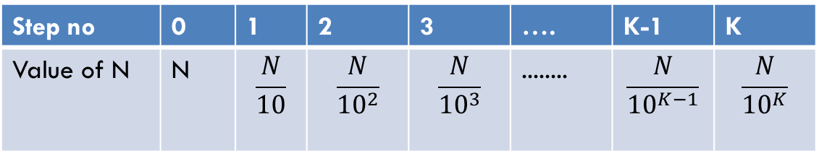


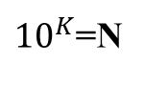
How to calculate Order?
Example 3:
Termination occur:
$\frac{N}{{10}^{K}}=1$
$\log_{10}{10}^{K}=\log_{10}{N}$
K=$\log_{10}{N}$
O(log N)
While N>1
N=N/10 // int division
End While
O(1) X #Iteration
O(1) X Log N= O(log N)
O(1)
Step no | 0 | 1 | 2 | 3 | …. | K-1 | K
Value of N | N | $$\frac{N}{10}$$ | $$\frac{N}{{10}^{2}}$$ | $$\frac{N}{{10}^{3}}$$ | ........ | $$\frac{N}{{10}^{K−1}}$$ | $$\frac{N}{{10}^{K}}$$
${10}^{K}$=N
$${K log}_{10}10=\log_{10}{N}$$

Slide 18
Thanks

