Slide 1
Algorithm analysis & design Sorting Algorithms
Presented By:
T.A. Asmaa Hamad El-saied
E-mail: eng.asmaa134@gmail.com
Lab 4
FCI, Minia University

Slide 2
Agenda
Insertion Sort
Algorithm
Analysis of Insertion Sort
Bubble Sort
Algorithm
Analysis of Bubble Sort
Selection Sort
Algorithm
Analysis of Selection Sort

Slide 3
Insertion Sort
Idea: like sorting a hand of playing cards
Start with an empty left hand and the cards facing down on the table.
Remove one card at a time from the table, and insert it into the correct position in the left hand
compare it with each of the cards already in the hand, from right to left
The cards held in the left hand are sorted

Slide 4
Insertion Sort
To insert 12, we need to make room for it by moving first 36 and then 24.

Slide 5
Insertion Sort

Slide 6
Insertion Sort

Slide 7
Insertion Sort

Slide 8
Insertion Sort: Example
input array
5 2 4 6 1 3
at each iteration, the array is divided in two sub-arrays:
left sub-array
right sub-array
5 2 4 6 1 3
sorted
unsorted

Slide 9
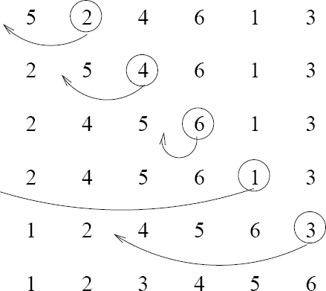
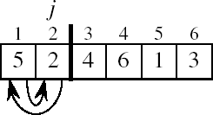
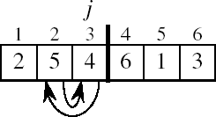
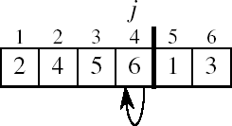
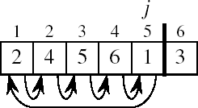
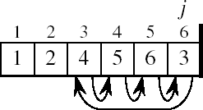
Insertion Sort : Example

Slide 10
Insertion Sort: pseudo-code
10
1
2
3
4
5
6
7
8
a₁ | a₂ | a₃ | a₄ | a₅ | a₆ | a₇ | a₈
Algorithm Insertion-sort(A,n)
for j ← 2 to n do
key ← A[ j ]
i ← j - 1
while i > =1 and A[i] > key do
A[i + 1] ← A[i]
i ← i – 1 A[i + 1] ← key
key

Slide 11
Analysis of Insertion Sort: Running Time
cost times
c₁ n
c₂ n-1
c₃ n-1
c₄
Algorithm Insertion-sort(A,n)
for j ← 2 to n do
key ← A[ j ]
i ← j - 1
while i >= 1 and A[i] > key do
A[i + 1] ← A[i]
i ← i – 1 A[i + 1] ← key
∑
n
j =2
t
j
c c
∑
n
(t − 1)
5
j=2
j
∑
n
(t − 1)
6
j=2
j
c₇
n-1
t_{j}: # of times the while statement is executed at iteration j
11

Slide 12

Analysis of Insertion Sort: Running Time
The running time of the algorithm is the sum of running times for each statement executed; a statement that takes${ c}_{i}$steps to execute and executes n times will contribute $c_{i}$n to the total running time.
To compute T(n), the running time of INSERTION-SORT on an input of n values, we sum the products of the cost and times columns, obtaining
4 ∑
n
n
∑
j =2
(t
−1)+ c
n
∑
j =2
(t
−1)+ c (n −1)
T (n) = c n + c (n −1) + c (n −1) + c
t + c
1
2
3
j
5
j
6
j
7
j =2

Slide 13
Best Case Analysis
The array is already sorted
“while i > 0 and A[i] > key”
A[i] ≤ key upon the first time the while loop test is run (when i = j -1)
t_{j} = 1
T(n) = c₁n + c₂(n -1) + c₃(n -1) + c₄(n -1) + c₇(n-1)
= (c₁ + c₂ + c₃ +c₄ + c₇)n + (c₂ + c₃ +c₄ + c₅)
= an + b = Θ(n)
13

Slide 14
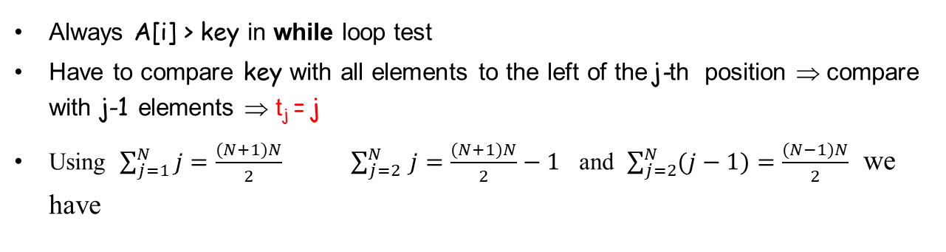
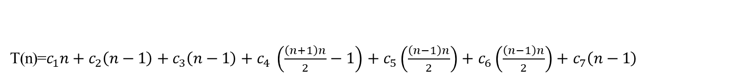
Worst Case Analysis
•
The array is in reverse sorted order“while i > 0 and A[i] > key”
Always A[i] > key in while loop test
Have to compare key with all elements to the left of the j-th position ⇒ compare with j-1 elements ⇒ t_{j} = j
Using $\sum_{j=1}^{N}{j}=\frac{(N+1)N}{2} \sum_{j=2 }^{N}{j}=\frac{(N+1)N}{2}−1$ and $\sum_{j=2}^{N}{(j−1)}=\frac{(N−1)N}{2}$ we have
T(n)=$c_{1}n+c_{2}\left(n−1\right)+c_{3}\left(n−1\right)+c_{4} \left(\frac{\left(n+1\right)n}{2}−1\right)+c_{5}\left(\frac{\left(n−1\right)n}{2}\right)+c_{6}\left(\frac{\left(n−1\right)n}{2}\right)+c_{7}\left(n−1\right)$
= an² + bn + c
T(n) = Θ(n²)
a quadratic function of n
order of growth in n²

Slide 15
Bubble sort

Slide 16
Bubble Sort
Idea:
Repeatedly pass through the array
Swaps adjacent elements that are out of order
j
1
2
3
n
8 | 4 | 6 | 9 | 2 | 3 | 1
Easier to implement, but slower than Insertion sort

Slide 17
Example
i= 1
i=2
8 | 4 | 6 | 9 | 2 | 3 | 1
4 | 6 | 8 | 2 | 3 | 1 | 9
J=1
J=1
4 | 8 | 6 | 9 | 2 | 3 | 1
4 | 6 | 8 | 2 | 3 | 1 | 9
J = 2
J=2
j
4 | 6 | 8 | 9 | 2 | 3 | 1
4 | 6 | 8 | 2 | 3 | 1 | 9
J=3
J = 3
4 | 6 | 2 | 8 | 3 | 1 | 9
4 | 6 | 8 | 2 | 9 | 3 | 1
J=4
J = 4
4 | 6 | 2 | 3 | 8 | 1 | 9
4 | 6 | 8 | 2 | 9 | 3 | 1
J=5
J = 5
4 | 6 | 2 | 3 | 1 | 8 | 9
4 | 6 | 8 | 2 | 3 | 9 | 1
J = 6
4 | 6 | 8 | 2 | 3 | 1 | 9

Slide 18
Example
i= 3
4 | 6 | 2 | 3 | 1 | 8 | 9
2 | 3 | 4 | 1 | 6 | 8 | 9
J=1
J=3
4 | 6 | 2 | 3 | 1 | 8 | 9
2 | 3 | 1 | 4 | 6 | 8 | 9
J = 2
4 | 2 | 6 | 3 | 1 | 8 | 9
i = 5
2 | 3 | 1 | 4 | 6 | 8 | 9
J = 3
4 | 2 | 3 | 6 | 1 | 8 | 9
J=1
2 | 3 | 1 | 4 | 6 | 8 | 9
J = 4
4 | 2 | 3 | 1 | 6 | 8 | 9
J=2
2 | 1 | 3 | 4 | 6 | 8 | 9
i = 4
i= 6
4 | 2 | 3 | 1 | 6 | 8 | 9
2 | 1 | 3 | 4 | 6 | 8 | 9
J = 1
2 | 4 | 3 | 1 | 6 | 8 | 9
J=1
1 | 2 | 3 | 4 | 6 | 8 | 9
J =2
J = 2

Slide 19
Bubble Sort : pseudo-code
Algorithm Bubble-sort(A, n)
for i ← 1 to n-1 do
for j ← 1 to n-i do
if A[j] > A[j +1] then
exchange A[j] ↔ A[j-1]
8 | 4 | 6 | 9 | 2 | 3 | 1
j = 1

Slide 20
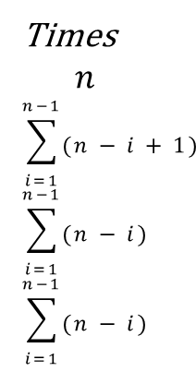

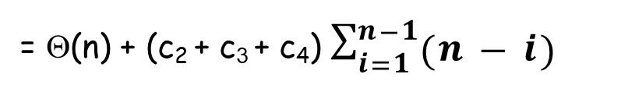
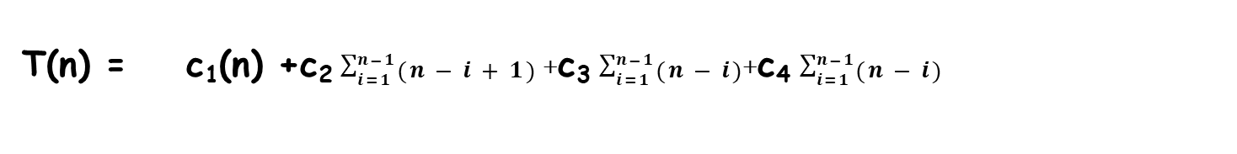
Bubble-Sort Running Time
$$c_{1}$$
$$c_{2}$$
$$c_{3}$$
$$c_{4}$$
cost
Algorithm Bubble-sort(A, n)
for i ← 1 to n-1 do
for j ← 1 to n-i do
if A[j] > A[j +1] then
exchange A[j] ↔ A[j-1]
Times
$$n$$
$$\sum_{i=1}^{n−1}{(n−i+1)}$$
$$\sum_{i=1}^{n−1}{(n−i)}$$
$$\sum_{i=1}^{n−1}{(n−i)}$$
T(n) = c₁(n) +c₂ $\sum_{i=1}^{n−1}{(n−i+1)}$+ c₃ $\sum_{i=1}^{n−1}{(n−i)}$+c₄ $\sum_{i=1}^{n−1}{(n−i)}$
= Θ(n) + (c₂ + c₃ + c₄) $\sum_{i=1}^{n−1}{(n−i)}$
where $\sum_{i=1}^{n−1}{(n−i)}=\sum_{i=1}^{n−1}{n }−\sum_{i=1}^{n−1}{i }$=$n^{2}−\frac{n(n+1)}{2}$=$\frac{n^{2}}{2}$ − $\frac{n}{2}$
Thus,T(n) = Θ(n²)

Slide 21
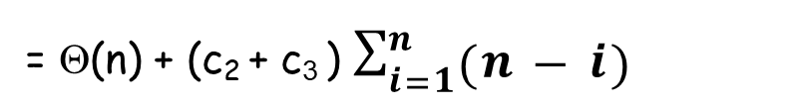
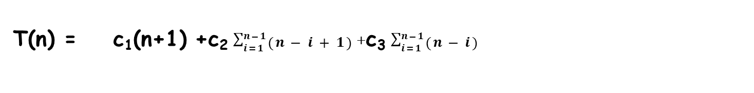
Best Case Analysis
The array is already sorted
T(n) = c₁(n+1) +c₂ $\sum_{i=1}^{n−1}{(n−i+1)}$+ c₃ $\sum_{i=1}^{n−1}{(n−i)}$
= Θ(n) + (c₂ + c₃ ) $\sum_{i=1}^{n}{(n−i)}$
where $\sum_{i=1}^{n−1}{(n−i)}=\sum_{i=1}^{n−1}{n }−\sum_{i=1}^{n−1}{i }$=$n^{2}−\frac{n(n+1)}{2}$=$\frac{n^{2}}{2}$ − $\frac{n}{2}$
Thus,T(n) = Θ(n²)

Slide 22
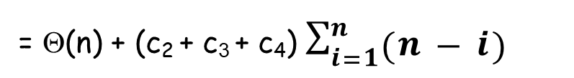
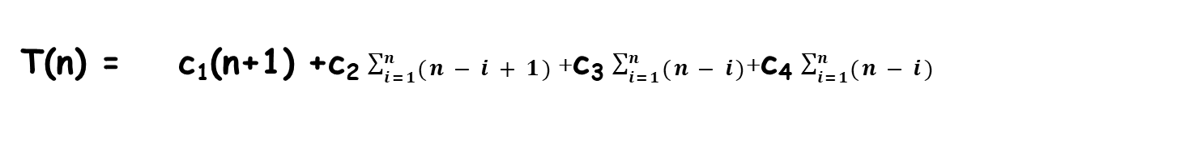
Worst Case Analysis
The array is in reverse sorted order
T(n) = c₁(n+1) +c₂ $\sum_{i=1}^{n}{(n−i+1)}$+ c₃ $\sum_{i=1}^{n}{(n−i)}$+c₄ $\sum_{i=1}^{n}{(n−i)}$
= Θ(n) + (c₂ + c₃ + c₄) $\sum_{i=1}^{n}{(n−i)}$
where $\sum_{i=1}^{n}{(n−i)}=\sum_{i=1}^{n}{n }−\sum_{i=1}^{n}{i }$=$n^{2}−\frac{n(n+1)}{2}$=$\frac{n^{2}}{2}$ − $\frac{n}{2}$
Thus,T(n) = Θ(n²)

Slide 23
Analysis of Bubble-Sort
In any cases, (worse case, best case or average case) to sort the list in ascending order the number of comparisons between elements is the same.
Best case : O(n²)
Average case: O(n²)
Worst case: O(n²)
How to optimize bubble sort in case sorted array ?

Slide 24
Selection sort

Slide 25
Selection Sort
Idea:
Find the smallest element in the array
Exchange it with the element in the first position
Find the second smallest element and exchange it with the element in the second position
Continue until the array is sorted

Slide 26
Example
8 | 4 | 6 | 9 | 2 | 3 | 1
1 | 2 | 3 | 4 | 9 | 6 | 8
1 | 4 | 6 | 9 | 2 | 3 | 8
1 | 2 | 3 | 4 | 6 | 9 | 8
1 | 2 | 6 | 9 | 4 | 3 | 8
1 | 2 | 3 | 4 | 6 | 8 | 9
1 | 2 | 3 | 9 | 4 | 6 | 8
1 | 2 | 3 | 4 | 6 | 8 | 9

Slide 27
Selection Sort
Algorithm Selection-sort(A,n)
for j ← 1 to n – 1 do
smallest ← j
for i ← j + 1 to n do
if A[i] < A[smallest]
then smallest ← i
exchange A[j] ↔ A[smallest]
8 | 4 | 6 | 9 | 2 | 3 | 1

Slide 28
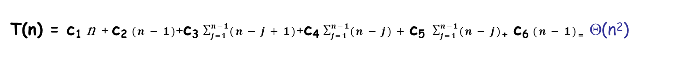
Analysis of Selection Sort: running time
cost times
c₁ n
c₂ n-1
Algorithm Selection-sort(A,n)
for j ← 1 to n – 1 do
smallest ← j
for i ← j + 1 to n do
if A[i] < A[smallest]
then smallest ← i
exchange A[j] ↔ A[smallest]
c
∑
n−1 j =1
3
(n − j +1)
c₄
∑
n−1 j =1
(n − j)
c₅
c₆ n-1
∑
n−1 j =1
(n − j)
T(n) = c₁ n + c₂ $(n−1)$+c₃ $\sum_{j=1}^{n−1}{(n−j+1)}$+c₄ $\sum_{j=1}^{n−1}{(n−j)}+\text{c}\text{5} \sum_{j=1}^{n−1}{(n−j)}$₊ c₆ $(n−1)$₌ Θ(n²)

Slide 29
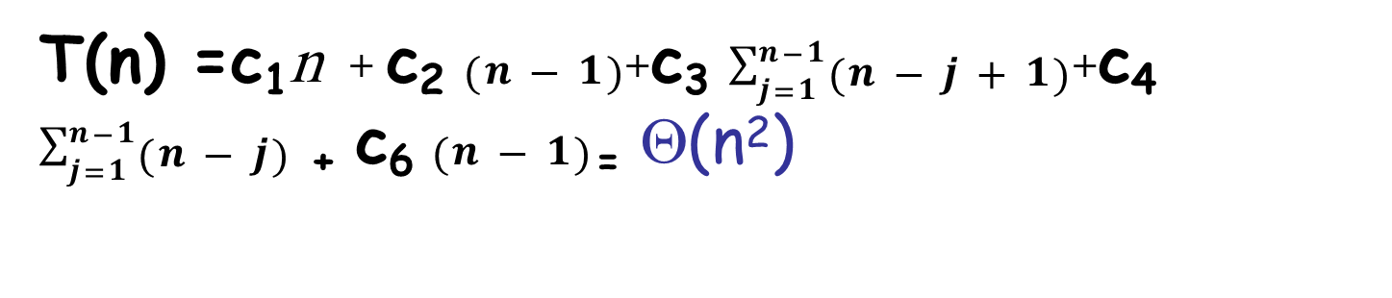
Best Case Analysis
T(n) =c₁n + c₂ $(n−1)$+c₃ $\sum_{j=1}^{n−1}{(n−j+1)}$+c₄ $\sum_{j=1}^{n−1}{(n−j)}$ ₊ c₆ $(n−1)$₌ Θ(n²)

Slide 30
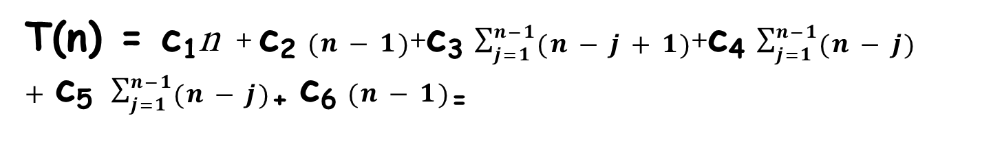
Worst Case Analysis
T(n) = c₁n + c₂ $(n−1)$+c₃ $\sum_{j=1}^{n−1}{(n−j+1)}$+c₄ $\sum_{j=1}^{n−1}{(n−j)}+\text{c}\text{5} \sum_{j=1}^{n−1}{(n−j)}$₊ c₆ $(n−1)$₌
where $\sum_{j=1}^{n−1}{(n−j)}=\sum_{j=1}^{n−1}{n }−\sum_{j=1}^{n−1}{j }$=$n^{2}−\frac{n(n+1)}{2}$=$\frac{n^{2}}{2}$ − $\frac{n}{2}$
Thus,T(n) = Θ(n²)

Slide 31
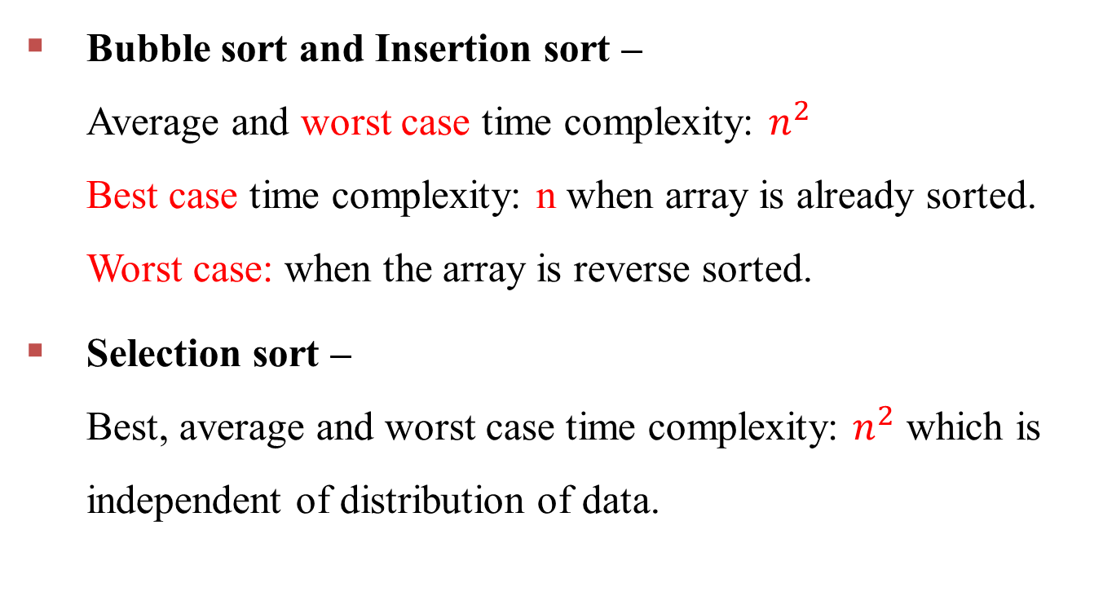
Summary
Bubble sort and Insertion sort – Average and worst case time complexity: $n^{2}$ Best case time complexity: n when array is already sorted. Worst case: when the array is reverse sorted.
Selection sort – Best, average and worst case time complexity: $n^{2}$ which is independent of distribution of data.

Slide 32
Thanks

