Slide 1
Algorithm analysis & design Analysis Of Recursive Algorithms
Presented By:
T.A. Asmaa Hamad El-saied
E-mail: eng.asmaa134@gmail.com
Lab 5
FCI, Minia University

Slide 2
Agenda
Analysis of recursive algorithms
Iteration (Substitution) method
Master Method (Theorem)
Recursion tree method
Examples of Recursive Algorithms
Divide and Conquer
Merge Sort
Quick Sort

Slide 3
General form of recursive function
f(N)
{
-------------
-------------
Recursive: f( ), f( ),…..
--------------
--------------
}
Non recursive part

Slide 4
How to Analyze the Recursive Functions?
Two Steps
Compute running time (T(N)) (recurrence equation) the recursive function
T(n)=T(non recursive part)+ T(different N)
Solve T(n) recurrence relation using one of Two methods to get the order (Θ or O)
Iteration Method
Master method

Slide 5
First Step

Slide 6
Examples
Compute the recurrence of the following examples (just deduce T(N)):
Factorial
Fibonacci
Binary search

Slide 7
Examples
Factorial
T(N)= C+T(N-1)
ALGORITHM Fact (N)
if N= =1 or N==0
return 1
else
return Fact(N-1) *N

Slide 8
Examples
Fibonacci
T(N)= C+T(N-1)+T(N-2)
fibonacci (N)
{
if N== 0
return 0
Else if N==1
return 1
else
return fibonacci(N – 1) + fibonacci(N – 2);
}

Slide 9
Examples
Binary search
item
T(N)= C+T(N/2)
<
>
Sorted

Slide 10
Second step

Slide 11
Iteration (Substitution)

Slide 12
Iteration Method
Idea…
Deduce the complexity by iteratively substitute the T(N) terms until reaching general formula. Then, get the complexity using both the formula and the termination condition.

Slide 13
Iteration Method
When to Use?!
Deduction of general formula is easier if there's exist one term in the recurrence. (i.e. recurrence is in the form of
T(N) = a T(something)+ something2
(One T: T(something))
and NOT appropriate if
T(N)= a T(something1) + b T(something2) + … + something
(More than One T: T(something1),T(something2) …)
(It will be difficult to deduce its general formula)

Slide 14
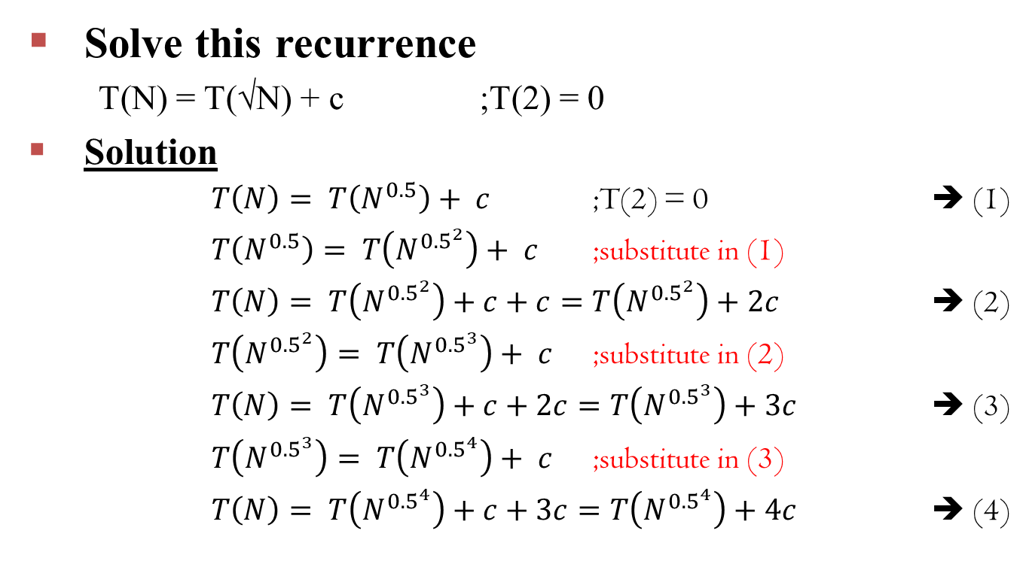
Example
Solve this recurrence
T(N) = T(√N) + c ;T(2) = 0
Solution
$T\left(N\right)= T\left(N^{0.5}\right)+ c$ ;T(2) = 0 ➔ (1)
$T\left(N^{0.5}\right)= T\left(N^{{0.5}^{2}}\right)+ c$ ;substitute in (1)
$T\left(N\right)= T\left(N^{{0.5}^{2}}\right)+c+c=T\left(N^{{0.5}^{2}}\right)+2c$ ➔ (2)
$T\left(N^{{0.5}^{2}}\right)= T\left(N^{{0.5}^{3}}\right)+ c$ ;substitute in (2)
$T\left(N\right)= T\left(N^{{0.5}^{3}}\right)+c+2c=T\left(N^{{0.5}^{3}}\right)+3c$ ➔ (3)
$T\left(N^{{0.5}^{3}}\right)= T\left(N^{{0.5}^{4}}\right)+ c$ ;substitute in (3)
$T\left(N\right)= T\left(N^{{0.5}^{4}}\right)+c+3c=T\left(N^{{0.5}^{4}}\right)+4c$ ➔ (4)

Slide 15
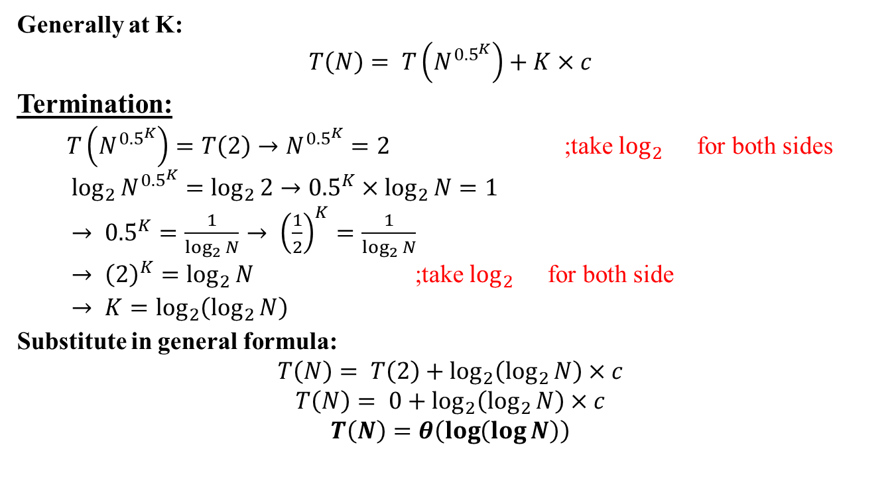
Example
Generally at K:
$$T\left(N\right)= T\left(N^{{0.5}^{K}}\right)+K×c$$
Termination:
$T\left(N^{{0.5}^{K}}\right)=T\left(2\right)→N^{{0.5}^{K}}=2$ ;take $\log_{2}{}$ for both sides
$\log_{2}{N^{{0.5}^{K}}}=\log_{2}{2}→{{0.5}^{K}×log}_{2}{N}=1$
$→ {0.5}^{K}=\frac{1}{\log_{2}{N}}→ {\left(\frac{1}{2}\right)}^{K}=\frac{1}{\log_{2}{N}}$
$→ {\left(2\right)}^{K}=\log_{2}{N}$ ;take $\log_{2}{}$ for both side
$→ K=\log_{2}\left(\log_{2}{N}\right)$
Substitute in general formula:
$$T\left(N\right)= T\left(2\right)+\log_{2}\left(\log_{2}{N}\right)×c$$
$$T\left(N\right)= 0+\log_{2}\left(\log_{2}{N}\right)×c$$
$$T\left(N\right)=θ\left(\log\left(\log{N}\right)\right)$$

Slide 16
MASTER THEOREM

Slide 17
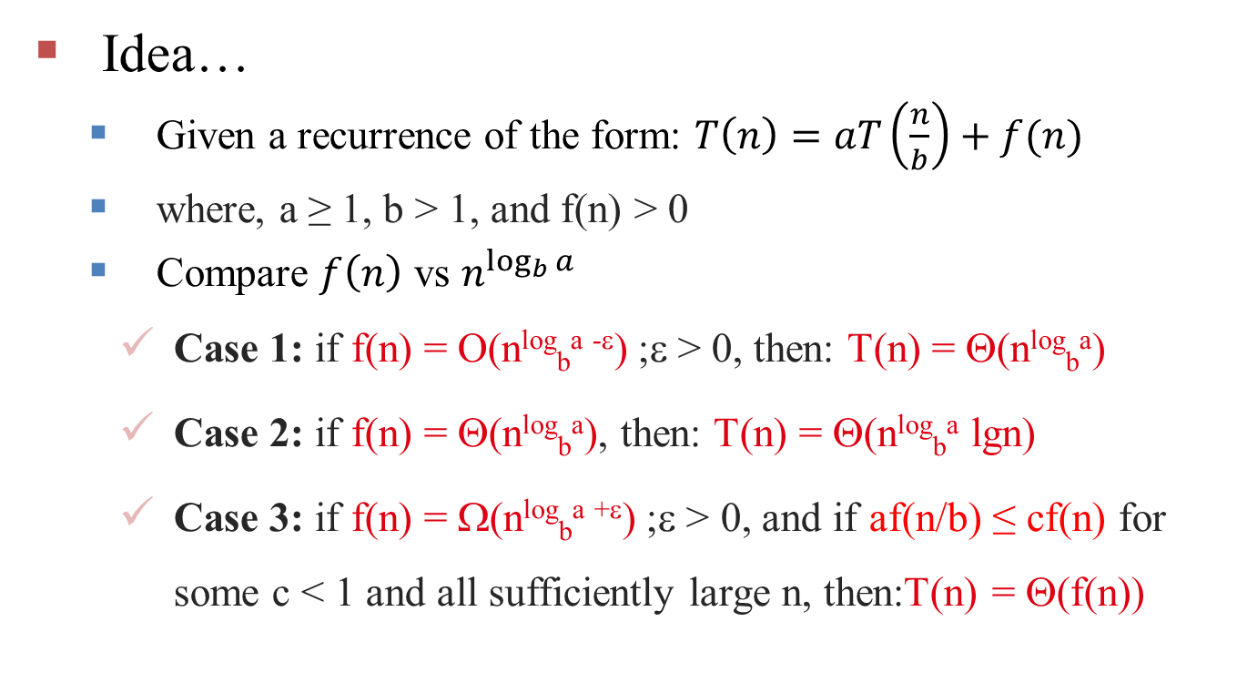
Master method
Idea…
Given a recurrence of the form: $T\left(n\right)=aT\left(\frac{n}{b}\right)+f(n)$
where, a ≥ 1, b > 1, and f(n) > 0
Compare $f\left(n\right)$ vs $n^{\log_{b}{a}}$
Case 1: if f(n) = O(n^{log}_{b}^{a -ε}) ;ε > 0, then: T(n) = Θ(n^{log}_{b}ª)
Case 2: if f(n) = Θ(n^{log}_{b}ª), then: T(n) = Θ(n^{log}_{b}ª lgn)
Case 3: if f(n) = Ω(n^{log}_{b}^{a +ε}) ;ε > 0, and if af(n/b) ≤ cf(n) for some c < 1 and all sufficiently large n, then:T(n) = Θ(f(n))
Notes:
T(N)=T(N-1)+C False
T(N)=2T(N-1)+N^2 False
T(N)=3T(N/4) +1 true

Slide 18
Master method
When to Use?!
If the recurrence is in the form of
T(N)= aT(N/b)+f(N)
Notes:
Sometimes master method fails. So if it fails use Recursion Tree.

Slide 19
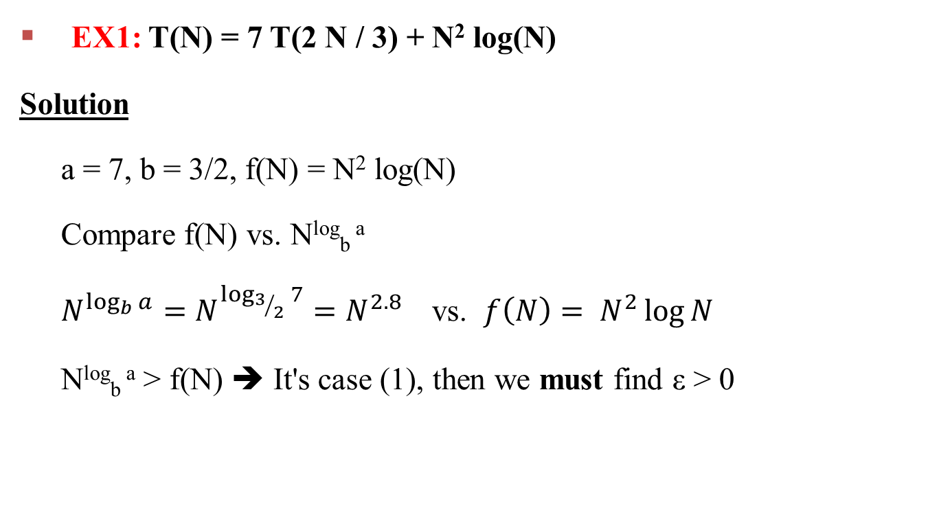
Examples
EX1: T(N) = 7 T(2 N / 3) + N² log(N)
Solution
a = 7, b = 3/2, f(N) = N² log(N)
Compare f(N) vs. N^{log}_{b} ª
$N^{\log_{b}{a}}=N^{\log_{3/2}{7}}=N^{2.8}$ vs. $f\left(N\right)= N^{2}\log{N}$
N^{log}_{b} ª > f(N) ➔ It's case (1), then we must find ε > 0

Slide 20
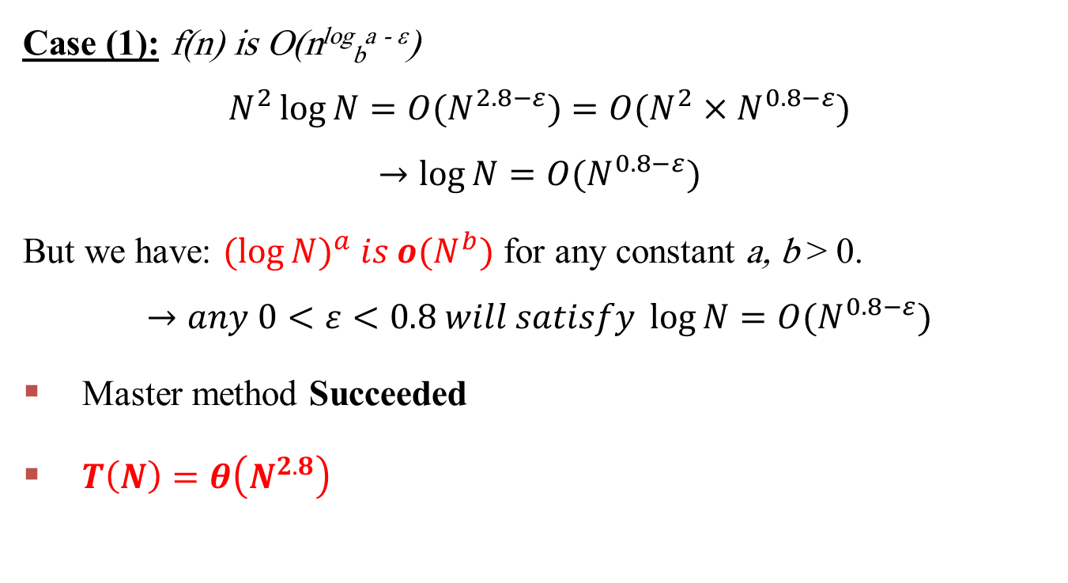
Examples
Case (1): f(n) is O(n^{log}_{b}^{a - ε})
$$N^{2}\log{N}=O(N^{2.8−ε})=O(N^{2}×N^{0.8−ε})$$
$$→\log{N}=O(N^{0.8−ε})$$
But we have: $({\log{N})}^{a} is o(N^{b})$ for any constant a, b > 0.
$$→any 0<ε<0.8 will satisfy \log{N}=O(N^{0.8−ε})$$
Master method Succeeded
$T\left(N\right)=θ\left(N^{2.8}\right)$

Slide 21
Examples
EX2: T(n) = 2T(n/2) + n
a = 2, b = 2, log₂2 = 1
Compare n^{log}₂² with f(n) = n
N^{log}_{b} ª = f(N) ➔ It's case (2),
Case 2
⇒ f(n) = Θ(n) ⇒ T(n) = Θ(nlgn)

Slide 22
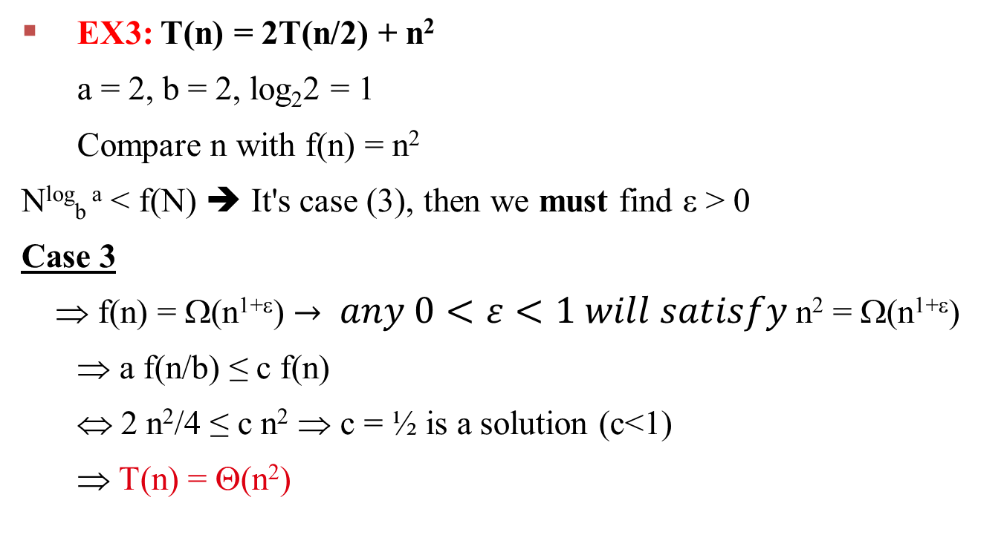
Examples
EX3: T(n) = 2T(n/2) + n²
a = 2, b = 2, log₂2 = 1
Compare n with f(n) = n²
N^{log}_{b} ª < f(N) ➔ It's case (3), then we must find ε > 0
Case 3
⇒ f(n) = Ω(n^{1+ε}) $→ any 0<ε<1 will satisfy$n² = Ω(n^{1+ε})
⇒ a f(n/b) ≤ c f(n)
⇔ 2 n²/4 ≤ c n² ⇒ c = ½ is a solution (c<1)
⇒ T(n) = Θ(n²)

Slide 23
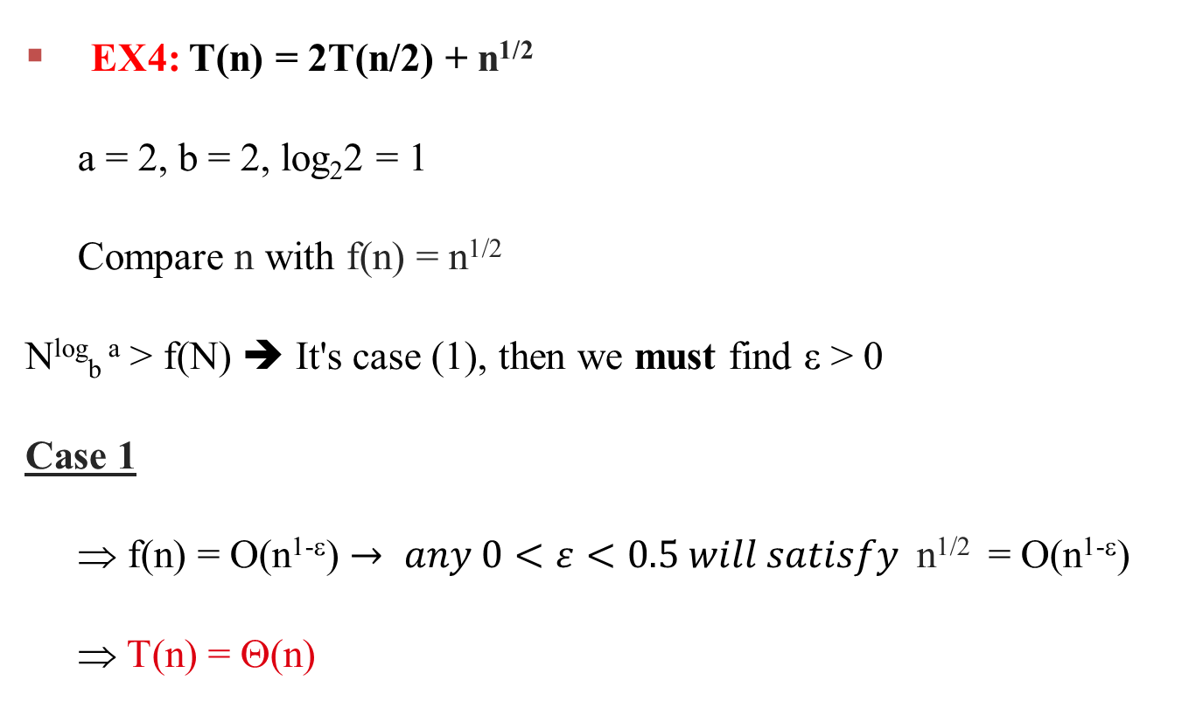
Examples
EX4: T(n) = 2T(n/2) + n^{1/2}
a = 2, b = 2, log₂2 = 1
Compare n with f(n) = n^{1/2}
N^{log}_{b} ª > f(N) ➔ It's case (1), then we must find ε > 0
Case 1
⇒ f(n) = O(n^{1-ε}) $→ any 0<ε<0.5 will satisfy$n^{1/2} = O(n^{1-ε})
⇒ T(n) = Θ(n)

Slide 24
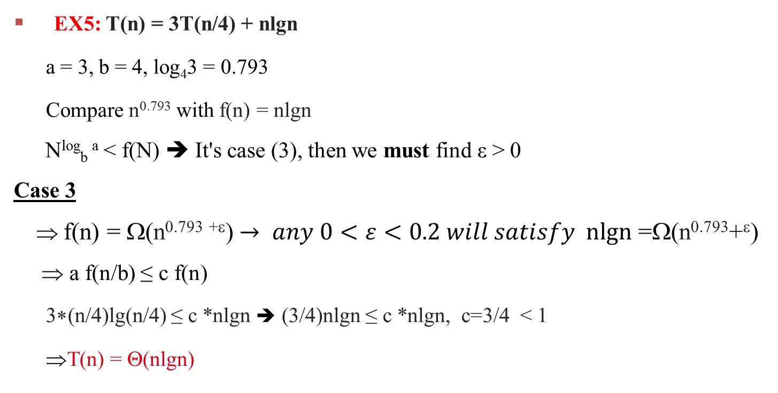
Examples
EX5: T(n) = 3T(n/4) + nlgn
a = 3, b = 4, log₄3 = 0.793
Compare n^{0.793} with f(n) = nlgn
N^{log}_{b} ª < f(N) ➔ It's case (3), then we must find ε > 0
Case 3
⇒ f(n) = Ω(n^{0.793} ^{+ε}) $→ any 0<ε<0.2 will satisfy nlgn$ =Ω(n^{0.793}+^{ε})
⇒ a f(n/b) ≤ c f(n)
3∗(n/4)lg(n/4) ≤ c *nlgn ➔ (3/4)nlgn ≤ c *nlgn, c=3/4 < 1
⇒T(n) = Θ(nlgn)

Slide 25
Divide and Conquer

Slide 26
Divide and Conquer
Divide-and conquer is a general algorithm design paradigm/model;
Divide: divide the problem into small sub-problem(s)
Conquer : Solve the sub-problems recursively in same manner
Combine : the solution of the sub-problems to get the final solution

Slide 27
Merge Sort

Slide 28
Merge Sort
Merge-sort on an input sequence/list S with n elements consists of three steps:
Divide: partition S into two sequences S1 and S2 of n/2 elements each
Conquer : recursively sort S1 and S2 using merge sort
Combine: merge S1 and S2 into a unique sorted sequence

Slide 29
Merge Sort
Divide:
Conquer and Merge:
8 | 3 | 2 | 9 | 7 | 1 | 5 | 4
8 | 3 | 2 | 9
7 | 1 | 5 | 4
8 3
2 9
7 1
5 4
8
3
2
9
7
1
5
4
3
8
2
9
1
7
4
5
2 | 3 | 8 | 9
1 | 4 | 5 | 7
1
2
3
4 5
7
8
9

Slide 30
Merge Sort: pseudo-code
Algorithm Merge-Sort(A, p, r):
if p < r then
q← ⎣(p+r)/2⎦
Merge-Sort(A, p, q)
Merge-Sort(A, q+1, r)
Merge(A, p, q, r)
A:
2 | 3 | 8 | 9 | 1 | 4 | 5 | 7
p
q
r

Slide 31


Pseudocode of the merge procedure
MERGE (A, p, q, r )
n₁ ← q − p + 1
n₂ ← r − q
Create arrays L[1 . . n₁ + 1] and R[1 . . n₂ + 1]
FOR i ← 1 TO n₁ DO
L[i] ← A[p + i − 1]
FOR j ← 1 TO n₂ DO
R[j] ← A[q + j ]
L[n₁ + 1] ← ∞
R[n₂ + 1] ← ∞
i ← 1
j ← 1
FOR k ← p TO r DO
IF L[i ] ≤ R[ j] THEN
A[k] ← L[i]
i ← i + 1
ELSE A[k] ← R[j]
j ← j + 1

Slide 32

ANALYSIS OF MERGE SORT
ALGORITHM Mergesort(A, p, r )
IF p < r
THEN q = FLOOR[(p + r)/2] 1
MERGE_Sort (A, p, q)
T(n/2)
MERGE_Sort (A, q + 1, r)
T(n/2)
MERGE (A, p, q, r)
θ(n)
T(n) = 2T(n/2) + θ(n)

Slide 33
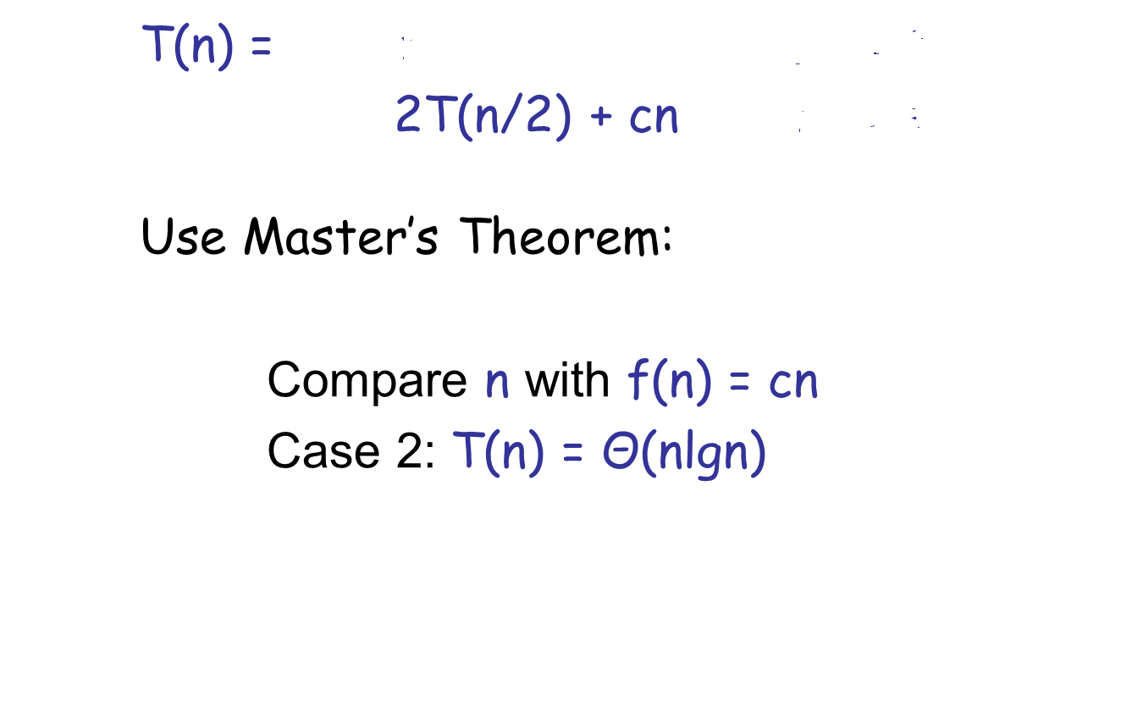
Solve the Recurrence
a = 2, b = 2, log₂2 = 1

Slide 34
Quick Sort

Slide 35
Quick Sort
Quick-sort on an input sequence/list S with n elements consists of three steps:
Divide: partition S into two sequences S1 and S2 based on pivot value.
Conquer : recursively sort S1 and S2
Combine: merge S1 and S2 into a unique sorted sequence

Slide 36
Quick Sort
Pivot selection
There are different methods for pivot selection for instance:
Use the list first element as a pivot
Use the list last element as a pivot
Use the middle element as a pivot
Use a random element as a pivot

Slide 37
Example
We are given array of n integers to sort:
40
20
10
80
60
50
7
30
100

Slide 38
Pick Pivot Element
There are a number of ways to pick the pivot element. In this example, we will use the first element in the array:
40
20
10
80
60
50
7
30
100

Slide 39
pivot_index = 0
40
20
10
80
60
50
7
30
100
[0] [1] [2] [3] [4] [5] [6] [7] [8]
low_index
big_index

Slide 40
While arr[low_index] <= arr[pivot]
low_index++
pivot_index = 0
40
20
10
80
60
50
7
30
100
[0] [1] [2] [3] [4] [5] [6] [7] [8]
low_index
big_index

Slide 41
While arr[low_index] <= arr[pivot]
low_index++
pivot_index = 0
40
20
10
80
60
50
7
30
100
[0] [1] [2] [3] [4] [5] [6] [7] [8]
low_index
big_index

Slide 42
While arr[low_index] <= arr[pivot]
low_index++
pivot_index = 0
40
20
10
80
60
50
7
30
100
[0] [1] [2] [3] [4] [5] [6] [7] [8]
low_index
big_index

Slide 43
While arr[low_index] <= arr[pivot]
low_index++
While arr[big_index] > arr[pivot]
big_index--
pivot_index = 0
40
20
10
80
60
50
7
30
100
[0] [1] [2] [3] [4] [5] [6] [7] [8]
low_index
big_index

Slide 44
While arr[low_index] <= arr[pivot]
low_index++
While arr[big_index] > arr[pivot]
big_index--
pivot_index = 0
40
20
10
80
60
50
7
30
100
[0] [1] [2] [3] [4] [5] [6] [7] [8]
low_index
big_index

Slide 45
While arr[low_index] <= arr[pivot]
low_index++
While arr[big_index] > arr[pivot]
big_index--
If low_index < big_index
swap arr[low_index] and arr[big_index]
pivot_index = 0
40
20
10
80
60
50
7
30
100
[0] [1] [2] [3] [4] [5] [6] [7] [8]
low_index
big_index

Slide 46
While arr[low_index] <= arr[pivot]
low_index++
While arr[big_index] > arr[pivot]
big_index--
If low_index < big_index
swap arr[low_index] and arr[big_index]
pivot_index = 0
40
20
10
30
60
50
7
80
100
[0] [1] [2] [3] [4] [5] [6] [7] [8]
low_index
big_index

Slide 47
While arr[low_index] <= arr[pivot]
low_index++
While arr[big_index] > arr[pivot]
big_index--
If low_index < big_index
swap arr[low_index] and arr[big_index]
While low_index <= big_index, go to 1.
pivot_index = 0
40
20
10
30
60
50
7
80
100
[0] [1] [2] [3] [4] [5] [6] [7] [8]
low_index
big_index

Slide 48
While arr[low_index] <= arr[pivot]
low_index++
While arr[big_index] > arr[pivot]
big_index--
If low_index < big_index
swap arr[low_index] and arr[big_index]
While low_index <= big_index, go to 1.
pivot_index = 0
40
20
10
30
60
50
7
80
100
[0] [1] [2] [3] [4] [5] [6] [7] [8]
low_index
big_index

Slide 49
While arr[low_index] <= arr[pivot]
low_index++
While arr[big_index] > arr[pivot]
big_index--
If low_index < big_index
swap arr[low_index] and arr[big_index]
While low_index <= big_index, go to 1.
pivot_index = 0
40
20
10
30
60
50
7
80
100
[0] [1] [2] [3] [4] [5] [6] [7] [8]
low_index
big_index

Slide 50
While arr[low_index] <= arr[pivot]
low_index++
While arr[big_index] > arr[pivot]
big_index--
If low_index < big_index
swap arr[low_index] and arr[big_index]
While low_index <= big_index, go to 1.
pivot_index = 0
40
20
10
30
60
50
7
80
100
[0] [1] [2] [3] [4] [5] [6] [7] [8]
low_index
big_index

Slide 51
While arr[low_index] <= arr[pivot]
low_index++
While arr[big_index] > arr[pivot]
big_index--
If low_index < big_index
swap arr[low_index] and arr[big_index]
While low_index <= big_index, go to 1.
pivot_index = 0
40
20
10
30
60
50
7
80
100
[0] [1] [2] [3] [4] [5] [6] [7] [8]
low_index
big_index

Slide 52
While arr[low_index] <= arr[pivot]
low_index++
While arr[big_index] > arr[pivot]
big_index--
If low_index < big_index
swap arr[low_index] and arr[big_index]
While low_index <= big_index, go to 1.
pivot_index = 0
40
20
10
30
7
50
60
80
100
[0] [1] [2] [3] [4] [5] [6] [7] [8]
low_index
big_index

Slide 53
While arr[low_index] <= arr[pivot]
low_index++
While arr[big_index] > arr[pivot]
big_index--
If low_index < big_index
swap arr[low_index] and arr[big_index]
While low_index <= big_index, go to 1.
pivot_index = 0
40
20
10
30
7
50
60
80
100
[0] [1] [2] [3] [4] [5] [6] [7] [8]
low_index
big_index

Slide 54
While arr[low_index] <= arr[pivot]
low_index++
While arr[big_index] > arr[pivot]
big_index--
If low_index < big_index
swap arr[low_index] and arr[big_index]
While low_index <= big_index, go to 1.
pivot_index = 0
40
20
10
30
7
50
60
80
100
[0] [1] [2] [3] [4] [5] [6] [7] [8]
low_index
big_index

Slide 55
While arr[low_index] <= arr[pivot]
low_index++
While arr[big_index] > arr[pivot]
big_index--
If low_index < big_index
swap arr[low_index] and arr[big_index]
While low_index <= big_index, go to 1.
pivot_index = 0
40
20
10
30
7
50
60
80
100
[0] [1] [2] [3] [4] [5] [6] [7] [8]
low_index
big_index

Slide 56
While arr[low_index] <= arr[pivot]
low_index++
While arr[big_index] > arr[pivot]
big_index--
If low_index < big_index
swap arr[low_index] and arr[big_index]
While low_index <= big_index, go to 1.
pivot_index = 0
40
20
10
30
7
50
60
80
100
[0] [1] [2] [3] [4] [5] [6] [7] [8]
low_index
big_index

Slide 57
While arr[low_index] <= arr[pivot]
low_index++
While arr[big_index] > arr[pivot]
big_index--
If low_index < big_index
swap arr[low_index] and arr[big_index]
While low_index <= big_index, go to 1.
pivot_index = 0
40
20
10
30
7
50
60
80
100
[0] [1] [2] [3] [4] [5] [6] [7] [8]
low_index
big_index

Slide 58
While arr[low_index] <= arr[pivot]
low_index++
While arr[big_index] > arr[pivot]
big_index--
If low_index < big_index
swap arr[low_index] and arr[big_index]
While low_index <= big_index, go to 1.
pivot_index = 0
40
20
10
30
7
50
60
80
100
[0] [1] [2] [3] [4] [5] [6] [7] [8]
low_index
big_index

Slide 59
While arr[low_index] <= arr[pivot]
low_index++
While arr[big_index] > arr[pivot]
big_index--
If low_index < big_index
swap arr[low_index] and arr[big_index]
While low_index <= big_index, go to 1.
pivot_index = 0
40
20
10
30
7
50
60
80
100
[0] [1] [2] [3] [4] [5] [6] [7] [8]
low_index
big_index

Slide 60
While arr[low_index] <= arr[pivot]
low_index++
While arr[big_index] > arr[pivot]
big_index--
If low_index < big_index
swap arr[low_index] and arr[big_index]
While low_index <= big_index, go to 1.
pivot_index = 0
40
20
10
30
7
50
60
80
100
[0] [1] [2] [3] [4] [5] [6] [7] [8]
low_index
big_index

Slide 61
While arr[low_index] <= arr[pivot]
low_index++
While arr[big_index] > arr[pivot]
big_index--
If low_index < big_index
swap arr[low_index] and arr[big_index]
While low_index <= big_index, go to 1.
Swap arr[big_index] and arr[pivot_index]
pivot_index = 0
40
20
10
30
7
50
60
80
100
[0] [1] [2] [3] [4] [5] [6] [7] [8]
low_index
big_index

Slide 62
While arr[low_index] <= arr[pivot]
low_index++
While arr[big_index] > arr[pivot]
big_index--
If low_index < big_index
swap arr[low_index] and arr[big_index]
While low_index <= big_index, go to 1.
Swap arr[big_index] and arr[pivot_index]
7
20
10
30
40
50
60
80
100
pivot_index = 4
[0] [1] [2] [3] [4] [5] [6] [7] [8]
low_index
big_index

Slide 63
Partition Result
7
20
10
30
40
50
60
80
100
[0] [1] [2] [3] [4] [5] [6] [7] [8]
<= arr[pivot]
> arr[pivot]

Slide 64
Recursion: Quicksort Sub-arrays
7
20
10
30
40
50
60
80
100
[0] [1] [2] [3] [4] [5] [6] [7] [8]
<= arr[pivot]
> arr[pivot]

Slide 65
Quick Sort: pseud-code
Algorithm quicksort(A, left, right)
if (left<right)
pivot_index=partition(A, left, right);
quicksort(A,left,pivot_index-1);
quicksort(A, pivot_index+1,right);

Slide 66
Pseudocode of the partition procedure
Algorithm partition(A, left, right)
low_index=left+1, big_index=right;
p=A[left];
while low_index <= big_index do
while A[low_index]<=p do
low_index++;
while arr[big_index]>p do
big_index--;
if low_index<=big_index the
exchange A[low_index] ↔ A[big_index]
End while
exchange A[left] ↔ A[big_index]
return big_index;

Slide 67
Quick-SORT Running Time
Worst Case Analysis
The worst case occurs when the partition process always picks greatest or smallest element as pivot. If we consider previous partition strategy where first element is always picked as pivot, the worst case would occur when the array is already sorted in increasing or decreasing order. Following is recurrence for worst case
Recurrence Relation:
T(0) = T(1) = 0 (base case)
T(N) = N + T(N-1)

Slide 68
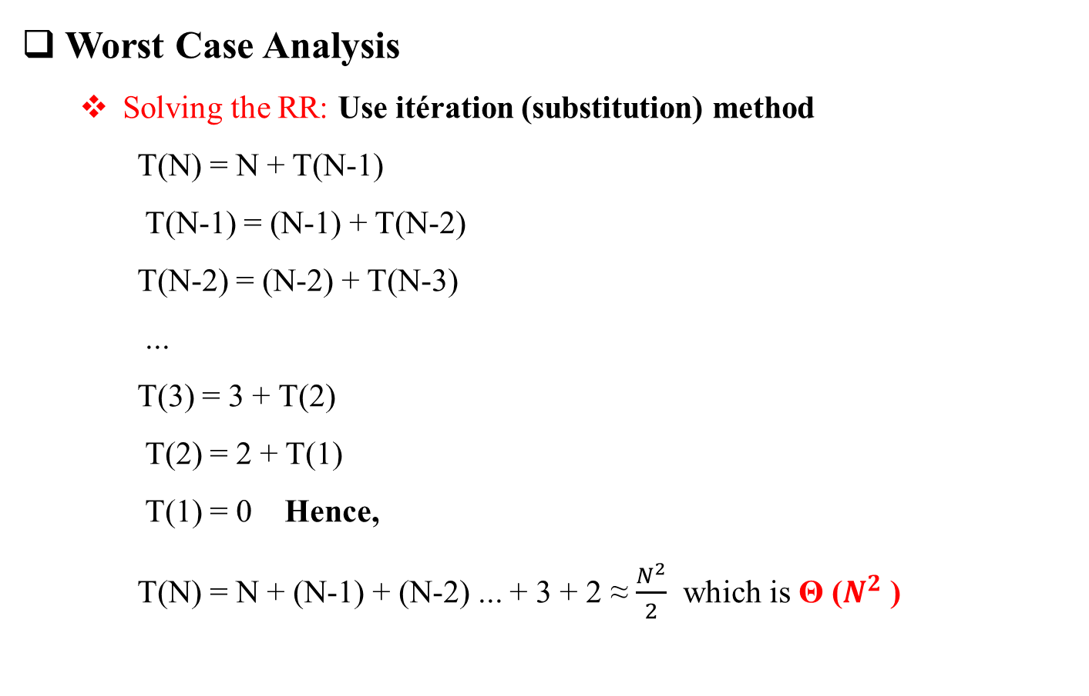
Quick-SORT Running Time
Worst Case Analysis
Solving the RR: Use itération (substitution) method
T(N) = N + T(N-1)
T(N-1) = (N-1) + T(N-2)
T(N-2) = (N-2) + T(N-3)
...
T(3) = 3 + T(2)
T(2) = 2 + T(1)
T(1) = 0 Hence,
T(N) = N + (N-1) + (N-2) ... + 3 + 2 ≈ $\frac{N^{2}}{2}$ which is Θ ($N^{2}$ )

Slide 69
Solve the Recurrence
Best Case Analysis
The best case occurs when the partition process always picks the middle element as pivot.
Following is recurrence for best case.
a = 2, b = 2, log₂2 = 1

Slide 70
Thanks

