Slide 1
Algorithm analysis & design Analysis Of searching Algorithms
Presented By:
T.A. Asmaa Hamad El-saied
E-mail: eng.asmaa134@gmail.com
Lab 6
FCI, Minia University

Slide 2
Agenda
Linear Search
Binary Search

Slide 3
Searching
Given a collection and an element (key) to find…
Output
Return a value (position of key or -1)

Slide 4
Linear Search

Slide 5
Linear Search: A Simple Search
A search traverses the collection until
The desired element is found
Or the collection is exhausted
There are two solutions
Iterative solution
Recursive solution

Slide 6
Iterative solution

Slide 7

Linear Search pseudo-code: Iterative solution
Algorithm Linear_search (A, n, target )
For i=1 to n do
If A[i]=target then
return i
return -1
End for

Slide 8
Linear Search: Example
my_array
target = 13
7 | 12 | 5 | 22 | 13 | 32
1
2
3
4
5
6

Slide 9
Linear Search: Example
my_array
7 | 12 | 5 | 22 | 13 | 32
target = 13
1
2
3
4
5
6
my_array
7 | 12 | 5 | 22 | 13 | 32
target = 13
1
2
3
4
5
6

Slide 10
Linear Search: Example
my_array
7 | 12 | 5 | 22 | 13 | 32
target = 13
1
2
3
4
5
6
my_array
target = 13
my_array
target = 13
7 | 12 | 5 | 22 | 13 | 32
1 | 2 | 3 | 4 | 5 | 6
7 | 12 | 5 | 22 | 13 | 32
1 | 2 | 3 | 4 | 5 | 6

Slide 11
Linear Search: Example
my_array
7 | 12 | 5 | 22 | 13 | 32
target = 13
1
2
3
4
5
6
Return 5

Slide 12

Linear Search Analysis: Best Case
Algorithm Linear_search ( A, n, target )
For i=1 to n do
If A[i]=target then
return i
return -1
End for
Best Case:
1 comparison
Best Case: match with the first item $θ$(1)
7 | 12 | 5 | 22 | 13 | 32
target = 7

Slide 13
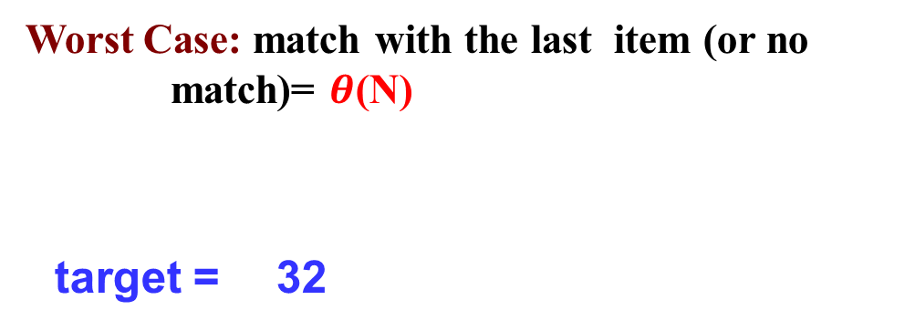
Linear Search Analysis: Worst Case
Algorithm Linear_search (A, n, target )
For i=1 to n do
If A[i]=target then
return i
return -1
End for
Worst Case:
N comparisons
Worst Case: match with the last item (or no match)= $θ$(N)
target = 32
7 | 12 | 5 | 22 | 13 | 32

Slide 14
Recursive solution

Slide 15
Linear Search pseudo-code: Recursive solution
Algorithm Linear_search (A, n, target )
If n<=0 then
return -1
Else if A[n-1]=target then
return n-1
Else
return Linear_search (A, n-1, target )

Slide 16
Linear Search analysis: Recursive solution
Algorithm Linear_search ( A, n, target )
If n<=0 then
return -1
Else if A[n-1]=target then
return n-1
Else
return Linear_search ( A, n-1, target )
Recurrence relation for iterative Linear search
T(n) = T( n-1 ) + c
The cost of searching n elements is the cost of looking at 1 element, plus the cost of searching n-1 elements

Slide 17
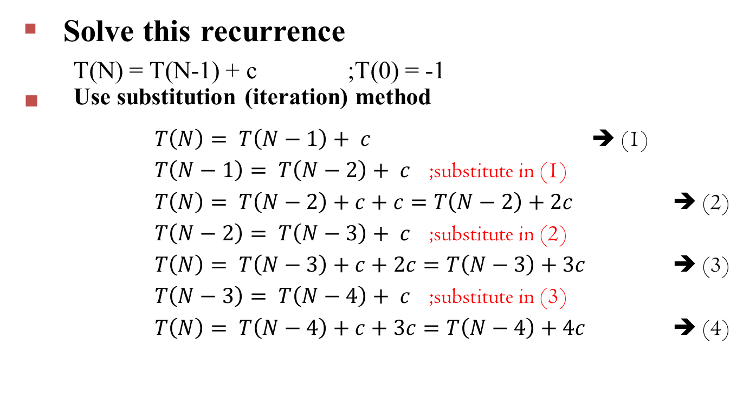
Solve the Recurrence
Solve this recurrence
T(N) = T(N-1) + c ;T(0) = -1
Use substitution (iteration) method
$T\left(N\right)= T\left(N−1\right)+ c$ ➔ (1)
$T\left(N−1\right)= T\left(N−2\right)+ c$ ;substitute in (1)
$T\left(N\right)= T\left(N−2\right)+c+c=T\left(N−2\right)+2c$ ➔ (2)
$T\left(N−2\right)= T\left(N−3\right)+ c$ ;substitute in (2)
$T\left(N\right)= T\left(N−3\right)+c+2c=T\left(N−3\right)+3c$ ➔ (3)
$T\left(N−3\right)= T\left(N−4\right)+ c$ ;substitute in (3)
$T\left(N\right)= T\left(N−4\right)+c+3c=T\left(N−4\right)+4c$ ➔ (4)

Slide 18
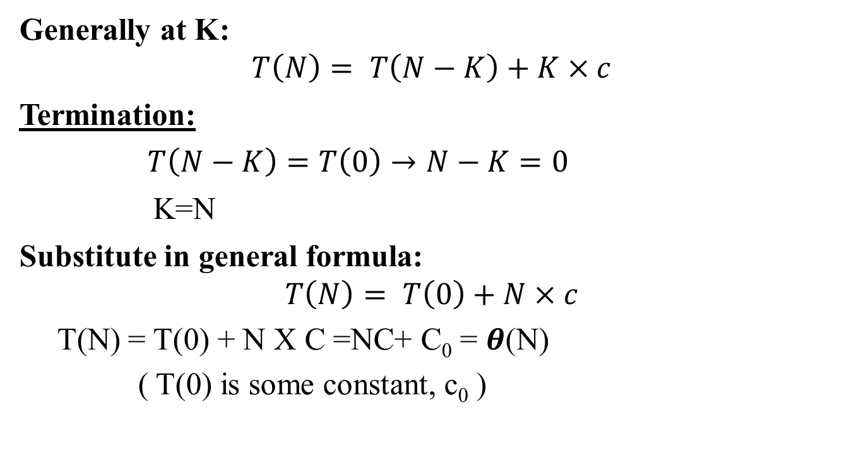
Solve the Recurrence
Generally at K:
$$T\left(N\right)= T\left(N−K\right)+K×c$$
Termination:
$T\left(N−K\right)=T\left(0\right)→N−K=0$
K=N
Substitute in general formula:
$$T\left(N\right)= T\left(0\right)+N×c$$
T(N) = T(0) + N X C =NC+ C₀ = $θ$(N)
( T(0) is some constant, c₀ )

Slide 19
Binary Search

Slide 20
Binary Search
Idea
Requires a sorted array or a binary search tree.
Cuts the “search space” in half each time.
Keeps cutting the search space in half until the target is found or has exhausted the all possible locations.
7 | 12 | 42 | 59 | 71 | 86 | 104 | 212

Slide 21
Binary search
Binary search is a better search algorithm
Of course we could use our simpler search and traverse the array. But we can use the fact that the array is sorted to our advantage. This will allow us to reduce the number of comparisons

Slide 22
Binary Search Algorithm
Look at “middle” element
If no match then
look left (if need smaller) or
right (if need larger)
 | 1 | 7 | 9 | 12 | 33 | 42 |  | 59 |  | 76 | 81 | 84 | 91 | 92 | 93 | 99

Slide 23
Binary Search Algorithm
23
Looking left:
Use indices “first” and “last” to keep track of where we are looking
Move left by setting first= middle + 1
 |  |  | 42 |  |  | 86
 | 7 | 12 |  | 59 | 71 |  | 104 | 212
F
L
M
L

Slide 24
Binary Search algorithm
24
Looking right:
Use indices “first” and “last” to keep track of where we are looking
Move rightby setting last = middle – 1
7
12 42 59 71 86 104 212
F
M
F
L

Slide 25
Binary Search Example - Found
7 | 12 | 42 59 | 71 | 86 | 104 | 212
F
M
L
Looking for 42

Slide 26
Binary Search Example - Found
7
12 42 59 71 86 104 212
F M L
Looking for 42

Slide 27
Binary Search Example - Found
7
12 42 59 71 86 104 212
F M L
42 found – in 3 comparisons

Slide 28
Binary Search Example – Not Found
7 | 12 | 42 | 59 71 | 86 | 104 | 212
F
M
L
Looking for 89

Slide 29
Binary Search Example – Not Found
7
12
42 59 71 86 104 212
F M L
Looking for 89

Slide 30
Binary Search Example – Not Found
7
12
42
59
71 86 104 212
F L
M
Looking for 89

Slide 31
Binary Search Example – Not Found
7
12 42 59 71 86 104 212
L F
89 not found – 3 comparisons

Slide 32
Binary Search
There are two solutions
Iterative solution
Recursive solution

Slide 33
Iterative solution

Slide 34
Binary Search pseudo-code: Iterative solution
Algorithm Binary_search ( A, n, target )
first=1
last=n
While first<=last do
mid=(first+last)/2
If A[mid]=target then
return mid
Else if A[mid]<target then
first=mid+1
Else
last=mid-1
End while
return -1

Slide 35
Binary Search Analysis: Best Case
Algorithm Binary_search ( A, n, target )
first=1
last=n
While first<=last do
mid=(first+last)/2
If A[mid]=target then
return mid
Else if A[mid]<target then
first=mid+1
Else
last=mid-1
End while
return -1
Best Case:
1 comparison
Best Case: match from the firs comparison $θ$(1)
 | 1 | 7 | 9 | 12 | 33 | 42 |  | 59 |  | 76 | 81 | 84 | 91 | 92 | 93 | 99
Target: 59

Slide 36

Binary Search Analysis: Worst Case
Algorithm Binary_search ( A, n, target )
first=1
last=n
While first<=last do
mid=(first+last)/2
If A[mid]=target then
return mid
Else if A[mid]<target then
first=mid+1
Else
last=mid-1
End while
return -1
How many
comparisons??
Worst Case: divide until reach one item, or no match.
1 7 9 12 33 42 59 76 81 84 91 92 93 99

Slide 37

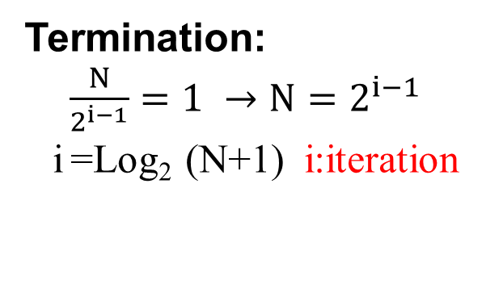
Binary Search Analysis: Worst Case
With each comparison we throw away ½ of the list
N
………… 1 comparison
Termination:
$\frac{N}{2^{i−1}}=1 →N=2^{i−1}$
i =Log₂ (N+1) i:iteration
N/2
………… 1 comparison
N/4
………… 1 comparison
………… 1 comparison
Number of steps is at most ➔Log₂N
N/8
.
.
.
.
………… 1 comparison
Worst case $→$ Θ(Log₂N)
1

Slide 38
Recursive solution

Slide 39
Binary Search pseudo-code: Recursive solution
Algorithm Binary_search ( A, first, last, target )
mid=(first+last)/2
If first > last then
return -1
Else
If A[mid]=target then
return mid
Else if target< A[mid] then
return Binary_search ( A, first, mid-1, target )
Else
return Binary_search ( A, mid+1, last, target )

Slide 40
Binary Search analysis: Recursive solution
Recurrence relation for iterative Binary search
T(N) = 1+T(N/2)
The cost of searching n elements is the cost of looking at mid element, plus the cost of searching N/2 elements (ONE OF THE haves of array)

Slide 41

Solve the Recurrence
T(N) = 1+T(N/2)
Use Master`s theorem
a = 1, b = 2, f(N) = 1
Compare f(N) vs. N^{log}_{b} ª
$N^{\log_{b}{a}}=N^{\log_{2}{1}}=N^{0}=1$ vs. $f\left(N\right)=1$
N^{log}_{b} ª = f(N) ➔ It's case (2),
Case 2
⇒ f(n) = Θ(n) ⇒ T(n) = Θ(logn)

Slide 42
Summary
Binary search reduces the work by half at each comparison
If array is not sorted ➔ Linear Search
Best Case Θ(1)
Worst Case Θ(N)
If array is sorted ➔ Binary search
Best Case Θ(1)
Worst Case Θ(Log₂N)

Slide 43
Thanks

