Slide 1
Algorithm analysis & design Asymptotic Notations
Presented By:
T.A. Asmaa Hamad El-saied
E-mail: eng.asmaa134@gmail.com
Lab 2
FCI, Minia University

Slide 2
Agenda
Asymptotic Notations
Examples

Slide 3
Running time vs. Asymptotic performance
Exact running time can be computed for small problem
size (small n)
Asymptotic performance can be found for large n where multiplication constants and lower-order terms of the exact running time are dominated.
Asymptotic performance of algorithm
How the running time of an algorithm increases with the size of the input in the limit, as the size of the input increases without bound.

Slide 4
Growth of Functions and Asymptotic Notation
When we study algorithms, we are interested in characterizing them according to their efficiency.
We are usually interesting in the order of growth of the running time of an algorithm, not in the exact running time. This is also referred to as the asymptotic running time.
We need to develop a way to talk about rate of growth of functions so that we can compare algorithms.
Asymptotic notation gives us a method for classifying functions according to their rate of growth.

Slide 5
Classifying Functions by Their Asymptotic Growth
Asymptotic growth: The rate of growth of a function
Given a particular differentiable function f(n), all other differentiable functions fall into three classes:
growing with the same rate
growing faster
growing slower

Slide 6
Bounds (asymptotic notations)
Ο Θ Ω
Bounds describe the limiting behavior of algorithm complexity at large (n). They are:
Upper Bound (Big O complexity)
Lower Bound (Big Ω complexity)
Exact (Big Θ complexity)

Slide 7
O-NOTATION: DEFINITION
Big-O:- defines an upper bound of an algorithm. It bounds a function only from above.
For function F(n), we define O (g(n)), big-Oh of n, as:
For example
T(n) = O(n¹⁰⁰)
T(n) will never grow asymptotically faster than n¹⁰⁰
f(N) is O(g(N)) If
∃ positive constants c and n_{0,} such that
f(n) ≤ c × g(n) ∀ n ≥ n₀

Slide 8
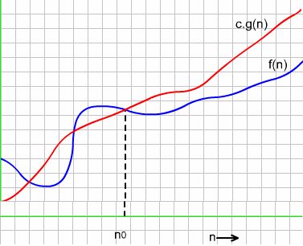
O-NOTATION: DEFINITION
Trend of running time

Slide 9
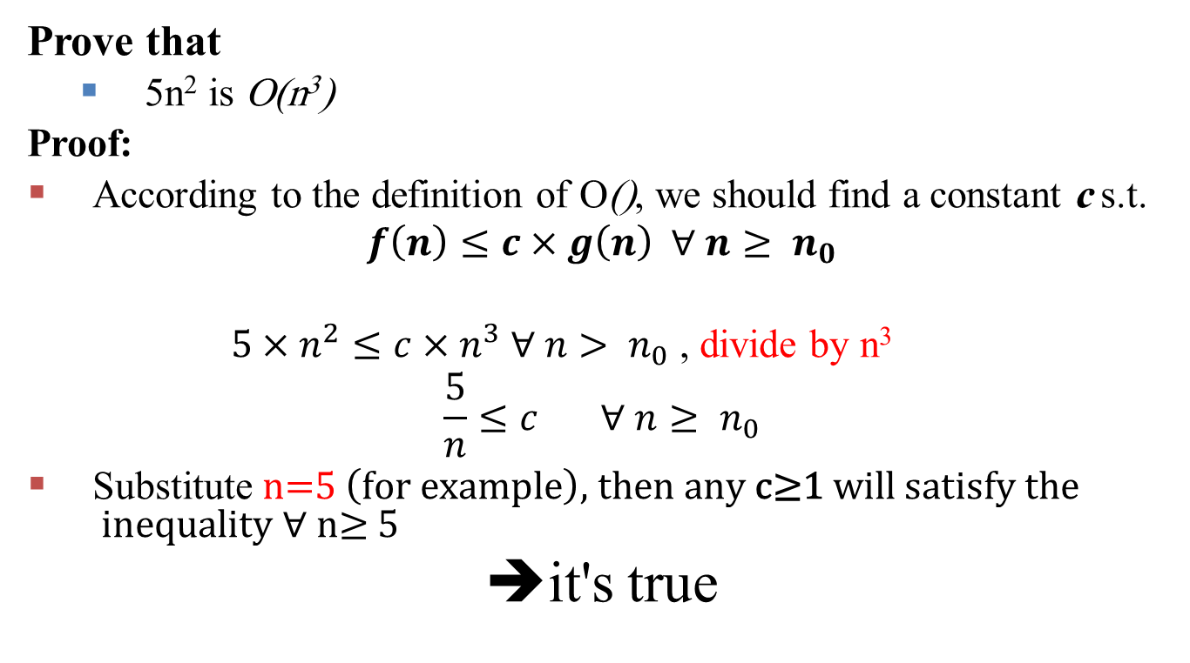
O-NOTATION : Example
Prove that
5n² is O(n³)
Proof:
According to the definition of O(), we should find a constant c s.t.
$$f\left(n\right)≤c×g\left(n\right) ∀ n≥ n_{0}$$
$5×n^{2}≤c×n^{3} ∀ n> n_{0}$ , divide by n³
$$\frac{5}{n}≤c ∀ n≥ n_{0}$$
Substitute $\text{n}\text{=5 }\left(\text{for} \text{example}\right)\text{, }\text{then} \text{any} \text{c}\text{≥1} \text{will} \text{satisfy} \text{the} \text{inequality}\text{ ∀ }\text{n}\text{≥}\text{ 5}$
➔it's true

Slide 10
Ω-NOTATION: DEFINITION
Ω notation provides an asymptotic lower bound of an algorithm.
For function F(n), we define Ω (g(n)), big-Omega of n, as:
For example:
T(n) = Ω(n³)
T(n) will never grow asymptotically slower than n³
f(n) is Ω(g(n)) If
∃ positive constants c and n_{0,} such that
c × g(n) ≤ f(n) ∀ n ≥ n₀

Slide 11
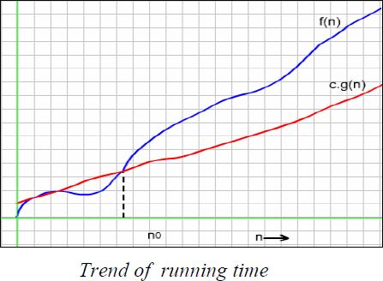
Ω-NOTATION
ASYMPTOTIC LOWER BOUND

Slide 12
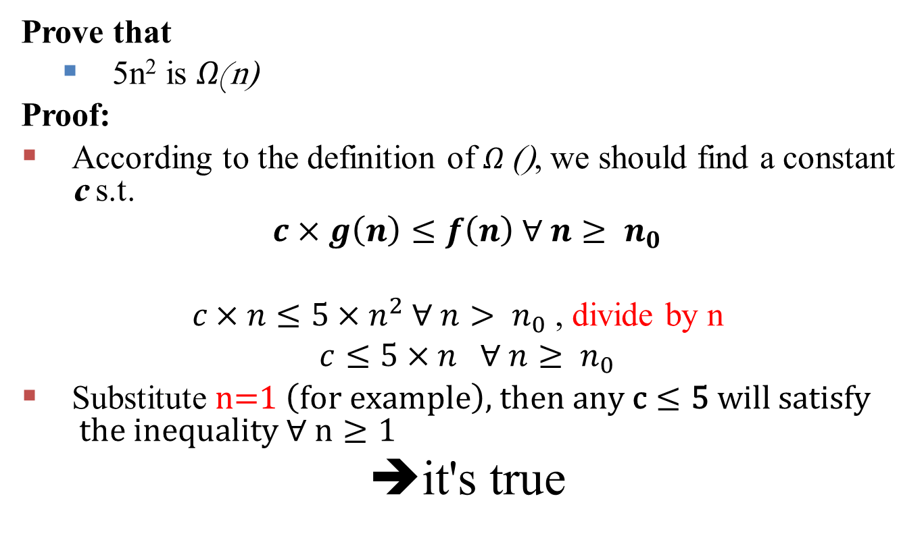
Ω-NOTATION : Example
Prove that
5n² is Ω(n)
Proof:
According to the definition of Ω (), we should find a constant c s.t.
$$c×g\left(n\right)≤f\left(n\right) ∀ n≥ n_{0}$$
$c×n≤5×n^{2} ∀ n> n_{0}$ , divide by n
$$c≤5×n ∀ n≥ n_{0}$$
Substitute $\text{n}\text{=}\text{1} \left(\text{for} \text{example}\right)\text{, }\text{then} \text{any} \text{c}≤\text{5} \text{will} \text{satisfy} \text{the} \text{inequality}\text{ ∀ }\text{n}≥\text{1}$
➔it's true

Slide 13
Θ-NOTATION: DEFINITION
Θ notation provides an asymptotic tight bound of an algorithm.
For function F(n), we define Θ (g(n)), big-Theta of n, as:
Θ(): Exact order (most difficult to compute in some algorithms)
For example:-
T(n) = Θ(n³)
T(n) grows asymptotically as fast as n³.
f(n) is Θ (g(n)) If
∃ positive constants c1,c2, and n_{0,} such that
c1×g(n) ≤ f(n) ≤ c2×g(n)
∀ n ≥ n₀

Slide 14
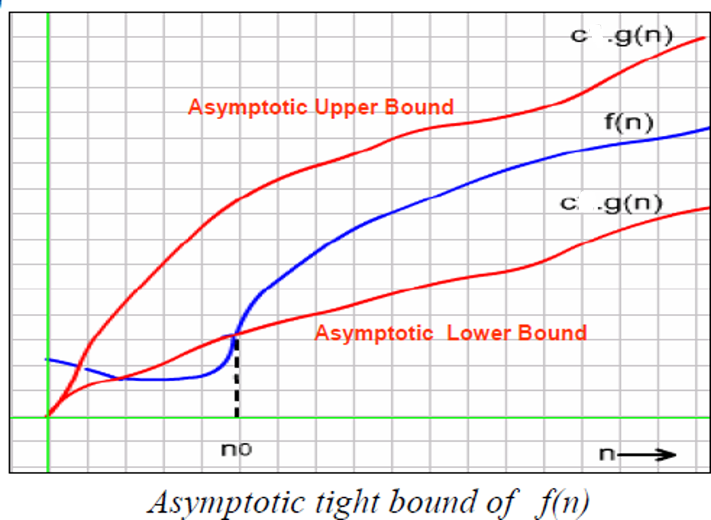
Θ-NOTATION: DEFINITION
2
1

Slide 15
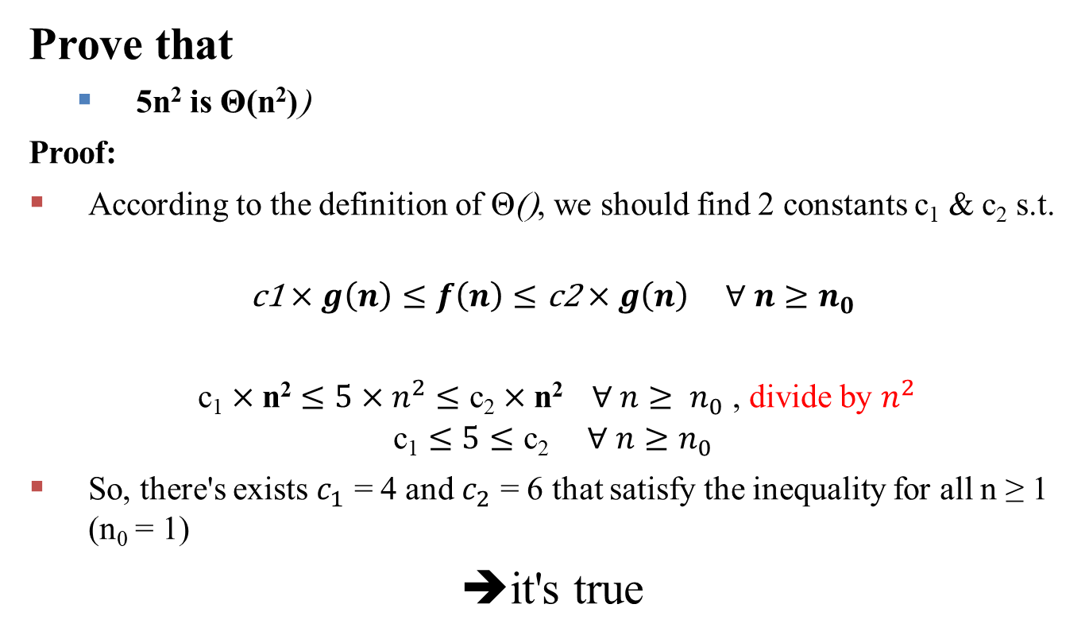
Θ -NOTATION : Example
Prove that
5n² is Θ(n²))
Proof:
According to the definition of Θ(), we should find 2 constants c₁ & c₂ s.t.
$$\text{c}\text{1}×g\left(n\right)≤f\left(n\right)≤\text{c}\text{2}×g\left(n\right) ∀ n≥n_{0}$$
$\text{c}\text{1}×\text{n}\text{2}≤5×n^{2}≤\text{c}\text{2}×\text{n}\text{2} ∀ n≥ n_{0}$ , divide by $n^{2}$
$$\text{c}\text{1}≤5≤\text{c}\text{2} ∀ n≥n_{0}$$
So, there's exists $c_{1}$ = 4 and $c_{2}$ = 6 that satisfy the inequality for all n ≥ 1 (n₀ = 1)
➔it's true

Slide 16
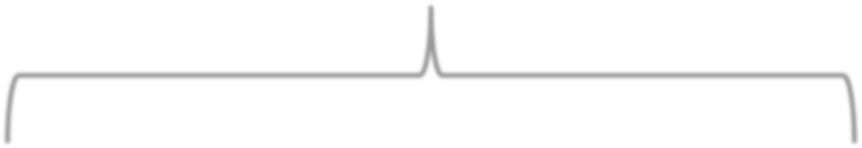
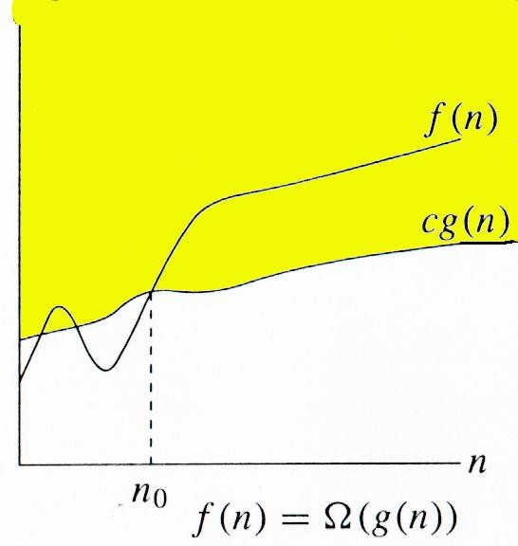
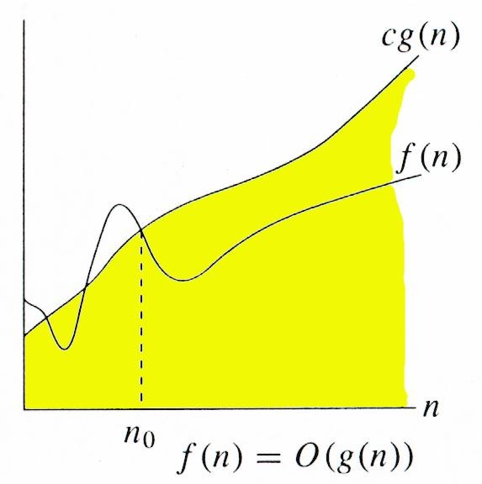
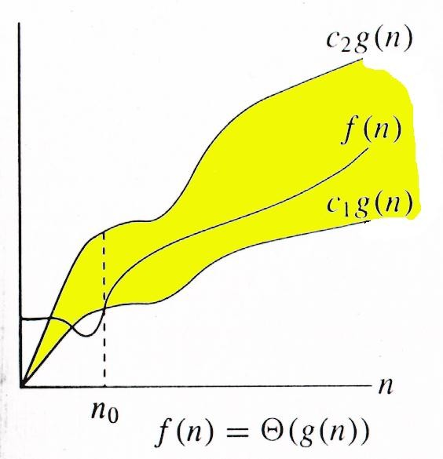
Ο Θ Ω
Relations Between Bounds (asymptotic notations)
f(n) ≤ c × g(n) for all n ≥ n₀
c1×g(n) ≤ f(n) ≤ c2×g(n)
for all n ≥ n₀
f(n) ≥ c × g(n)
for all n ≥ n₀

Slide 17
Relations Between Bounds (asymptotic notations)
Theorem :
For any two functions g(n) and f(n),
f(n) = Θ(g(n)) iff
f(n) = O(g(n))
and
f(n) = Ω(g(n)).
I.e. f(N) is Θ(g(N)) iff it's O(g(N)) & Ω(g(N)) (by their definitions)

Slide 18
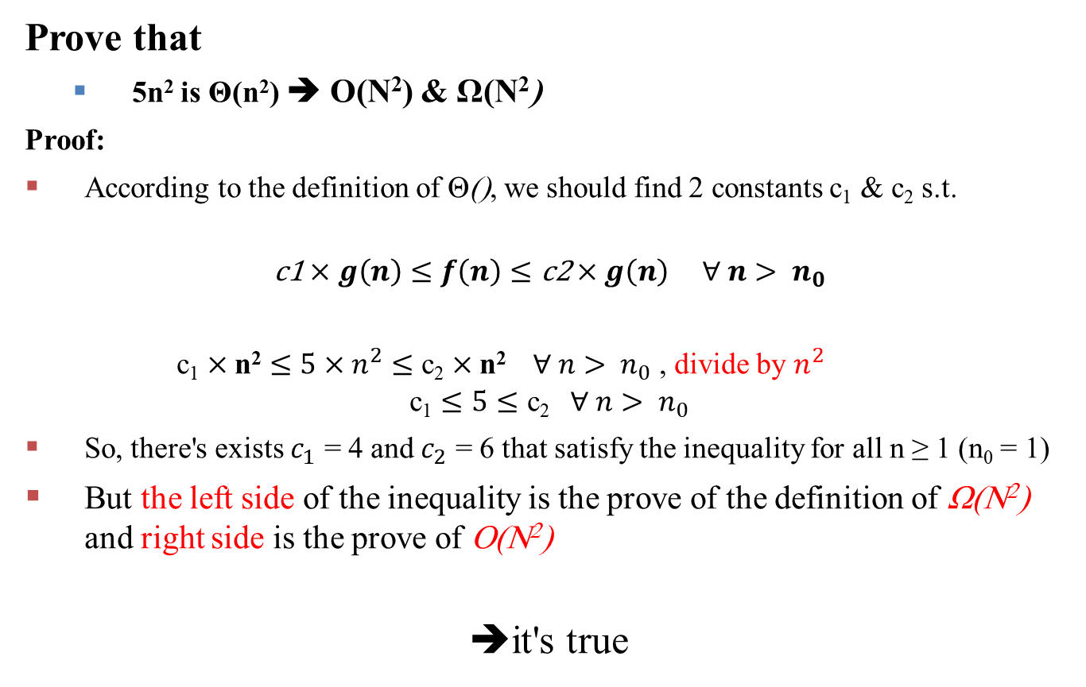
Relations Between Bounds : Example
Prove that
5n² is Θ(n²) ➔ O(N²) & Ω(N²)
Proof:
According to the definition of Θ(), we should find 2 constants c₁ & c₂ s.t.
$$\text{c}\text{1}×g\left(n\right)≤f\left(n\right)≤\text{c}\text{2}×g\left(n\right) ∀ n> n_{0}$$
$\text{c}\text{1}×\text{n}\text{2}≤5×n^{2}≤\text{c}\text{2}×\text{n}\text{2} ∀ n> n_{0}$ , divide by $n^{2}$
$$\text{c}\text{1}≤5≤\text{c}\text{2} ∀ n> n_{0}$$
So, there's exists $c_{1}$ = 4 and $c_{2}$ = 6 that satisfy the inequality for all n ≥ 1 (n₀ = 1)
But the left side of the inequality is the prove of the definition of Ω(N²) and right side is the prove of O(N²)
➔it's true

Slide 19
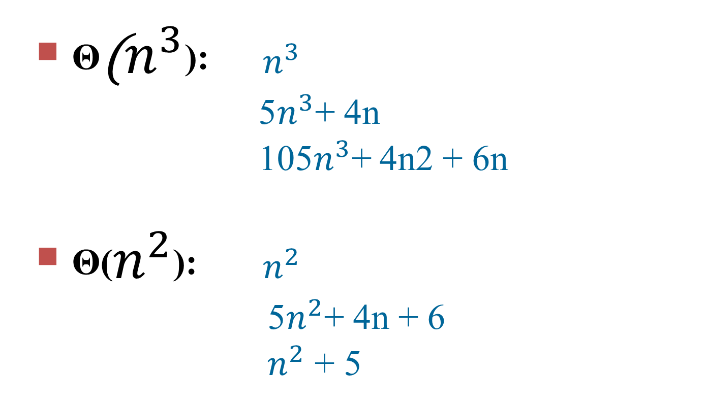
Examples
Θ($n^{3}$): $n^{3}$
5$n^{3}$+ 4n
105$n^{3}$+ 4n2 + 6n
Θ($n^{2}$): $n^{2}$
5$n^{2}$+ 4n + 6
$n^{2}$ + 5

Slide 20
Examples
True or false?
N² = O(N²) true
2N = O(N²) true
N = O(N²) true
N² = O(N) false
2N = O(N) true
N = O(N) true

Slide 21
Examples
N² = Θ (N² ) true
2N = Θ (N² ) false
N = Θ (N² ) false
N² = Θ (N) false
2N = Θ (N) true
N = Θ (N) true
4+3n = O(n) true
n+2logn = O(logn) false
logn+2 = O(1) False

Slide 22
What is the difference between worst case and Big-O?
Worst, best and average cases describe distinct runtime functions (Different types of analysis) : one for the sequence of highest runtime of any given n, one for that of lowest, and so on..
asymptotic notations are just representation methods of any time complexity of an algorithm.

Slide 23
What is the difference between worst case and Big-O?
Worst case:- happen
Upper Bound:- may not happen

Slide 24
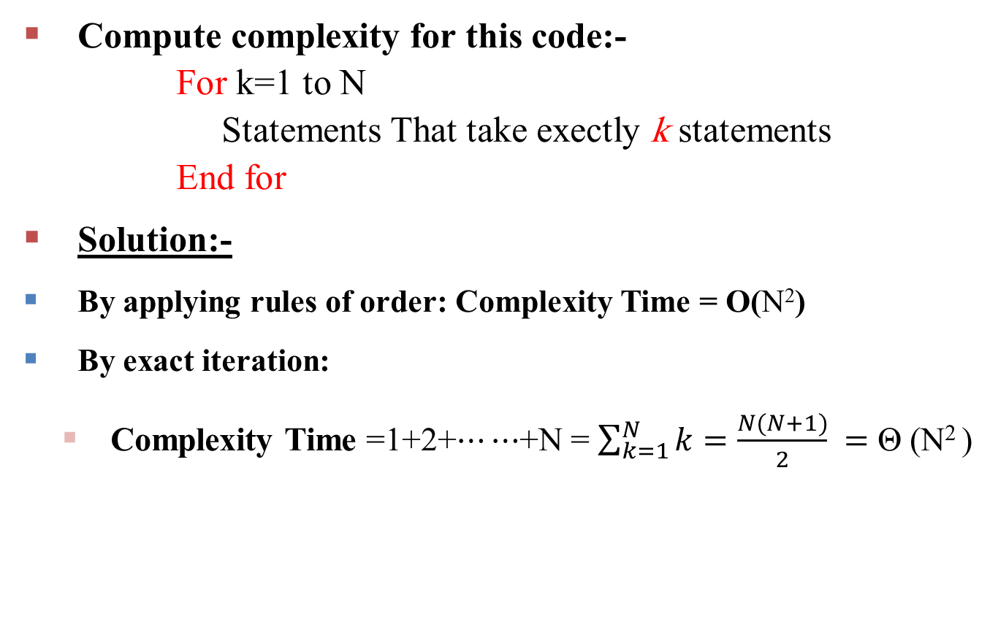
Example1:
Compute complexity for this code:-
For k=1 to N
Statements That take exectly k statements
End for
Solution:-
By applying rules of order: Complexity Time = O(N²)
By exact iteration:
Complexity Time =1+2+$⋯⋯$+N = $\sum_{k=1}^{N}{k}=\frac{N(N+1)}{2} =$ Θ (N² )

Slide 25
Example2:
Indicate, for each pair of expressions (A, B) in the table below, whether A is O, Ω, or Θ of B. Log are base 2. Your answer should be in the form of the table with “yes” or “no” written in each box:
A | B | O | Ω | Θ
2^{N+1} | 2^{N}
N (Log(N))² | N Log(N)
(N-1)! | N!

Slide 26
Example2:
Indicate, for each pair of expressions (A, B) in the table below, whether A is O, Ω, or Θ of B. Log are base 2. Your answer should be in the form of the table with “yes” or “no” written in each box:
A | B | O | Ω | Θ
2^{N+1} | 2^{N} | yes | yes | yes
N (Log(N))² | N Log(N) | no | yes | no
(N-1)! | N! | yes | no | no

Slide 27
Example3:
Let f(n) and g(n) be asymptotically positive functions. Prove or disprove each of the following:
f(n) = O(g(n)) implies g(n) = O(f(n)).
h(n) + k(n) = Θ(min(h(n), k(n))).

Slide 28
Example3:
Let f(n) and g(n) be asymptotically positive functions. Prove or disprove each of the following:
f(n) = O(g(n)) implies g(n) = O(f(n)). #Disproved
h(n) + k(n) = Θ(min(h(n), k(n))). #Disproved

Slide 29
Example 4:
Write the big-Θ expression (tight bound) to describe the number of operations required for the following algorithms:
1)
z = 0 ;
for (w = 0 ; w < K ; w++)
for (x = 0 ; x < N ; x++)
z = z + x
End for
for (y = 0 ; y < M ; y++)
z = z + y
End for
End for
Solution:
By applying rules of order:
Complexity Time = Θ (K × (N + M)) = Θ(K × N) = Θ(N²) if K is O(N)
Note: Θ(N+M)=Θ (N) say N max

Slide 30

Example 4:
Write the big-Θ expression (tight bound) to describe the number of operations required for the following algorithms:
2)
F1 (N)
For i = 1 to N Do
j = N
While I > j Do
j = j – 1
End while
End for
EndF1
Solution:-
By applying rules of order: Complexity Time = O(N²)
By exact iteration:
Complexity Time =0+1+2+$⋯⋯$+N-1 = $\sum_{i=0}^{N−1}{i}=\frac{(N−1)N}{2} =$ Θ (N² )

Slide 31

Example 4:
Write the big-Θ expression (tight bound) to describe the number of operations required for the following algorithms:
3)
Solution:
By summing the # iterations in the inner loop: 1 + 2 + 4 + 8 + 16 + … + 2^{L} ,where L is # iterations
Termination:
when 2^{L} = N ➔ log 2^{L} = log N
➔ L = log₂ (N)
1 + 2 + 4 + 8 + 16 + … + 2^{L} = $\sum_{0}^{l}{2^{i}}$= $\sum_{0}^{log N}{2^{i}}$= ${(2}^{log N+1}−1)$=${(2}^{log N }2−1$) =${(N}^{log 2 }2−1$) = N 2-1= Θ (N)
F2 (N)
I = 1
While I < N Do
For J = 1 to I
K = 1
End for
I = 2 × I
End while
EndF2
By applying rules of order:
Complexity Time = O (NlogN)

Slide 32
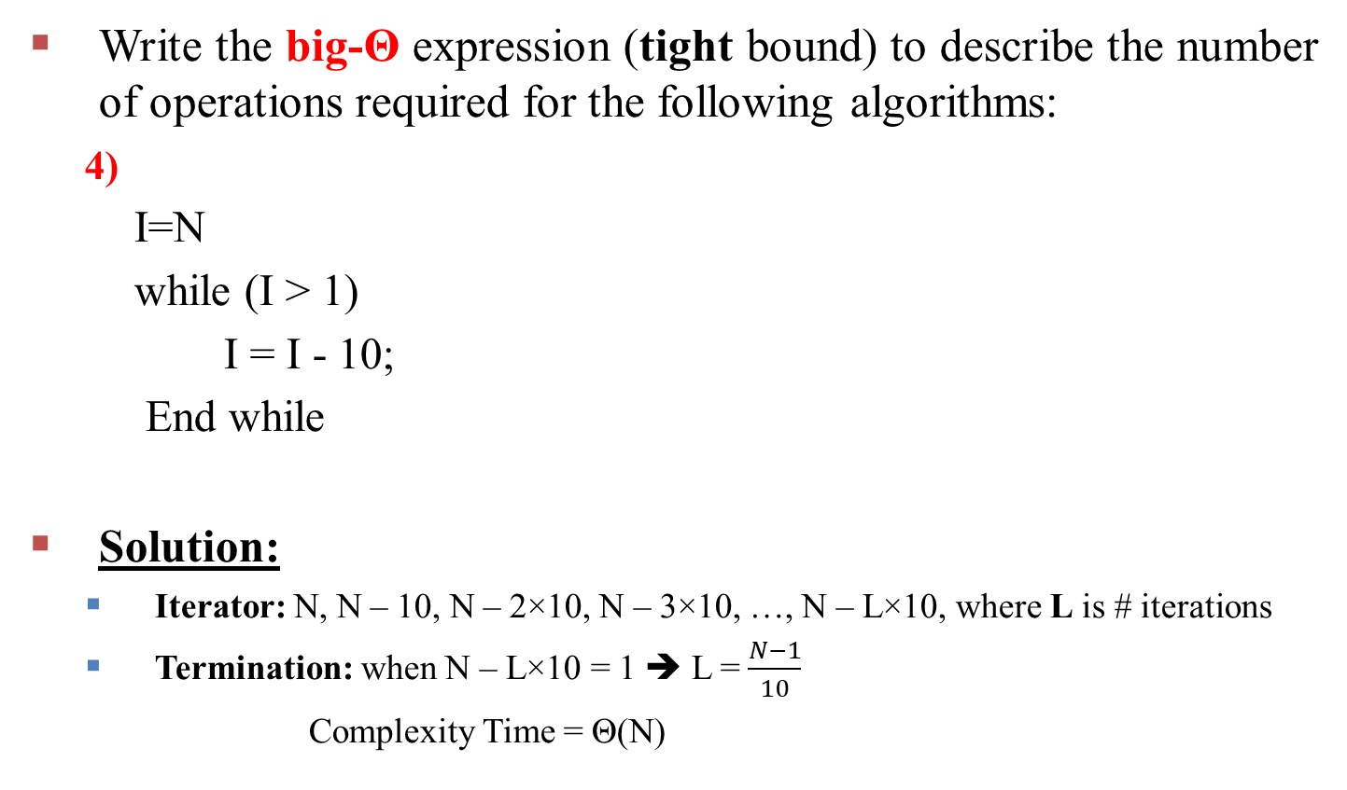
Example 4:
Write the big-Θ expression (tight bound) to describe the number of operations required for the following algorithms:
4)
I=N
while (I > 1)
I = I - 10;
End while
Solution:
Iterator: N, N – 10, N – 2×10, N – 3×10, …, N – L×10, where L is # iterations
Termination: when N – L×10 = 1 ➔ L = $\frac{N−1}{10}$
Complexity Time = Θ(N)

Slide 33
Example 4:
Write the big-Θ expression (tight bound) to describe the number of operations required for the following algorithms:
5)
For i = 1 to N Do
A[i] = i
B[i] = 1
Endfor
InsertionSort(A, N)
Solution: Θ(N+N)=Θ(N) since the array is already sorted (insertion sort best case)

Slide 34
Eight growth functions
Eight functions O(n) that occur frequently in the analysis of algorithms (in order of increasing rate of growth relative to n):
Constant ≈ 1
Logarithmic ≈ log n
Linear ≈ n
Log Linear ≈ n log n
Quadratic ≈ n2
Cubic ≈ n3
Exponential ≈ 2^{n}
Factorial≈ n!
24

Slide 35
Growth rates compared
 | n=1 | n=2 | n=4 | n=8 | n=16 | n=32
1 | 1 | 1 | 1 | 1 | 1 | 1
logn | 0 | 1 | 2 | 3 | 4 | 5
n | 1 | 2 | 4 | 8 | 16 | 32
nlogn | 0 | 2 | 8 | 24 | 64 | 160
_{n}2 | 1 | 4 | 16 | 64 | 256 | 1024
_{n}3 | 1 | 8 | 64 | 512 | 4096 | 32768
₂n | 2 | 4 | 16 | 256 | 65536 | 4294967296
n! | 1 | 2 | 24 | 40320 | 20.9T | Don’t ask!

Slide 36
Thanks

