Slide 1

CryptoAnalyticsPro
Crypto Trading Analytics & Risk Management
CryptoAnalyticsPro is a Windows desktop app designed for cryptocurrency traders to track trade history, assess risk, and analyze profits and losses using real-time market data. Built with C# WinForms and MS Access, it offers portfolio management, trade insights, and market trend analysis in a user-friendly interface.
This lightweight, offline-capable platform includes AI-powered trade recommendations and real-time sentiment analysis, helping traders minimize risks and maximize returns with actionable insights.
Muhammad Ali Saleem (23L-2638)
Ammar Hassan (23L-2614)
k

Slide 2

INTRODUCTION
CryptoAnalyticsPro is a Windows desktop app built with C# WinForms and MS Access to help traders manage crypto portfolios.
It integrates real-time market data for live price tracking and supports multi-currency valuation.
The app offers tools for profit/loss analysis, stop-loss and take-profit calculations, and risk assessment.
AI-powered trade recommendations and sentiment analysis assist users in making data-driven decisions.
Designed to be lightweight and offline-capable, it ensures secure local data storage without cloud complexity.
k

Slide 3

ADVANTAGES
AI-powered trade recommendations improve decision-making based on real data
Real-time sentiment analysis gives users market mood insights
Stop-loss and take-profit tools help manage risk automatically
Multi-currency support enables tracking in various fiat and crypto currencies
Simple, user-friendly desktop UI with offline capability
Uses local database (MS Access), ensuring fast, lightweight data storage
Custom alerts and portfolio visualizations increase usability for all user levels

Slide 4

CONSTRAINTS
Limited scalability due to MS Access backend
AI recommendation engine is rule-based, not machine learning-powered
No mobile app or cross-platform support
Sentiment analysis is dependent on third-party APIs (availability issues)
Real-time price updates limited by API rate limits
Offline functionality restricts access to updated market data without internet

Slide 5

Non-Functional Requirements
Performance Requirements
The application must load the dashboard within 3 seconds after startup.
Trade history retrieval should take less than 2 seconds for up to 1,000 records.
The system should support at least 10,000 trade records without performance degradation.
Usability Requirements
The interface should be intuitive and easy to navigate, even for non-technical traders.
Portfolio summaries and trade analytics should be visually appealing using charts and graphs.
The system should provide error messages when incorrect inputs are entered.

Slide 6
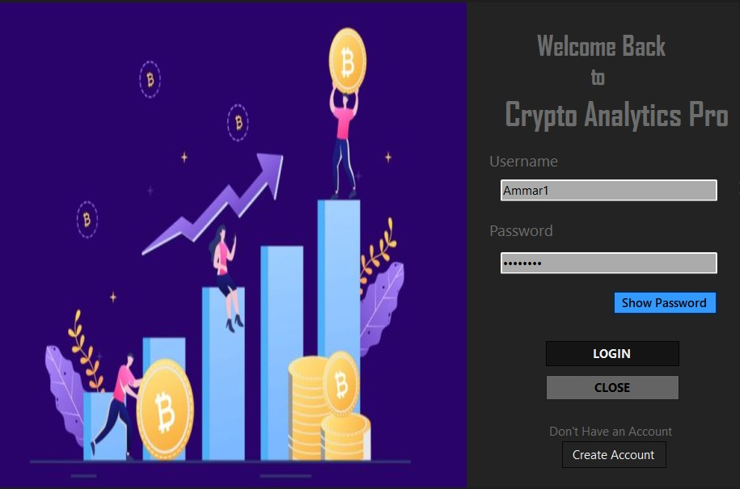
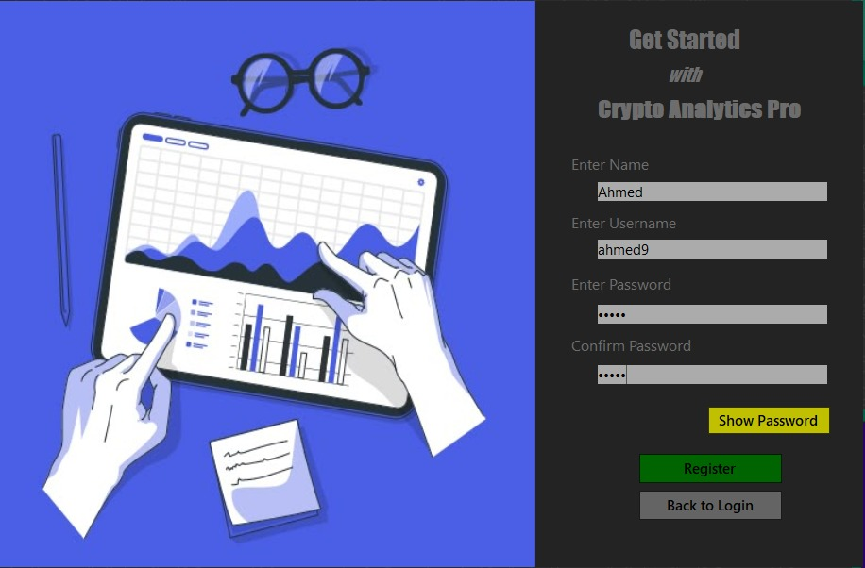
Implementation

Slide 7




Portfolio Analysis & Risk Metrics
Risk Indicators
Visualize key risk metrics such as volatility and profit-loss concentration per asset to understand portfolio risk.
Historical Performance
Track portfolio trends over time to identify patterns and inform future decisions.
Asset Categorization
Organize assets into categories for clearer portfolio management and analysis.

Slide 8

Multi-Currency Portfolio Support
Multiple Fiat & Crypto Accounts
Base Currency Conversion
Trade Price Display
Portfolio Breakdown
Trade prices and outputs show both crypto and base fiat values, clearly displaying conversion rates and resulting balances.
View portfolio exposure and diversification by currency for better risk management.
Manage balances across various fiat currencies (USD, EUR) and cryptocurrency wallets, tracked separately and in aggregate.
Select a base currency for automatic conversion of all asset values using real-time exchange rates, with charts and reports reflecting the chosen currency.

Slide 9
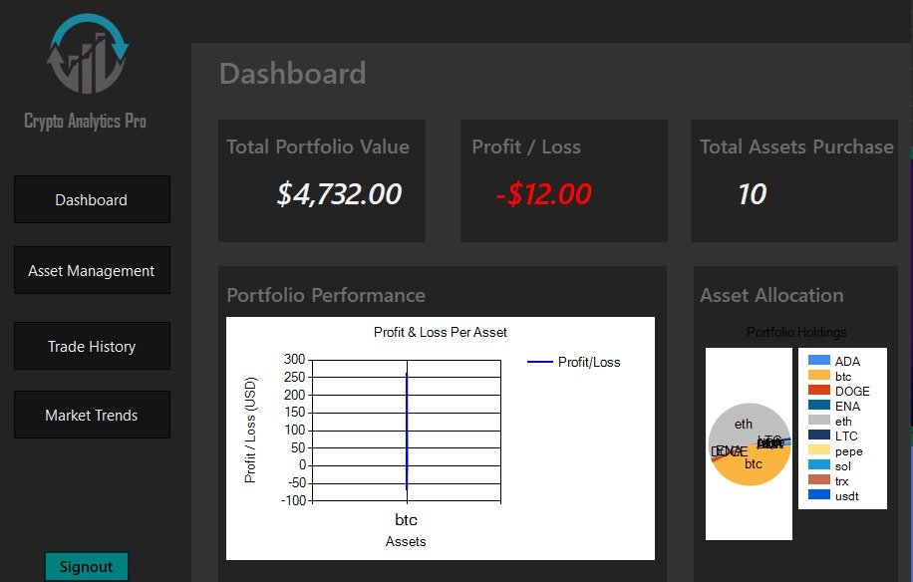
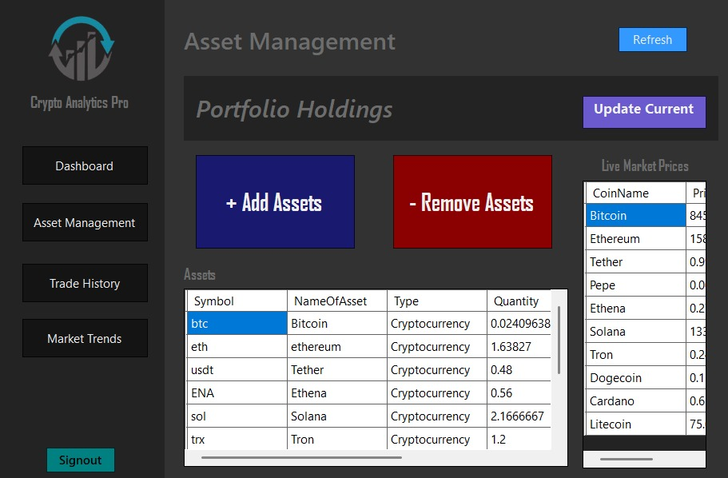
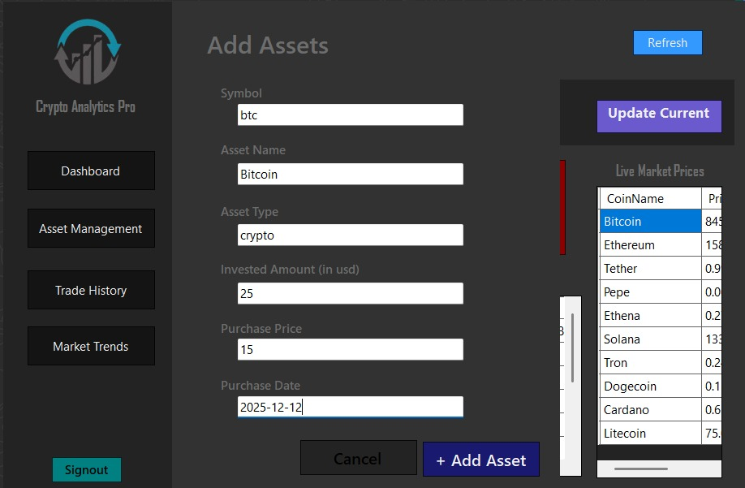
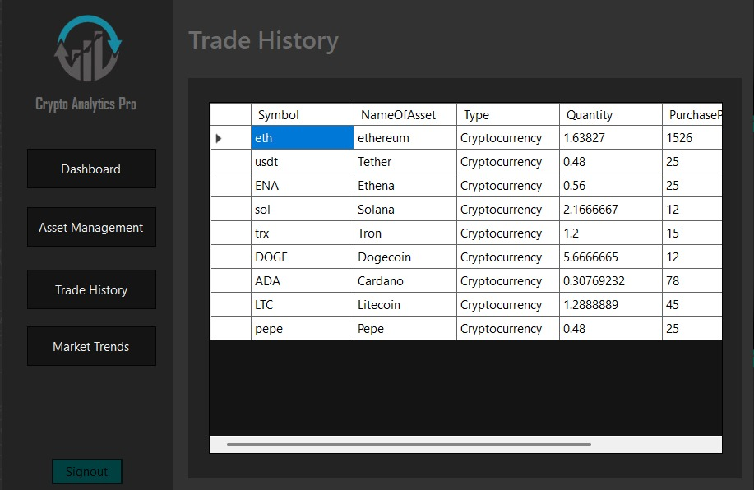

Slide 10
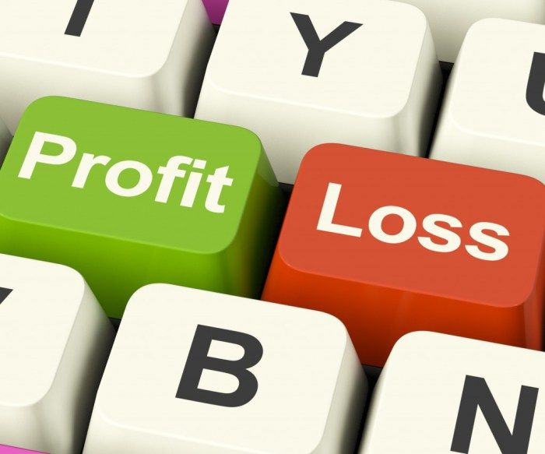
Stop-Loss & Take-Profit Calculator
Set Trade Exit Levels
Potential Outcomes
Enter current price, stop-loss %, and take-profit % to calculate target exit values automatically.
Display potential loss and profit based on user inputs to aid risk management.
Save Thresholds
Allow saving of calculated stop-loss and take-profit levels for later use and reference.

Slide 11
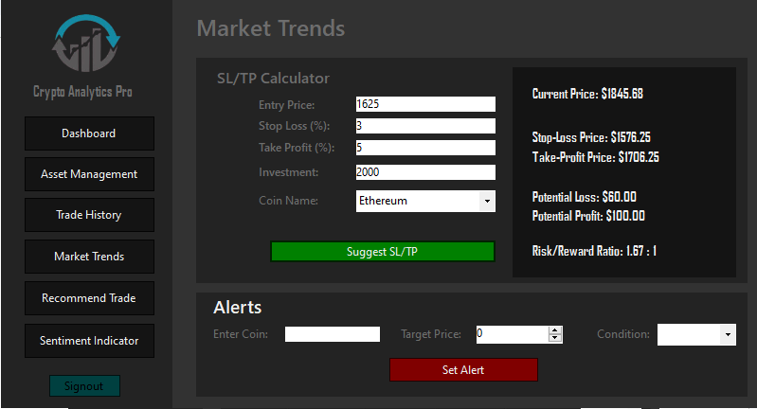

Slide 12

Price Alert System
Set Price Thresholds
Active Monitoring
Users select a cryptocurrency and define a target price to monitor.
Alerts are stored in the database and actively monitored for price triggers.
User Notifications
Notify users immediately when the set price is reached, with options to edit or delete alerts.

Slide 13
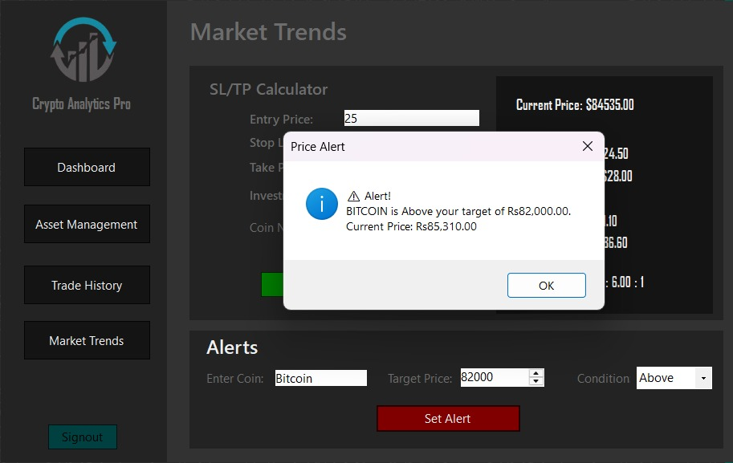

Slide 14

Trade Recommendations
Personalized Suggestions
Filtering & Metrics
Users can filter recommendations by asset, timeframe, and risk level, and view detailed metrics like predicted ROI and confidence scores with explanations.
AI analyzes market trends and portfolio data to provide tailored trade recommendations, helping traders discover high-potential opportunities quickly.
Risk & Preferences
Traders set risk tolerance and preferred coins, allowing AI to tailor future recommendations to individual goals and portfolio composition.

Slide 15
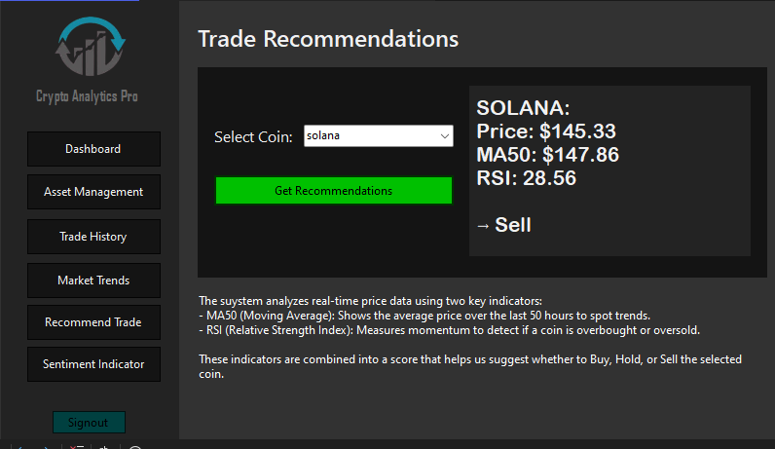

Slide 16
Sentiment Analysis Features
Market Mood Visualization
Trend Overlays
Alerts for Sentiment Changes
Displays sentiment scores and gauges for overall market and specific cryptocurrencies, providing quick snapshots of positive vs. negative moods.
Sentiment trends can be overlaid with price charts to identify correlations between sentiment spikes or drops and price movements.
Users receive notifications when sentiment for a coin becomes extremely positive or negative, enabling timely trading decisions.

Slide 17
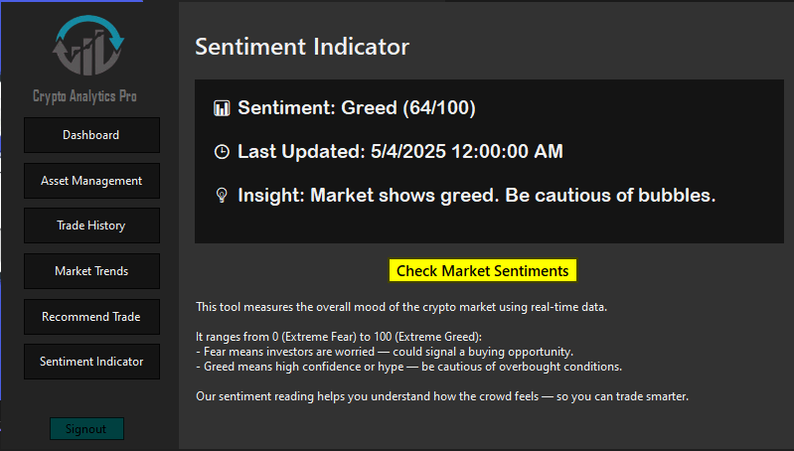

Slide 18
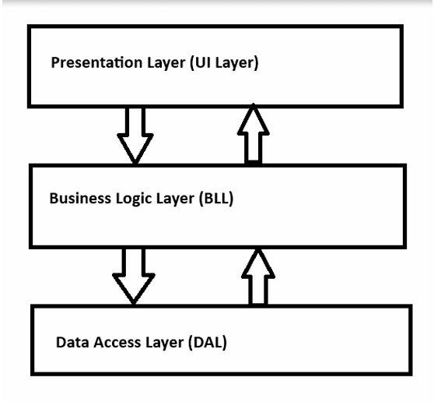
Application Architecture Overview
Presentation Layer (UI Layer):
Handles user interactions and displays information.
Contains:
WinForms UI , Event handlers ,Displays sentiment, recommendations, and prices
Business Logic Layer (BLL) :
Handles all the core logic of the application.
Contains:
TradeAnalyzer.cs , Recommendation , SentimentHelper
3. Data Access Layer (DAL):
Handles all external data fetching from APIs.
Contains:
Api Services , PriceFetcher ,SentimentApi
Presentation Layer
Business Logic Layer
Data Access Layer
Handles user interactions, displays sentiment, recommendations, and prices with event-driven UI components.
Processes AI calculations like MA50 and RSI, generates trade signals, and interprets sentiment data.
Fetches external data from APIs, including price histories and market sentiment, with error handling.

Slide 19

Lessons Learned & Project Insights
Consistency in progress is crucial. Small early delays can accumulate and impact later phases. Having a solid plan is not enough without regular check-ins to reassess progress and adjust workloads.
Stepping back to view the bigger picture and adapting as the project evolves proved essential. Flexibility and frequent progress reviews help keep the team aligned and the project on track.

