Slide 1
Sentiment Analysis of News Headlines
Do computational sentiment labels match what headlines mean?
Python · pandas · VADER | NLP Mini Assignment | 26 October 2026

Slide 2
Research question & data
• Question: when VADER labels a headline positive / negative / neutral, does the label reflect its meaning?
• Dataset: News Headlines Dataset for Sarcasm Detection (Misra & Arora, 2023)
  – 28,619 headlines: HuffPost (real news) + The Onion (satire), with an is_sarcastic flag
  – The satire flag gives an independent test of how VADER handles sarcasm
• Cleaning: 0 missing values; 116 duplicate headlines removed → 28,503 unique
  – e.g. "'no way to prevent this,' says only nation where this regularly happens" appears 12×

Slide 3
Method: VADER + documented decision rules
• VADER: dictionary of ~7,500 human-rated words (−4 … +4) + rules for negation, intensifiers, 'but', punctuation, capitals
• Produces a compound score in [−1, +1]
• Decision rules (Hutto & Gilbert, 2014):
  – compound ≥ +0.05 → positive
  – compound ≤ −0.05 → negative
  – otherwise → neutral
• Note: the dataset is all lower case, so VADER's capitalisation rule never applies

Slide 4
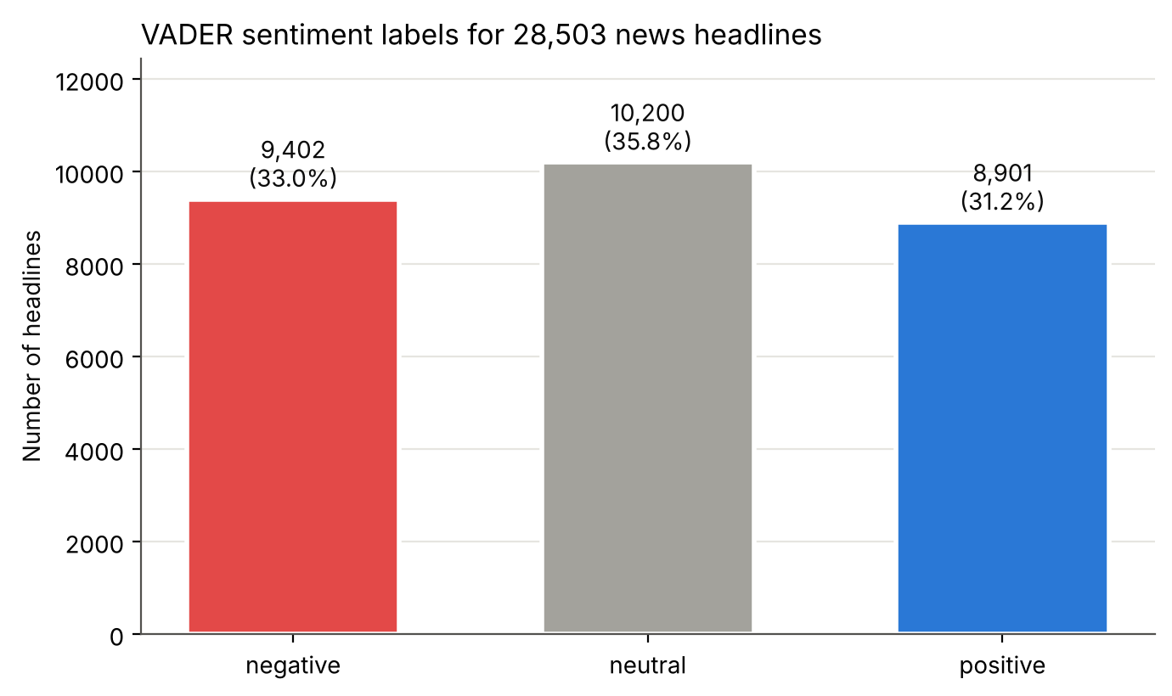
Results: a seemingly balanced picture
• Negative: 9,402 (33.0%)
• Neutral: 10,200 (35.8%)
• Positive: 8,901 (31.2%)
• Taken at face value: news is emotionally balanced
• …but is it?

Slide 5
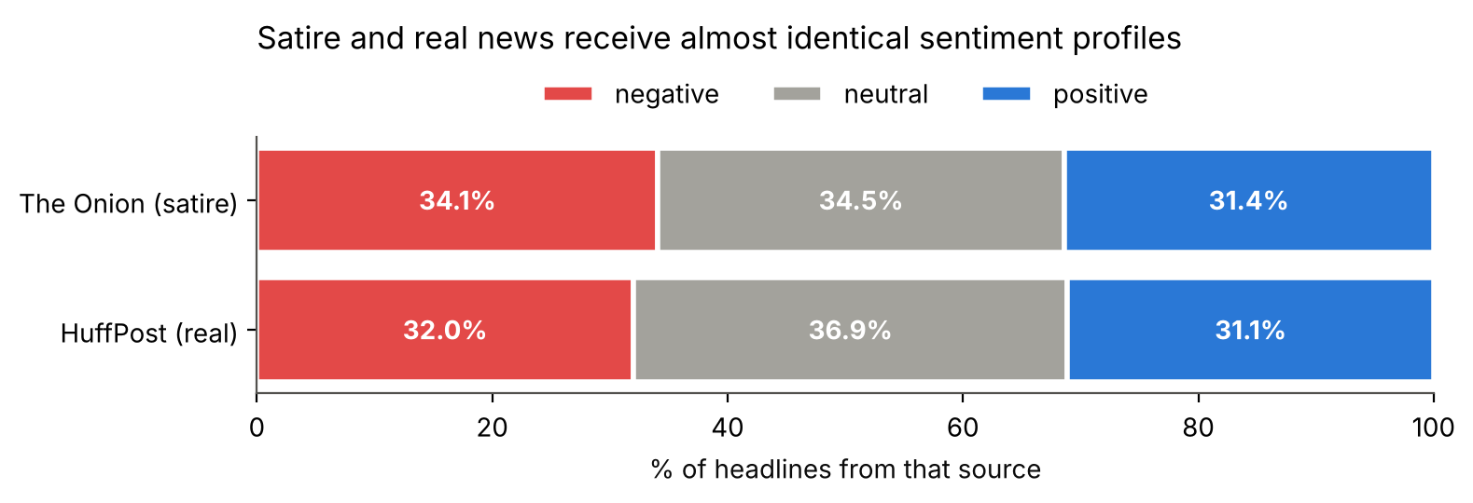
Finding 1: VADER cannot see satire
• Satire and real news get almost the same label mix; mean compound −0.016 vs −0.011
• χ² is 'significant' only because n is huge; Cramér's V ≈ 0.03 → negligible effect

Slide 6
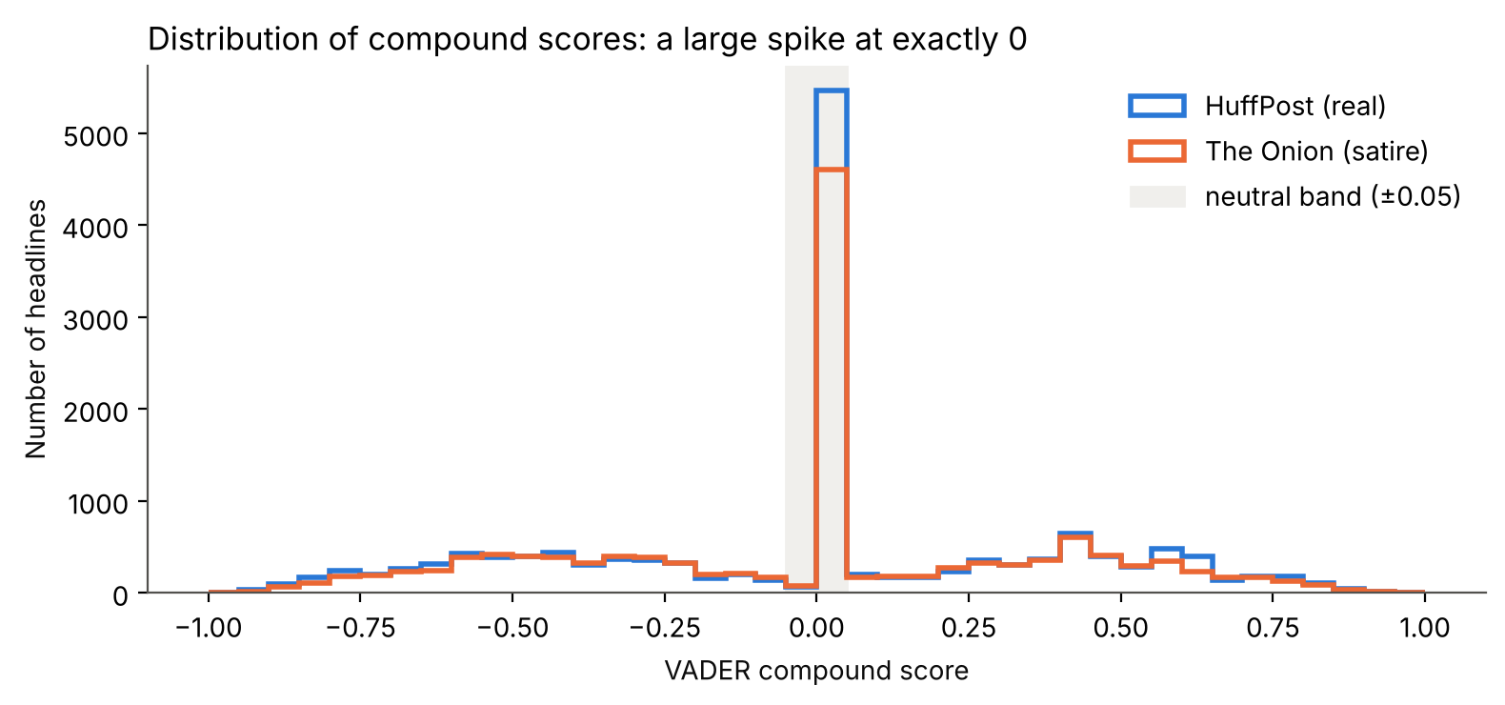
Finding 2: 'Neutral' often means 'unknown'
• 95.6% of neutral headlines contain no VADER dictionary word at all
• Missing: dies, shooting, hurricane, flood, layoffs, deported
  – 'died' is in the dictionary; 'dies' is not
  – "cilla black dies at 72" → 0.00
• Finding 3: widening the neutral band to ±0.20 makes 43% neutral; ±0.50 makes 75%

Slide 7
Close reading: 10 headlines (VADER agrees on 2/10)
Headline | VADER | Human | Why
student killed herself after university mishandled her rape report | neg −0.88 | neg | explicit cue ✓
mexico mayor killed less than a day after taking office | neg −0.67 | neg | explicit cue ✓
british singer … cilla black dies at 72 | neu 0.00 | neg | missing word
how fake meat may change our future thanksgiving dinners | neg −0.48 | neu | word sense
duke students refuse to read 'fun home' … | pos +0.27 | neg | book title
bob hope happy to see so many troops in heaven | pos +0.87 | neg | name + irony
…underfunded schools leave students perfectly prepared… | pos +0.82 | neg | sarcasm
'no way to prevent this,' says only nation … | neu +0.03 | neg | satire / implicit
boeing lays off only guy who knows how to keep wings on plane | neu 0.00 | neg | implicit
separating from a wonderful man after 27 years | pos +0.57 | neg/mixed | mixed

Slide 8
Why VADER goes wrong
• Sarcasm & irony: positive words carry negative meaning ("perfectly prepared")
• Ambiguity: word sense (fake meat) and names (Bob Hope, Fun Home) are scored as emotions
• Context & world knowledge: meaning lies in the situation, not in emotional words (a plane without wings)
• Dictionary coverage: missing words → false 'neutral', so negative news is hidden
• What is being measured? topic vs. writer's stance vs. reader's reaction are mixed together
• Thresholds & preprocessing: category sizes are partly a researcher's choice

Slide 9
Conclusion
• VADER is fast and transparent, and works when emotion is stated directly
• Its balanced-looking output (33 / 36 / 31%) hides three problems:
  – it does not tell satire from sincere reporting
  – most 'neutral' labels come from missing vocabulary
  – category sizes depend on arbitrary thresholds
• Use computational labels as a first rough pass that must be checked by reading the headlines
• Next steps: human-annotated random sample (with inter-annotator agreement); compare with a transformer model

Slide 10
References
• Hutto, C. J., & Gilbert, E. (2014). VADER: A parsimonious rule-based model for sentiment analysis of social media text. ICWSM, 8(1), 216–225.
• Misra, R., & Arora, P. (2023). Sarcasm detection using news headlines dataset. AI Open, 4, 13–18.
• Misra, R., & Grover, J. (2021). Sculpting Data for ML: The first act of Machine Learning.
• Dataset: github.com/rishabhmisra/News-Headlines-Dataset-For-Sarcasm-Detection

