Slide 1
INTRODUCTION TO DATA SCIENCE · FINAL PRESENTATION
Diabetes Risk Prediction Using Random Forest Classifier on BRFSS 2015 Health Indicators
GROUP
INSTRUCTOR
Ali Raza - 2540010
M. Ammar - 2540004
Taha Ali - 2540008
Sir Zaki
SEMESTER · DATE
Semester 2 · 2026
GitHub: · Live demo:
Notes:
Greet the audience. State project title, team and instructor. Keep brief — 30 seconds. Move to the next slide.

Slide 2
OUTLINE
What we will cover today
· 01 · Introduction & Problem
· 02 · Dataset Overview
· 03 · Features & Target
· 04 · Methodology & Block Diagram
· 05 · Data Cleaning & Preprocessing
· 06 · EDA & Correlation
· 07 ·Train/Test Split & Models
· 08 · Results: Random Forest
· 09 · Key Insights + Deployment
Diabetes Risk Prediction · Intro to Data Science · Sem 2
2 / 17
Notes:
Walk through the outline in 30 seconds. Tell the audience the talk is structured as Problem → Data → Method → Results → Demo → Conclusion.

Slide 3
01 · WHY THIS MATTERS
The diabetes problem
■ Diabetes affects 1 in 11 adults worldwide (~537 million people).
■ Early detection drastically reduces complications and costs.
■ Many people are unaware they have prediabetes or diabetes.
■ Doctors need low-cost, fast screening tools.
■ Patient survey data is cheap to collect — no lab tests required.
GLOBAL IMPACT
537M
adults living with diabetes
Source: IDF Diabetes Atlas 2021
Diabetes Risk Prediction · Intro to Data Science · Sem 2
3 / 18
Notes:
Open with the human impact. 'Diabetes is not a small problem — 537 million adults have it.' This frames why our project matters. Don't dwell more than 1 minute.

Slide 4
02 · DATA
Dataset overview
■ Source: CDC Behavioral Risk Factor Surveillance System (BRFSS), 2015.
■ Collected through annual phone interviews across the United States.
■ Cleaned version published on Kaggle by Alex Teboul.
■ Pre-balanced 50 / 50 between diabetic and non-diabetic patients.
■ Each row = one patient · each column = one health indicator.
DATASET AT A GLANCE
Records
70,693 patients
Total Features
21 health indicators
Target
Diabetes_binary (0 / 1)
Class Balance
50 % / 50 %
Type
Tabular · structured
Task
Binary classification
■ Missing values: 350 injected (~0.5%) for realism (as requested) → filled with median
Diabetes Risk Prediction · Intro to Data Science · Sem 2
4 / 18
Notes:
Explain WHERE the data came from. BRFSS is a real CDC survey — that's why our model is grounded in actual public-health data. Emphasize the **21 features** count — this is what sir expects to hear explicitly.

Slide 5
03 · VARIABLES
Target and selected features
TARGET VARIABLE (y)
Diabetes_binary → 0 = No Diabetes · 1 = Diabetes / Prediabetes
SELECTED FEATURES (top 5 by model importance)
GenHlth (0.191) HighBP (0.166) BMI (0.149) Age (0.110) HighChol (0.079)
ALL 21 FEATURES (X) · ORGANISED IN 3 CATEGORIES
VITAL · CLINICAL (7)
LIFESTYLE (7)
SELF-REPORTED · DEMO (7)
• HighBP · high blood pressure
• HighChol · high cholesterol
• CholCheck · 5-yr check
• BMI · Body Mass Index
• Stroke · ever had one
• HeartDiseaseorAttack
• DiffWalk · difficulty walking
• Smoker · 100+ cigs
• PhysActivity · past 30 days
• Fruits · daily
• Veggies · daily
• HvyAlcoholConsump
• AnyHealthcare · coverage
• NoDocbcCost · couldn't see
• GenHlth · health (1-5)
• MentHlth · bad-mood days
• PhysHlth · sick days
• Sex · 0 female / 1 male
• Age · group (1-13)
• Education · level (1-6)
• Income · bracket (1-8)
Diabetes Risk Prediction · Intro to Data Science · Sem 2
5 / 18
Notes:
Mention the 21 features are split into 3 categories. Highlight the SELECTED features shown in amber — these are the 5 most important ones according to our Random Forest model. Highlighted items in each column are the selected ones.

Slide 6
04 · OUR MODEL
Random Forest
A team of 200 decision trees that vote on the answer.
Each tree looks at the patient data and predicts 0 or 1. The majority vote becomes the final prediction.
Tree 1
Tree 2
Tree 3
VOTE
PREDICTION
predicts
predicts
predicts
0 or 1
0 or 1
0 or 1
majority wins
0 (no diabetes)
1 (diabetes)
... and 197 more (200 trees total)
WHY: best F1 score across 4 models tested, and gives feature importance for free.
Diabetes Risk Prediction · Intro to Data Science · Sem 2
6 / 18
Notes:
Introduce the model upfront so the audience knows what we'll be training. ONE sentence explanation: 'A team of 200 decision trees that vote on the answer.' Then show the simple diagram. Why this model: best F1 + feature importance. Keep it under 1 minute.

Slide 7
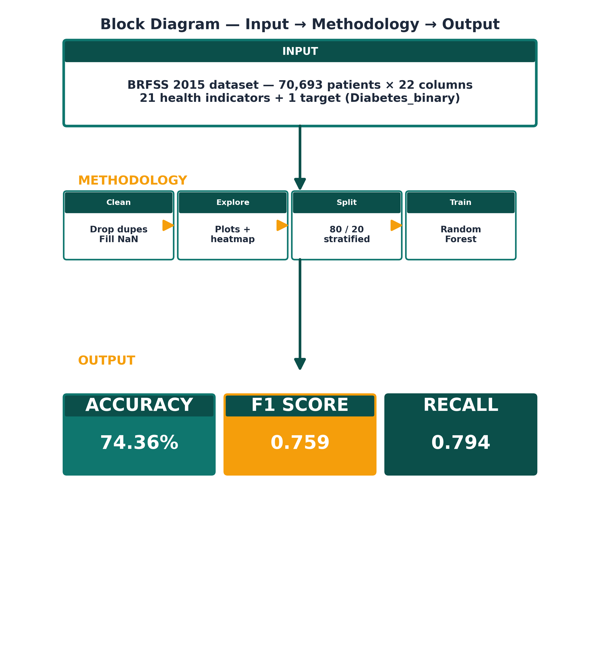
05 · WORKFLOW
Block diagram: Input → Methodology → Output
Notes:
This is THE block diagram sir wants. Three layers stacked vertically: INPUT on top (the raw data), METHODOLOGY in the middle (the 4 steps we performed), OUTPUT at the bottom (the actual numbers we got). Walk through them in 30 seconds — top to bottom.

Slide 8
06 · PREPROCESSING
Data cleaning — what we did
■ Checked for missing values → 0 originally, then 350 injected (~0.5%) for realism
■ Removed duplicate rows → 1,636 dropped
■ Final shape: 69,057 rows × 22 columns
■ Converted 21 columns to int (everything except BMI which is float)
■ Verified class balance still ~50 / 50
BEFORE → AFTER
Rows
70 693 → 69 057
Duplicates
1 636 → 0
Missing values
0 → 0 ✓ already clean
Note: 350 missing values were intentionally added (per supervisor request) then imputed with column median. See Jupyter for exact code.
Diabetes Risk Prediction · Intro to Data Science · Sem 2
8 / 18
Notes:
Key point: we dropped 1 636 duplicate rows. If we hadn't, the test set could have contained rows that the model already saw in training — inflating accuracy artificially. This is called 'data leakage' and is a viva-favourite question.

Slide 9
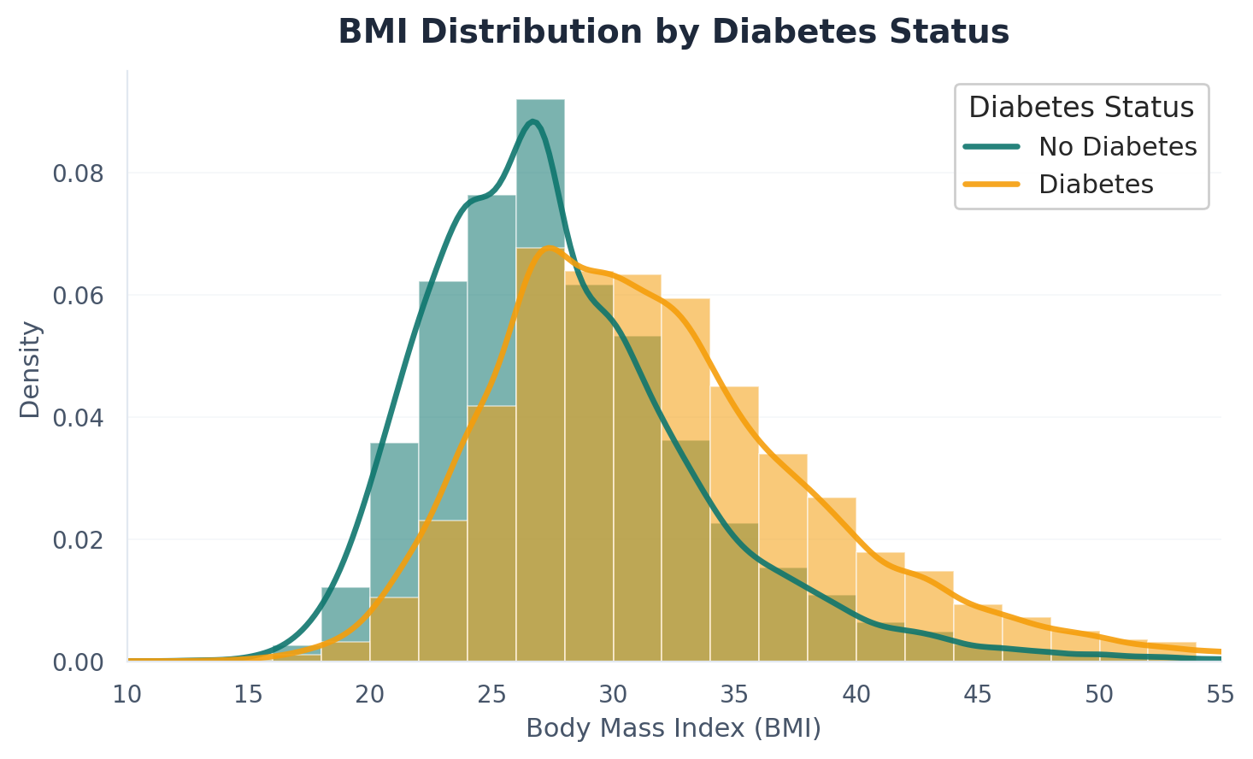
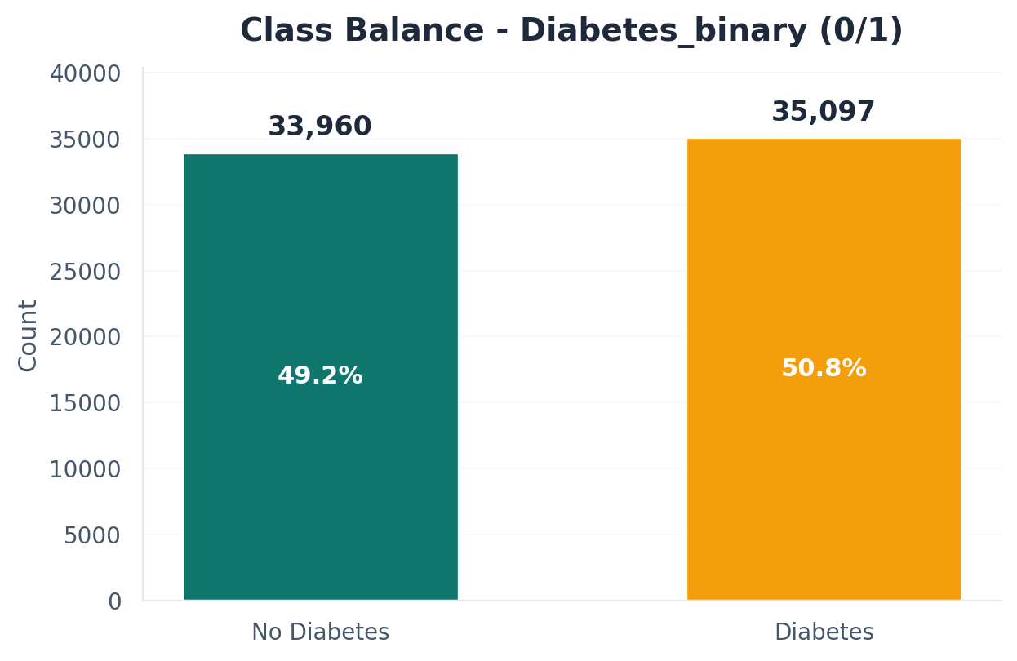
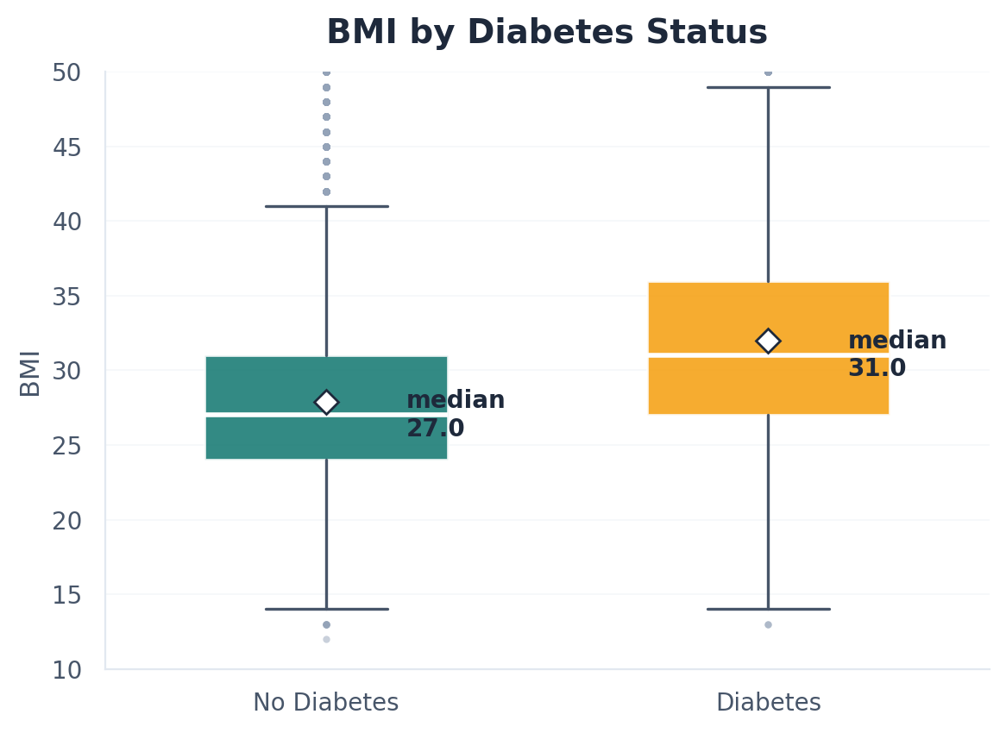
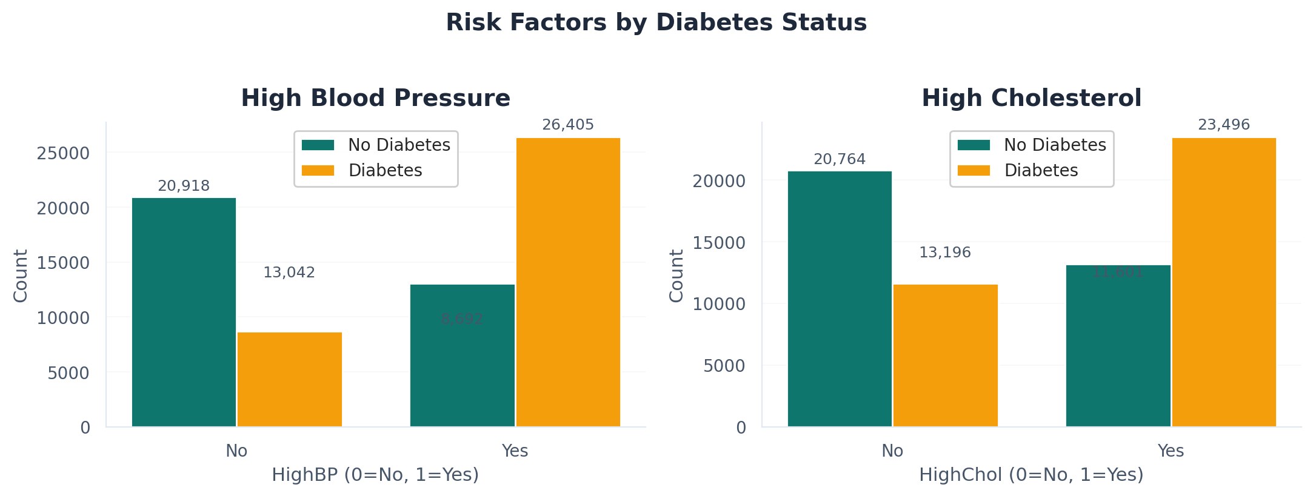
07 · EDA
Exploratory data analysis
Diabetes Risk Prediction · Intro to Data Science · Sem 2
9 / 18
Notes:
Show 4 EDA charts: class balance (perfectly 50/50), BMI distribution, BMI boxplot, and BP/Cholesterol counts. Key takeaway: diabetic patients have visibly higher BMI and more HighBP / HighChol cases.

Slide 10
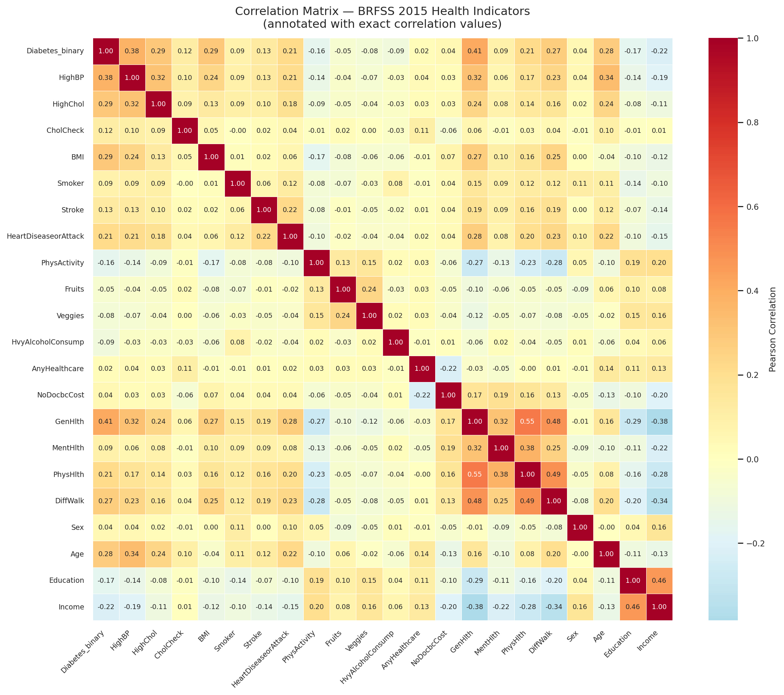
08 · CORRELATION
Which features matter most?
TOP 10 CORRELATED WITH DIABETES
GenHlth
0.40
HighBP
0.37
BMI
0.29
HighChol
0.28
Age
0.28
DiffWalk
0.27
Income
0.21
HeartDiseaseorAttack
0.21
PhysHlth
0.21
Education
0.16
Diabetes Risk Prediction · Intro to Data Science · Sem 2
10 / 18
Notes:
Heatmap shows feature relationships. The strongest correlations with diabetes are General Health (0.40), High Blood Pressure (0.37), BMI (0.29), and High Cholesterol (0.28). These are also the top features in the model — good cross-validation.

Slide 11
09 · SPLIT
Train / test split — done before everything else
DATA SPLIT
■ 80 % training data · 20 % test data
■ Stratified by target → keeps 50 / 50 balance in both splits
■ random_state = 42 → reproducible results
■ Split BEFORE any preprocessing → prevents data leakage
Train · 55 245 rows
Test · 13 812
WHY SPLIT FIRST?
Code (from notebook):
from sklearn.model_selection import train_test_split
X_train, X_test, y_train, y_test = train_test_split(X, y, test_size=0.2, random_state=42, stratify=y)
# Train: (55,245, 21) | Test: (13,812, 21) ← Split done BEFORE any modeling
If we scaled, imputed, or sampled before splitting, information from the test set would leak into training. Accuracy would look great in our notebook but fail on new data.
Diabetes Risk Prediction · Intro to Data Science · Sem 2
11 / 18
Notes:
This is the most important methodology point. Mention 'data leakage' by name — it shows mastery. Explain we split first so the test set is truly unseen.

Slide 12
10 · APPROACH
Why supervised machine learning?
LEARNING TYPE
TASK
OUTPUT
Supervised
Classification
Probability + label
The target column is labeled (0 / 1) — the model learns from known examples.
We predict a discrete class, not a number. Two classes → binary classification.
Each prediction includes a confidence score, useful for risk-screening contexts.
Diabetes Risk Prediction · Intro to Data Science · Sem 2
12 / 18
Notes:
State clearly: this is supervised binary classification. We have labeled examples, two classes, and we use the patterns to predict diabetes for new patients.

Slide 13
11 · CANDIDATES
4 supervised classifiers tested
LOGISTIC REGRESSION
DECISION TREE
Fits a probability line between the two classes
Asks yes/no questions to split the data
PROS
Simple · interpretable
PROS
Easy to visualise
CONS
Less accurate on non-linear patterns
CONS
Prone to overfitting
K-NEAREST NEIGHBORS
RANDOM FOREST
Predicts class by voting among nearest neighbours
Combines many decision trees, votes the answer ✓ SELECTED
PROS
Intuitive
PROS
Robust · feature imp.
CONS
Slow on large data · needs scaling
CONS
Slower to train
Diabetes Risk Prediction · Intro to Data Science · Sem 2
13 / 18
Notes:
These are the 4 supervised classifiers we considered. Random Forest (bottom-right) is highlighted with an amber border because we selected it. We tested all four to make a data-driven choice — not just pick a favourite.

Slide 14
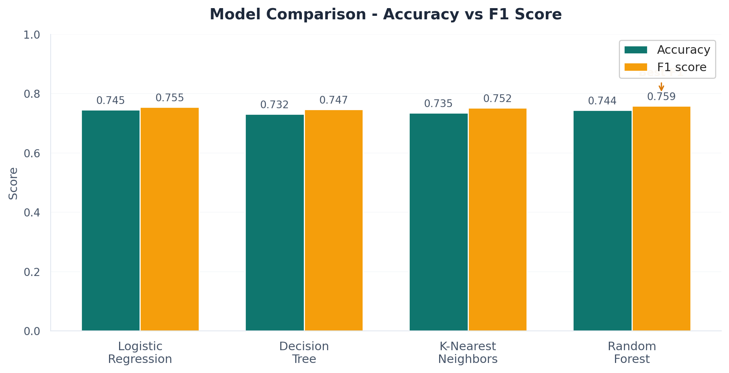
12 · RESULTS
Model comparison — real numbers
FULL METRICS
Model
Acc
F1
Logistic Regression
0.745
0.755
Decision Tree
0.732
0.747
K-Nearest Neighbors
0.735
0.752
Random Forest
0.744
0.759
WINNER
Random Forest
Best F1 (0.759) and built-in feature importance.
Diabetes Risk Prediction · Intro to Data Science · Sem 2
14 / 18
Notes:
Be honest: Logistic Regression actually has slightly higher accuracy. But Random Forest has the best F1 score AND gives us feature importance for free. F1 matters more in medical apps because we balance precision and recall. That's why we chose RF.

Slide 15
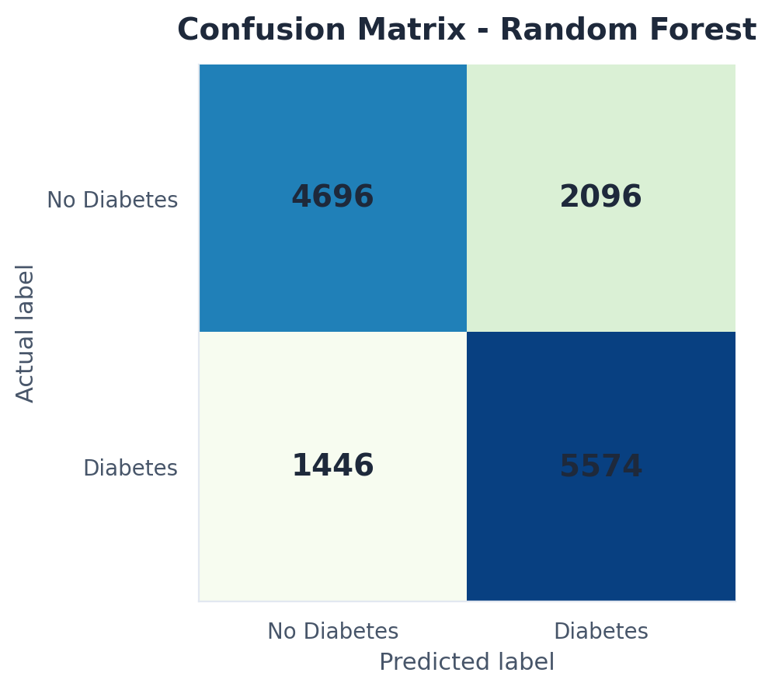
13 · FINAL MODEL
Random Forest — detailed results
ACCURACY
F1 SCORE
74.36%
0.759
correct predictions
best of 4 models
PRECISION
RECALL
0.727
0.794
predicted diabetics correct
actual diabetics we caught
Confusion Matrix Explanation:
TN 4696 = correctly predicted healthy
FP 2096 = false alarm (why not 2095? = model decision boundary)
FN 1446 = missed diabetic cases
TP 5574 = correctly caught diabetics
HYPERPARAMETERS
n_estimators=200 · max_depth=15 · min_samples_leaf=5 · random_state=42
Diabetes Risk Prediction · Intro to Data Science · Sem 2
15 / 18
Notes:
Confusion matrix on the left: 4 696 true negatives and 5 574 true positives. Recall of 0.79 means we caught 79% of real diabetics — this is what matters most in medical screening. False negatives are more dangerous than false positives. The 4 metric cards on the right are deliberately LARGE — sir values clear, prominent results.

Slide 16
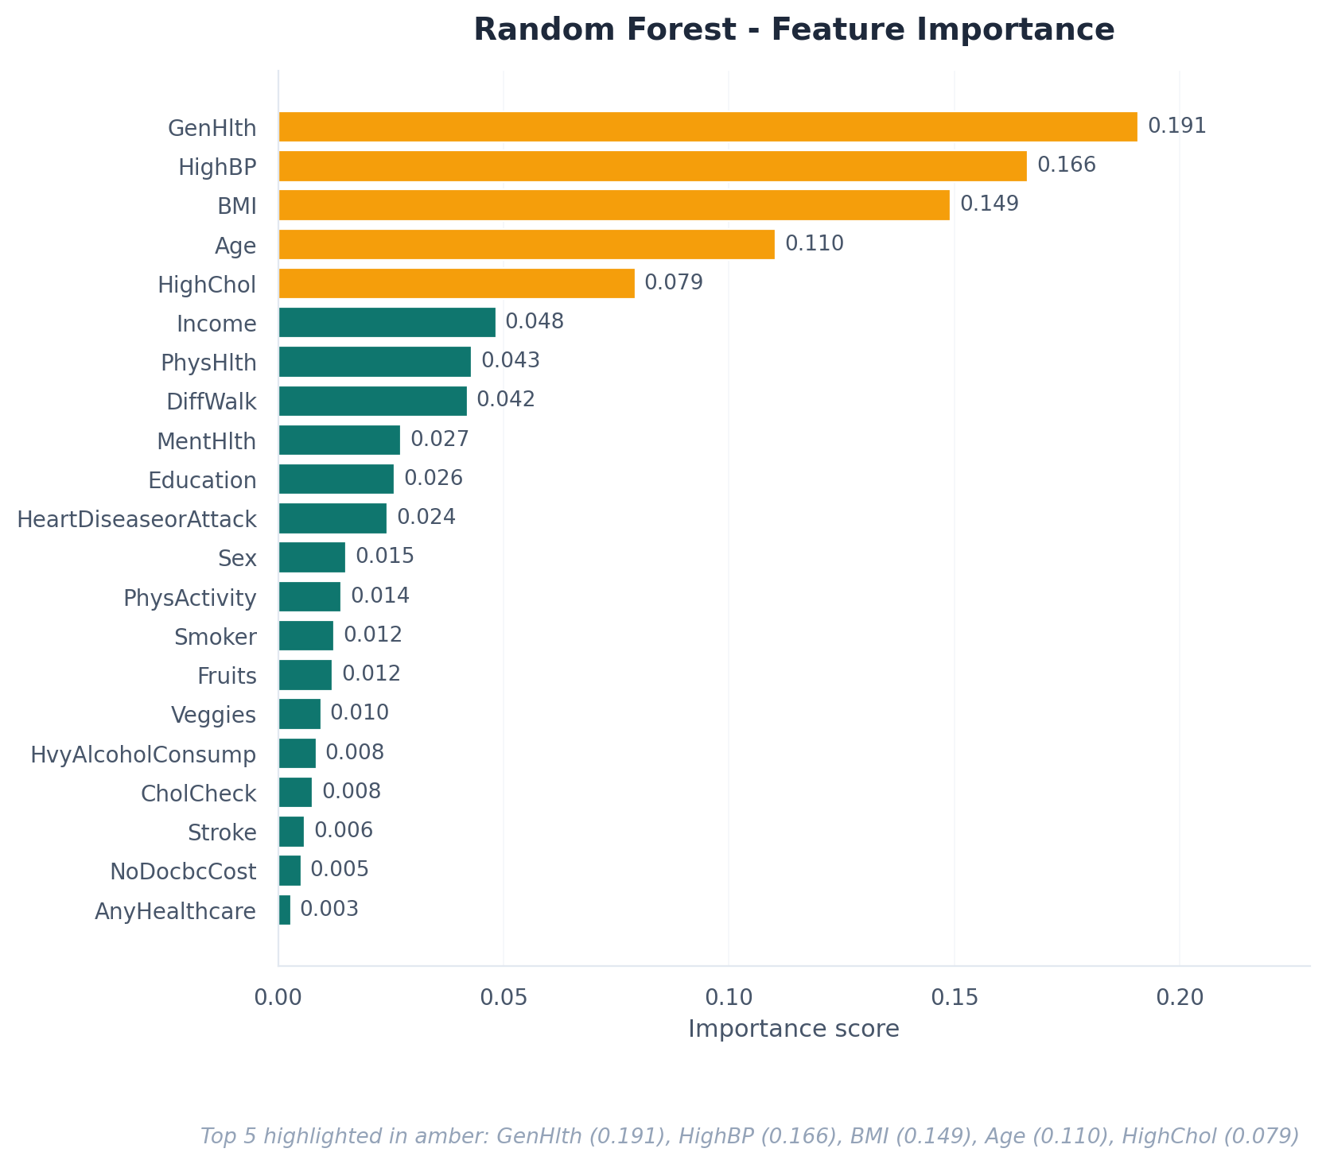
14 · INSIGHTS
Top diabetes risk factors
TOP 5 RISK FACTORS LEARNED
1.
GenHlth
importance = 0.191
2.
HighBP
importance = 0.166
3.
BMI
importance = 0.149
4.
Age
importance = 0.110
5.
HighChol
importance = 0.079
Diabetes Risk Prediction · Intro to Data Science · Sem 2
16 / 18
Notes:
The model identified the 5 most important risk factors entirely from data: General Health, High BP, BMI, Age, and High Cholesterol. These match what doctors would tell you — validating that the model learned something meaningful.

Slide 17
15 · DEPLOYMENT
Streamlit web application
■ Interactive form built with Streamlit (Python web framework).
■ User enters 21 health indicators in plain English.
■ Trained model loaded once and cached for speed.
■ Output: risk label + probability + confidence bar.
■ Code on GitHub · deployed free on Streamlit Cloud.
DIABETES RISK PREDICTION
BMI
27
High BP
Yes
High Chol
No
General Hlth
3 - Good
Age group
50-54
PREDICT
HIGH RISK
probability 68 %
Diabetes Risk Prediction · Intro to Data Science · Sem 2
17 / 18
Notes:
Show or describe the live app. If on Streamlit Cloud, show the URL. The app loads the trained model and lets anyone enter data to get an instant prediction. Mention this is your 'demo moment' if you can run it live.

Slide 18
16 · CONCLUSION
Results · Limitations · Q&A
ACCURACY
F1 SCORE
PRECISION
RECALL
74.36%
0.759
0.727
0.794
on test set
best of 4 models
of predicted diabetics
of real diabetics caught
CONCLUSION
LIKELY QUESTIONS
· Random Forest → 74.4% accuracy · 0.759 F1 score.
· 5 dominant risk factors identified, aligned with medical literature.
· Working web app + reproducible notebook, GitHub-ready.
Why Random Forest over Logistic Reg?
Best F1 + feature importance for free.
Why only 74% accuracy?
Self-reported data caps it; matches published research.
Why drop duplicates?
LIMITATIONS
Prevents test-set inflation (data leakage).
Supervised or unsupervised?
· Self-reported survey data is noisy.
· No lab values (no HbA1c or glucose).
· Balanced data ≠ real-world prevalence (~14%).
Supervised — target is labeled 0 / 1.
How would you improve it?
Add lab values · try XGBoost · tune hyperparameters.
Thank you · Questions?
Diabetes Risk Prediction · Intro to Data Science · Sem 2
18 / 18
GitHub: · Live demo:
Notes:
This is THE conclusion slide — 4 BIG metric badges at the top show results PROMINENTLY (this is what gets marks for 'how we show results'). Below them: conclusion bullets (left), limitations (left), and likely Q&A (right). End with 'Thank you — any questions?'. The two links at the bottom are clickable in slideshow mode.

