Slide 1
FemShield – Femeia Empowerment Application
Presented By:
Muhammad Anas - F2024065172
Muhammad Umair Hassan - F2024065232

Slide 2
FemShield: Architecture Analysis
A deeper dive into the design choices and their benefits for the FemShield application.
Modularity
Data Integrity
Microservices allow independent development and deployment of features.
Robust database management ensures data consistency and reliability.
User Experience
Future-Proofing
Responsive design and efficient data handling for a seamless user journey.
Scalable infrastructure supports future growth and feature additions.

Slide 3
1. Layered Architecture
Divides the system into horizontal layers, each with specific responsibilities.
Common Layers
FemShield Suitability
Presentation (UI)
✅ Suitable (Partially Used)
Business Logic
UI Layer: Flutter / React Native
Data Access
Application Layer: SOS, chat, tracking
Database
Data Layer: Firebase / PostgreSQL
Security Layer: Auth & encryption
Benefits include clear separation of responsibilities and easier debugging. Drawbacks are performance overhead and tight dependencies.

Slide 4
2. Client–Server Architecture
Consists of a client (mobile/web app) and a server (backend system handling logic, database, and APIs).
Explanation
FemShield Suitability
Clients send requests; the server processes and responds, centralizing data and logic.
✅ Highly Suitable (Primary Architecture)
Centralized data storage
Real-time SOS alerts
User authentication
Admin monitoring
Benefits include centralized control and security, easy data management, and support for various clients. Risks involve server failure impacting all users and high server load during emergencies.

Slide 5

3. Microservices Architecture
Breaks the system into independent services, each handling a specific function and communicating via APIs.
SOS Service
Chat Service
AI Threat Detection
Job & Learning
✅ Suitable (Recommended for Large Scale) for FemShield's independent modules (Safety, Health, Education). Benefits are high scalability and fault isolation. Drawbacks include complex implementation and higher infrastructure costs.

Slide 6



4. Event-Driven Architecture
Works on events and triggers, where events automatically trigger actions.
SOS Button Pressed
AI Detects Sound
Enters Unsafe Zone
✅ Highly Suitable for FemShield's real-time reactions like SOS alerts and push notifications. Benefits include real-time responsiveness and loose coupling. Risks involve harder debugging and potential event loss.

Slide 7
5. MVC (Model–View–Controller) Architecture
Separates application into Model (data), View (UI), and Controller (user actions & logic).
Suitability for FemShield
Benefits
✅ Suitable (Frontend Level)
Clean UI structure
Web dashboards
Easy UI maintenance
Admin panels
Parallel development
UI-heavy modules
Not ideal for full backend systems and can become complex with large logic.

Slide 8
6. SOA (Service-Oriented Architecture)
Uses reusable services that communicate over a network. Services are larger and less independent than microservices.
Not Recommended
Risks If Used
FemShield needs real-time speed, but SOA services are heavy and slow.
Performance delays
Complex dependencies
Harder scaling
Better alternatives like Microservices exist for FemShield's needs.

Slide 9


7. Peer-to-Peer (P2P) Architecture
In P2P, all nodes act as both client and server.
❌ Not Suitable for FemShield
Risks If Used
No centralized control
Data leakage
Significant security risks
Unreliable emergency handling
Cannot ensure data integrity
No administrative monitoring
This architecture would compromise the core safety and reliability features of FemShield.

Slide 10
8. Pipe-and-Filter Architecture
Data flows through a sequence of processing units (filters).
Not Suitable
Risks If Used
FemShield is interactive, not primarily data-stream based.
Poor user interaction
Difficult integration with UI
This architecture is not designed for real-time, interactive user interfaces.

Slide 11
9. Broker Architecture
Uses a broker to manage communication between components.
⚠️ Partially Suitable
Benefits & Risks
Can be used for:
Decouples components
Message routing
Flexible communication
Notification services
Broker failure affects system
Adds latency
While useful for specific communication aspects, it introduces potential single points of failure and latency.

Slide 12
10. Component-Based Architecture
System is built using reusable, independent components.
FemShield Suitability
Benefits
Drawbacks
✅ Suitable
Reusability
Component dependency issues
UI modules are component-based:
Easy maintenance
Version management complexity
SOS Component
Faster development
Chat Component
Map Component
This architecture promotes modularity and efficiency in development.

Slide 13
Final Architecture Choice for FemShield
Client–Server
Layered Architecture
Microservices
Core communication model.
Structured organization.
Ensures scalability.
Event-Driven
Component-Based + MVC
Real-time SOS response.
For user interface.
This hybrid architecture ensures security, scalability, real-time response, and maintainability, making it ideal for FemShield.

Slide 14
Conclusion of Architecture Analysis
FemShield requires a robust, scalable, and real-time architecture due to its safety-critical nature. The selected architectures align with both academic requirements and real-world industry standards, ensuring clarity, performance, and future growth.
Robustness
Scalability
Real-Time
Ensuring system resilience and reliability.
Ability to handle future growth and demand.
Immediate response for critical situations.

Slide 15
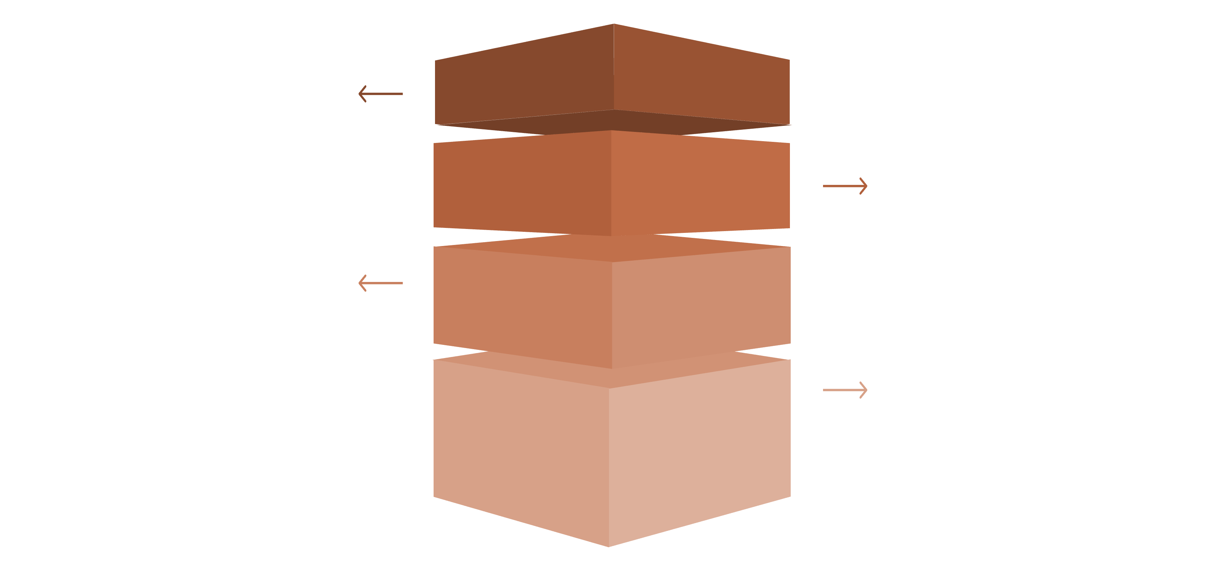
FemShield – Architecture Diagram
Presentation Layer
User interfaces for web and mobile clients.
Application Layer
Microservices handling auth, API, and business logic.
Data Layer
Databases, caches, and secure data stores.
External Integrations
Third-party APIs, payment, and notification services.

Slide 16
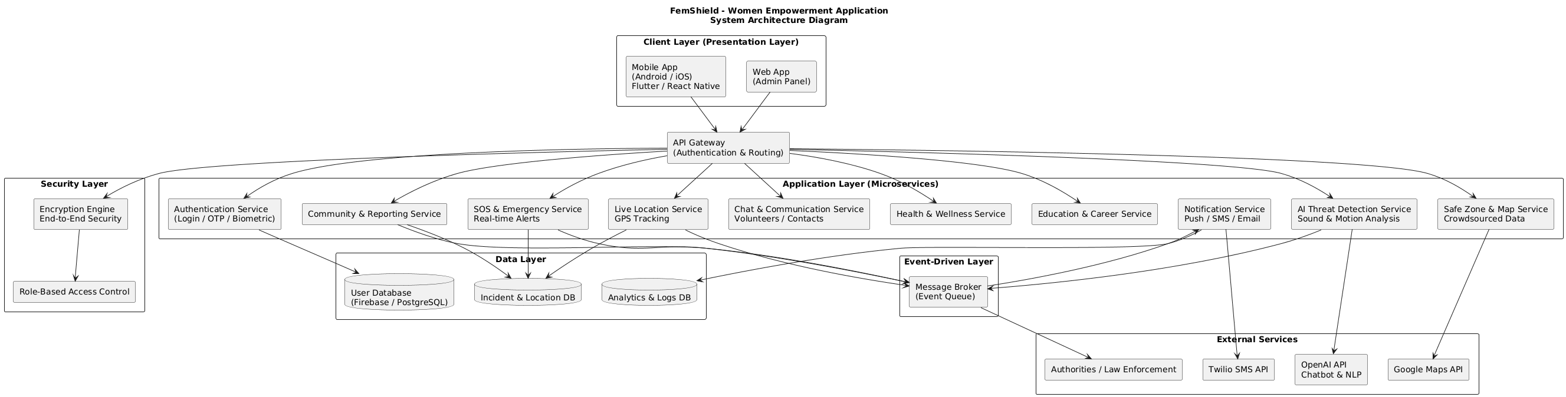

Slide 17
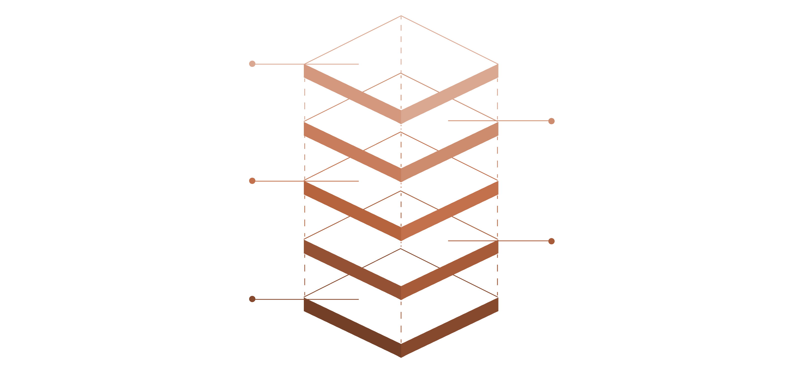
FemShield System Architecture Diagram Explaination
A visual explanation of the core components and their interactions within the FemShield system.
External Integrations
Emergency services and community APIs
Database Layer
Encrypted user and event storage
Microservices
Auth, alerts, profiles, analytics
API Gateway
Routing, auth, rate limiting
User Interface
Mobile and web apps for users

Slide 18
FemShield: Hybrid Architecture
Overview
The FemShield application uses a hybrid software architecture to meet its safety-critical, real-time, and scalable requirements. This combination ensures security, scalability, modularity, and real-time responsiveness essential for a women's safety platform.
Client–Server
Layered
Microservices
Event-Driven
Component-Based & MVC

Slide 19
Client Layer: User Interaction
The Presentation Layer provides the user interface for all features, collects user input, and displays real-time alerts. It leverages Client-Server and MVC architectures.
Components
Key Responsibilities
Mobile Application (Android / iOS)
for users.
SOS triggering & location sharing
Safe zone viewing
Web Application (Admin Panel) for monitoring and control.
Chat and community access
Real-time alerts & notifications

Slide 20
API Gateway: Secure Entry Point
The API Gateway acts as the single entry point, routing client requests to appropriate microservices while enforcing security policies.
Authentication & Authorization
Request Routing
Security Policies
Directs client requests to the correct backend services.
Enforces security measures and reduces direct client access.
Performs checks to ensure secure access.

Slide 21
Application Layer: Microservices
This layer uses Microservices Architecture, with each service performing a single, well-defined function.
Authentication Service
SOS & Emergency
Live Location Service
User login, OTP, biometric authentication, session management.
Handles SOS, sends alerts, shares live location, triggers notifications.
Tracks GPS, shares with contacts, stores history.
AI Threat Detection
Safe Zone & Map
Detects unusual sound/motion, auto-triggers SOS using ML and NLP.
Displays safe/unsafe areas, uses crowd-sourced data, integrates Google Maps.

Slide 22
Application Layer: Extended Services
Chat & Communication
1
In-app chat with contacts/volunteers, anonymous helpline, end-to-end encrypted.
Health & Wellness
2
Mental health counseling, fitness plans, medication reminders, health articles.
Education & Career
3
E-learning, scholarships, job board, resume builder, mentorship.
Community & Reporting
4
Incident reporting, discussions, anonymous reports, NGO integration.
Notification Service
5
Push, SMS, email alerts for SOS, warnings, updates (Twilio SMS API).

Slide 23



Event-Driven Layer: Real-time
Responsiveness
The Message Broker implements an Event-Driven Architecture for real-time operations, ensuring loose coupling, high scalability, and reliable communication.
Services Publish Events
Broker Distributes Events
Instant Processing
e.g., "SOS triggered"
To relevant subscribers
Notifications and alerts

Slide 24
Security Layer: Trust & Privacy
The Security Layer is critical for user trust and data privacy, ensuring end-to-end
encryption and controlled access.
Encryption Engine
Role-Based Access Control (RBAC)
End-to-end encryption of sensitive data.
Controls user permissions.
Protects chat, location, and personal
information.
Ensures only authorized actions are
performed.

Slide 25
Data Layer: Secure Storage
The Data Layer utilizes a Layered Architecture for data abstraction and security separation, storing various types of critical information.
User Database
Incident & Location Database
Analytics & Logs Database
User profiles, authentication, emergency contacts (Firebase / PostgreSQL).
System logs, performance metrics, usage analytics.
SOS incidents, location history, community reports.

Slide 26
External Services Layer: Key Integrations
FemShield integrates with several external services to enhance functionality and provide comprehensive
support.
Google Maps API
Twilio SMS API
Location tracking, safe zone mapping.
SMS emergency alerts.
OpenAI API
Authorities / Law Enforcement
AI chatbot, NLP for guidance.
Receives SOS alerts during critical emergencies.

Slide 27
End-to-End Flow Summary
01
02
03
User Interaction
API Gateway
Microservice Processing
Via Mobile or Web App.
Routes and authenticates requests.
Appropriate service handles request.
04
05
06
Event Publishing
Real-time Notifications
Secure Data Storage
To Message Broker (if needed).
Sent instantly.
In relevant databases.
07
External Service Support
Maps, SMS, and AI integration.

Slide 28
FemShield Architecture: Key Pillars
Secure
Scalable
Real-Time
Encryption + Role-Based Access Control (RBAC)
Microservices + Cloud Infrastructure
Event-Driven Processing
Maintainable
Reliable
Layered & Component-Based Design
Client-Server + API Gateway
This robust architecture ensures FemShield effectively supports women’s safety, empowerment, and well-
being.

