Slide 1
OPPOSITION REPORT
Spain
UEFA Euro 2024 champions | 7 matches analysed
Opposition analysis by Muhammed Ashhar A, Performance Analyst
Tools: Nacsport (video coding) | StatsBomb event data | Python (mplsoccer)
Notes:
Non-confidential sample report built on StatsBomb open data, written as if our team plays Spain next.

Slide 2
Summary: how Spain play and how we can hurt them
Control
Wide threat
58% possession, 87% passing and 65% field tilt on average.
49% of final-third entries come down their left, 37% down the right and only 14% centrally.
Selective press
Vulnerable without the ball
PPDA 15.2 and 22 high regains per match. Short build-up is risky.
1.65 xG conceded per match when their press dropped (PPDA above 18), vs 0.37 otherwise.
Data: StatsBomb Open Data | Euro 2024 | Non-confidential sample
Notes:
Four messages for the team meeting. Each is backed by the slides that follow.

Slide 3
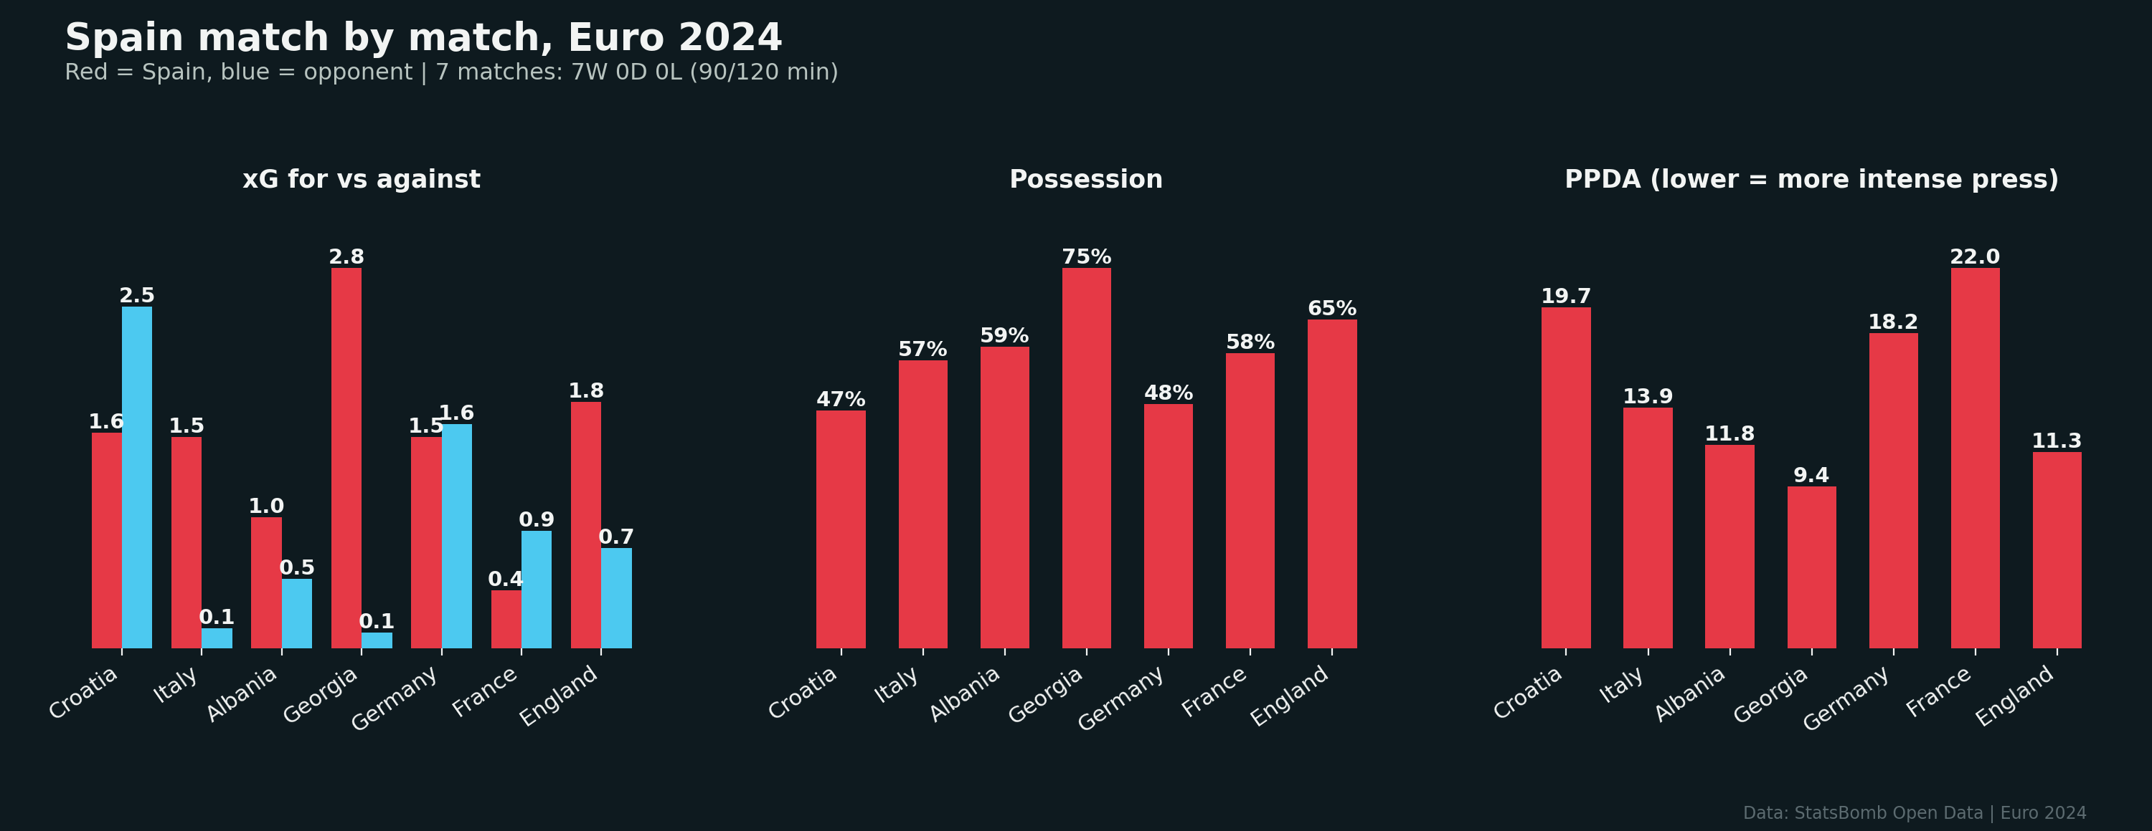
7 wins from 7, built on control
Match-by-match xG, possession and pressing intensity
15-4
10.6 - 6.4
123 - 75
5 of 7
Goals for and against
xG for and against
Shots for and against
Matches in 4-2-3-1
Data: StatsBomb Open Data | Euro 2024 | Non-confidential sample

Slide 4
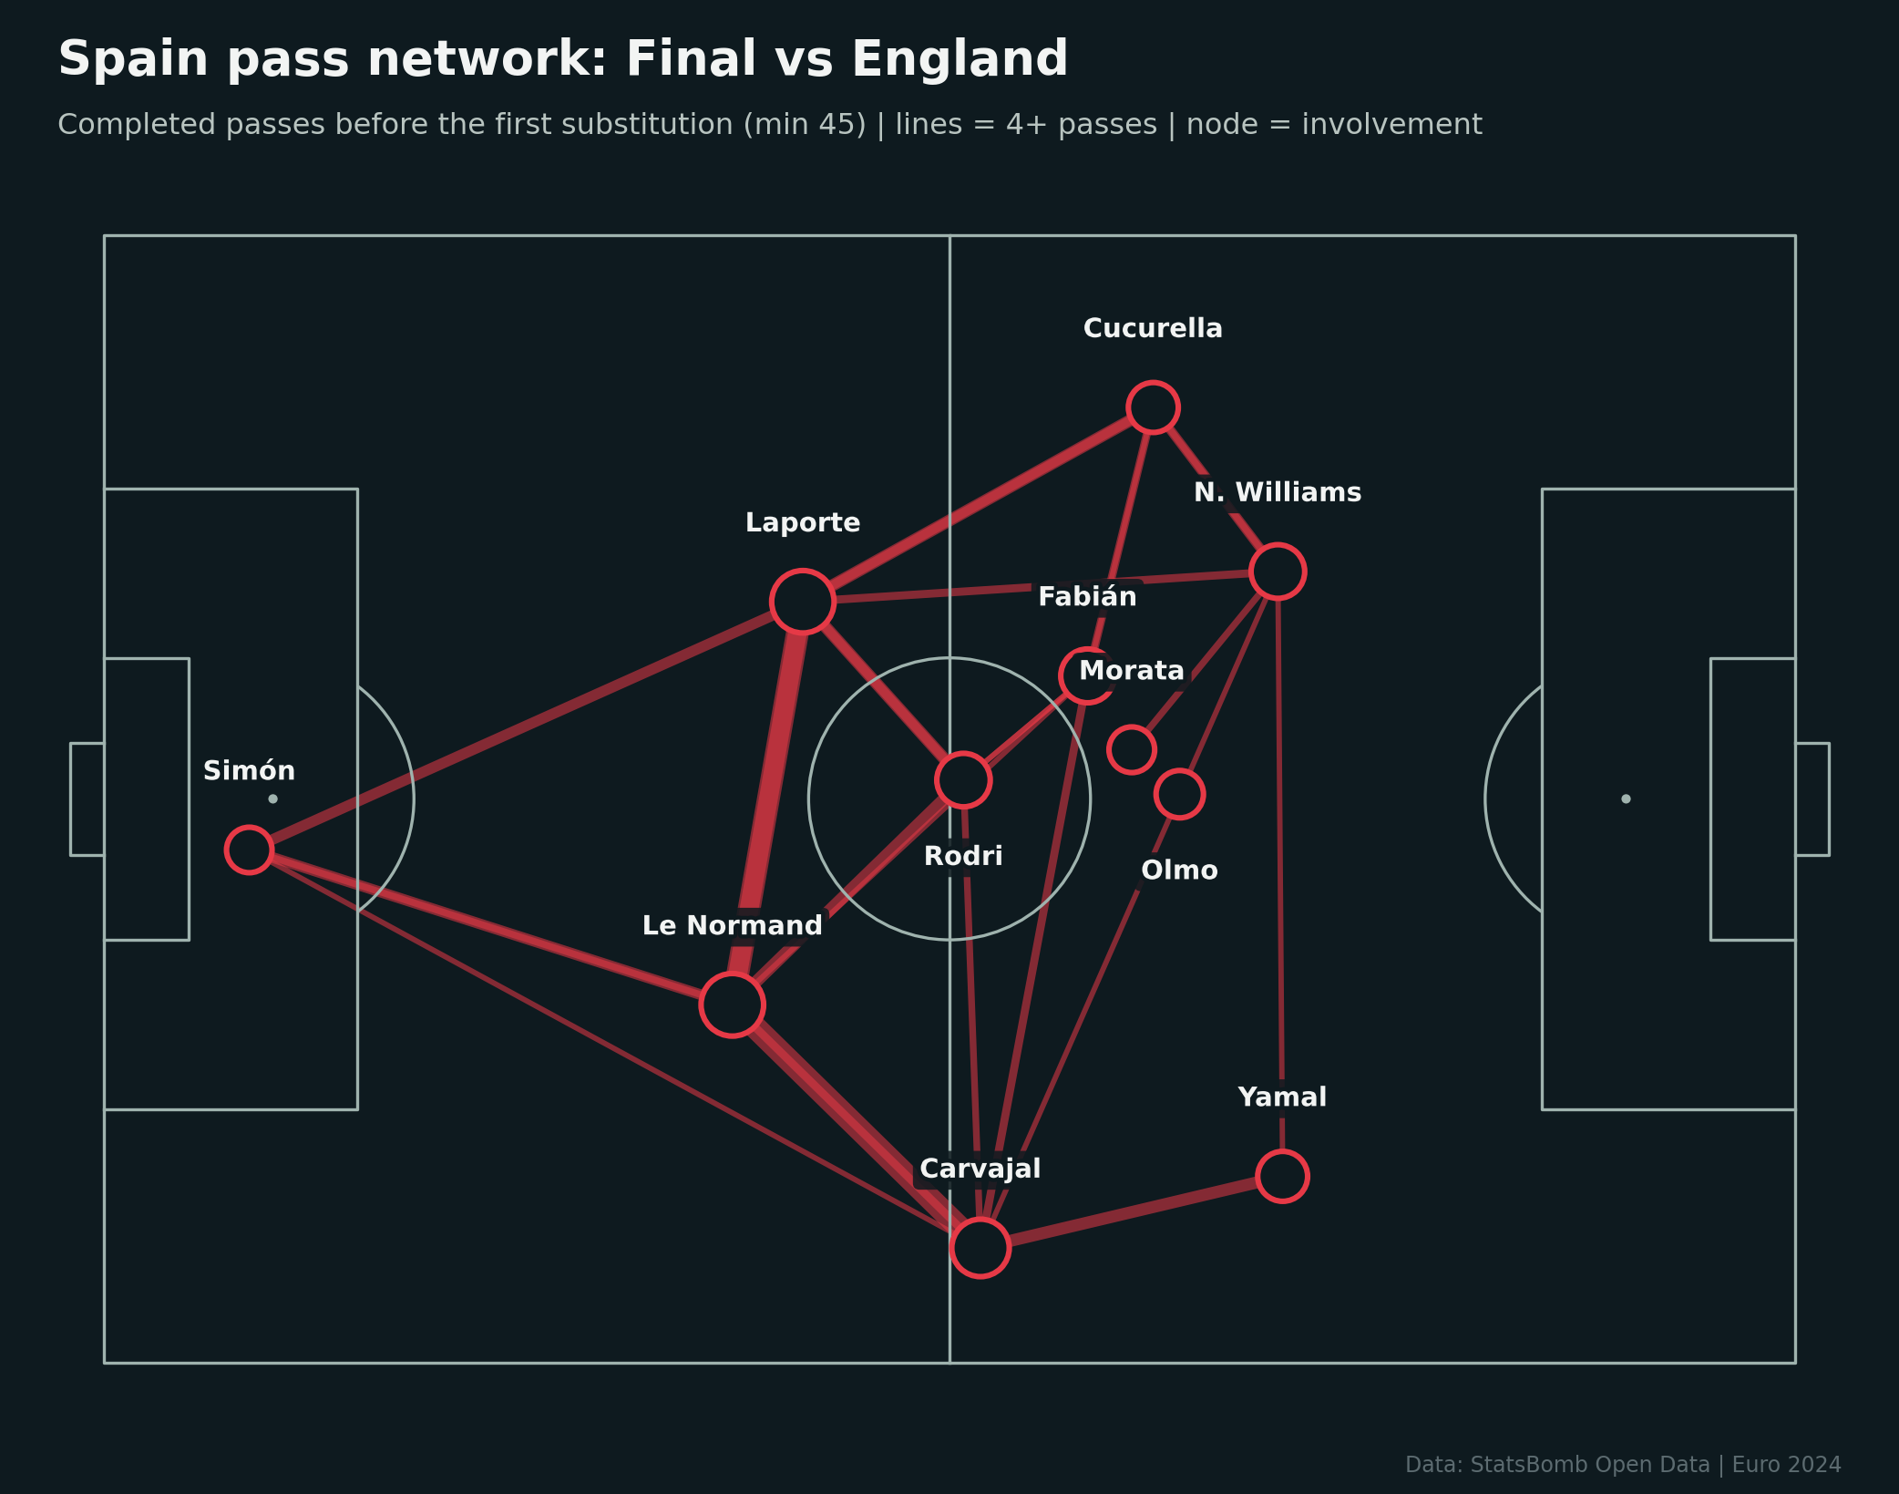
Shape and build-up: 4-2-3-1 with high full-backs
Pass network, final vs England (before first substitution)
Rodri and Fabián Ruiz form the double pivot; the build-up runs through Laporte, Le Normand and Rodri.
Cucurella pushes high on the left, freeing Nico Williams to go 1v1.
Yamal stays wide on the right with Carvajal behind him.
Olmo floats between the lines as the No.10.
Data: StatsBomb Open Data | Euro 2024 | Non-confidential sample

Slide 5
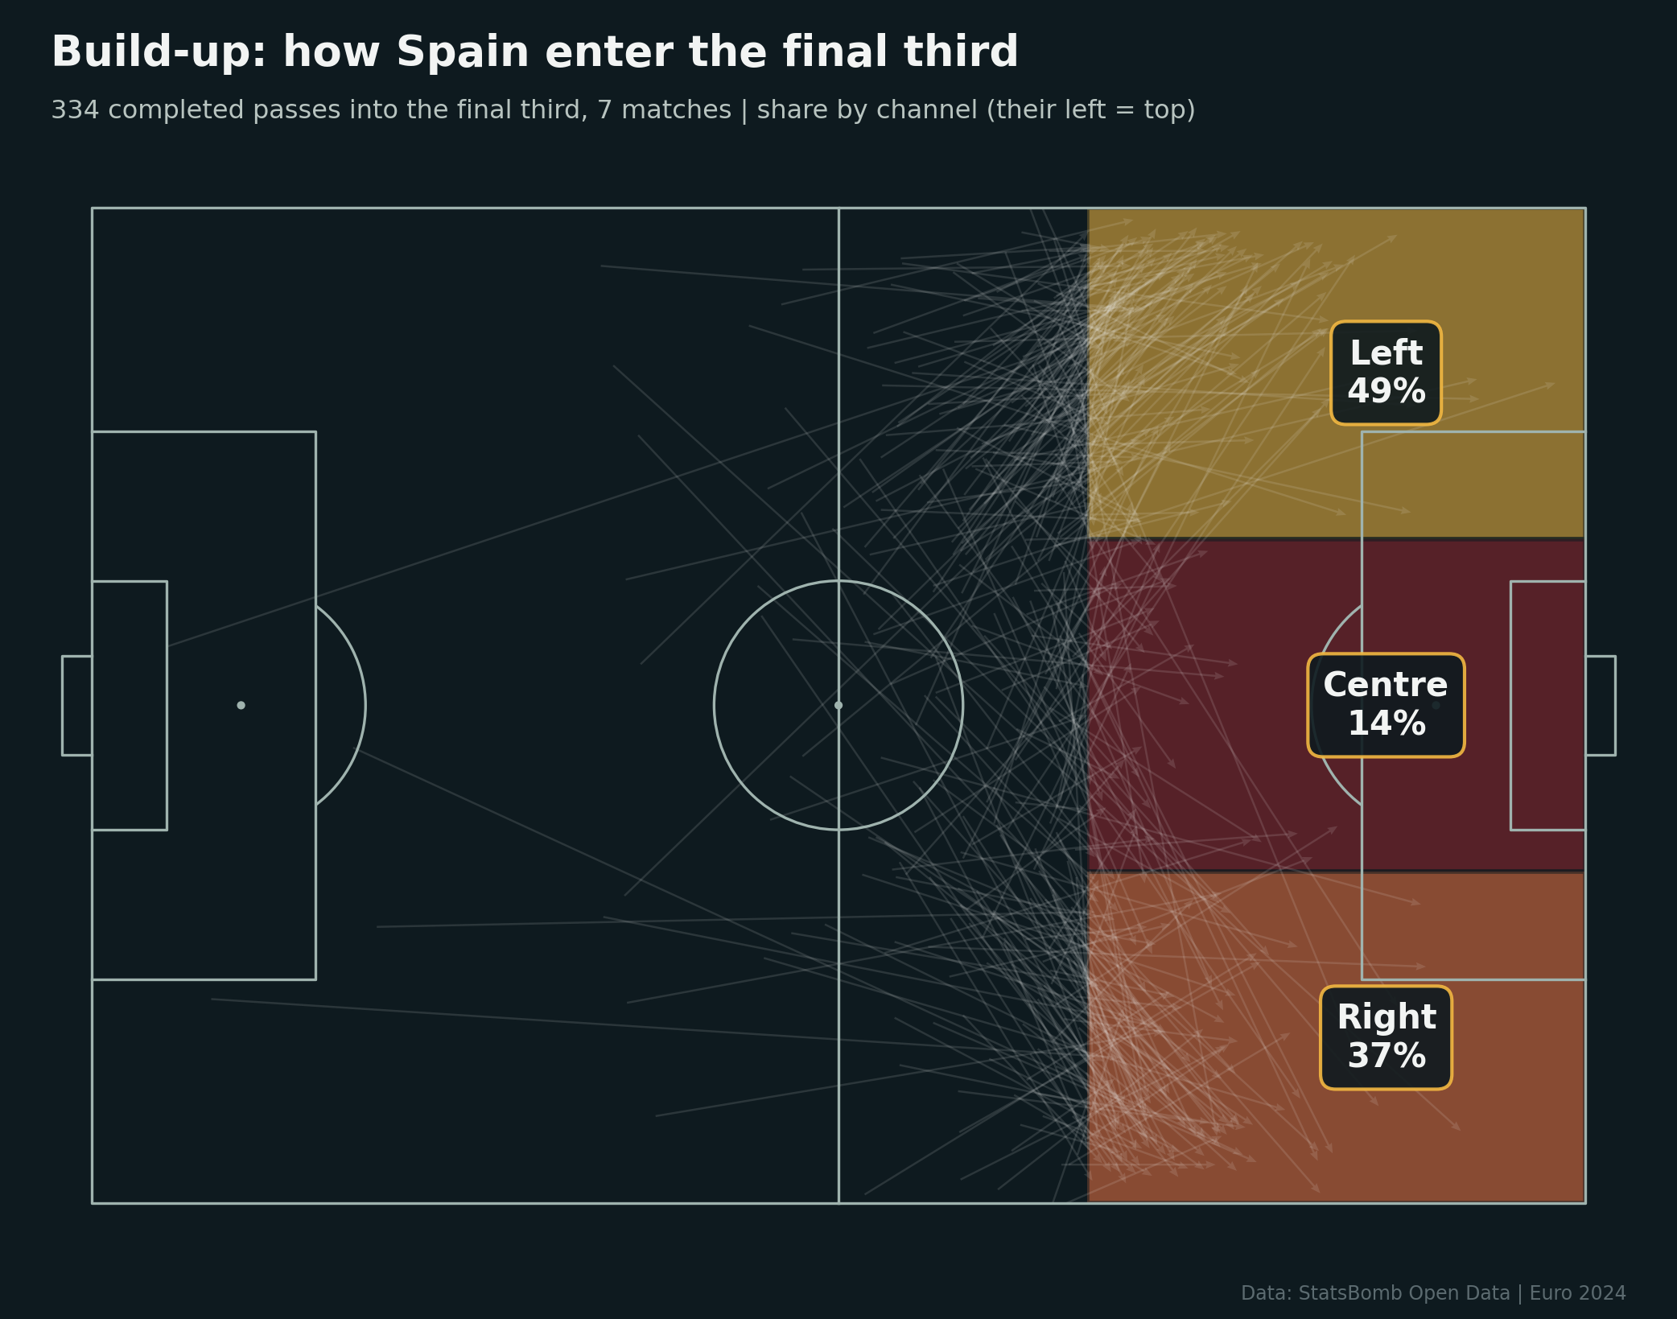
They attack down the flanks, mostly the left
334 completed passes into the final third
49%
Entries down their left (Nico, Cucurella)
37%
Entries down their right (Yamal, Carvajal)
14%
Entries through the centre
Plan: protect both flanks and keep the middle compact.
Data: StatsBomb Open Data | Euro 2024 | Non-confidential sample

Slide 6
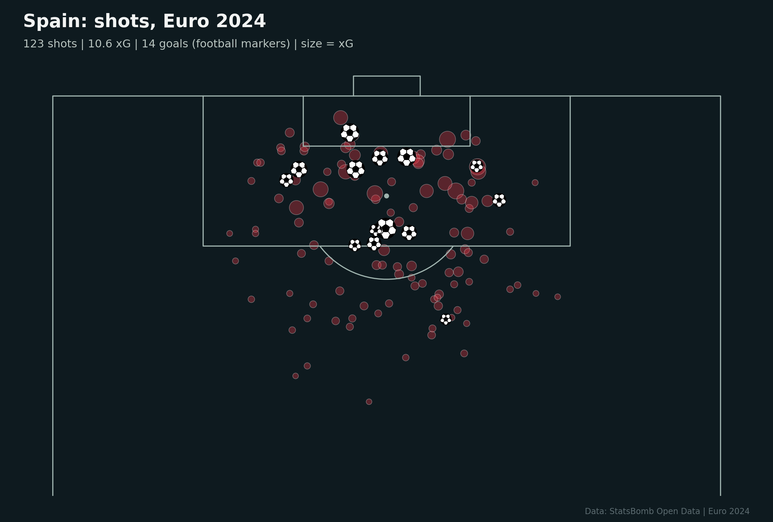
Chances come from central zones in the box
123 shots, 10.6 xG, 14 goals from shots
Most shots are taken inside the box, between the posts.
Average shot quality 0.09 xG: they work the ball into good positions rather than shooting from range.
Defend the six-yard box and the penalty spot area; track late runners like Olmo and Fabián Ruiz.
Data: StatsBomb Open Data | Euro 2024 | Non-confidential sample

Slide 7
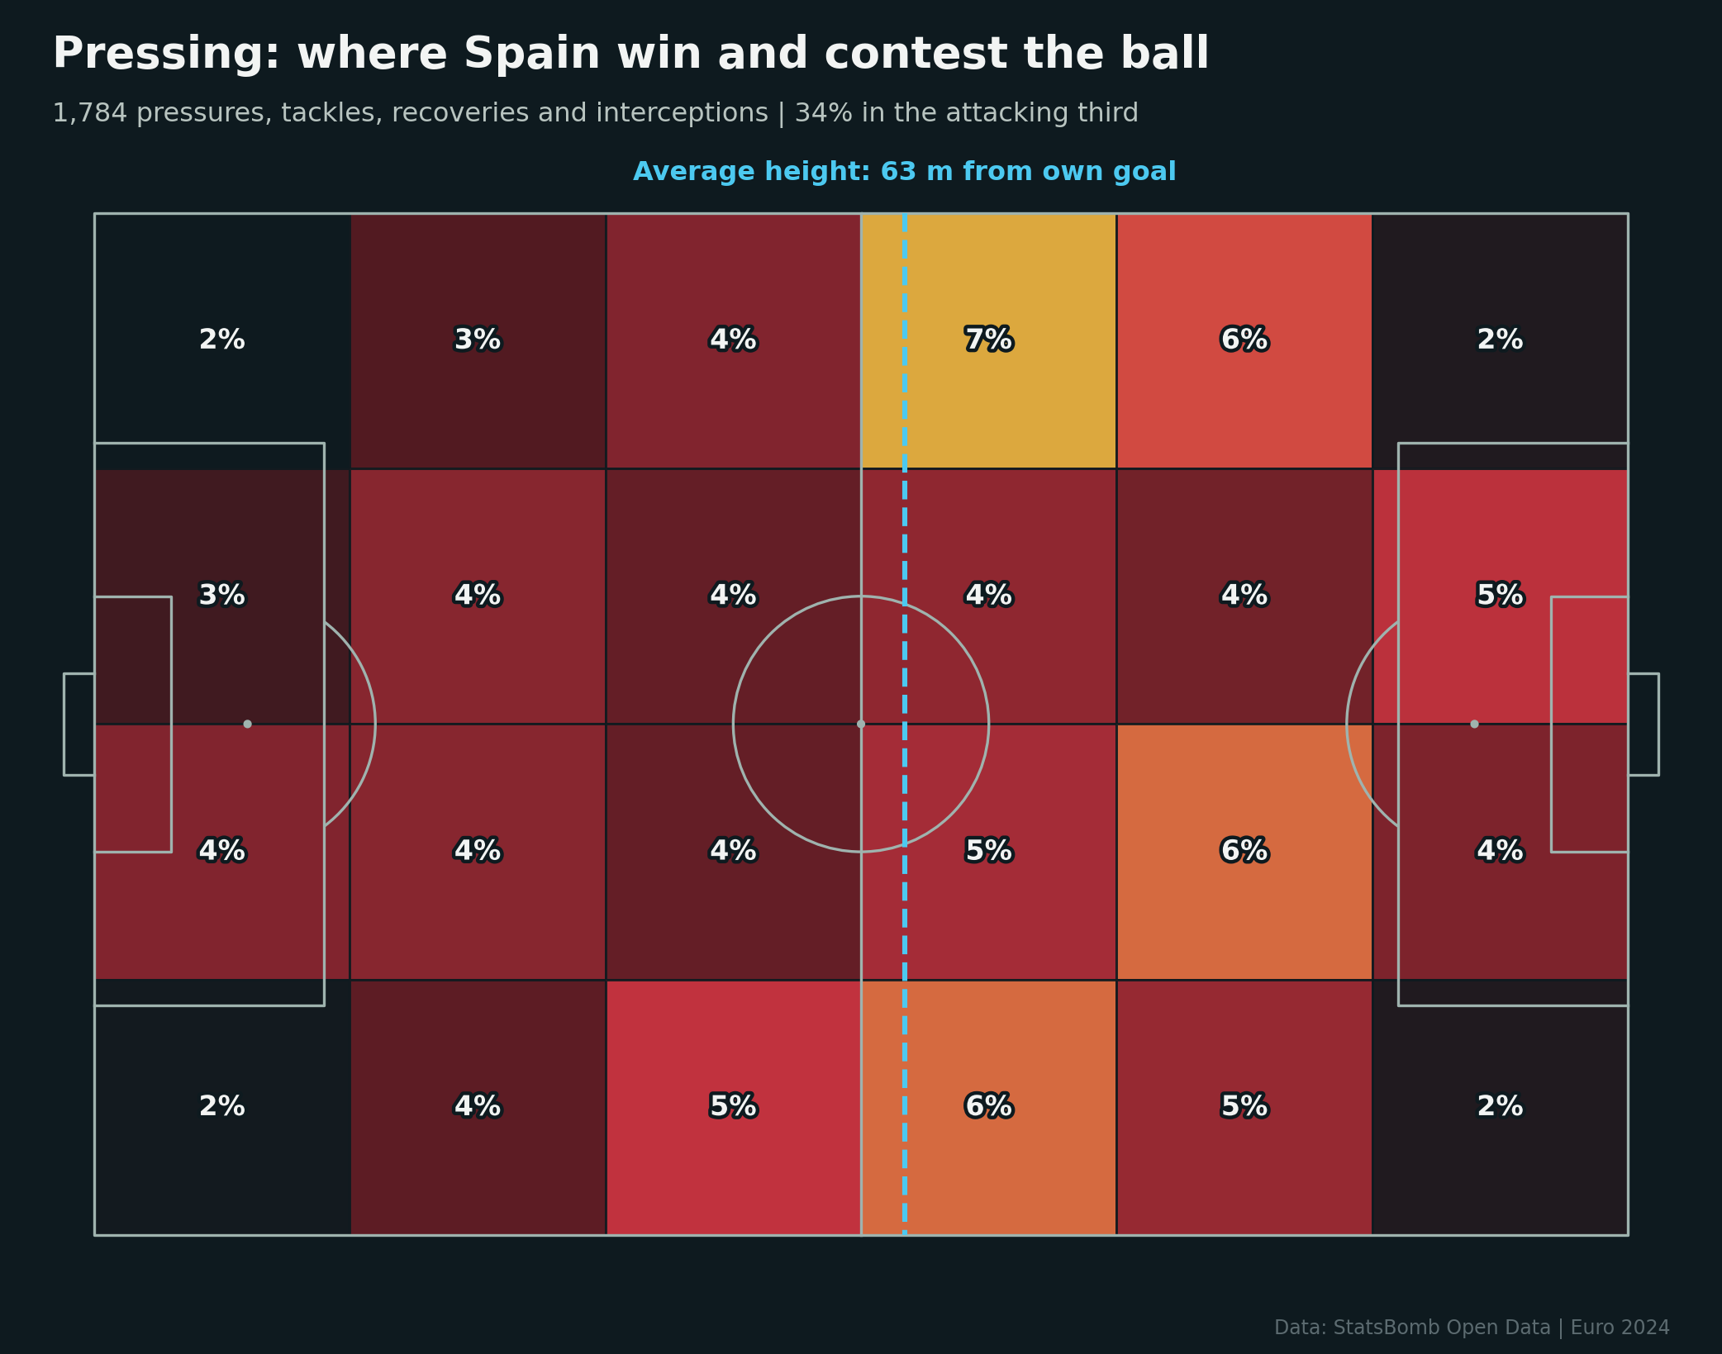
Pressing: selective, but sharp when it triggers
Share of Spain defensive actions by zone
15.2
Average PPDA
22
High regains per match
34%
Defensive actions in the attacking third
Plan: avoid slow short build-up; play beyond the first line.
Data: StatsBomb Open Data | Euro 2024 | Non-confidential sample

Slide 8
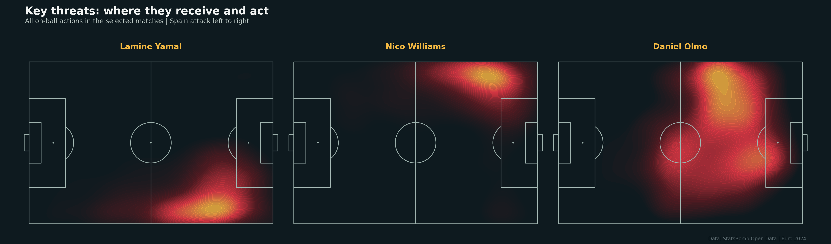
Key threats
Where they receive and act, plus tournament output
Player | Goals | xG | xA | Key passes | Prog. carries | Dribbles
Lamine Yamal | 1 | 1.59 | 2.15 | 18 | 45 | 12
Daniel Olmo | 3 | 1.38 | 1.24 | 11 | 17 | 10
Fabián Ruiz | 2 | 1.14 | 1.17 | 11 | 11 | 7
Nico Williams | 2 | 0.95 | 1.23 | 12 | 32 | 15
Álvaro Morata | 1 | 1.57 | 0.34 | 3 | 8 | 1
Data: StatsBomb Open Data | Euro 2024 | Non-confidential sample

Slide 9
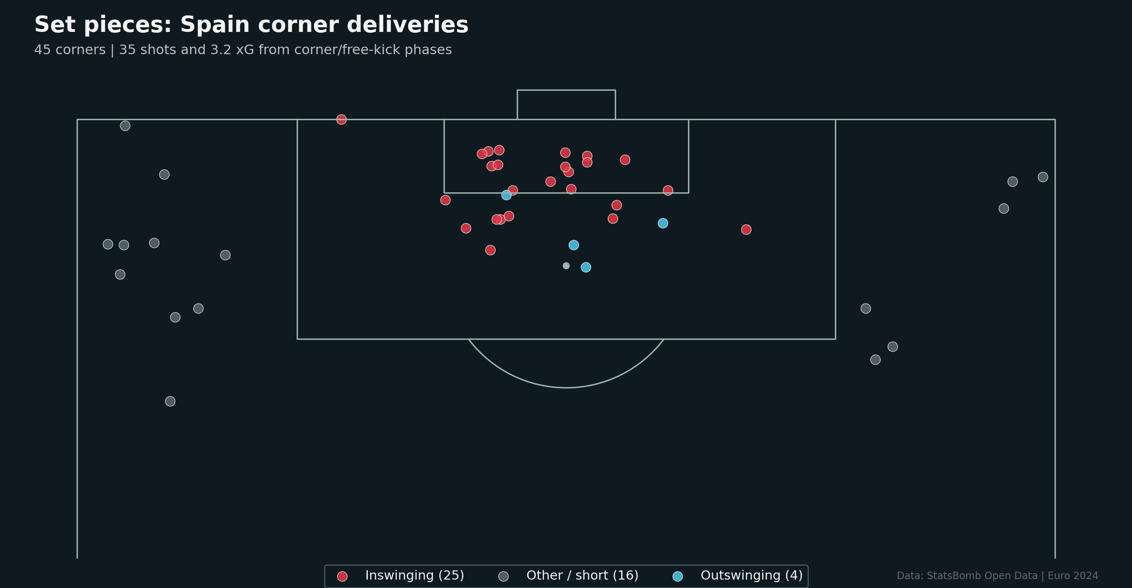
Set pieces: inswinging corners to the six-yard box
45 corners analysed
25 of 45
Corners delivered inswinging
35 shots, 3.2 xG
From corner and free-kick phases
3
Goals from set-piece phases
Plan: zone the six-yard box and near post; man-mark Laporte and Le Normand.
Data: StatsBomb Open Data | Euro 2024 | Non-confidential sample

Slide 10
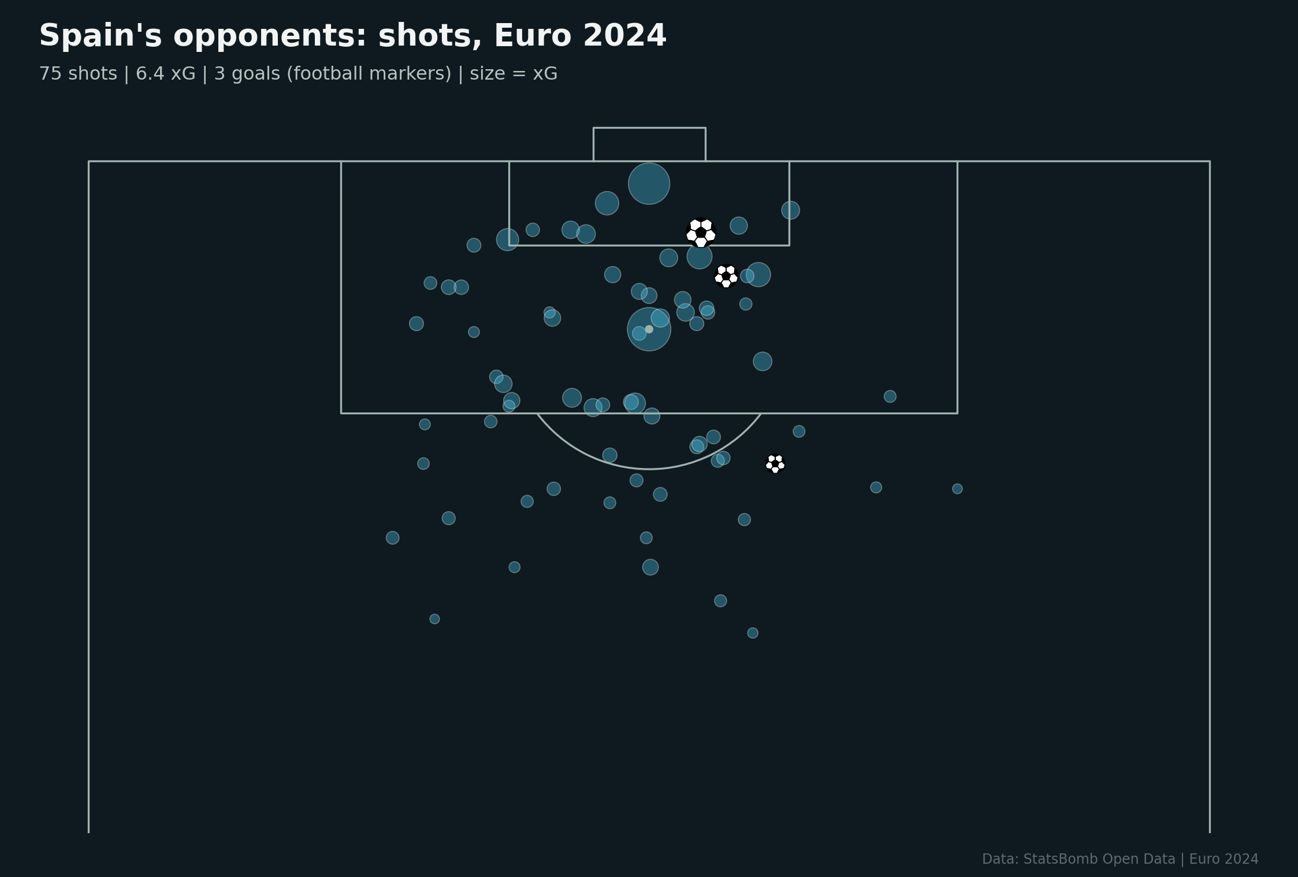
Where Spain are vulnerable
Shots conceded across the tournament
1.65 vs 0.37
xG conceded per match: low press (PPDA 18+) vs others
Croatia (2.48 xG) and Germany (1.63 xG) hurt Spain when possession was close to 50/50.
When games become open and less controlled, Spain concede far more chances.
Compete for the ball and play quickly in transition rather than sitting deep for 90 minutes.
Data: StatsBomb Open Data | Euro 2024 | Non-confidential sample

Slide 11
Game plan
1
Protect the flanks
Double up on Nico Williams and Yamal: full-back plus winger, show them inside.
2
Stay compact centrally
Force play wide early; defend crosses and cut-backs into the six-yard area.
3
Break their control
Press Rodri and the centre-backs in short, planned spells to deny rhythm.
4
Play beyond the press
Avoid slow short build-up; attack the space behind their high full-backs.
5
Set pieces
Zonal six-yard box and near post for inswinging corners; mark the centre-backs.

Slide 12
Video plan: clips for the team meeting
369 timecoded moments to code and cut in Nacsport
Playlists by phase: build-up, final-third entries, chance creation, pressing, transitions, set pieces.
6-10 clips per playlist, drawn with arrows and zones.
2-3 minute key-threat reels for Yamal, Nico Williams and Olmo.
Clip list and code window template included with this report.
Data: StatsBomb Open Data | Euro 2024 | Non-confidential sample

