Slide 1


Slide 2
Introduction
JUSTDICE is dedicated to crafting games that captivate and challenge players, with a focus on delivering seamless and immersive gameplay. Our team of talented developers, designers, and artists work together to create high-quality games that appeal to a wide range of players.
From casual mobile games to complex console titles, JUSTDICE is committed to pushing the boundaries of what's possible in the gaming industry. With a passion for game development and a dedication to excellence, we strive to deliver the best gaming experiences possible.
So sit back, relax, and get ready to learn more about JUSTDICE and the exciting games we have in store.
we're excited to showcase our BI Dashboard, a powerful tool that provides insights and data visualization to help make informed business decisions.
Our BI Dashboard is designed to give you a comprehensive view of your organization's data, with customizable widgets that allow you to focus on the metrics that matter most to you. With real-time data integration, you'll have up-to-the-minute insights that can help you identify trends, patterns, and opportunities.
2

Slide 3
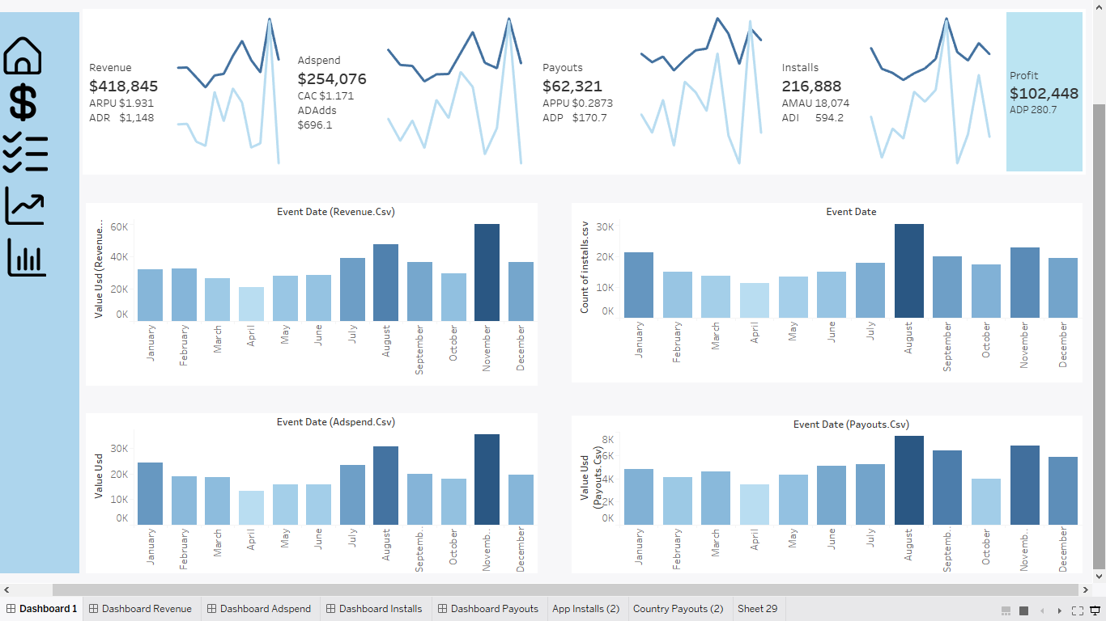
Findings of Dashboard
The first finding suggests that the more you spend on ads, the more revenue you can generate. This can be attributed to the fact that ads can help increase visibility and awareness of your product or service, which can lead to more clicks, conversions, and ultimately, more revenue. By investing in targeted and effective advertising campaigns, businesses can see a significant return on investment and increase their bottom line.
The second finding suggests that targeting ads towards countries and apps that generate less revenue can be a more effective strategy. This can be due to lower competition and lower ad costs in those regions, which can result in a higher return on investment. By analyzing data and identifying the most profitable markets, businesses can optimize their ad spend and improve their overall performance.

Slide 4
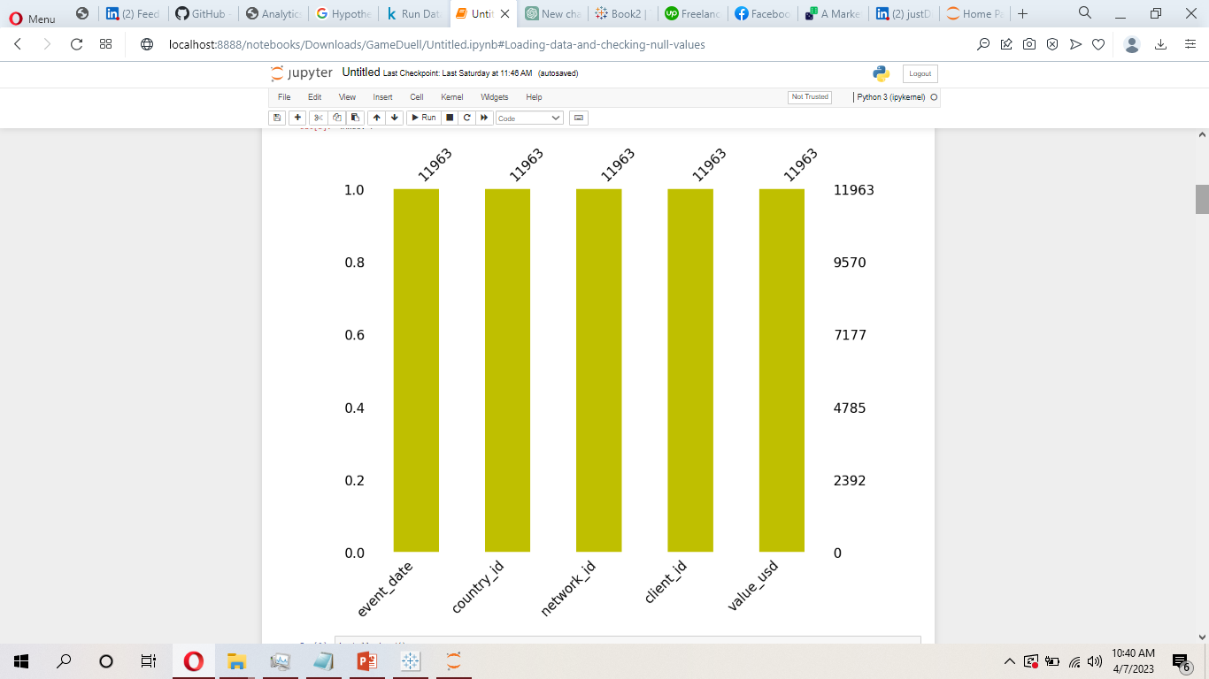
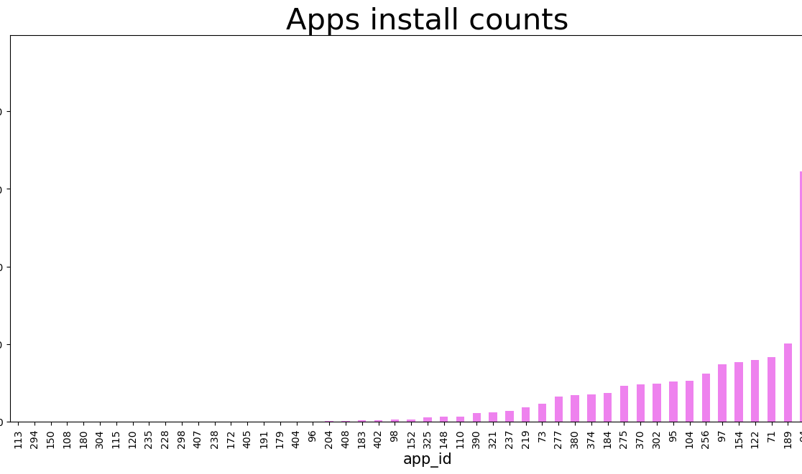
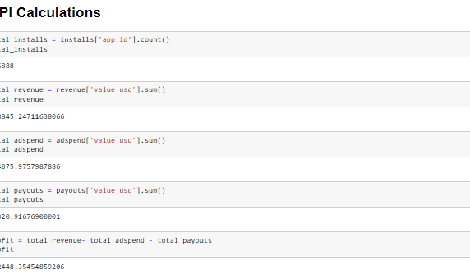
Data Wrangling And Analysis Techniques
Loading Data And Checking Null Values
Exploratory Data Analysis
KPI Calculations
Loaded all files in Jupyter Notebook. And tried different techniques to check null values. But no Null Values found
In Exploratory Data analysis different graph were developed to check data.
In KPI Calculations different KPIs were calculated using python,

Slide 5
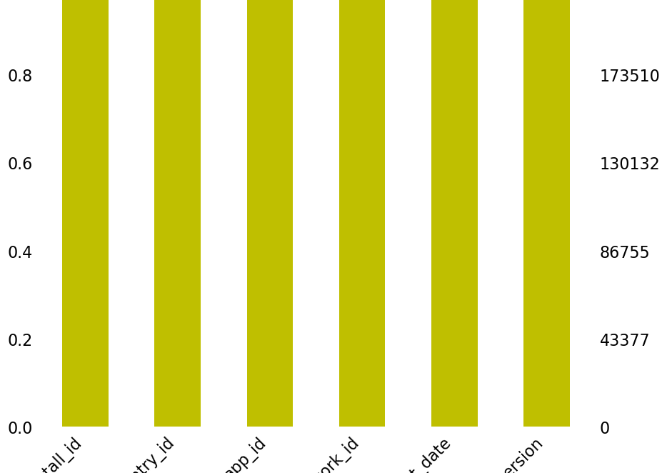
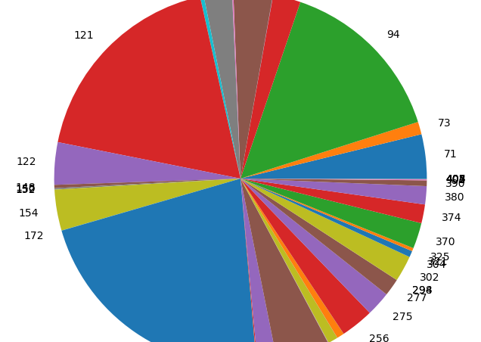
Findings of Data Wrangling
No Null Data
3 games are doing well
No null data found during data wrangling. It is food to used in Dashboard and ML models.
3 games are doing well. While all other games are struggling.

Slide 6
Business Findings
01
Firstly, we found that the more we spend on ads, the more revenue we generate. This suggests that there is a positive correlation between ad spending and revenue, and that we should consider increasing our ad budget to see even greater returns.
02
Secondly, we found that targeting ads towards less revenue-generating countries and apps can be a cost-effective strategy. By focusing our ad campaigns on these areas, we can potentially lower our costs while still reaching a wide audience.
03
Thirdly, we identified that some apps are performing exceptionally well. By examining the data on these successful apps, we can gain insights into what is working and apply those strategies to other apps that are not performing as well.
04
Finally, we found that there is potential for growth in more countries. By expanding our ad campaigns to target more countries, we can tap into new markets and drive even more revenue.

Slide 7
Impact of these Findings
01
Firstly, the positive correlation between ad spending and revenue means that we should consider increasing our ad budget to maximize our returns. This may require some adjustments in our financial planning and resource allocation to ensure that we can invest more in ad campaigns without compromising other aspects of our business.
02
Secondly, the strategy of targeting ads towards less revenue-generating countries and apps can help us optimize our ad spending and potentially lower costs. This means that we may need to reassess our current ad targeting approach and allocate resources towards targeting these areas more effectively.
03
Thirdly, identifying successful apps and applying their strategies to other apps can help us improve our overall app performance and increase revenue. This may require some investment in research and development to identify what is working and how we can replicate those strategies across our other apps.
04
Finally, expanding our ad campaigns to target more countries presents an opportunity for growth and revenue generation. This means that we may need to allocate resources towards developing ad campaigns that are tailored to the needs and preferences of these new markets.

Slide 8
Main Dashboard
Our main dashboard provides an at-a-glance view of several key performance indicators (KPIs) that are critical to our business success. These KPIs include monthly revenue, ad spends, payouts, and installs.
Monthly revenue is a key indicator of our overall business performance and reflects the amount of revenue we generate each month. By tracking this KPI on our main dashboard, we can quickly identify trends and changes in our revenue performance and take action to optimize our revenue generation strategy accordingly.
Ad spends are another important KPI that we track on our main dashboard. This reflects the amount of money we spend on advertising each month, and helps us to monitor the effectiveness of our advertising campaigns. By tracking this KPI on our main dashboard, we can quickly identify changes in our ad spending and take action to optimize our ad campaigns to maximize returns.
Payouts are also a critical KPI that we track on our main dashboard. This reflects the amount of money we pay out to app Users each month, and helps us to monitor the overall profitability of our business model. By tracking this KPI on our main dashboard, we can quickly identify changes in our payouts and take action to ensure that our business remains profitable.
Finally, installs are a key KPI that we track on our main dashboard. This reflects the number of app installs we generate each month, and helps us to monitor the effectiveness of our app marketing strategy. By tracking this KPI on our main dashboard, we can quickly identify changes in our install performance and take action to optimize our app marketing strategy to drive more installs.
Creative Point Important #2
A wonderful serenity has taken possession of my entire soul, like these sweet mornings of spring which I enjoy with my whole heart. I am alone, and feel the charm of existence in this spot, which was created for the bliss of souls like mine. I am so happy, my dear friend, so absorbed in the exquisite sense of mere tranquil existence, that I neglect my talents.

Slide 9
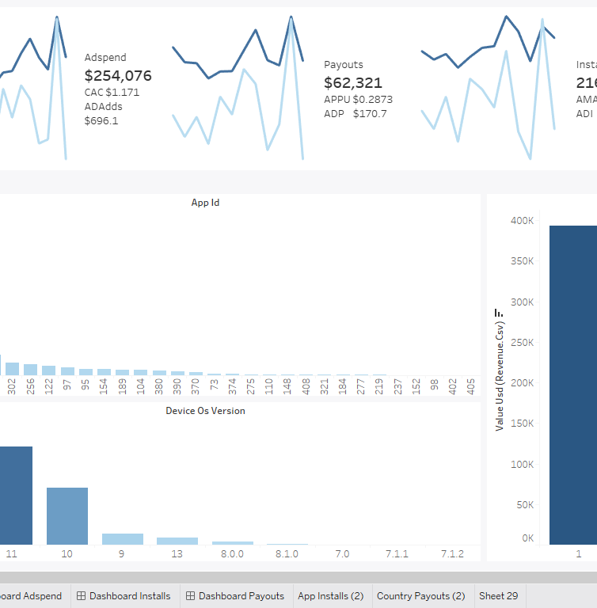
Revenue Dashboard
Our revenue dashboard provides detailed insights into the revenue generated by our apps across different countries, apps, and mobile versions. By tracking these metrics, we can identify trends and opportunities to optimize our revenue generation strategy.
The country-wise revenue section of our revenue dashboard provides a breakdown of revenue generated by each country where our apps are available. This helps us to identify which countries are generating the most revenue and which countries have the most potential for growth. By focusing our revenue generation strategy on the countries with the highest revenue potential, we can optimize our revenue generation and increase overall profitability.
The app-wise revenue section of our revenue dashboard provides a breakdown of revenue generated by each of our apps. This helps us to identify which apps are generating the most revenue and which apps have the most potential for growth. By focusing our revenue generation strategy on the apps with the highest revenue potential, we can optimize our revenue generation and increase overall profitability.
The mobile version-wise revenue section of our revenue dashboard provides a breakdown of revenue generated by different mobile versions of our apps. This helps us to identify which mobile versions are generating the most revenue and which mobile versions have the most potential for growth. By optimizing our apps for the mobile versions with the highest revenue potential, we can improve our revenue generation and increase overall profitability.
Creative Point Important #1
A wonderful serenity has taken possession of my entire soul, like these sweet mornings of spring which I enjoy with my whole heart. I am alone, and feel the charm of existence in this spot, which was created for the bliss of souls like mine. I am so happy, my dear friend, so absorbed in the exquisite sense of mere tranquil existence, that I neglect my talents.

Slide 10
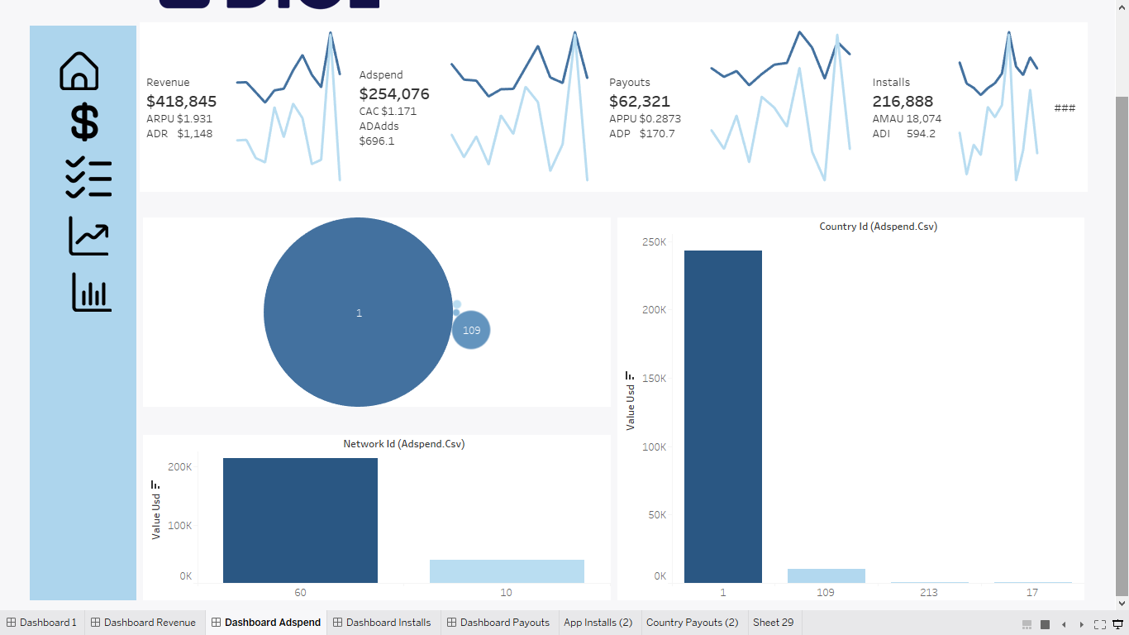
Adds Spending Dashboard
Our ad spend dashboard provides detailed insights into the amount of money we spend on advertising across different countries and networks. By tracking these metrics, we can identify trends and opportunities to optimize our advertising strategy and improve overall return on investment.
The country-wise ad spend section of our ad spend dashboard provides a breakdown of the amount of money we spend on advertising in each country where our apps are available. This helps us to identify which countries have the highest potential for advertising ROI and which countries may require additional advertising spend to drive growth.
The network-wise ad spend section of our ad spend dashboard provides a breakdown of the amount of money we spend on advertising across different advertising networks. This helps us to identify which networks are generating the highest return on investment and which networks may require additional investment to improve overall ROI.
By tracking our ad spend across different countries and networks, we can identify trends and patterns that can help us optimize our advertising strategy to generate higher returns on investment. For example, we may identify that certain advertising networks perform better in certain countries, or that certain types of advertising generate higher returns than others. By using these insights to optimize our advertising strategy, we can improve overall advertising ROI and drive more revenue for our business.
Creative Point Important #2
A wonderful serenity has taken possession of my entire soul, like these sweet mornings of spring which I enjoy with my whole heart. I am alone, and feel the charm of existence in this spot, which was created for the bliss of souls like mine. I am so happy, my dear friend, so absorbed in the exquisite sense of mere tranquil existence, that I neglect my talents.

Slide 11
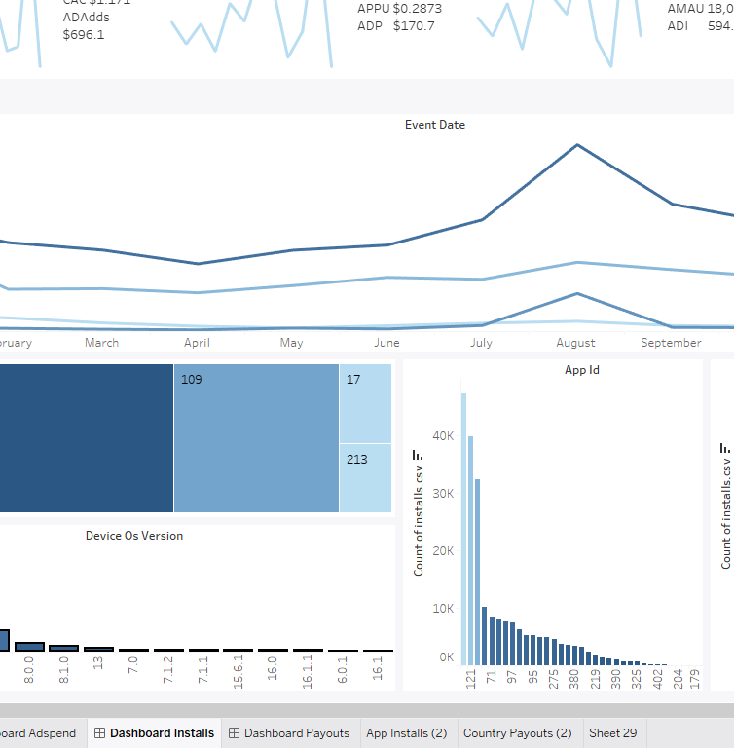
Dashboard of Installs
Our installs dashboard provides detailed insights into the number of installs our apps receive across different countries, apps, and mobile versions. By tracking these metrics, we can identify trends and opportunities to optimize our user acquisition strategy and improve overall app performance.
The country-wise installs section of our installs dashboard provides a breakdown of the number of installs our apps receive in each country where they are available. This helps us to identify which countries have the highest potential for user acquisition and which countries may require additional investment to drive growth.
The app-wise installs section of our installs dashboard provides a breakdown of the number of installs each of our apps receives. This helps us to identify which apps are generating the most installs and which apps may require additional investment to improve overall user acquisition.
The mobile version-wise installs section of our installs dashboard provides a breakdown of the number of installs for different mobile versions of our apps. This helps us to identify which mobile versions are generating the most installs and which mobile versions may require additional optimization to improve overall user acquisition.
Creative Point Important #1
A wonderful serenity has taken possession of my entire soul, like these sweet mornings of spring which I enjoy with my whole heart. I am alone, and feel the charm of existence in this spot, which was created for the bliss of souls like mine. I am so happy, my dear friend, so absorbed in the exquisite sense of mere tranquil existence, that I neglect my talents.

Slide 12
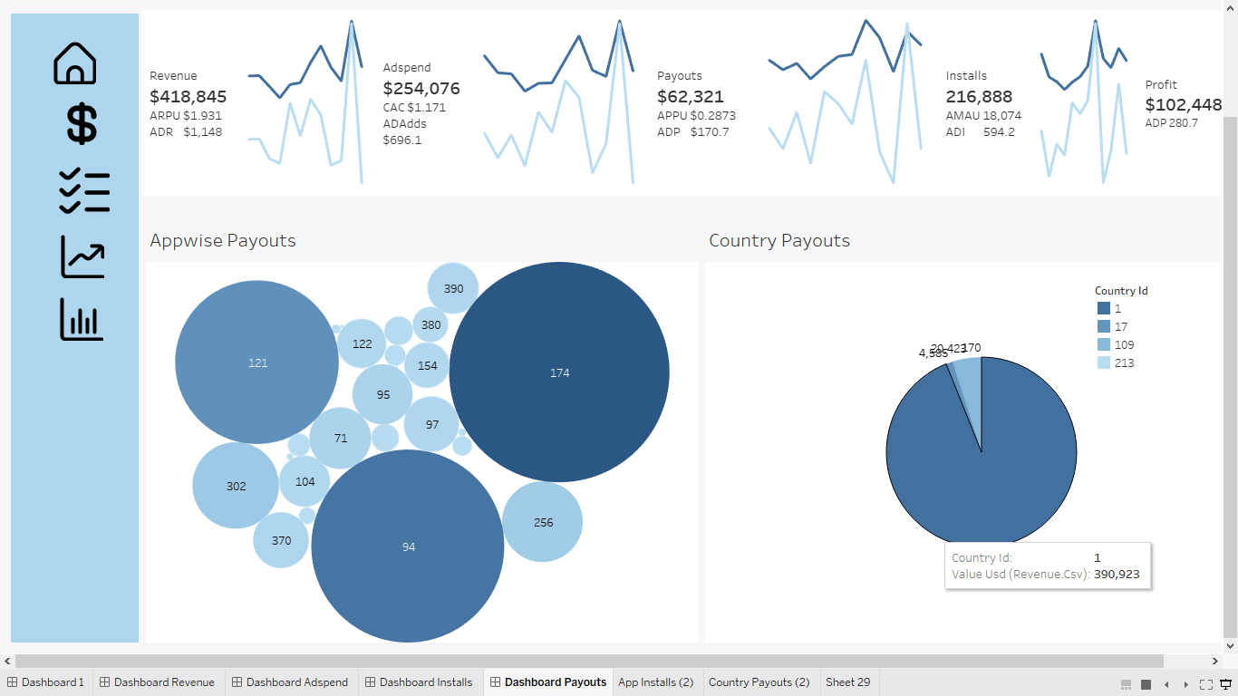
Payouts Dashboard
Our payouts dashboard provides detailed insights into the amount of money we pay out to users across different countries and apps. By tracking these metrics, we can identify trends and opportunities to optimize our payouts strategy and improve overall user retention and engagement.
The country-wise payouts section of our payouts dashboard provides a breakdown of the amount of money we pay out to users in each country where our apps are available. This helps us to identify which countries have the highest user engagement and retention rates and which countries may require additional investment to improve overall user engagement and retention.
The app-wise payouts section of our payouts dashboard provides a breakdown of the amount of money we pay out to users for each of our apps. This helps us to identify which apps are generating the most user engagement and retention and which apps may require additional investment to improve overall user engagement and retention.
Creative Point Important #2
A wonderful serenity has taken possession of my entire soul, like these sweet mornings of spring which I enjoy with my whole heart. I am alone, and feel the charm of existence in this spot, which was created for the bliss of souls like mine. I am so happy, my dear friend, so absorbed in the exquisite sense of mere tranquil existence, that I neglect my talents.

Slide 13
Actionable Recommendations
Increase ad spending
Our analysis shows that the more we spend on ads, the more revenue we generate. Therefore, we recommend increasing our ad spend to maximize revenue. However, it's important to monitor the impact of increased ad spend on revenue and adjust our strategy accordingly.

Slide 14
Actionable Recommendations
Target less revenue-generating countries and apps
Our analysis shows that targeting ads to countries and apps that generate less revenue can be more effective in generating installs and revenue. Therefore, we recommend identifying and targeting these countries and apps to improve user acquisition and revenue.

Slide 15
Actionable Recommendations
Focus on high-performing apps
Our analysis shows that some of our apps are performing better than others. Therefore, we recommend focusing our resources on these high-performing apps to maximize revenue and user engagement.

Slide 16
Actionable Recommendations
Expand into more countries
Our analysis shows that there is potential for growth in additional countries. Therefore, we recommend expanding our operations to these countries to increase revenue and user acquisition.

Slide 17
Actionable Recommendations
Optimize payouts strategy
Our analysis shows that optimizing our payouts strategy can improve user engagement and retention. Therefore, we recommend identifying and adjusting our payouts strategy to improve overall user engagement and retention.

Slide 18
Actionable Recommendations
Monitor and track metrics
We recommend continuing to monitor and track metrics across all dashboards to identify new trends and opportunities for optimization. Regular review of our BI dashboard can help identify new opportunities and help us stay ahead of competitors.

Slide 19
Thank You
FOR YOUR TIME

