Slide 1

ALBERTO / ATELIER
APTECH / E-PROJECT
IMPLEMENTATION
NOTES
Frontend architecture · Features and limitations
DEVELOPER GUIDE
01 / 13

Slide 2
ALBERTO / ATELIER
DEVELOPER GUIDE / IMPLEMENTATION
Project team
E-PROJECT / TEAM DETAILS
STUDENT
STUDENT ID
Muhammad Awais
1733752
Haider Shah
—
Habib Alam
—
Hassan
—
FACULTY
COORDINATOR
Muhammad Arkam Tariq
Shazma Shoukat
02 / 13

Slide 3
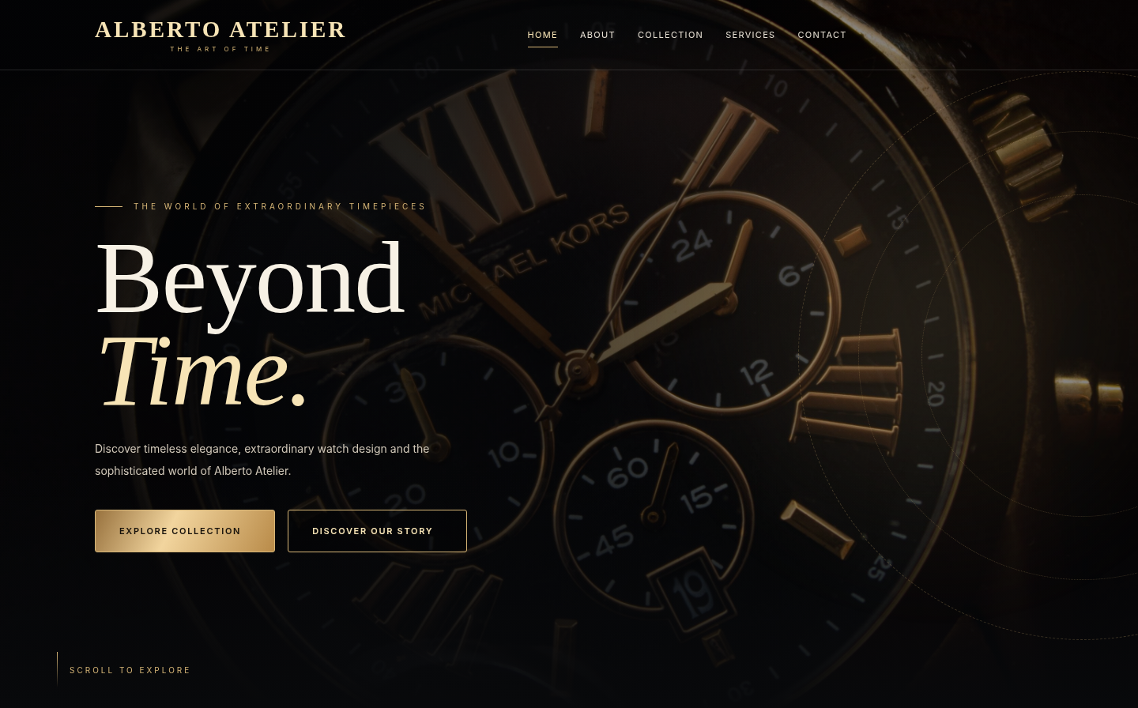
ALBERTO / ATELIER
DEVELOPER GUIDE / IMPLEMENTATION
Project structure
FILE ORGANIZATION
The source is organised by purpose.
01
index.html is the main entry point.
02
pages/ contains the inner HTML documents.
03
css/ and js/ keep styles and behavior outside HTML.
04
images/ contains the project photography.
03 / 13

Slide 4
ALBERTO / ATELIER
DEVELOPER GUIDE / IMPLEMENTATION
Navigation system
COMMON INTERFACE
Familiar navigation across pages.
01
The header links Home, About, Collection, Services and Contact.
02
Account and cart controls are available from the navigation.
03
Mobile layouts use a responsive menu.
04
Links use relative paths between pages.
04 / 13

Slide 5
ALBERTO / ATELIER
DEVELOPER GUIDE / IMPLEMENTATION
Product catalogue
COLLECTION
Product data drives the catalogue.
01
js/product-catalog.js holds the watch collection.
02
js/product.js builds the product cards and filters.
03
Product ID links a selected card to the cart.
04
Image assets are stored in the website project.
05 / 13

Slide 6
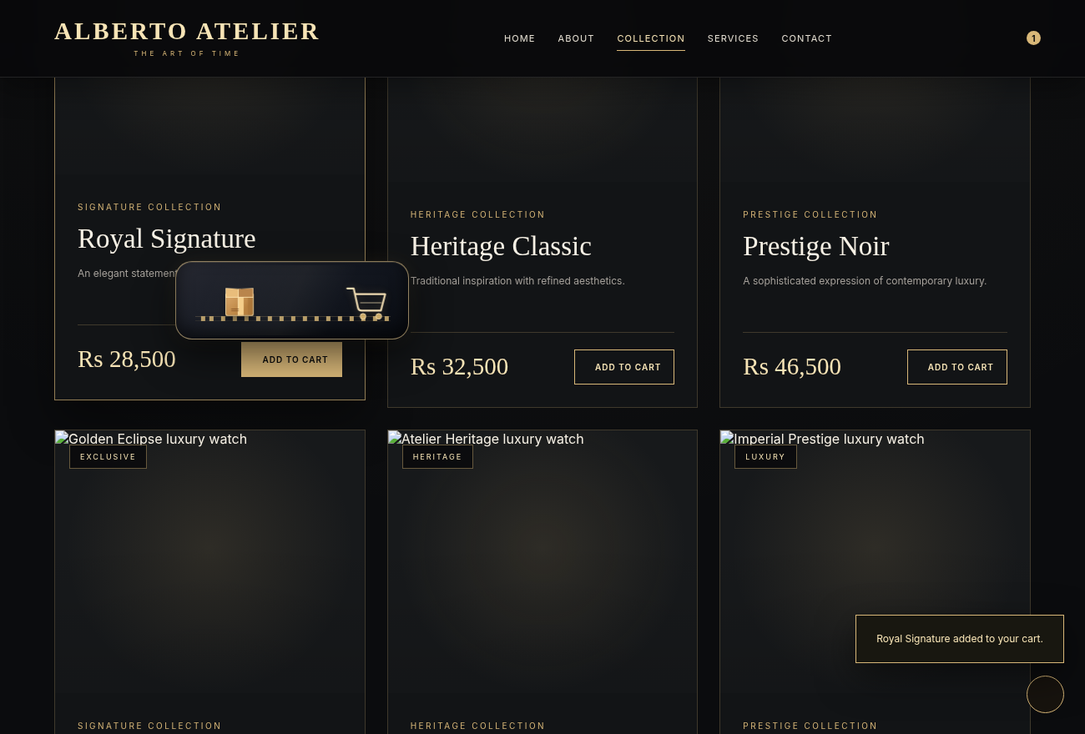
ALBERTO / ATELIER
DEVELOPER GUIDE / IMPLEMENTATION
Shopping cart
BROWSER STORAGE
Items persist in the browser.
01
Cart selections use localStorage rather than a database.
02
The Cart page reads saved items and quantities.
03
Total prices are recalculated as quantities change.
04
A trolley animation appears after an item is added.
06 / 13

Slide 7
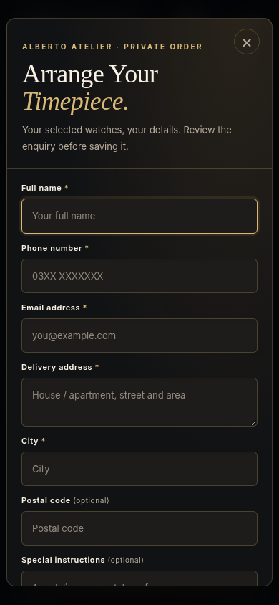
ALBERTO / ATELIER
DEVELOPER GUIDE / IMPLEMENTATION
Order request
FRONTEND DEMO
Customer details and a local reference.
01
The order form collects delivery/contact details.
02
A request reference is generated on submission.
03
Order history is saved locally in the browser.
04
Sending the request to the store requires a separate email action.
The popup does not process payments or send orders automatically.
07 / 13

Slide 8
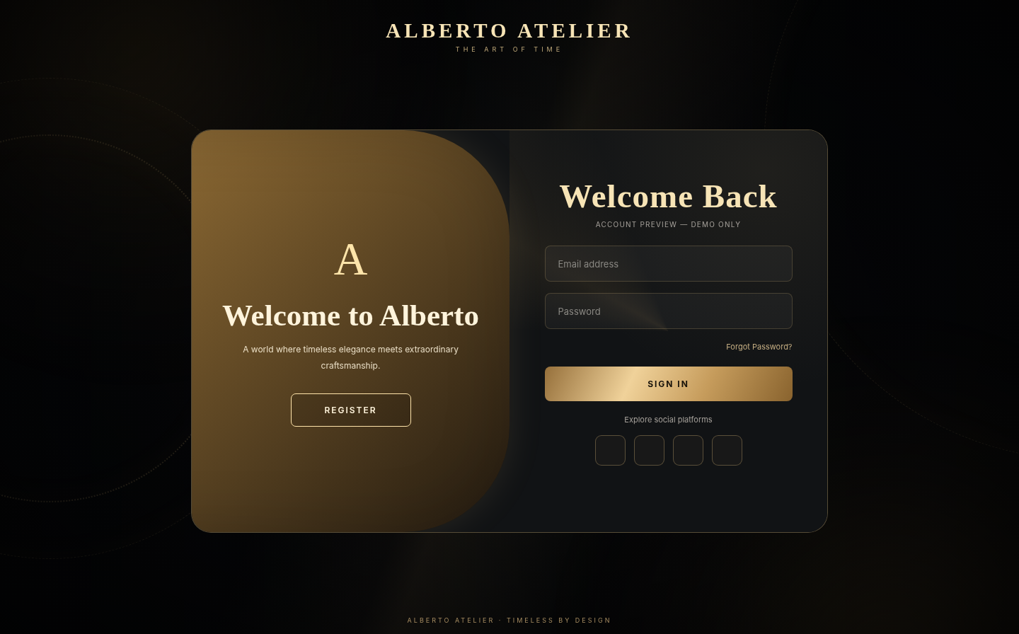
ALBERTO / ATELIER
DEVELOPER GUIDE / IMPLEMENTATION
Account screens
LOGIN / REGISTER
A demo authentication flow.
01
Login and Register are separate HTML screens.
02
js/account-store.js stores accounts in the browser.
03
A signed-in state can be displayed in the interface.
04
The demo is not a production authentication service.
08 / 13

Slide 9
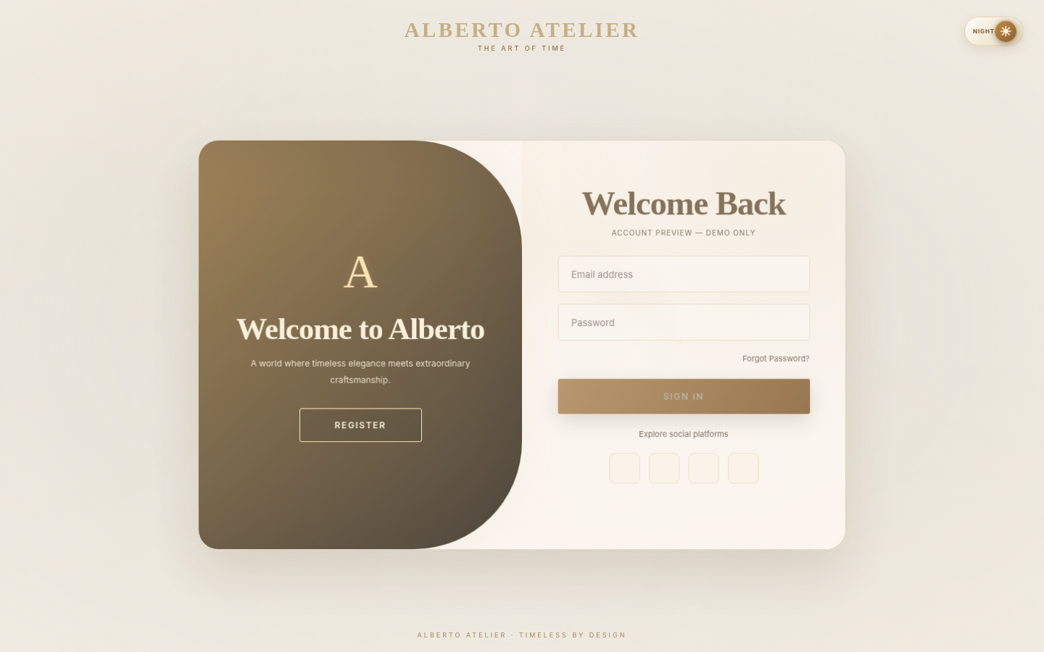
ALBERTO / ATELIER
DEVELOPER GUIDE / IMPLEMENTATION
Day and Night modes
APPEARANCE
One visual identity, two palettes.
01
Dark mode uses charcoal with champagne-gold accents.
02
Light mode uses warm ivory and gold.
03
js/theme.js reads and updates the selected preference.
04
The chosen preference is reused when navigating pages.
09 / 13

Slide 10
ALBERTO / ATELIER
DEVELOPER GUIDE / IMPLEMENTATION
Libraries
FRONTEND TOOLS
Standard HTML, CSS and JavaScript.
ALBERTO
Bootstrap supports responsive layouts on inner pages.
ATELIER
01
02
jQuery is included for supported page behavior.
THE ART OF TIME
03
Bootstrap Icons provides interface iconography.
04
Custom design remains inside the project CSS files.
CDN-based libraries require connectivity unless stored locally.
10 / 13

Slide 11
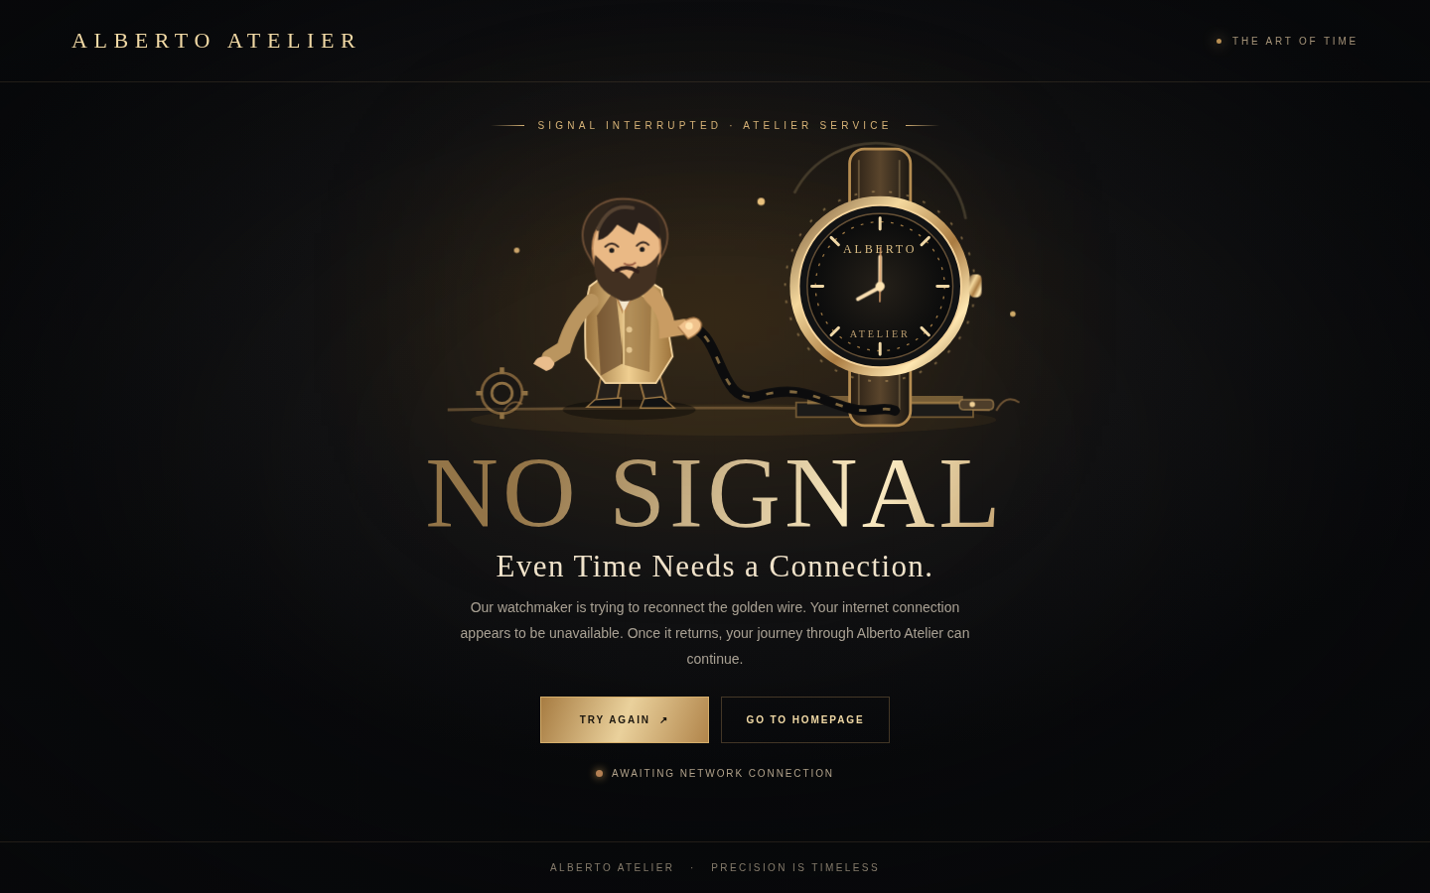
ALBERTO / ATELIER
DEVELOPER GUIDE / IMPLEMENTATION
Offline experience
SERVICE WORKER
A custom page for failed navigation.
01
sw.js caches the animated offline page and its assets.
02
js/network-guard.js registers the worker when permitted.
03
The page can appear after it has been cached.
04
A custom server-side HTTP 404 response is not provided by static files alone.
Offline fallback must be tested after a successful initial visit.
11 / 13

Slide 12
ALBERTO / ATELIER
DEVELOPER GUIDE / IMPLEMENTATION
Project boundaries
CLEAR SCOPE
Frontend demonstration, not a hosted shop.
ALBERTO
No Python or Node.js backend is included in the submitted site.
ATELIER
01
02
Cart, accounts and order requests use browser storage.
THE ART OF TIME
03
Payments, server-side orders and account sync are not implemented.
04
VS Code Live Server is suitable for local demonstration.
12 / 13

Slide 13
ALBERTO / ATELIER
Thank you
Alberto Atelier · Implementation notes
Muhammad Awais · Student ID: 1733752
DEVELOPER GUIDE / IMPLEMENTATION
13 / 13

