Slide 1
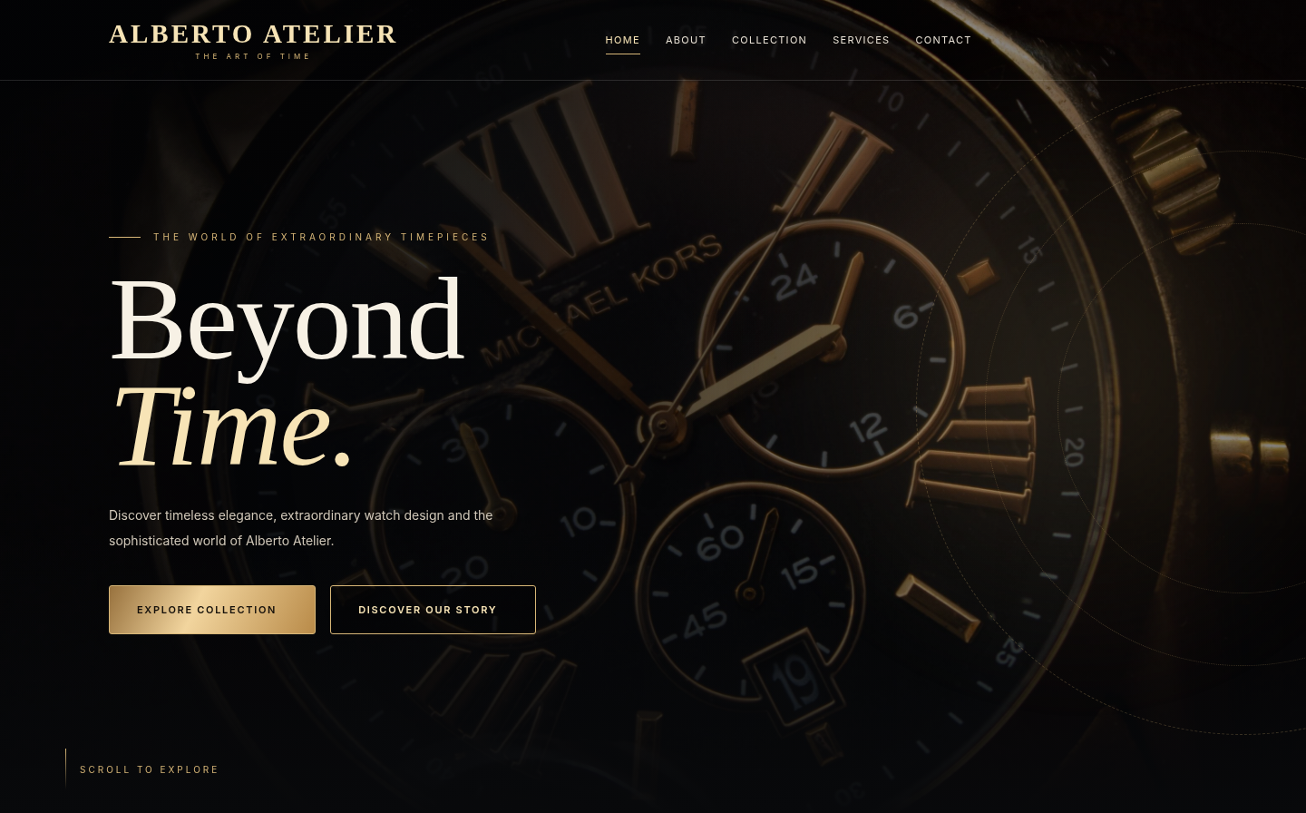
ALBERTO / ATELIER
APTECH / E-PROJECT
DEVELOPER
GUIDE
Source walkthrough · HTML, CSS and JavaScript
FRONTEND IMPLEMENTATION
01 / 12

Slide 2
ALBERTO / ATELIER
DEVELOPER GUIDE / SOURCE
Project team
E-PROJECT / TEAM DETAILS
STUDENT
STUDENT ID
Muhammad Awais
1733752
Haider Shah
—
Habib Alam
—
Hassan
—
FACULTY
COORDINATOR
Muhammad Arkam Tariq
Shazma Shoukat
02 / 12

Slide 3
ALBERTO / ATELIER
DEVELOPER GUIDE / SOURCE
Navigation markup
SOURCE FILE
index.html
CODE EXCERPT / ABRIDGED
WHAT IT DOES
<header class="header" id="header">
<div class="container nav">
<a class="logo" href="index.html">
<strong>ALBERTO ATELIER</strong>
</a>
<nav class="nav-menu" id="navMenu"
aria-label="Main navigation">
<a href="pages/about.html">About</a>
<a href="pages/product.html">Collection</a>
</nav>
</div>
</header>
A shared way to move around.
—
Semantic header and navigation.
—
Page links use local HTML paths.
—
CSS handles its responsive layout.
03 / 12

Slide 4
ALBERTO / ATELIER
DEVELOPER GUIDE / SOURCE
Homepage hero
SOURCE FILE
index.html / css/index.css
CODE EXCERPT / ABRIDGED
WHAT IT DOES
<main>
<section class="hero" id="home">
<div class="hero-bg"></div>
<div class="hero-ring" aria-hidden="true"></div>
<div class="hero-light" aria-hidden="true"></div>
<div class="container">
<div class="hero-content">
<!-- Main headline and actions -->
</div>
</div>
</section>
</main>
Brand message first.
—
The hero has visual layers.
—
Headline and actions sit inside the container.
—
Separate CSS controls placement and motion.
04 / 12

Slide 5
ALBERTO / ATELIER
DEVELOPER GUIDE / SOURCE
About page
SOURCE FILE
pages/about.html
CODE EXCERPT / ABRIDGED
WHAT IT DOES
<section class="page-hero">
<div class="hero-ring" aria-hidden="true"></div>
<div class="container-custom hero-inner">
<span class="eyebrow reveal">
The Essence of Alberto
</span>
<h1 class="reveal reveal-delay-1">
Our Story.
</h1>
</div>
</section>
Page-level storytelling.
—
A hero heading identifies the page.
—
Reveal classes are used for motion.
—
Shared layout structure keeps pages consistent.
05 / 12

Slide 6
ALBERTO / ATELIER
DEVELOPER GUIDE / SOURCE
Services page
SOURCE FILE
pages/services.html / css/services.css
CODE EXCERPT / ABRIDGED
WHAT IT DOES
<section class="page-hero">
<div class="hero-ring" aria-hidden="true"></div>
<div class="container-custom hero-inner">
<span class="eyebrow reveal">
The Alberto Experience
</span>
<h1 class="reveal">Our Services.</h1>
</div>
</section>
A consistent page structure.
—
Reusable hero conventions.
—
Service content follows the opening section.
—
Page-specific styling stays in CSS.
06 / 12

Slide 7
ALBERTO / ATELIER
DEVELOPER GUIDE / SOURCE
Collection & cart
SOURCE FILE
js/product.js / js/cart-motion.js
CODE EXCERPT / ABRIDGED
WHAT IT DOES
function addToCart(productId) {
const product = PRODUCTS.find(
item => item.id === productId
);
// Update the browser shopping cart
}
if (saved && window.AlbertoCartMotion) {
window.AlbertoCartMotion.play(button);
}
From product card to cart.
—
Products are selected by ID.
—
Cart data is saved in browser storage.
—
Trolley animation confirms a successful add.
07 / 12

Slide 8
ALBERTO / ATELIER
DEVELOPER GUIDE / SOURCE
Contact form
SOURCE FILE
pages/contact.html / js/contact.js
CODE EXCERPT / ABRIDGED
WHAT IT DOES
<form id="contactForm" novalidate>
<div class="form-row">
<div class="form-group">
<label for="firstName">First Name *</label>
<input id="firstName"
autocomplete="given-name" />
</div>
</div>
</form>
const contactForm =
document.getElementById("contactForm");
Clear input and feedback.
—
Labels match the input controls.
—
Validation is handled on the client.
—
No contact API is assumed.
08 / 12

Slide 9
ALBERTO / ATELIER
DEVELOPER GUIDE / SOURCE
Login & registration
SOURCE FILE
js/account-store.js / pages/login.html
CODE EXCERPT / ABRIDGED
WHAT IT DOES
async function register(
nameInput, emailInput, password
) {
const name = String(nameInput || '').trim();
const email = normEmail(emailInput);
// Validate and save a demo account
}
async function signIn(emailInput, password) {
const account = loadAccounts().find(
a => a.email === normEmail(emailInput)
);
}
Browser-local account demo.
—
Registration validates the form.
—
Login reads the local demo account.
—
This is not a secure hosted identity system.
09 / 12

Slide 10
ALBERTO / ATELIER
DEVELOPER GUIDE / SOURCE
Footer markup
SOURCE FILE
index.html
CODE EXCERPT / ABRIDGED
WHAT IT DOES
<footer class="footer">
<div class="container">
<div class="footer-grid">
<div class="footer-about">
<a class="logo" href="index.html">
<strong>ALBERTO ATELIER</strong>
</a>
</div>
<!-- Links and contact details -->
</div>
</div>
</footer>
Helpful links at the end.
—
Brand and navigation repeated.
—
Contact information stays available.
—
Footer styling is in separate CSS.
10 / 12

Slide 11
ALBERTO / ATELIER
DEVELOPER GUIDE / IMPLEMENTATION
Technology & file structure
FRONTEND ONLY
One website, separate responsibilities.
ALBERTO
HTML files define the content and page structure.
ATELIER
01
02
CSS files hold typography, layout and animation styling.
THE ART OF TIME
03
JavaScript handles UI, cart, theme and demo account state.
04
Bootstrap and jQuery are loaded on supported pages.
No Python or Node.js server files are required in the submitted frontend ZIP.
11 / 12

Slide 12
ALBERTO / ATELIER
Thank you
Alberto Atelier · Source walkthrough
Muhammad Awais · Student ID: 1733752
DEVELOPER GUIDE / SOURCE
12 / 12

