Slide 1
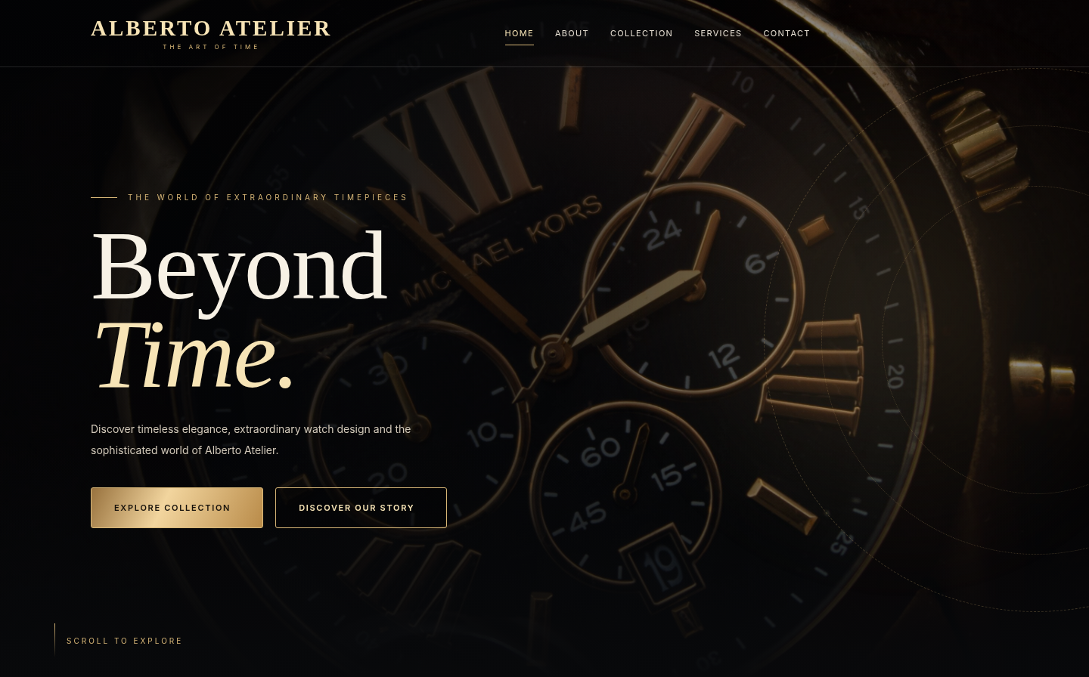
ALBERTO / ATELIER
APTECH / E-PROJECT
ALBERTO
ATELIER
User Guide · Website tour and shopping flow
FRONTEND WEBSITE
01 / 13

Slide 2
ALBERTO / ATELIER
USER GUIDE
Project team
E-PROJECT / TEAM DETAILS
STUDENT
STUDENT ID
Muhammad Awais
1733752
Haider Shah
—
Habib Alam
—
Hassan
—
FACULTY
COORDINATOR
Muhammad Arkam Tariq
Shazma Shoukat
02 / 13

Slide 3
ALBERTO / ATELIER
USER GUIDE
Navigation
Find every section
The top bar links to Home, About, Collection, Services and Contact. Account and cart controls sit alongside the navigation.
03 / 13

Slide 4
ALBERTO / ATELIER
USER GUIDE
Home page
ON THIS PAGE
The first impression
A watch-led hero introduces the brand. Explore Collection opens the product catalogue; Discover Our Story leads to About.
04 / 13

Slide 5

ALBERTO / ATELIER
USER GUIDE
About page
ON THIS PAGE
Brand story
A short introduction explains the watch-inspired identity, with the same navigation used throughout the site.
05 / 13

Slide 6
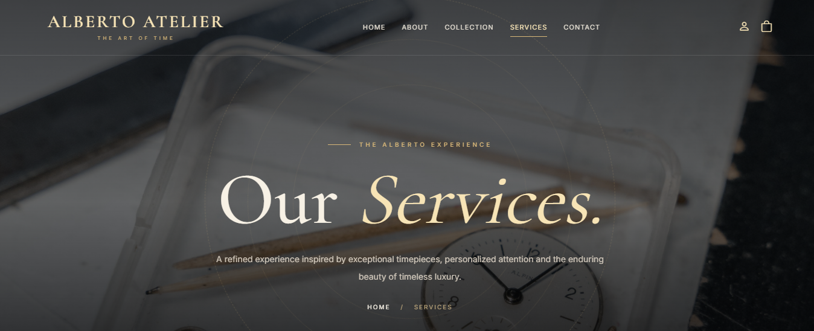
ALBERTO / ATELIER
USER GUIDE
Services
ON THIS PAGE
Service information
This page explains the services and brand experience. Use the navigation links to move to other sections.
06 / 13

Slide 7

ALBERTO / ATELIER
USER GUIDE
Collection
ON THIS PAGE
Browse watches
View product cards, choose a category and use Add to Cart to save selections to the browser shopping bag.
07 / 13

Slide 8
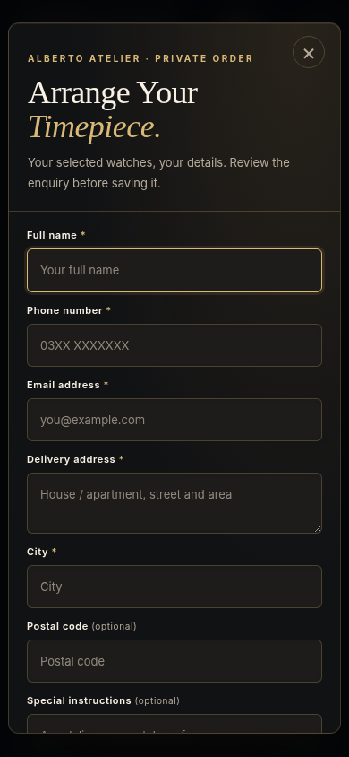
ALBERTO / ATELIER
USER GUIDE
Shopping cart & order request
ON THIS PAGE
Review before sending
Adjust quantities, enter delivery/contact details and save an order request. Requests are stored locally; email must be sent separately.
08 / 13

Slide 9
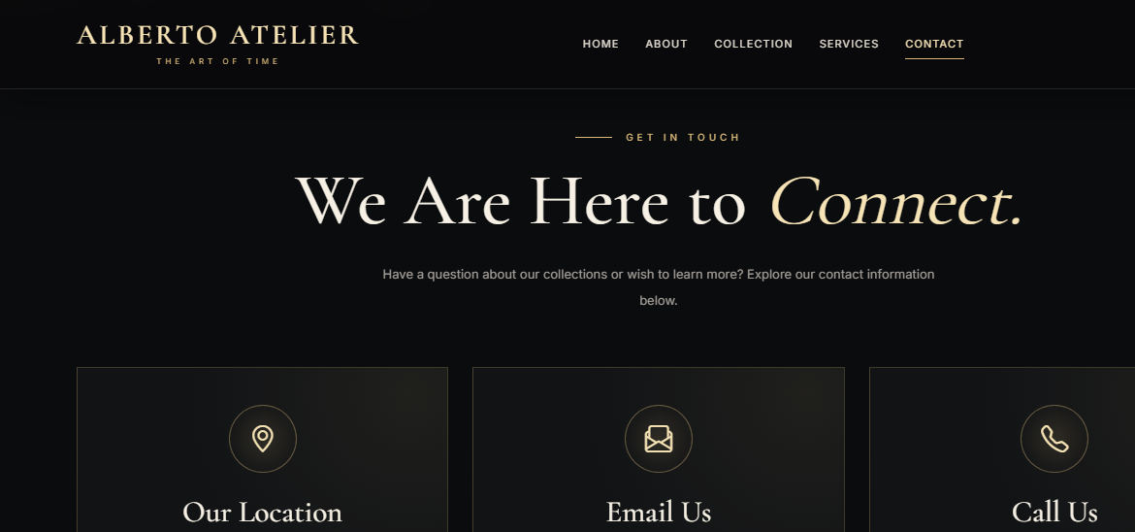
ALBERTO / ATELIER
USER GUIDE
Contact page
ON THIS PAGE
Get in touch
The contact section lists ways to reach the project team and includes an enquiry form.
09 / 13

Slide 10
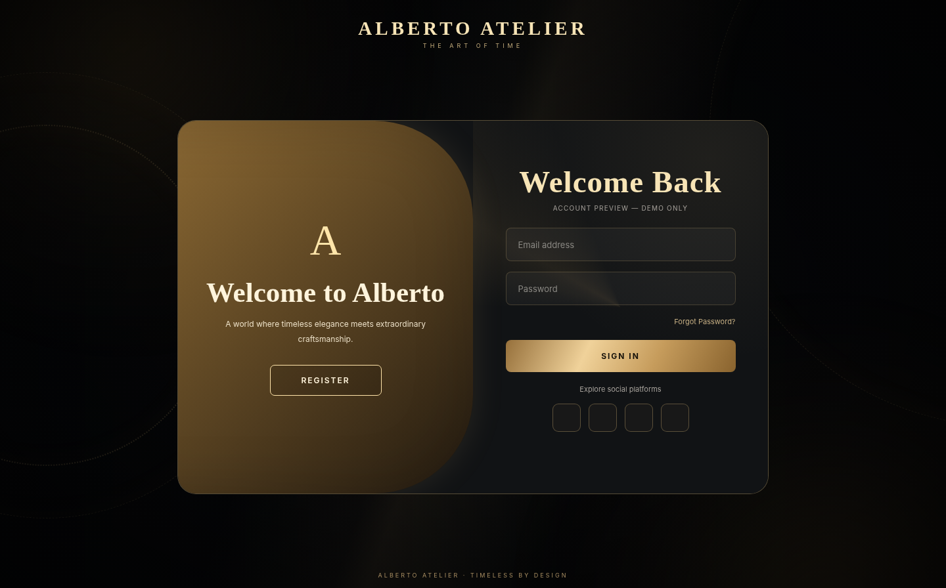
ALBERTO / ATELIER
USER GUIDE
Login & registration
ON THIS PAGE
Access your profile
Sign In opens the account form; Register creates a browser-local demo account. No server-side authentication is connected.
10 / 13

Slide 11
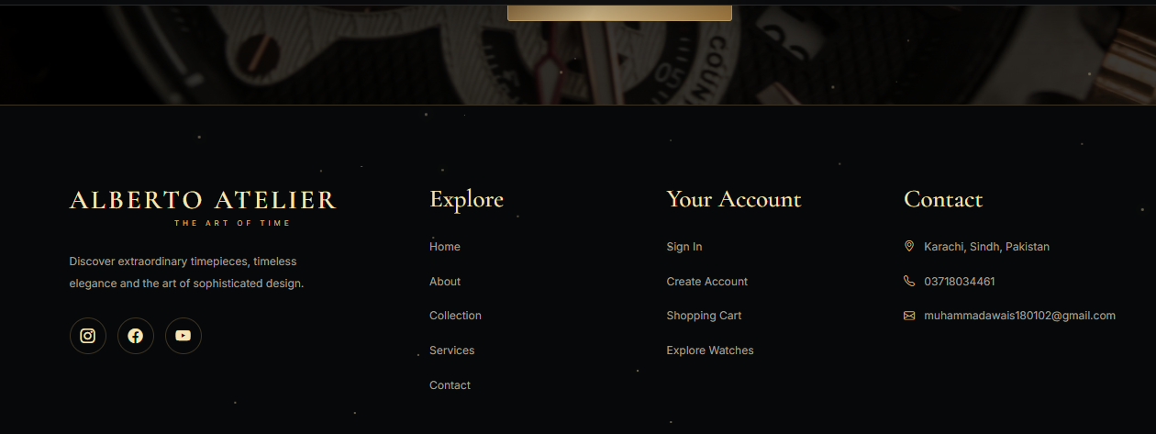
ALBERTO / ATELIER
USER GUIDE
Footer
Quick links & contact
The footer groups navigation, account links and contact details so visitors can reach key pages without scrolling up.
11 / 13

Slide 12
ALBERTO / ATELIER
USER GUIDE
How to explore the website
01
Start at Home
02
Browse Collection
Open index.html through VS Code Live Server to see the site.
Filter products and add a watch to the cart.
03
Review your cart
04
Switch appearance
Change quantities and open the order request form.
Use the Day / Night control where provided.
12 / 13

Slide 13
ALBERTO / ATELIER
Thank you
Alberto Atelier · E-Project
Muhammad Awais · Student ID: 1733752
USER GUIDE
13 / 13

