Slide 1


SVMU (Smart Vehicle Management in UAAR) AI based License Plate Recognition System
PMAS-Arid Agriculture University- Rawalpindi University Institute of Information Technology
Muhammad Bilal 19-ARID-825
Hira Tassadaq 19-ARID-805
Supervisor: Dr. Muhammad Aqib

Slide 2

Contents
Introduction
Existing System
Problem Statement
Problem Solution
Project Scope
Project Objective
Diagrams - Use case, Class, Activity
Tools and Technologies
Task Distribution
Screenshots
Future Project Schedule

Slide 3
Introduction
Smart vehicle management System.
Automated enter and exit system of vehicles.
AI based number plate recognition.
User-friendly website.
Maintain the log of vehicle on entrance and exit.
Security guard can register the vehicle record easily.
Privilege will be maintainted.

Slide 4
Existing System
There exists some existing system related to our project are as follows:
In China, a method to find horizontal and vertical difference to find exact rectangle with vehicle number. The authors claim to have average recognition rate of 0.8s.
In India, they also used morphological operation for better performance in complicated background. Sobel mask is used to detect vertical edges.

Slide 5
Problem Statement
UAAR doesn’t have any automated enter and exit system for vehicles.
Manual checking is time consuming.
Maintain the log of the vehicles.
Excessive queue only for vehicle checking and authorization.

Slide 6
Proposed Solution
The proposed system will automate the vehicle authorization by detecting the number plates of the vehicle.
The barricade will automatically be uplift on successful vehicle authorization.
Smart Management System.
Maintain the log of vehicle on entrance and exit.
Record can be maintained with the help of database.
Vehicle registration and screening can be seen with the help of user-friendly website.

Slide 7
Project Scope
The proposed system is limited to the UAAR and it will only identify the vehicle number plates.
Vehicle’s data can be accessed through webapp.
System will maintain entry and exit record of vehicle.
Automatic barricade uplift in case of successful authorization.
If the vehicle is unauthorized and then it need to be regsitration with the help of web application.
Will maintain database of the system.

Slide 8
Project Objectives
To automate the manual time taking vehicle entrance process.
Smartly maintain log of the vehicle.
Maintain database of the system.
To avoid excessive queue only for vehicle checking and authorization.
Efficient and reliable system.

Slide 9
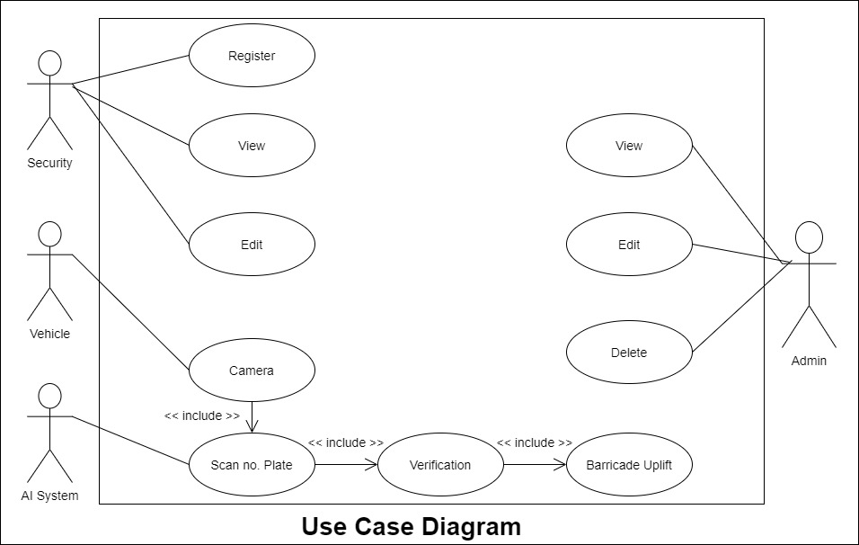
Diagrams - Use Case Diagram

Slide 10
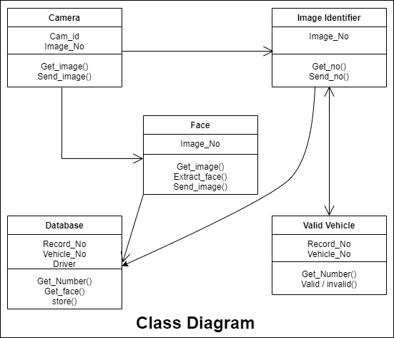
Diagrams – Class Diagram

Slide 11
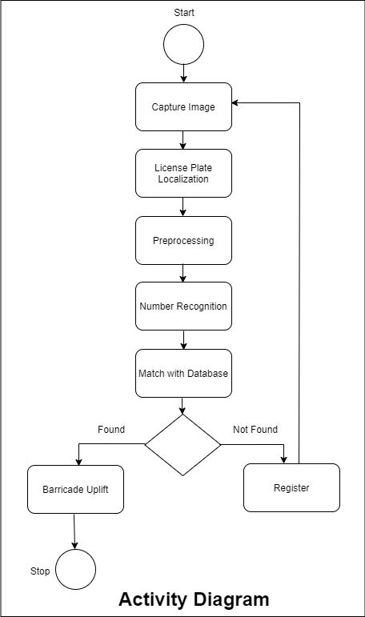
Diagrams – Activity Diagram

Slide 12
Tasks Distribution
Group Members | Responsibilities
Muhammad Bilal | Data Collection Annotation Preprocessing Model Training Model Evaluation Hardware Integration. Documentation
Hira Tassadaq | Website frontend Website Backend Database Connectivity. Hardware Integration. Documentation

Slide 13







Tools & Technologies

Slide 14
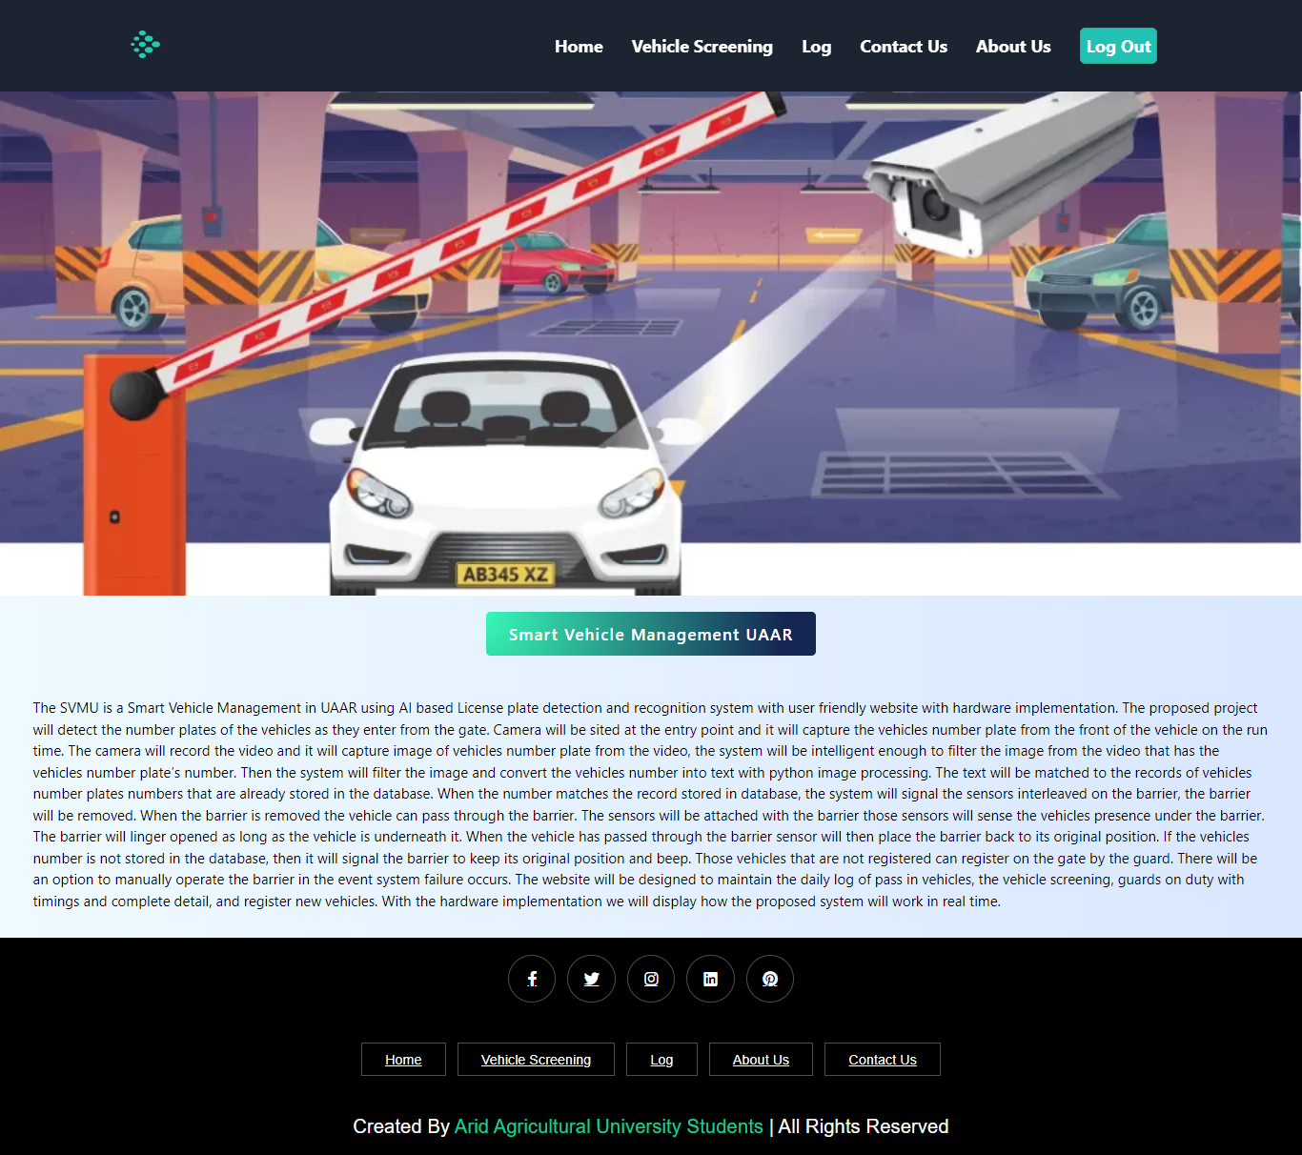
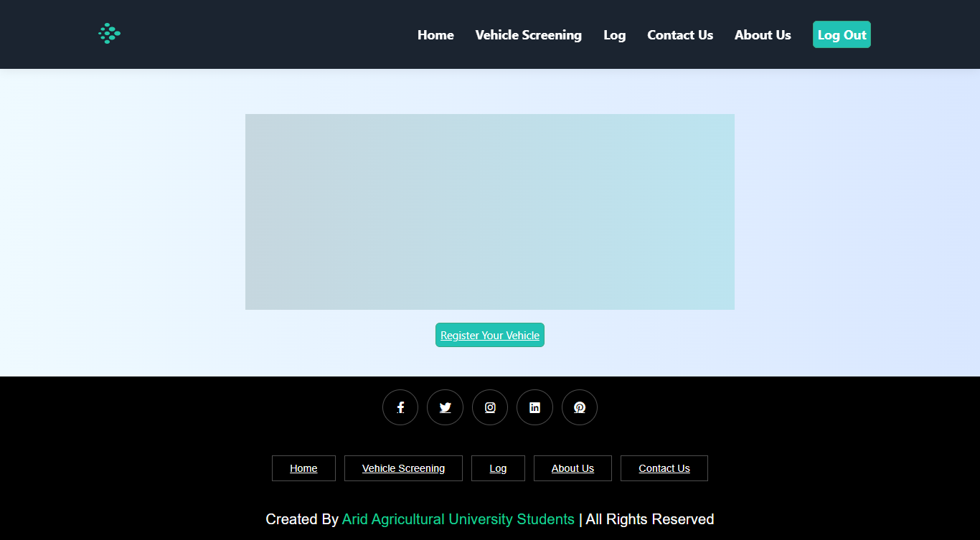
Screen Shots

Slide 15
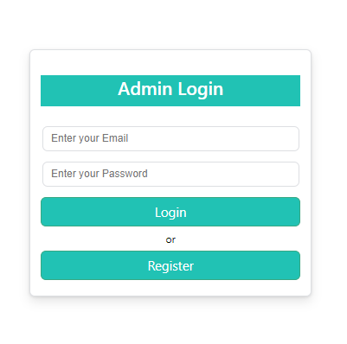
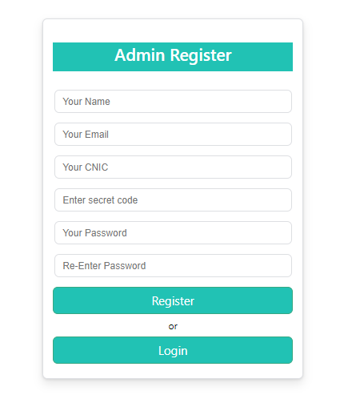
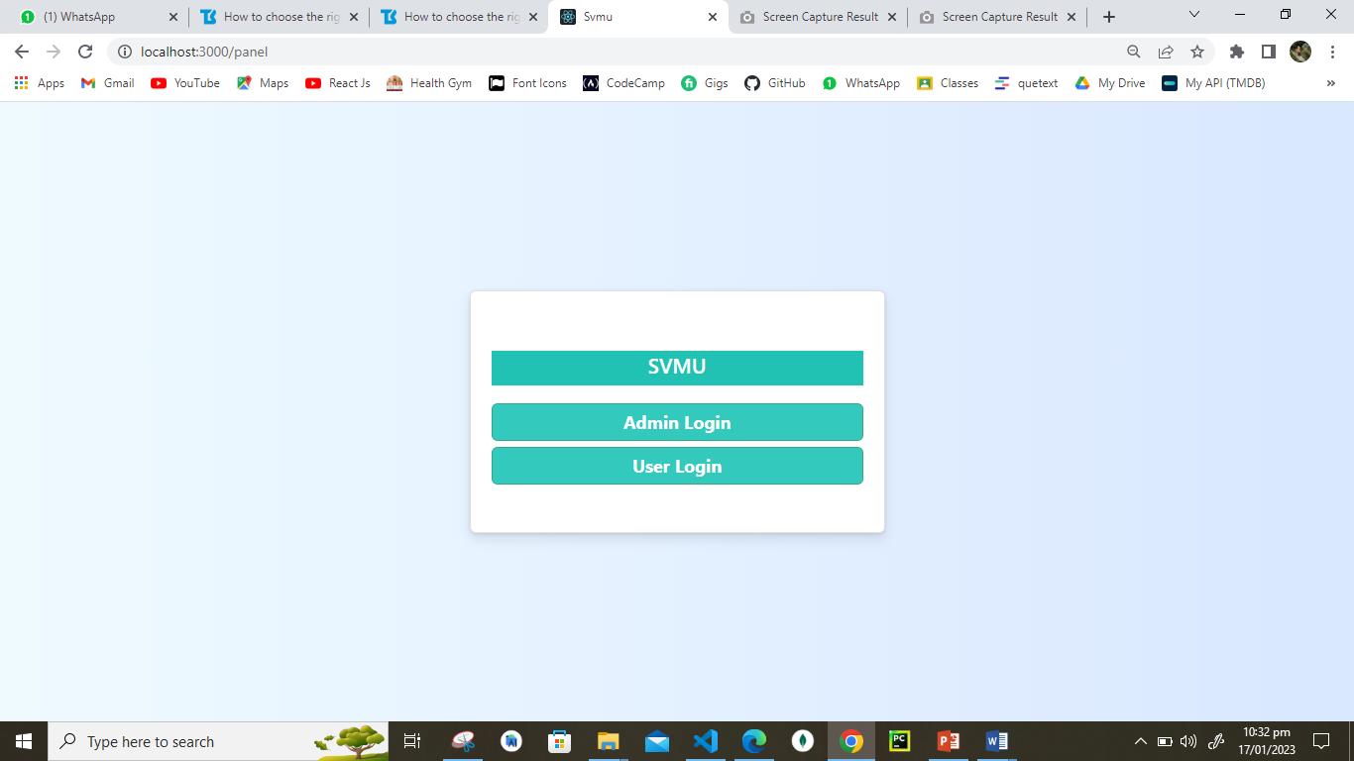
Screen Shots

Slide 16
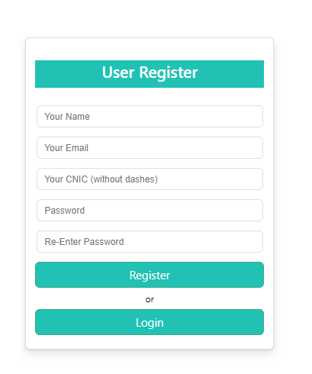
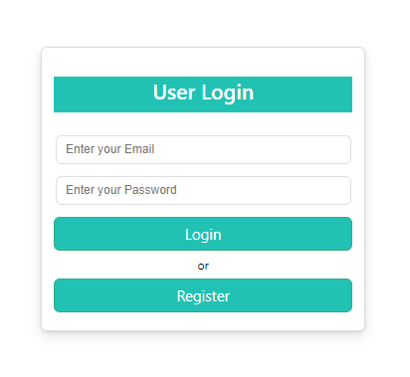
Screen Shots

Slide 17
Future Project Schedule
Tasks | Schedule
Design & Coding of Project Manage Vehicles Manage Driver Details Manage Feedback, Session, Gallery Pages & other Pages | 10th February To 30th March 2023
Creating Reports | 1st April to 20th April 2023
Testing of Project Module wise & Finishing the Code | 21st April To 30th April 2023
Integrating Project | 1st May 2023 To 20th May 2023
Testing of Project | 21st May To Finish Date

Slide 18
Thank You
For your kind Attention

