Slide 1
An On-chip learning Neuromorphic Accelerator for Wireless Edge AI application
Muhammad Farhan Azmine
Committee Members
Dr. Yang (Cindy) Yi
Dr. Dong Sam Ha
Dr. Creed F. Jones
Dr. Xiaoting Jia
Dr. Jeffrey Walling

Slide 2
Outline
Introduction
Challenges
State of the Art
Research improvement (Concept)
Detailed Hardware Implementation (Novelty)
Performance Analysis
Summary
Future Work
Acknowledgement
Reference

Slide 3
About me
Educational Background
BSc in Electrical and Electronic Engineering in Bangladesh University of Engineering & Technology (BUET)
Direct PhD (Fourth Semester) in Virginia Tech CPE
Research Interest
Hardware Accelerator for AI
Spiking Neural Network Accelerator on FPGA
Publications
Lin, Chunxiao, Muhammad Farhan Azmine, and Yang Yi. "Accelerating Next-G Wireless Communications with FPGA-Based AI Accelerators." 2023 IEEE/ACM International Conference on Computer Aided Design (ICCAD). IEEE, 2023.
Lin, Chunxiao, Muhammad Farhan Azmine, Yibin Liang, and Yang Yi. "Leveraging neuro-inspired AI accelerator for high-speed computing in 6G networks." Frontiers in Computational Neuroscience 18 (2024): 1345644.

Slide 4
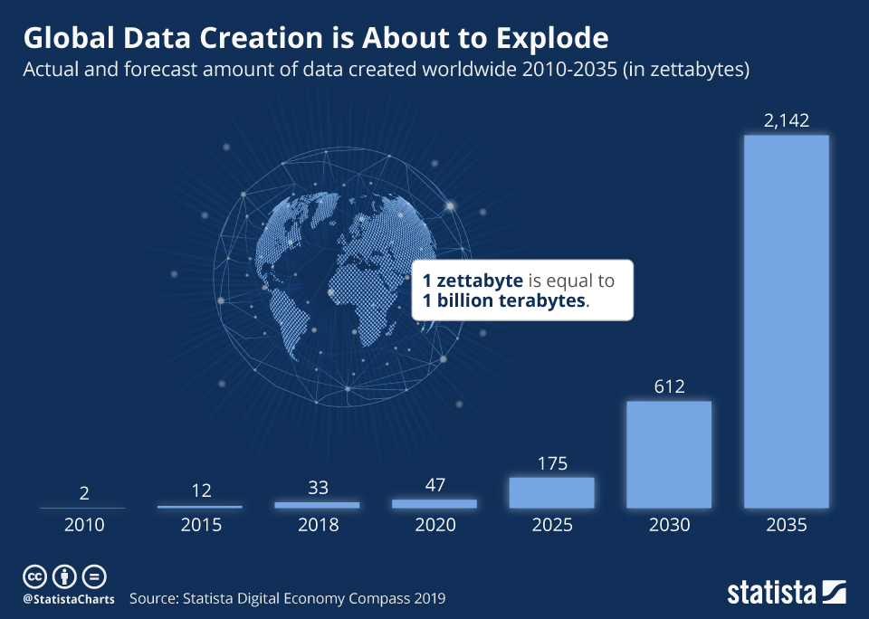
Introduction
Importance of Edge Computing based AI hardware
Exponential growth of IoT (Internet of Things) applications
Extensive workload on Data centers
Incurs high latency
High network bandwidth usage
Industry and research effort to push AI
computing to network edge
Figure: Global estimation data generation [1]
https://www.statista.com/chart/17727/global-data-creation-forecasts/

Slide 5
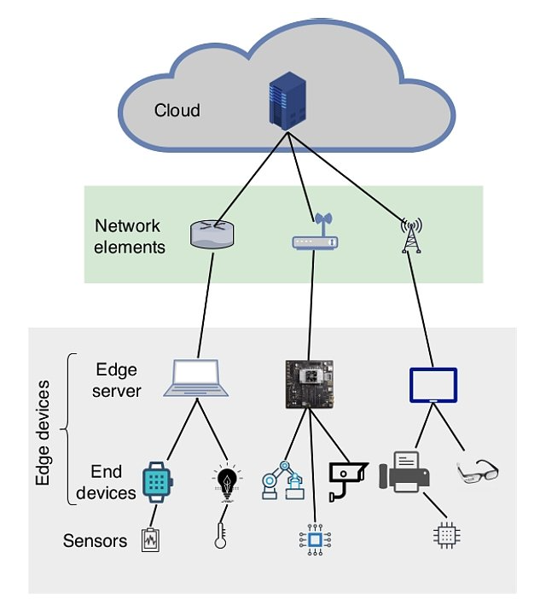
Introduction
What is Edge AI and Why ?
Combination of computation on end edge of network and AI applications
Traditional AI applications are cloud driven
Worsens latency in network connection
Increased communication cost
Privacy concerns
https://viso.ai/edge-ai/edge-ai-applications-and-trends/
Figure: Network hierarchy for edge AI applications [2]

Slide 6
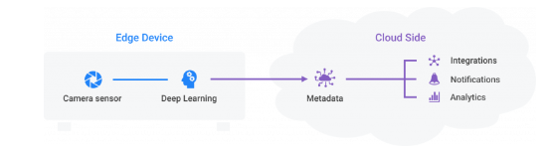
Introduction
Edge cloud and Edge AI [2]
Computations being performed as close to data sources as possible
Edge computing can decentralize the cloud to edge nodes
Data can be sent to edge nodes to be processed for machine learning
Creating edge cloud
Figure: Data is analyzed on-device, and the processed insights of multiple edge devices are gathered in the cloud [2]
https://viso.ai/edge-ai/edge-ai-applications-and-trends/ [2]

Slide 7
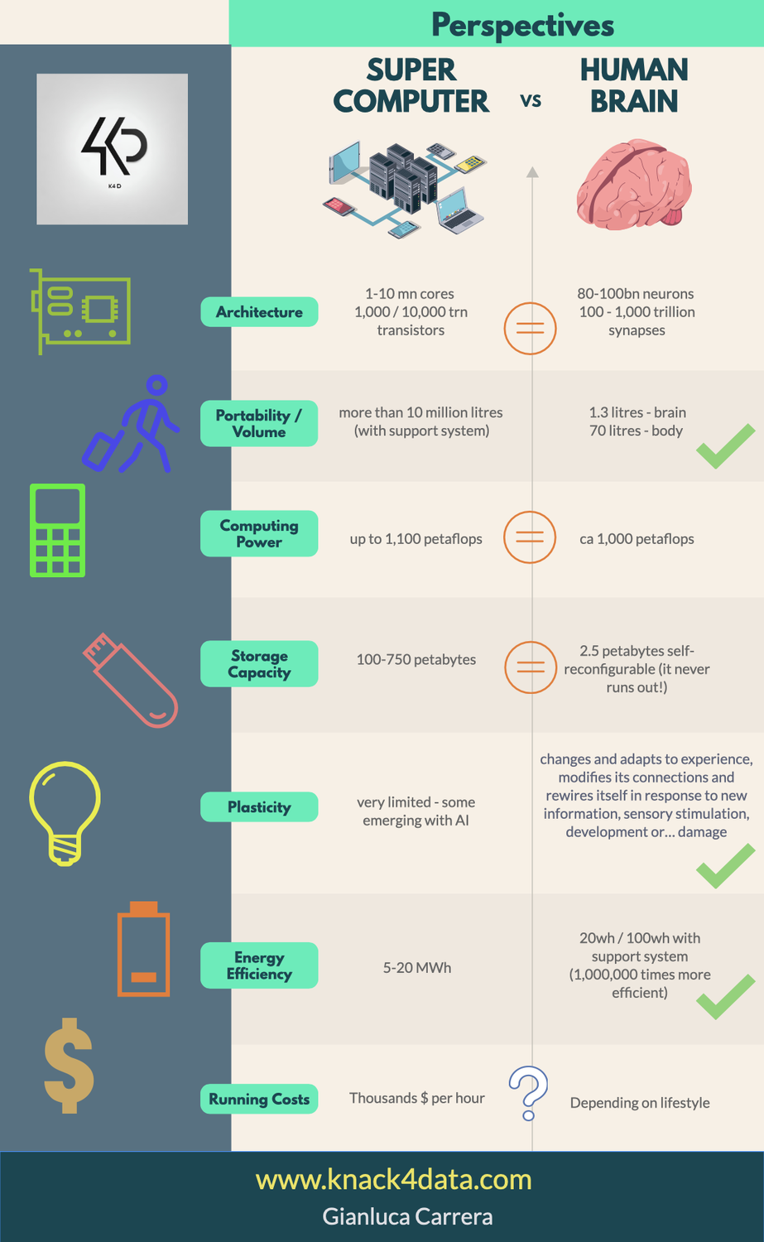
Introduction
Spike based-Computing for Edge AI
Building up dedicated energy efficient accelerator for AI training is crucial
Human brain can perform 1000 petaflops of instructions against supercomputers which perform 1100 petaflop instructions !!
Human brain can perform using only 20 Wh/100 Wh power against supercomputers that uses 5-20 MWh power
https://www.knack4data.com/celebrating-the-human-brain-brain-versus-machine-a92ecf8e3b92 [3]

Slide 8
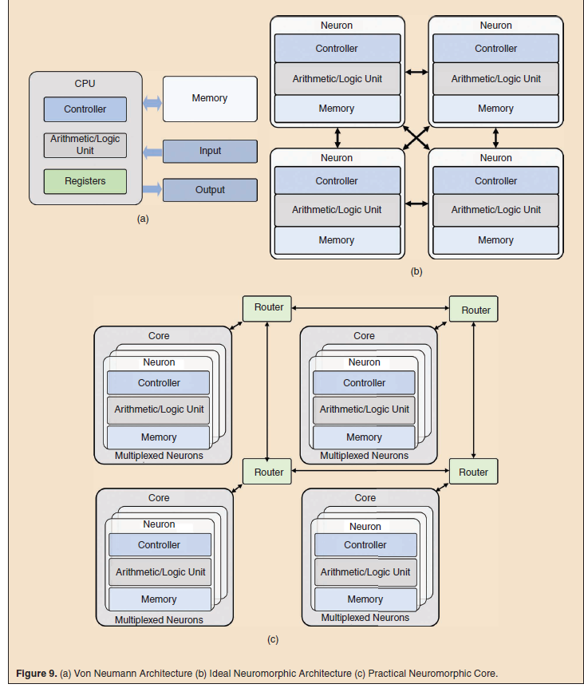
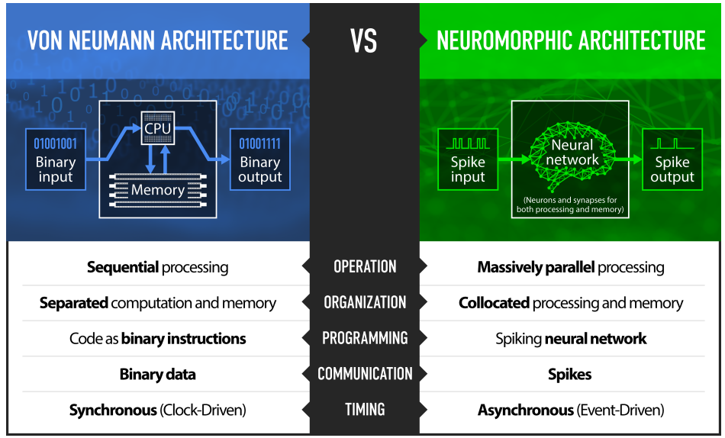
Introduction
Schuman, Catherine D., Shruti R. Kulkarni, Maryam Parsa, J. Parker Mitchell, and Bill Kay. "Opportunities for neuromorphic computing algorithms and applications." Nature Computational Science 2, no. 1 (2022): 10-19. [4]
Shrestha, Amar, et al. "A survey on neuromorphic computing: Models and hardware." IEEE Circuits and Systems Magazine 22.2 (2022): 6-35. [5]

Slide 9
Introduction
Spike Based On Chip Training
Leveraging on-chip training on hardware accelerator can benefit Edge AI
So far, the ANN based accelerators use off-line software training and inference on hardware
Spiking networks use local learning vs propagation-based learning of ANN

Slide 10
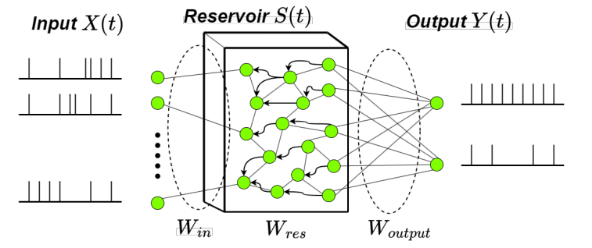
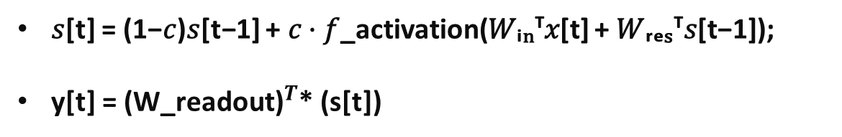
Introduction
Why LSM ?
Simpler Network (Less parameters)
Sparse Spike based computation
Local learning (No back propagation needed)
Avoidance of Overfitting
Hardware friendly design
Figure : Liquid State Machine Network
𝑠[t] = (1−𝑐)𝑠[t−1] + 𝑐 ⋅ 𝑓_activation(𝑊ᵢₙᵀ𝑥[t] + 𝑊ᵣₑₛᵀ𝑠[t−1]);
y[t] = ${\text{(}\text{W}\text{_}\text{readout}\text{)}}^{T}$* (s[t])

Slide 11

Introduction
Challenges ?
Accuracy : Poorer performance because of low complex learning
Solution: Find out combination of unsupervised local learning in reservoir and supervised learning in readout layer
Figure : Liquid State Machine Network
𝑠[t] = (1−𝑐)𝑠[t−1] + 𝑐 ⋅ 𝑓_activation(𝑊ᵢₙᵀ𝑥[t] + 𝑊ᵣₑₛᵀ𝑠[t−1]);
y[t] = ${\text{(}\text{W}\text{_}\text{readout}\text{)}}^{T}$* (s[t])

Slide 12
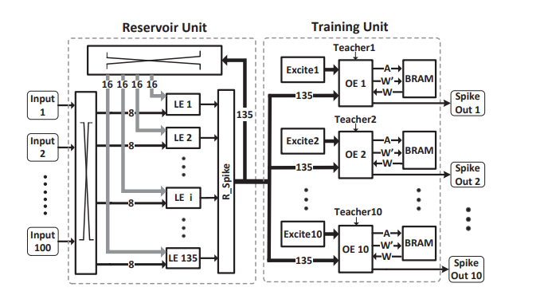
State of the Art
Peng Li et ai. [6] Developed LSM in FPGA for speech signal recognition
Developed two types of separate neuron named as LE (Learning Element) and OE (Output Element)
Figure : LSM network by Peng Li et ai [6]

Slide 13
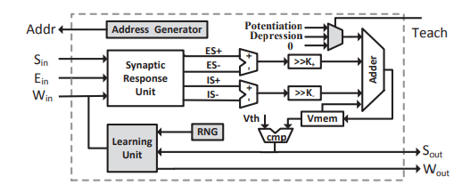


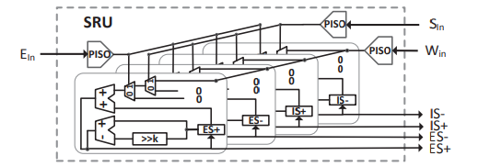
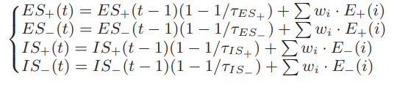
State of the Art
Neuron Structure (LE and OE)
LIF spiking equation :
SRU (Synaptic Response Unit) calculation :
Figure : Digital Neuron by Peng Li et ai [7]
Figure : SRU unit by Peng Li et ai [7]

Slide 14
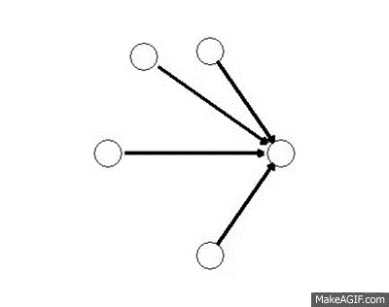
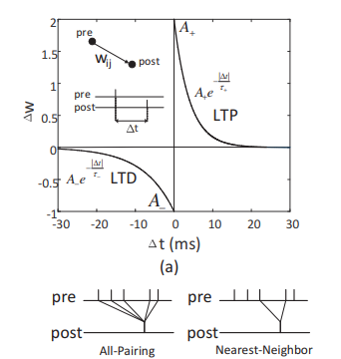
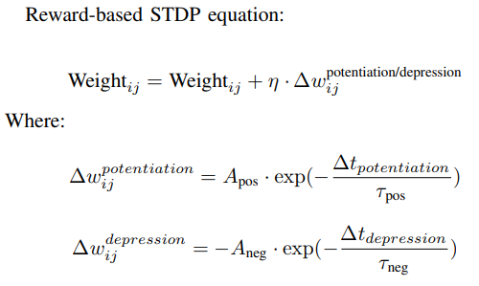
State of the Art
LSM Learning (Spike-timing-dependent-plasticity)
STDP Equation
Figure : STDP GIF
Figure : STDP nearest neighbor
by Y. Jin et ai [8]

Slide 15
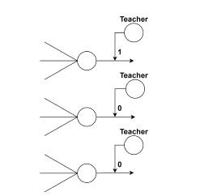
State of the Art
LSM Learning (Spike-timing-dependent-plasticity)
STDP Equation
Supervised STDP Learning :
Uses a teacher signal (CT)
Follows one hot encoding
Figure [10] : Supervised STDP (Classification Teacher)
Figure : STDP nearest neighbor
by Y. Jin et ai [8]

Slide 16
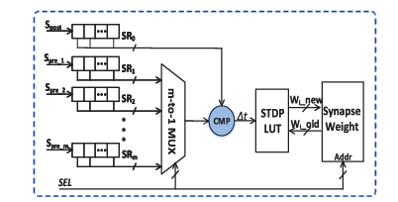

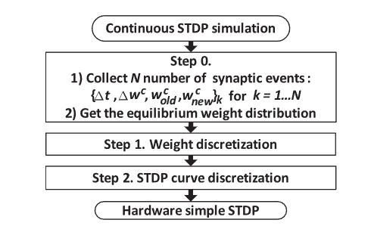
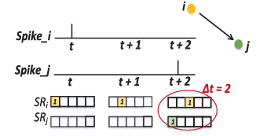
State of the Art
Learning Engine (Unsupervised LE)
STDP Equation curve:
Hardware STDP LUT:
Figure : Unsupervised Learning unit by Peng Li et ai [6]

Slide 17
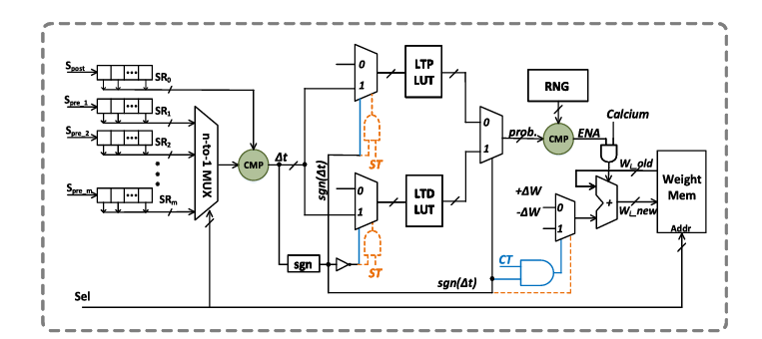
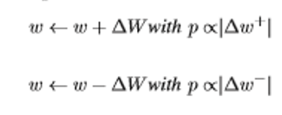
State of the Art
Learning Engine (Supervised OE)
STDP Equation :
Activity based Probabilistic-STDP :
Figure : Supervised Learning unit by Peng Li et ai [6]
Two stages of training :
Sparsification training period
Classification training period
Uses two look up tables for AP-STDP

Slide 18
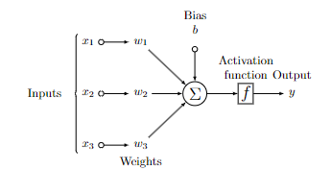

Research improvement (Concept)
Simplified LIF neuron vs SRU
Membrane Potential Equation:
Advantages :
Vmem is directly calculated from weight and input spikes
Simplified digital neuron structure
Does not exacerbate performance
No need of Synaptic Response Unit (SRU)
Figure [10]: Spiking Neuron Model

Slide 19

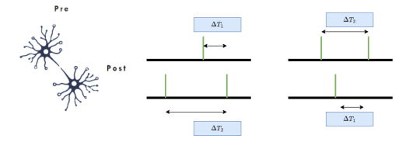
Research improvement (Concept)
Triplet STDP vs Duplet STDP in Unsupervised LE
STDP Equation curve:
Advantages :
Considers 3 spike event instead of two spike events
Real-time exponential approximation
Encoder based asynchronous architecture
More accurate weight update
Figure : TSTDP Timing Differences for pre-post-pre spiking and post-pre-post spiking respectively

Slide 20

Research improvement (Concept)
Adaptive threshold vs Sparsification in Supervised OE:
Adaptive Threshold Equation:
Advantages :
Cth input is directly the spike event input
Helps to avoid weight saturation and thus overfitting
Reduces training time period as no sparsification mode needed
Used in typical software SNN models

Slide 21
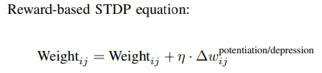
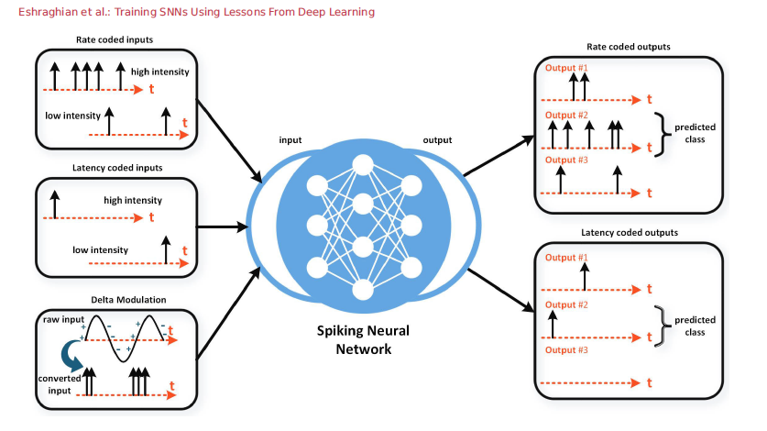
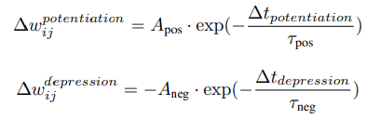

Research improvement (Concept)
Hardware Friendly Loss function
Figure [11] : Spike Output Encoding Scheme
Predicted Output

Slide 22
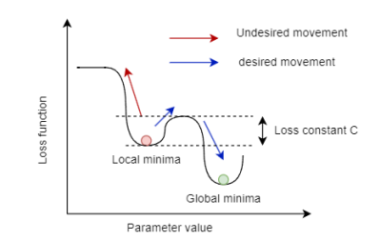
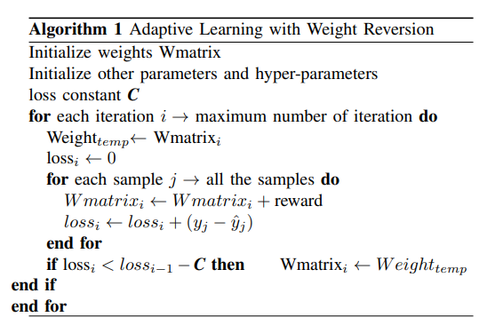

Research improvement (Concept)
Hardware friendly reward prediction error (RPE)
Figure : Loss function landscape
Predicted Output
Advantages
Guides to reach Global Minima
Helps reduce training period
Helps retaining optimized weights in hardware
Loss function

Slide 23
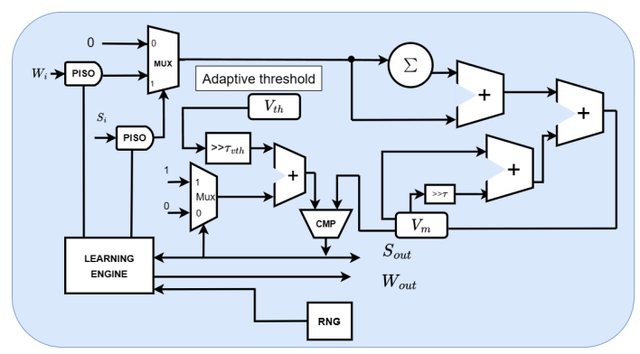
Detailed Hardware Implementation (Proposed)
Digital LIF neuron
Membrane Potential Calculation :
Adaptive threshold Calculation :
No SRU needed
Learning engine differs for LE and OE
No sparsification stage needed
Figure: Spiking Neuron Model

Slide 24
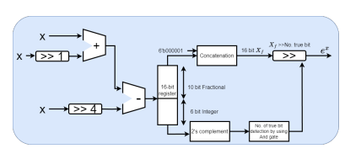
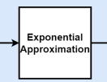

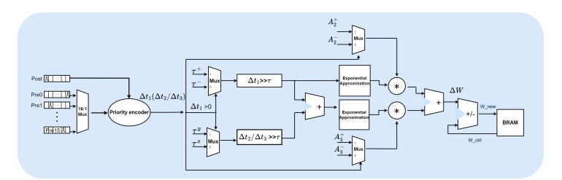
Detailed Hardware Implementation (Proposed)
Triplet STDP in Unsupervised LE
Finalized Triplet Equation
Figure: Implementation of exponential approximation in Triplet-STDP
Figure: Hardware implementation of Triplet-based STDP

Slide 25
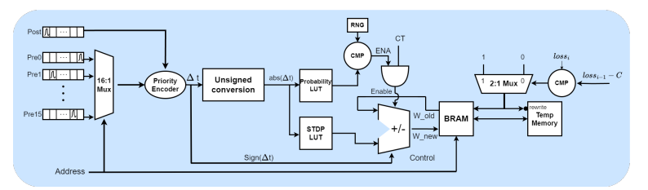
Detailed Hardware Implementation (Proposed)
Supervised Learning Engine (SLE)
Simplified hardware design
Less look up tables
No sparsification gates or modes
Implements the loss function weight adaptation
Figure: Implementation of exponential approximation in Triplet-STDP

Slide 26
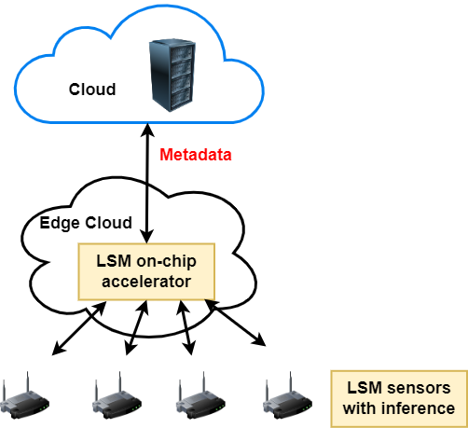
Performance Analysis
Spectrum Sensing dataset from RWTH Achen University
Input contains one feature data of received energy signal
Output contains binary target label (1/0)
Chosen for testing performance against other accelerators
Central Frequency of channel (fc=3750 MHz)
Bandwidth (Bw=1500 MHz)
Frequency resolution (fr=200 KHz)
Total Samples (7500)
Train data (6000) (80%)
Test data (1500) (20%)
Wang, L., Hu, J., Jiang, R., & Chen, Z. (2024). A Deep Long-Term Joint Temporal–Spectral Network for Spectrum Prediction. Sensors, 24(5), 1498 [12].

Slide 27
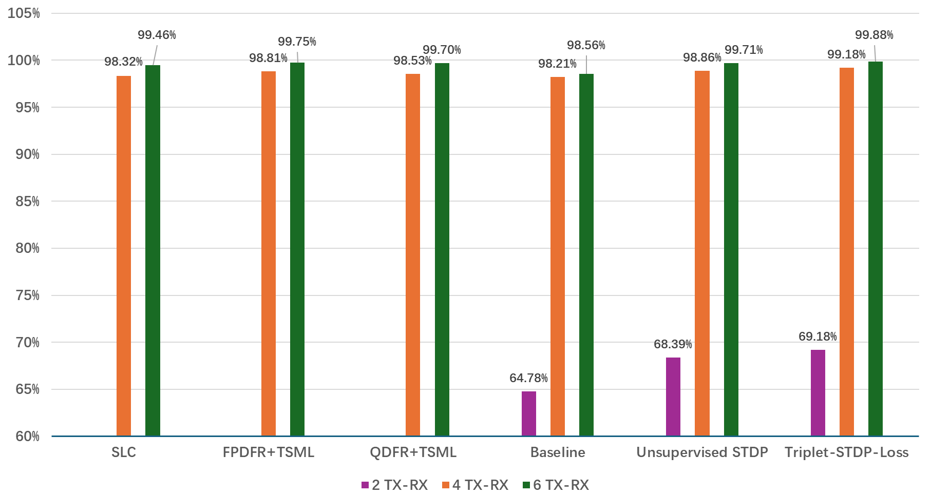
Performance Analysis
Comparative Analysis (Accuracy)
SNR=-10 dB
Figure: Accuracy comparison of different models

Slide 28
Performance Analysis
Comparative Analysis (Accuracy)
Figure: Accuracy comparison of different models

Slide 29
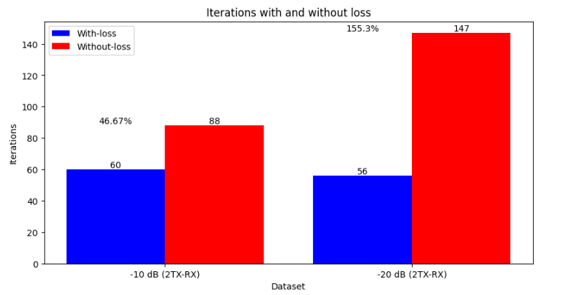
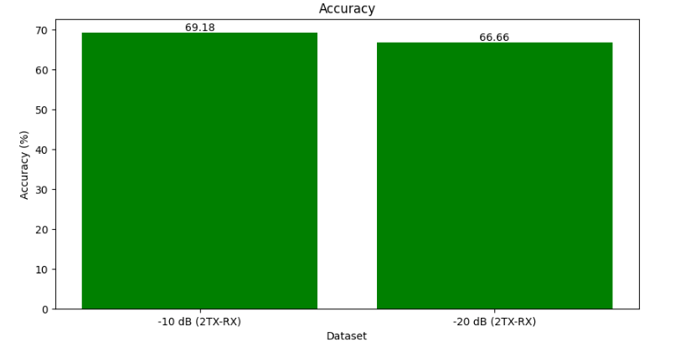
Performance Analysis
Loss function Training period improvement (%)
Figure: Training period improvement

Slide 30
Performance Analysis
FPGA resource utilization
Table : Resource Comparisons of different architecture and accuracy comparison for -20 db dataset

Slide 31
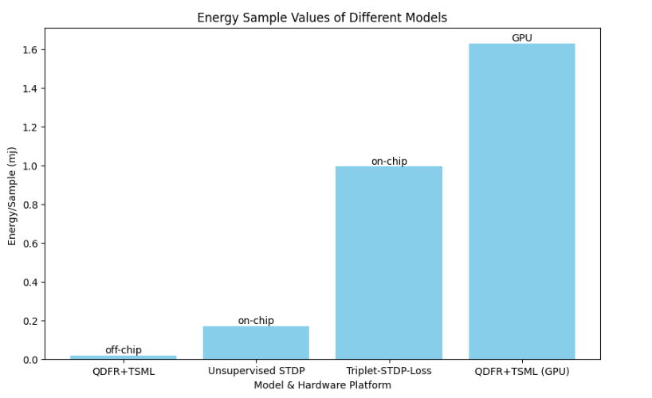
Performance Analysis
Power Report
Table : Power consumption of different accelerators for spectrum sensing

Slide 32
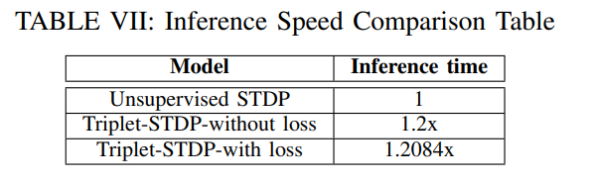
Performance Analysis
Inference Time
Table : Latency time during inference mode

Slide 33
Summary
Improved accuracy in real-time on-chip training
Reduced training period for worst case scenarios
No sparsification training period needed
Achieved satisfactory power and design optimization for on-chip training hardware

Slide 34
Future Work
Introduce local supervised learning with better and hardware friendly loss function to increase accuracy
Build an LSM with Time-to-first-spike (TTFS) based R-STDP
Simplify the reservoir structure with smarter unsupervised learning method and architectural optimization
Increase power efficiency of the design using power clock gating

Slide 35


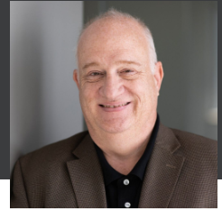

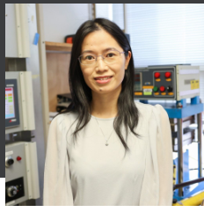



Acknowledgments
Advisory Committee
Dr. Yang (Cindy) Yi
Dr. Creed F. Jones
Dr. Dong Ha
Dr. Xiaoting Jia
Dr. Jeffrey Walling

Slide 36
Reference
https://www.statista.com/chart/17727/global-data-creation-forecasts/
https://viso.ai/edge-ai/edge-ai-applications-and-trends/
https://www.knack4data.com/celebrating-the-human-brain-brain-versus-machine-a92ecf8e3b92
Schuman, Catherine D., Shruti R. Kulkarni, Maryam Parsa, J. Parker Mitchell, and Bill Kay. "Opportunities for neuromorphic computing algorithms and applications." Nature Computational Science 2, no. 1 (2022): 10-19.
Shrestha, Amar, et al. "A survey on neuromorphic computing: Models and hardware." IEEE Circuits and Systems Magazine 22.2 (2022): 6-35.
Y. Liu, S. S. Yenamachintala, and P. Li, “Energy-efficient fpga spiking neural accelerators with supervised and unsupervised spike-timingdependent-plasticity,” ACM Journal on Emerging Technologies in Computing Systems (JETC), vol. 15, no. 3, pp. 1–19, 2019.
Wang, Qian, Yingyezhe Jin, and Peng Li. "General-purpose LSM learning processor architecture and theoretically guided design space exploration." In 2015 IEEE Biomedical Circuits and Systems Conference (BioCAS), pp. 1-4. IEEE, 2015.
Jin, Y., & Li, P. (2016, July). AP-STDP: A novel self-organizing mechanism for efficient reservoir computing. In 2016 International Joint Conference on Neural Networks (IJCNN) (pp. 1158-1165). IEEE.
Lagani, Gabriele, et al. "Spiking Neural Networks and Bio-Inspired Supervised Deep Learning: A Survey." arXiv preprint arXiv:2307.16235 (2023).
Shrestha, Amar, et al. "Approximating back-propagation for a biologically plausible local learning rule in spiking neural networks." Proceedings of the International Conference on Neuromorphic Systems. 2019.
Eshraghian, Jason K., et al. "Training spiking neural networks using lessons from deep learning." Proceedings of the IEEE (2023).
Wang, L., Hu, J., Jiang, R., & Chen, Z. (2024). A Deep Long-Term Joint Temporal–Spectral Network for Spectrum Prediction. Sensors, 24(5), 1498.

Slide 37
Contribution
Gauri Sharma
Software design of LSM for Algorithm Verification
Muhammad Farhan Azmine
Fixed point software design of Baseline LSM reservoir for hardware verification
RTL design of LIF neuron, SRU, Learning engines of both Unsupervised and Supervised algorithm and verification
Triplet STDP RTL design
Encoder RTL designs
Integration of LSM reservoir RTL and verification of baseline
Integration of Triplet STDP in LSM reservoir RTL
Integration of Triplet STDP in LSM reservoir RTL

