Slide 1
Prediction of mortality after radical cystectomy for bladder cancer by machine learning techniques Guanjin Wang, Kin-ManLam, ZhaohongDeng, Kup-SzeChoi
Moh. Faturrahman
1506706276

Slide 2
Outline...
Bladder Cancer and Radical Cystectomy
Prediction and Decision Support
Machine Learning in Medicine
Current Research

Slide 3
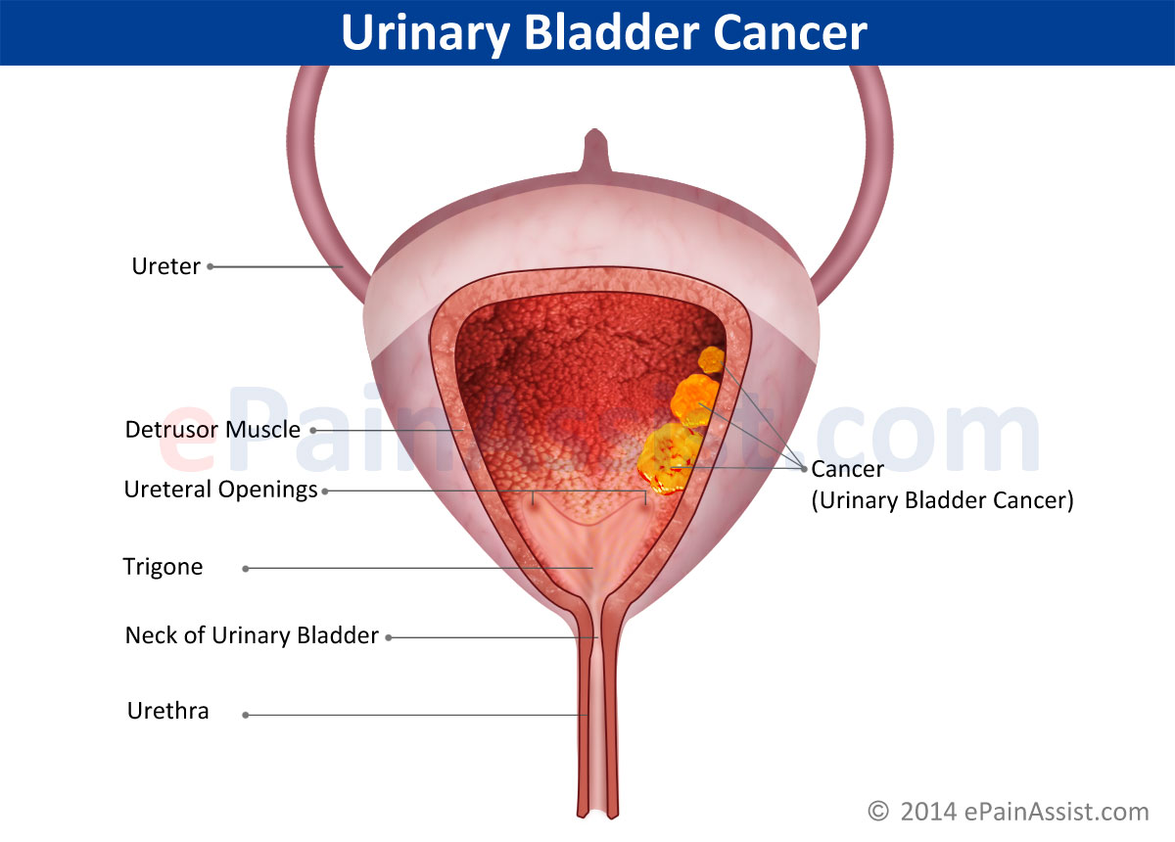
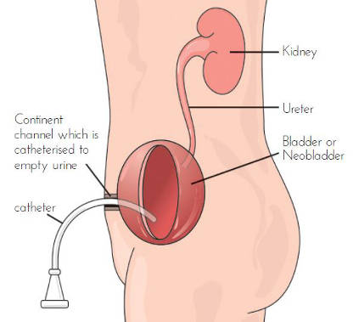
Bladder Cancer

Slide 4
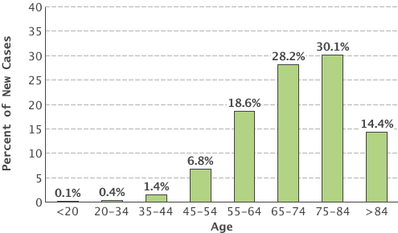
Bladder Cancer
Incidence
The 5TH Common Disease
Cases by Age Group
380.000 new cases each year, and causes 150.200 deaths. 73.510 diagnoses and 14.880 deaths in 2015 in US
74.000 New Cases, 16.000 Estimated Death in 2015
Reported by seer.cancer.gov/

Slide 5
Chemoteraphy
Radical Cystectomy

Slide 6
Radical Cystectomy
Complication
AKD
Cardiovascular
Survivor < 5
Others
Survivor
Urinary Diversion

Slide 7
Prediction and Decision Support
Clinical Data
Cox Regression
Statistical Methods
Logistic Regression
Kaplan-Meier
Cox Propotional Hazards
Support Clinicians
Prediction, Diagnosis, Formulating Treatmen
The Weakness
Handling Data with High variability,
Heterogeneous distribution
Non Linear Interactions among variables
Machine Learning Method ?

Slide 8
Machine Learning in Medicine
Clinical Data
Large and Complex
Noisy
Machine Learning
Statistics
Optimization
Powerfull Support in Medicine
Cancer Diagnosis
Artificial Inteligence
High Variability
Non-linear Interaction
Predictive Medicine
Prevention and Treatmen Policy

Slide 9
Current Research : Predicting Mortality of Bladder Cancer after Radical Cystectomy
Author | Year | Method | Accuracy | Sensitivity | Specificity
Guanjing Wang et al | 2015 | RELM | 0.80 | 0.85 | 0.72
Kin Man Lam et al | 2014 | ANN | 0.78 | 0.75 | 0.81
Buchner | 2013 | ANN | REC : 0.74 CSM: 0.759 ACD:68.5 | 0.4 0.37 0.58 | 0.89 0.91 0.76
KHAVER N. QURESHI et al | 2003 | ANN | 0.82 | 1 | 0.78

Slide 10
Prediction Model and Research Method

Slide 11
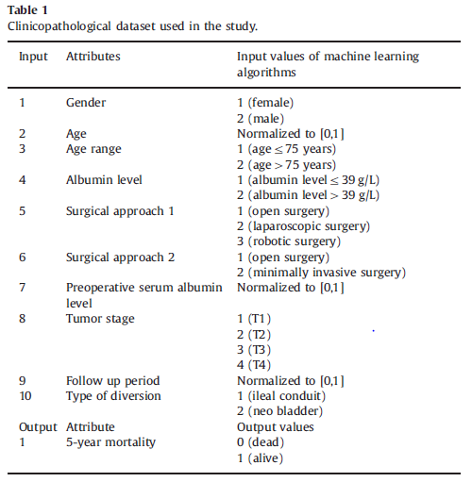
Clinical Data
5 Year survival Patient
Undergone Radical Cystectomy for Bladder Cancer
117 Record patient (Hongkong)
Within Period 2003-2011
Others Attribute
Hospital stay duration
Preoperative albumin level
Tumor stage

Slide 12
Bladder Cancer Dataset
Remove Irelevan Information
5-Year Survival of RC
99 Patients were male
Normalize into scale [0,1]
Mean Age was 68
71 Open Radical Cystectomy
96 Ileal Conduit and 21 Continent Diversion
Add Other attribute

Slide 13
Prediction Model
ANN BP
KNN
SVM
ELM
RELM
NB
RBF

Slide 14
Machine Learning
Clinical Data Of Bladder Cancer
KNN
SVM
BPN
ELM
RELM
NB
RBF
Patient Mortality : Dead or Alive

Slide 15
Methods
TRAINING DATA
TRAINING DATA
TRAINING DATA
TRAINING DATA
TRAINING DATA
Training
ML Algorithms
Pertemuted
Clinical Data
Preprocessing Data
K-Fold
Classification Model
No
TESTING DATA
TESTING DATA
TESTING DATA
TESTING DATA
Testing
TESTING DATA
Good Performance ACC, SP,SN,PR ?
REPORT & ANALYSIS
Evaluation

Slide 16
Latihan
Data Latih
ELM
Data Klinik Pasien
Pemrosesan Data
K-Fold
Model Klasifikasi
Pengujian
Data Uji
Laporan Analisa
Analisis

Slide 17
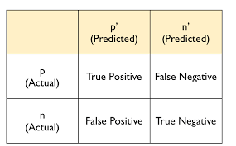
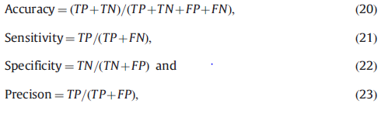
Evaluation

Slide 18
RESULT AND ANALYSIS

Slide 19
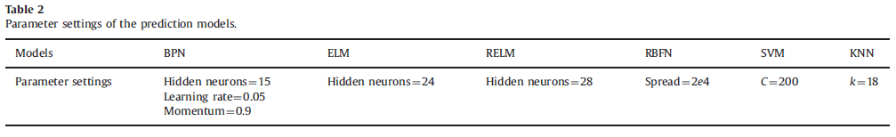
Parameter Settings of the Prediction Model

Slide 21
Discussion
BPN
SVM
ELM
ACC : 0,76
ACC : 0,8
KNN
ACC 0,72
RBF
RELM
ACC : 0,75
ACC 0,76
SN : 0.77
SP : 0.68
Naive Bayes
ACC : 0,73
ACC 0,72
PR : 0.70
SN : 0,75
SP : 0,70
PR : 0,76
SN : 0,73
SP : 0,73
PR : 0,72
SN : 0,75
SP : 0,77
PR : 0,72
SN : 0,79
SP : 0,75
PR : 0,74
SN : 0,73
SP : 0,81
PR :0,84
SN : 0,85
SP : 0,72
PR : 0,81

Slide 22
KNN
Non Linear Method
Low-bias-high-variance
Naive Bayes
Linear Method
Have no occurences certain atribute value
K in KNN is is case dependent
Small Dataset

Slide 23
Discussion
Small Dataset
Learning Speed
Gradient Based Learning Algorithm
BPN and RBFN multiple iterations were required to adjust and optimize weights to avoid sub optima solution.
Incured More Computations

Slide 26
Performance of ELM, RELM and the adopted nomogram prediction method
on the test data

Slide 27
Conclusion
ELM anda RELM demonstrated competitive performance among the machine learning methods investigated.
ELM and RELM relatively more effective in the prediction of mortality of Radical Cystectomy ( Superiority in Accuracy and Speed ).
ELM based Algorithm is also advantageous over the gradient-descent algorithm.
The proposed ELM based Algorithms exhibited better accuracy than one common used nomogram prediction method.

Slide 28
Future Work of the Study
Evaluate performance other regression model
Increase Dataset
External Validation

Slide 29


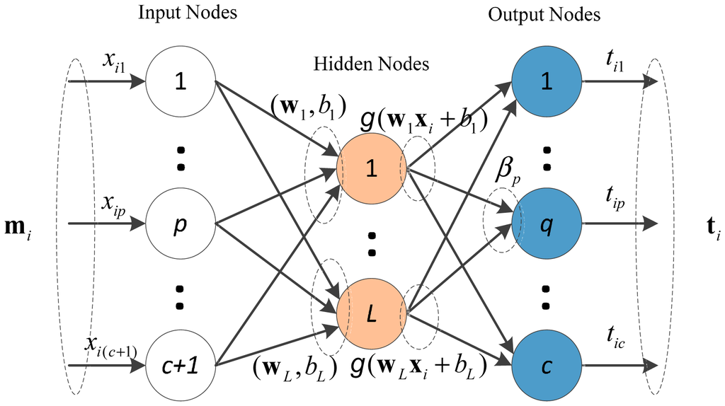
Extreme Learning Machine (ELM)

Slide 30
Extreme Learning Machine
Step 1
Randomly Assign input Weigth Wi and Bias bi i= N˜
Step 2
Calculate Hidden Layer output Matrix H
Step 3
Calculate the Output Weight β :
β = H†T

Slide 31


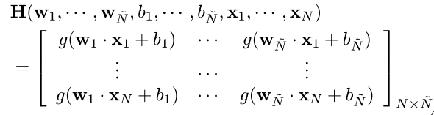
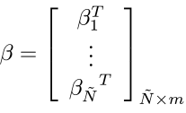
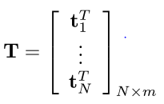


Slide 32
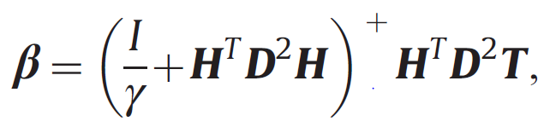
Regularized ELM

Slide 33
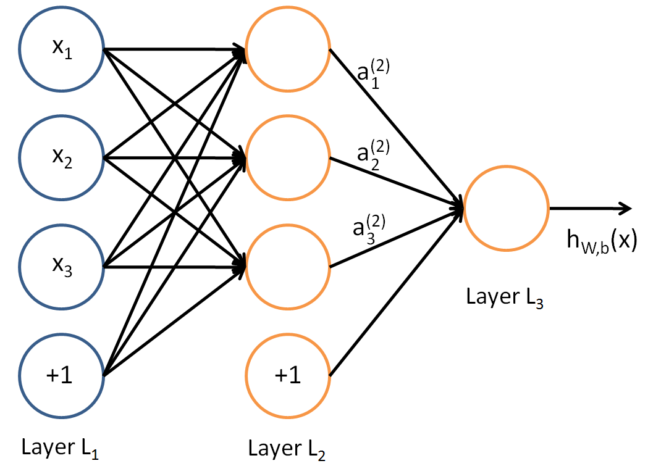



Neural Network
H

Slide 34
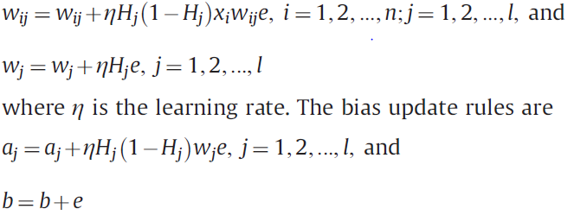
Update Weight

Slide 35
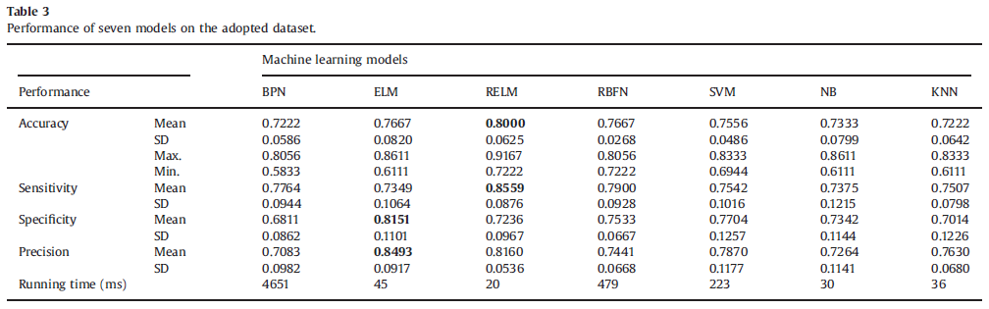
Performance of Seven Models on the adopted Dataset

Slide 36
Discussion
BPN(72%), NB(73%), KNN(72%) exhibited relatively low performance.
RBF(76%) and SVM(75%)
ELM(76%) and RELM(80%)
The difference between sensitivity and specificity was relatively large for the model developed using RELM
ELM and SVM ,sensitivity was lower than the specificity
Computational Time

Slide 37
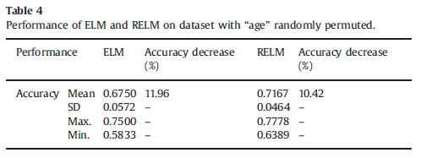
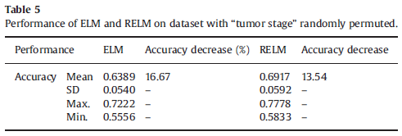
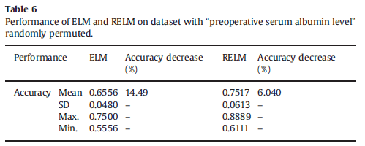
Performance ELM and RELM on dataset with Age,Tumor Stage, Preoperative serum albumin level randomly permuted

Slide 38
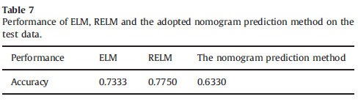
Performance of ELM and RELM and the adopted nomogram prediction method on test data

Slide 39
Conclusion
Experimental result indicate that ELM and RELM demonstrated competitive performance among the machine learning methods investigated
The running time was also among the lowest
ELM based algorithms are relatively more effective in the prediction of mortality of radical cystectomy.
The proposed ELM-Based Algorithms exhibited better accuracy than one common-used nomogram prediction method

