Slide 1
Deteksi Dini Penyakit Ginjal Kronis Menggunakan Extreme Learning Machine
PROGRES REPORT

Slide 2
Laporan Progress
Donwload Dataset
KNN Imputasi (K = 3 )
Menjalankan Algoritma Extreme Learning Machine pada Data
10-Fold Crossvalidation
1 – 199 Hidden Neuron {1,5,7,- 301}
Sin, Sig, RadBas, HardLim, Tribas

Slide 3
Laporan Progress Minggu II (19 April)
Melakukan Repeated CrossValidation 100;
Standard Deviasi Accuracy, Sensitivity, Specificity
Menghitung Sensitivity dan Spesificity
Melakukan Percobaan ANN and SVM (Mencari Model Terbaik)

Slide 4
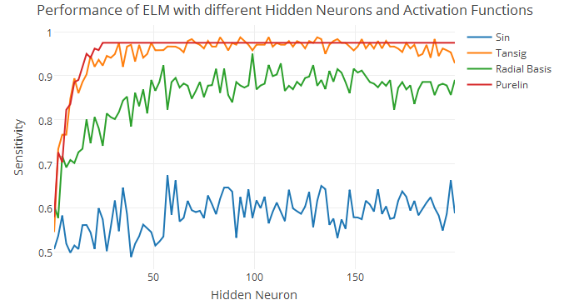
Performance ELM

Slide 5
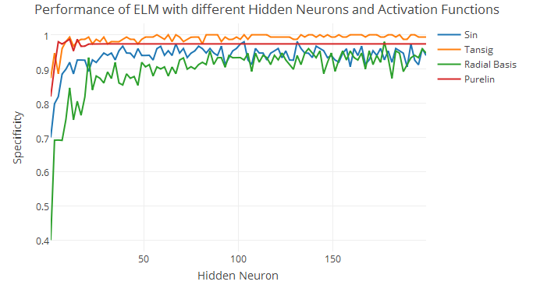

Slide 6
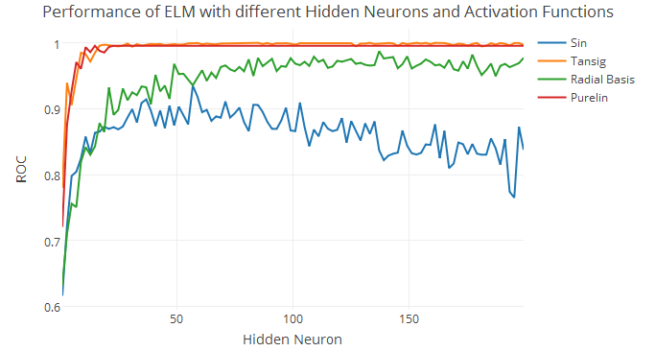

Slide 7
Konfigurasi
Nhid | Fungsi Aktivasi | ROC | Sensitivity | Specificity | ROC SD | Sens SD | Spec SD
99 | tansig | 1 | 0.9706522 | 1.0000000 | 0 | 0.03438107 | 0.00000000
131 | tansig | 1 | 0.9831522 | 1.0000000 | 0 | 0.02175674 | 0.00000000
139 | tansig | 1 | 0.9748188 | 1.0000000 | 0 | 0.03523643 | 0.00000000
155 | tansig | 1 | 0.9621377 | 0.9933333 | 0 | 0.03700316 | 0.02108185
157 | tansig | 1 | 0.9577899 | 1.0000000 | 0 | 0.03972723 | 0.00000000
163 | tansig | 1 | 0.9498188 | 1.0000000 | 0 | 0.05119014 | 0.00000000
181 | tansig | 1 | 0.9663043 | 1.0000000 | 0 | 0.03882808 | 0.00000000
183 | tansig | 1 | 0.9532609 | 1.0000000 | 0 | 0.03172216 | 0.00000000

Slide 8
Experiment Selanjutnya

