Slide 1
JSON
The Fat Free
Alternative to XML
Douglas Crockford
Yahoo! Inc.
http://www.JSON.org/xml2006.ppt

Slide 2
Data Interchange
The key idea in Ajax.
An alternative to page replacement.
Applications delivered as pages.
How should the data be delivered?

Slide 3
History of Data Formats
Ad Hoc
Database Model
Document Model
Programming Language Model

Slide 4
JSON
JavaScript Object Notation
Minimal
Textual
Subset of JavaScript

Slide 5
JSON
A Subset of ECMA-262 Third Edition.
Language Independent.
Text-based.
Light-weight.
Easy to parse.

Slide 6
JSON Is Not...
JSON is not a document format.
JSON is not a markup language.
JSON is not a general serialization format.
  No cyclical/recurring structures.
  No invisible structures.
  No functions.

Slide 7
History
1999 ECMAScript Third Edition
2001 State Software, Inc.
2002 JSON.org
2005 Ajax
2006 RFC 4627

Slide 8
MIME Media Type
application/json

Slide 9

Languages
Chinese
English
French
German
Italian
Japanese
Korean
Spanish

Slide 10
Languages
ActionScript
C / C++
C#
Cold Fusion
D
Delphi
E
Erlang
Haskell
Java
Lisp
LotusScript
Lua
Perl
Objective-C
OCAML
PHP
Python
Rebol
Ruby
Scheme
Squeak

Slide 11
Object Quasi-Literals
JavaScript
Python
NewtonScript

Slide 12
Values
Strings
Numbers
Booleans
Objects
Arrays
null

Slide 13
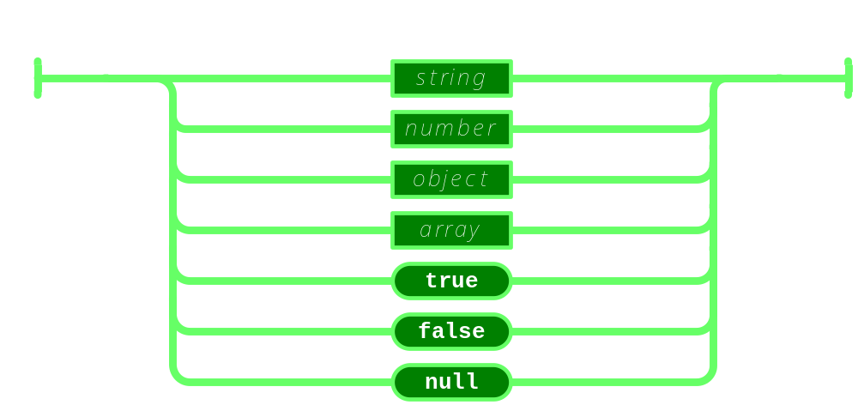
Value

Slide 14
Strings
Sequence of 0 or more Unicode characters
No separate character type
  A character is represented as a string with a length of 1
Wrapped in "double quotes"
Backslash escapement

Slide 15
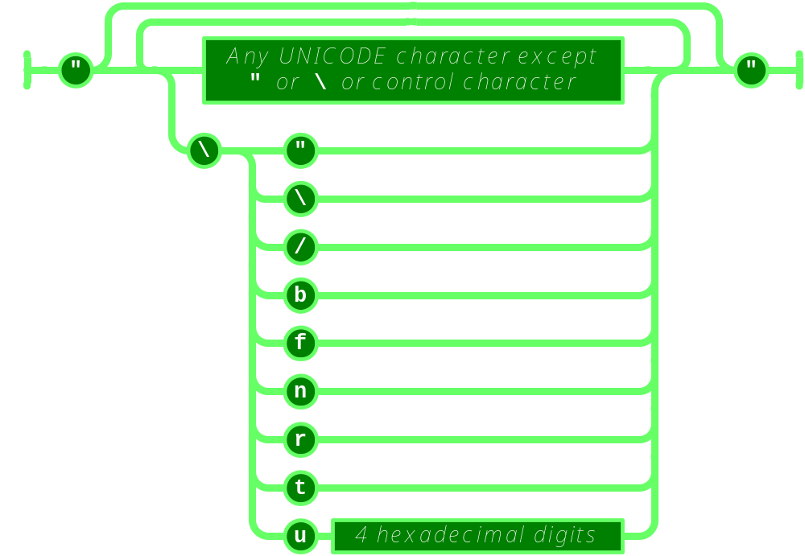
String

Slide 16
Numbers
Integer
Real
Scientific
No octal or hex
No NaN or Infinity
  Use null instead

Slide 17
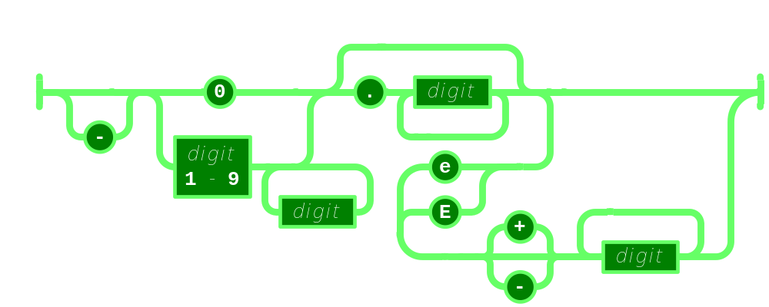
Number

Slide 18
Booleans
true
false

Slide 19
null
A value that isn't anything

Slide 20
Object
Objects are unordered containers of key/value pairs
Objects are wrapped in { }
, separates key/value pairs
: separates keys and values
Keys are strings
Values are JSON values
  struct, record, hashtable, object

Slide 21
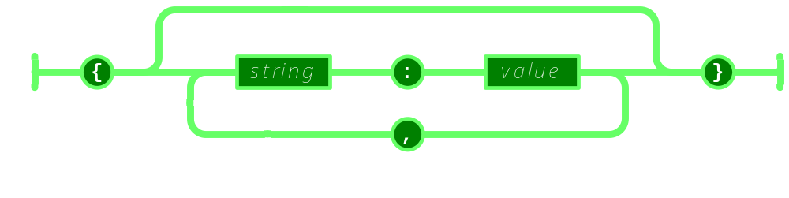
Object

Slide 22
Object
{"name":"Jack B. Nimble","at large": true,"grade":"A","level":3, "format":{"type":"rect","width":1920, "height":1080,"interlace":false, "framerate":24}}

Slide 23
Object
{
"name": "Jack B. Nimble",
"at large": true,
"grade": "A",
"format": {
"type": "rect",
"width": 1920,
"height": 1080,
"interlace": false,
"framerate": 24
}
}

Slide 24
Array
Arrays are ordered sequences of values
Arrays are wrapped in []
, separates values
JSON does not talk about indexing.
  An implementation can start array indexing at 0 or 1.

Slide 25
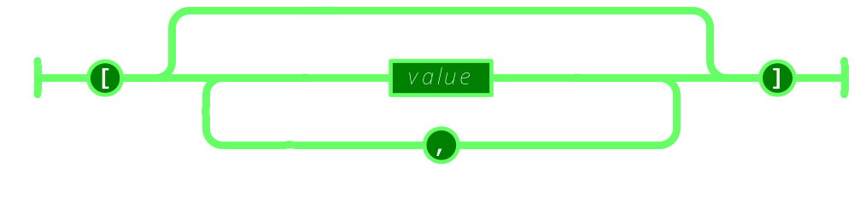
Array

Slide 26
Array
["Sunday", "Monday", "Tuesday", "Wednesday", "Thursday", "Friday", "Saturday"]
[
  [0, -1, 0],
  [1, 0, 0],
  [0, 0, 1]
]

Slide 27
Arrays vs Objects
Use objects when the key names are arbitrary strings.
Use arrays when the key names are sequential integers.
Don't get confused by the term Associative Array.

Slide 28
Character Encoding
Strictly UNICODE.
Default: UTF-8.
UTF-16 and UTF-32 are allowed.

Slide 29
Versionless
JSON has no version number.
No revisions to the JSON grammar are anticipated.
JSON is very stable.

Slide 30
Rules
A JSON decoder must accept all well-formed JSON text.
A JSON decoder may also accept non-JSON text.
A JSON encoder must only produce well-formed JSON text.
Be conservative in what you do, be liberal in what you accept from others.

Slide 31
Supersets
YAML is a superset of JSON.
  A YAML decoder is a JSON decoder.
JavaScript is a superset of JSON.
  A JavaScript compiler is a JSON decoder.
New programming languages based on JSON.

Slide 32
JSON is the X in Ajax

Slide 33
JSON in Ajax
HTML Delivery.
JSON data is built into the page.
  <html>...
  <script>
  var data = { ... JSONdata ... };
  </script>...
  </html>

Slide 34
JSON in Ajax
XMLHttpRequest
  Obtain responseText
  Parse the responseText
    responseData = eval(
    '(' + responseText + ')');
    responseData =
    responseText.parseJSON();

Slide 35
JSON in Ajax
Is it safe to use eval with XMLHttpRequest?
The JSON data comes from the same server that vended the page. eval of the data is no less secure than the original html.
If in doubt, use string.parseJSON instead of eval.

Slide 36
JSON in Ajax
Secret <iframe>
Request data using form.submit to the <iframe> target.
The server sends the JSON text embedded in a script in a document.
  <html><head><script>
  document.domain = 'penzance.com';
  parent.deliver({ ... JSONtext ... });
  </script></head></html>
The function deliver is passed the value.

Slide 37
JSON in Ajax
Dynamic script tag hack.
Create a script node. The src url makes the request.
The server sends the JSON text embedded in a script.
  deliver({ ... JSONtext ... });
The function deliver is passed the value.
The dynamic script tag hack is insecure.

Slide 38
JSONRequest
A new facility.
Two way data interchange between any page and any server.
Exempt from the Same Origin Policy.
Campaign to make a standard feature of all browsers.

Slide 39
Tell your favorite browser maker
I want JSONRequest!
http://www.JSON.org/JSONRequest.html

Slide 40
ECMAScript Fourth Ed.
New Methods:
  Object.prototype.toJSONString
  Array.prototype.toJSONString
  Date.prototype.toJSONString
  Boolean.prototype.toJSONString
  Number.prototype.toJSONString
  String.prototype.toJSONString
  String.prototype.parseJSON
Available now: JSON.org/json.js

Slide 41
supplant
var template = '<table border="{border}">' +
'<tr><th>Last</th><td>{last}</td></tr>' +
'<tr><th>First</th><td>{first}</td></tr>' +
'</table>';
var data = {
"first": "Carl",
"last": "Hollywood",
"border": 2
};
mydiv.innerHTML = template.supplant(data);

Slide 42
supplant
String.prototype.supplant = function (o) {
return this.replace(/{([^{}]*)}/g,
function (a, b) {
var r = o[b];
return typeof r === 'string' ?
r : a;
}
);
};

Slide 43
JSONT
var rules = {
  self:
'<svg><{closed} stroke="{color}" points="{points}" /></svg>',
  closed: function (x) {return x ? 'polygon' : 'polyline';},
  'points[*][*]': '{$} '
};
var data = {
  "color": "blue",
  "closed": true,
  "points": [[10,10], [20,10], [20,20], [10,20]]
};
jsonT(data, rules)
<svg><polygon stroke="blue"
points="10 10 20 10 20 20 10 20 " /></svg>

Slide 44
http://goessner.net/articles/jsont/
function jsonT(self, rules) {
var T = {
output: false,
init: function () {
for (var rule in rules) if (rule.substr(0,4) != "self") rules["self." + rule] = rules[rule];
return this;
},
apply: function(expr) {
var trf = function (s) {
return s.replace(/{([A-Za-z0-9_\$\.\[\]\'@\(\)]+)}/g, function ($0, $1){
return T.processArg($1, expr);
})
}, x = expr.replace(/\[[0-9]+\]/g, "[*]"), res;
if (x in rules) {
if (typeof(rules[x]) == "string") res = trf(rules[x]);
else if (typeof(rules[x]) == "function") res = trf(rules[x](eval(expr)).toString());
} else res = T.eval(expr);
return res;
},
processArg: function (arg, parentExpr) {
var expand = function (a, e) {
return (e = a.replace(/^\$/,e)).substr(0, 4) != "self" ? ("self." + e) : e;
}, res = "";
T.output = true;
if (arg.charAt(0) == "@") res = eval(arg.replace(/@([A-za-z0-9_]+)\(([A-Za-z0-9_\$\.\[\]\']+)\)/, function($0, $1, $2){
return "rules['self." + $1 + "'](" + expand($2,parentExpr) + ")";
}));
else if (arg != "$") res = T.apply(expand(arg, parentExpr));
else res = T.eval(parentExpr);
T.output = false;
return res;
},
eval: function (expr) {
var v = eval(expr), res = "";
if (typeof(v) != "undefined") {
if (v instanceof Array) {
for (var i = 0; i < v.length; i++) if (typeof(v[i]) != "undefined") res += T.apply(expr + "[" + i + "]");
} else if (typeof(v) == "object") {
for (var m in v) if (typeof(v[m]) != "undefined") res += T.apply(expr+"."+m);
} else if (T.output) res += v;
}
return res;
}
};
return T.init().apply("self");
}

Slide 45
Some features that make it well-suited for data transfer
It's simultaneously human- and machine-readable format;
It has support for Unicode, allowing almost any information in any human language to be communicated;
The self-documenting format that describes structure and field names as well as specific values;
The strict syntax and parsing requirements that allow the necessary parsing algorithms to remain simple, efficient, and consistent;
The ability to represent the most general computer science data structures: records, lists and trees.

Slide 46
JSON Looks Like Data
JSON's simple values are the same as used in programming languages.
No restructuring is required: JSON's structures look like conventional programming language structures.
JSON's object is record, struct, object, dictionary, hash, associate array...
JSON's array is array, vector, sequence, list...

Slide 47
Arguments against JSON
JSON Doesn't Have Namespaces.
JSON Has No Validator.
JSON Is Not Extensible.
JSON Is Not XML.

Slide 48
JSON Doesn't Have Namespaces
Every object is a namespace. Its set of keys is independent of all other objects, even exclusive of nesting.
JSON uses context to avoid ambiguity, just as programming languages do.

Slide 49
Namespace
http://www.w3c.org/TR/REC-xml-names/
In this example, there are three occurrences of the name title within the markup, and the name alone clearly provides insufficient information to allow correct processing by a software module.
<section>
<title>Book-Signing Event</title>
<signing>
<author title="Mr" name="Vikram Seth" />
<book title="A Suitable Boy" price="$22.95" />
</signing>
<signing>
<author title="Dr" name="Oliver Sacks" />
<book title="The Island of the Color-Blind"
price="$12.95" />
</signing>
</section>

Slide 50
Namespace
{"section":
"title": "Book-Signing Event",
"signing": [
{
"author": { "title": "Mr", "name": "Vikram Seth" },
"book": { "title": "A Suitable Boy",
"price": "$22.95" }
}, {
"author": { "title": "Dr", "name": "Oliver Sacks" },
"book": { "title": "The Island of the Color-Blind",
"price": "$12.95" }
}
]
}}
section.title
section.signing[0].author.title
section.signing[1].book.title

Slide 51
JSON Has No Validator
Being well-formed and valid is not the same as being correct and relevant.
Ultimately, every application is responsible for validating its inputs. This cannot be delegated.
A YAML validator can be used.

Slide 52
JSON is Not Extensible
It does not need to be.
It can represent any non-recurrent data structure as is.
JSON is flexible. New fields can be added to existing structures without obsoleting existing programs.

Slide 53
JSON Is Not XML
objects
arrays
strings
numbers
booleans
null
element
attribute
attribute string
content
<![CDATA[ ]]>
entities
declarations
schema
stylesheets
comments
version
namespace

Slide 54
Data Interchange
JSON is a simple, common representation of data.
Communication between servers and browser clients.
Communication between peers.
Language independent data interchange.

Slide 55
www.JSON.org
http://www.JSON.org/xml2006.ppt

